Slide 1
10-Repeat 4-Fold CV Metabolite Variant Analysis
series_idor cohort · n = 139 organoids · 25 Not-Acceptable / 114 Acceptable
3 metabolite variants: nan-floor · raw · no-malate Modalities: Metabolite (LightGBM) · Morphology (LightGBM) · Image (EfficientNet-B0) Late fusion: mean probability · majority vote

Slide 2
Experimental Design
Cohort • 139 organoids from series_idor (BA1 + BA2), including 6 stitched organoids • Labels: 25 Not-Acceptable (NAcc), 114 Acceptable (Acc) • 11 time points: Dy03 → Dy30 Cross-Validation • Stratified 4-fold CV × 10 repeats (different random seeds) • Seed for repeat r: SEED + r × 1000 → genuinely independent splits • Same fold partition shared across all modalities within each repeat • OOF balanced accuracy computed per repeat; mean ± SD reported 3 Metabolite Variants (trained independently each fold) • met_nan — values below −500 µM replaced with NaN (original approach) • met_raw — raw concentration, no floor correction • met_no_malate — MalateGlo feature excluded entirely Late Fusion Strategies • mean_prob: average OOF probabilities across modalities, threshold 0.5 • majority_vote: ≥ 2-of-3 modalities predict NAcc

Slide 3
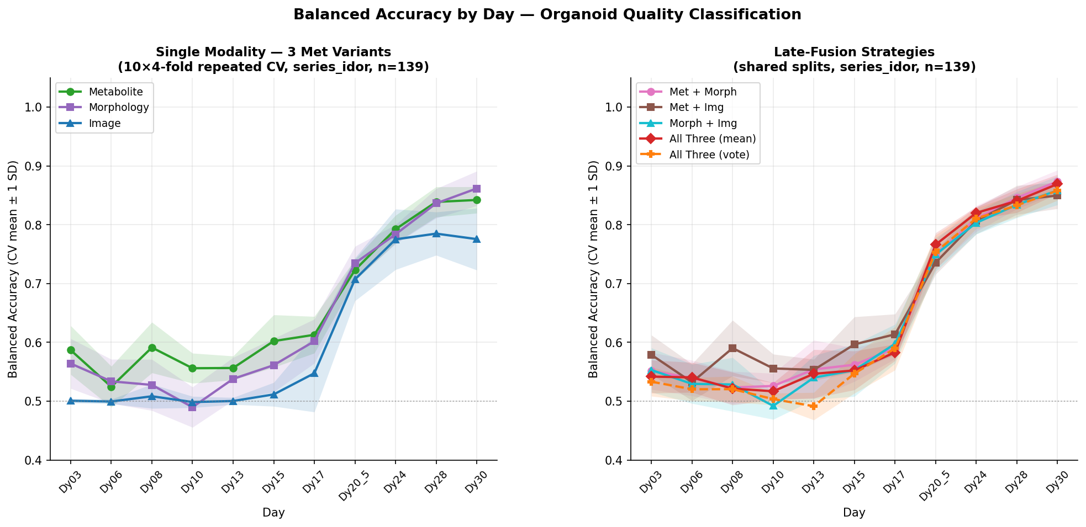
Aggregated Results: Mean ± SD over 10 Repeats

Slide 4
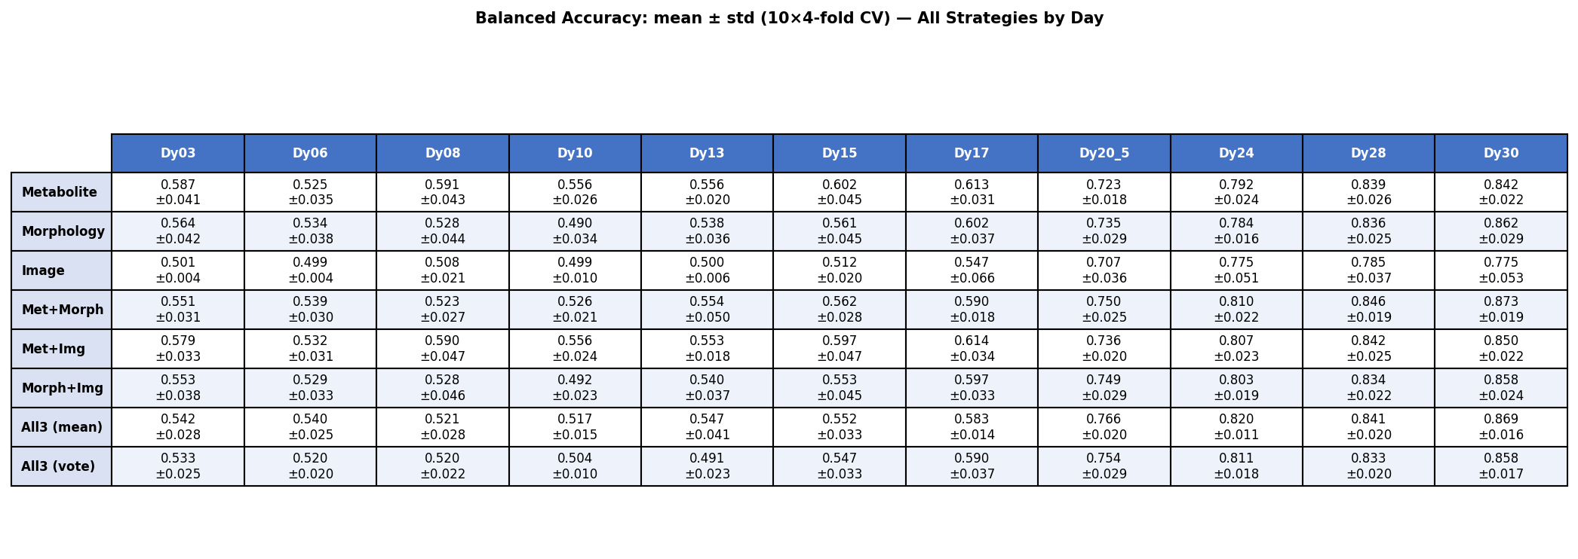
Summary Table: Balanced Accuracy (mean ± SD)

Slide 5
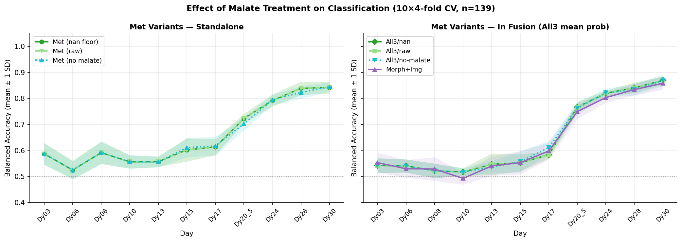
Metabolite Variant Comparison

Slide 6
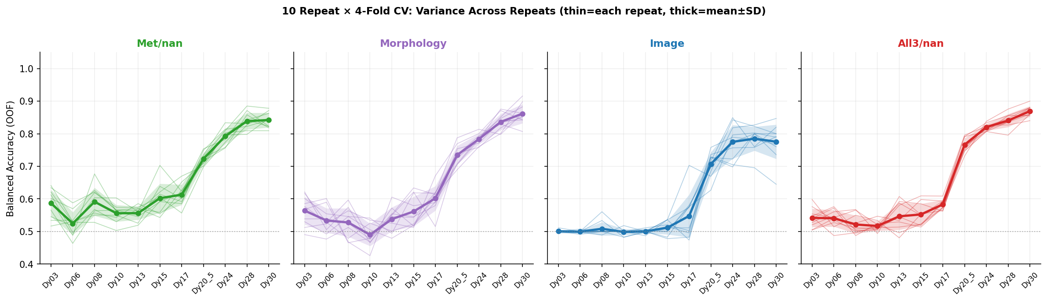
Variance Across 10 Repeats — Key Strategies

Slide 7
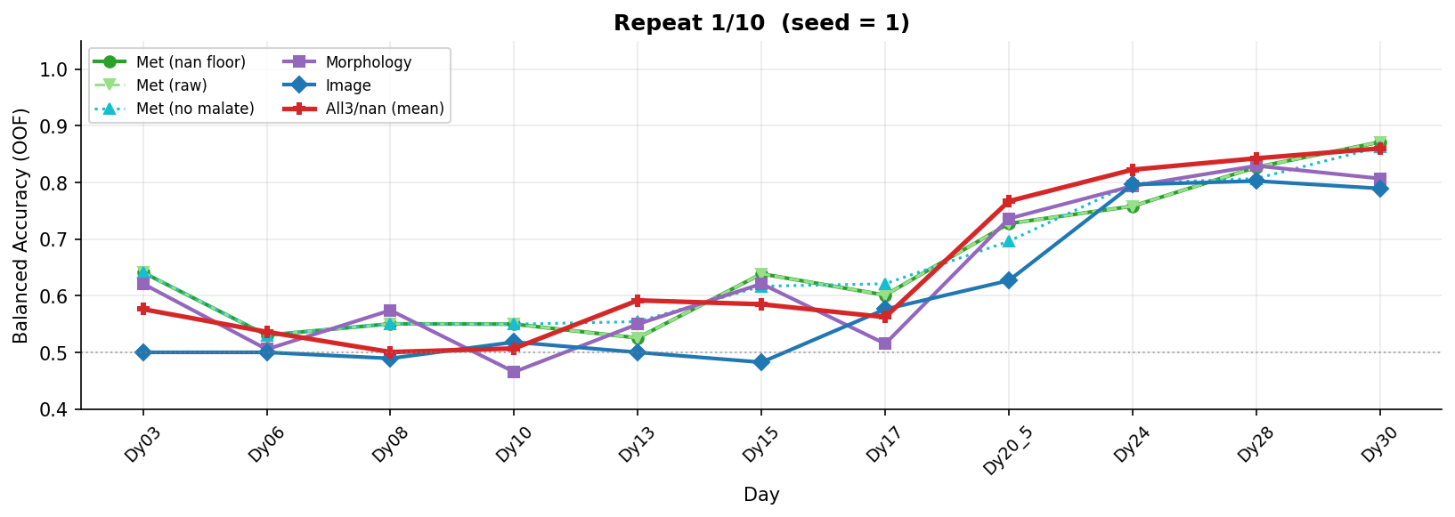
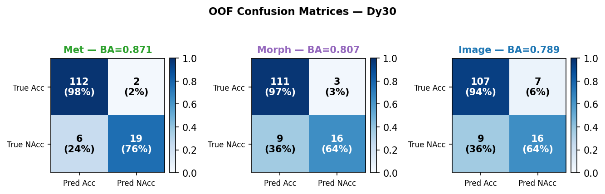
Repeat 1 / 10 — OOF Balanced Accuracy by Day

Slide 8
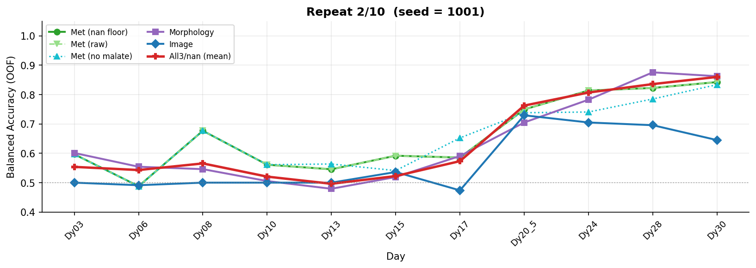
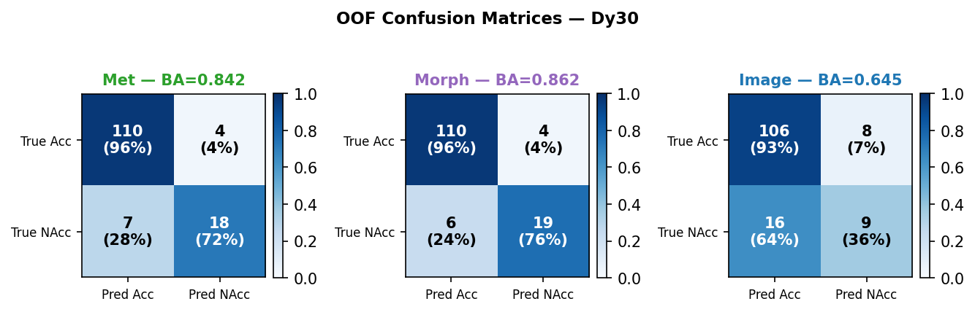
Repeat 2 / 10 — OOF Balanced Accuracy by Day

Slide 9
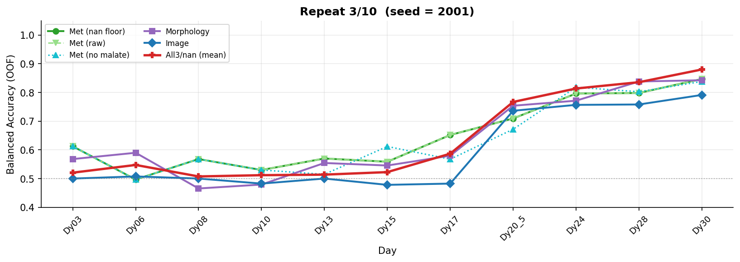
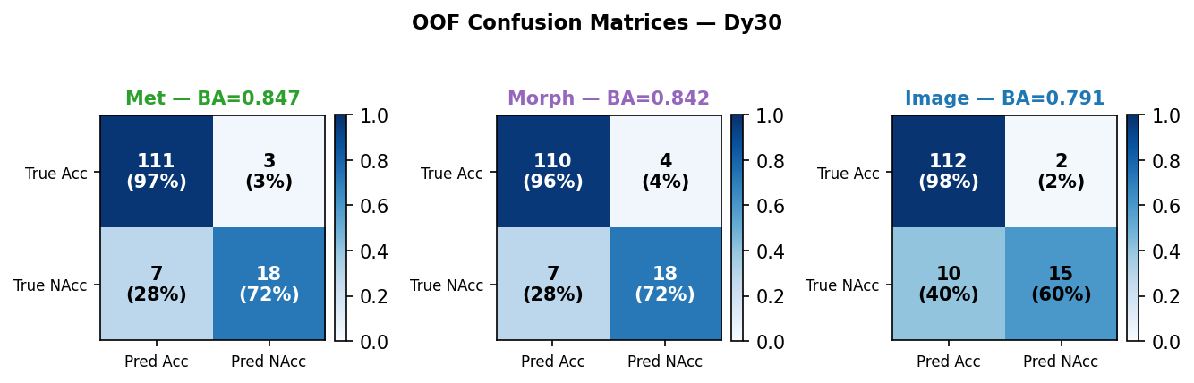
Repeat 3 / 10 — OOF Balanced Accuracy by Day

Slide 10
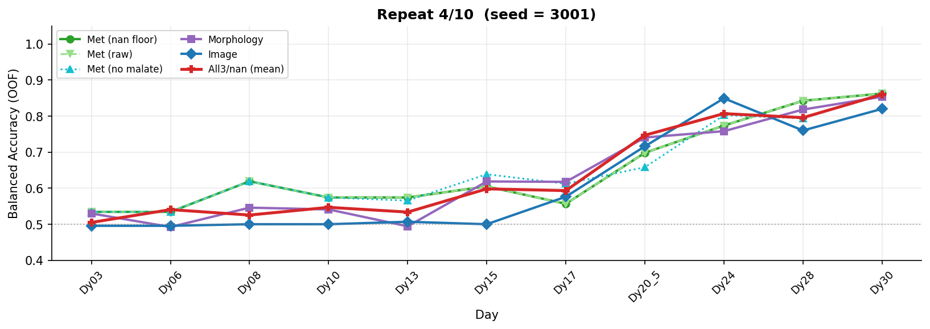
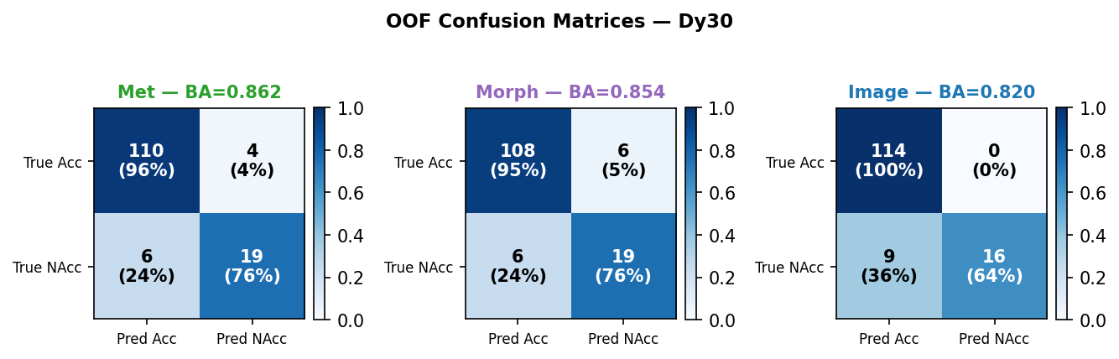
Repeat 4 / 10 — OOF Balanced Accuracy by Day

Slide 11
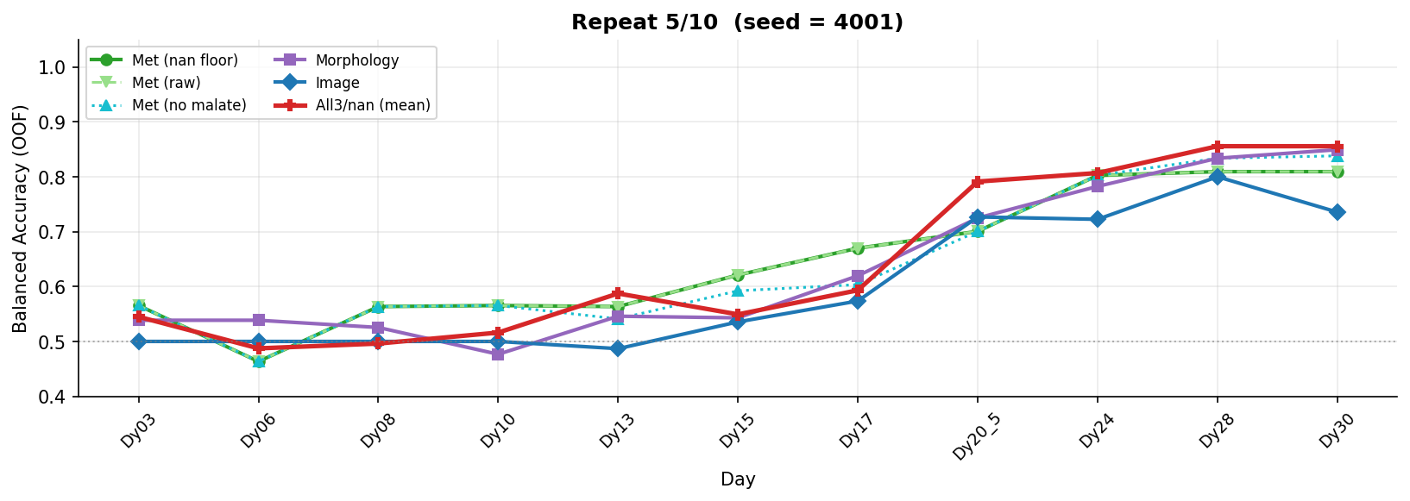
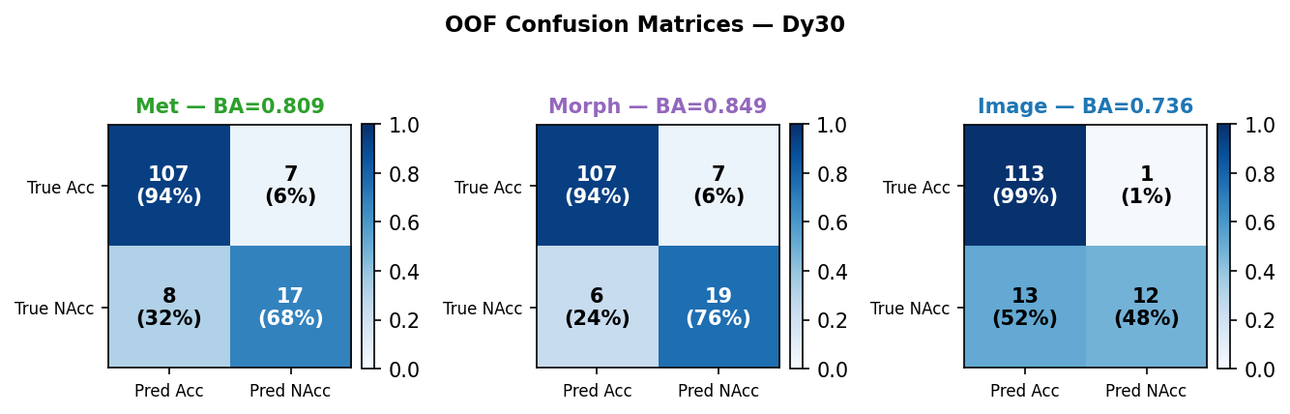
Repeat 5 / 10 — OOF Balanced Accuracy by Day

Slide 12
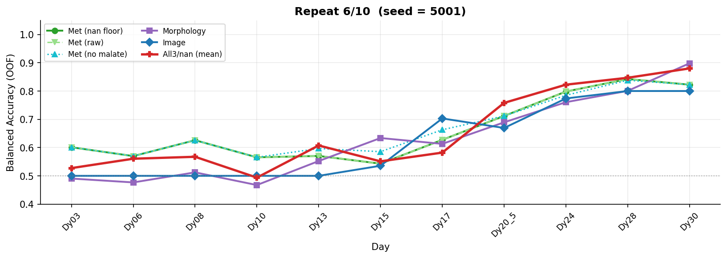
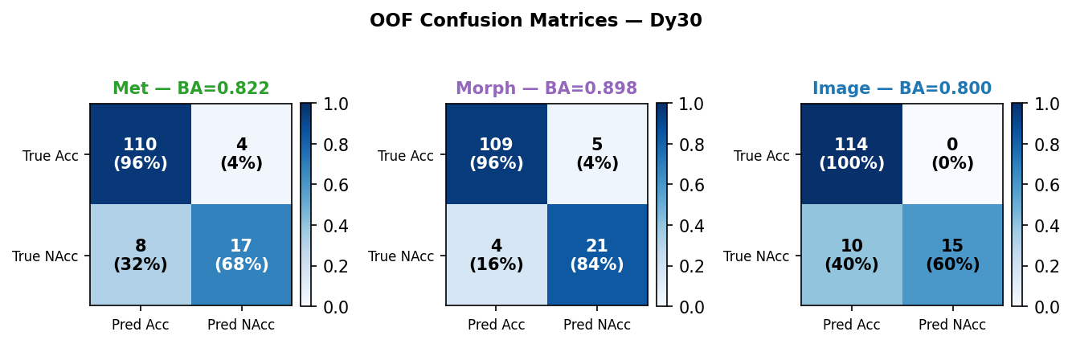
Repeat 6 / 10 — OOF Balanced Accuracy by Day

Slide 13
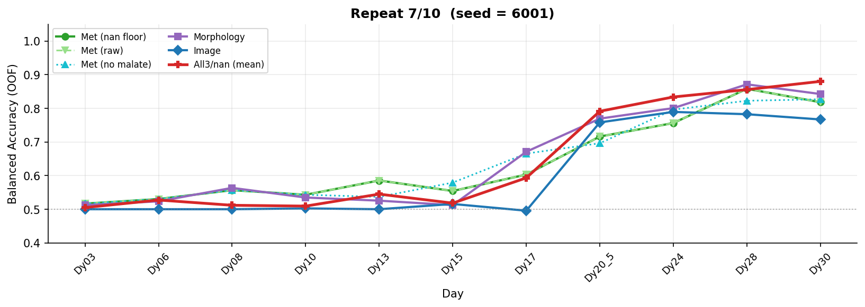
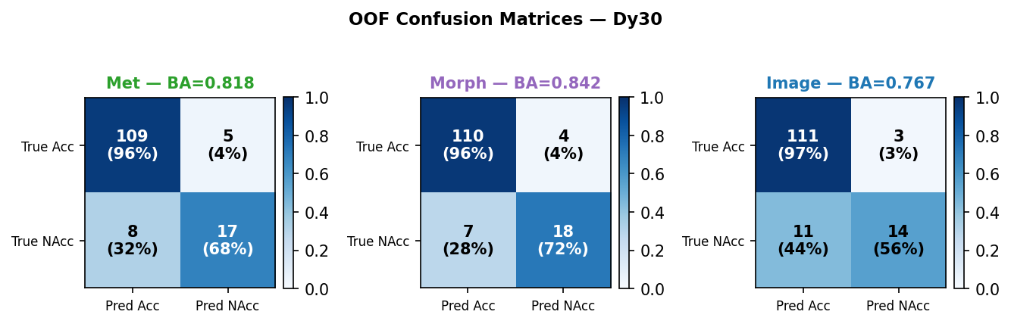
Repeat 7 / 10 — OOF Balanced Accuracy by Day

Slide 14
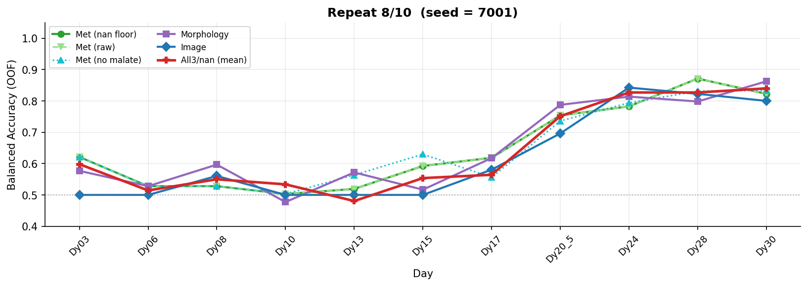
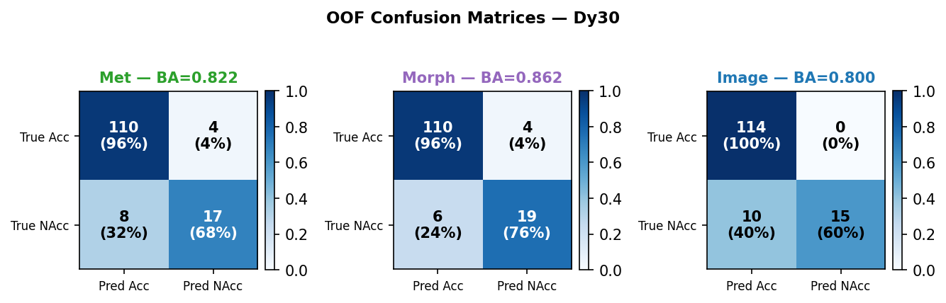
Repeat 8 / 10 — OOF Balanced Accuracy by Day

Slide 15
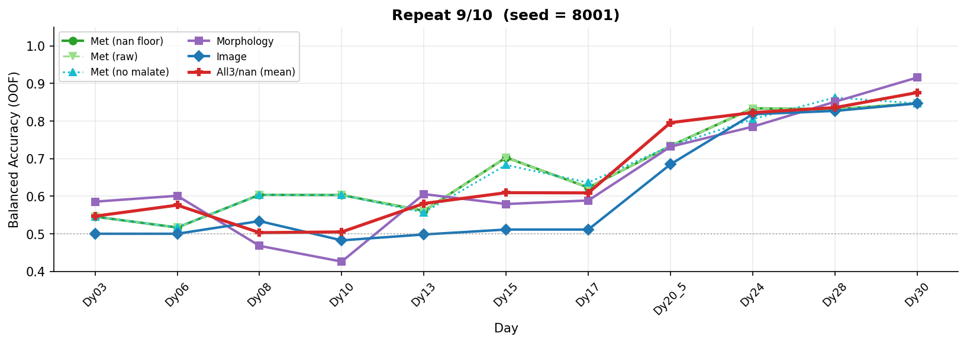
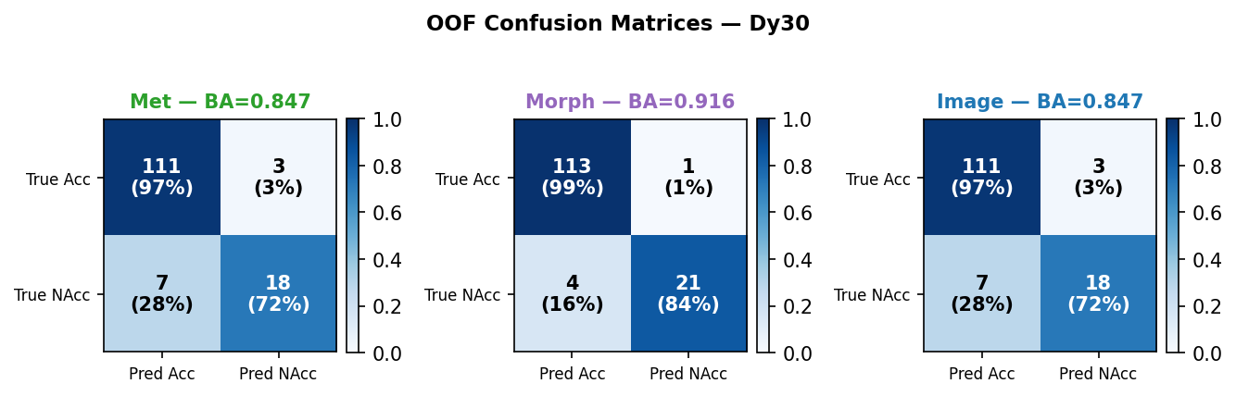
Repeat 9 / 10 — OOF Balanced Accuracy by Day

Slide 16
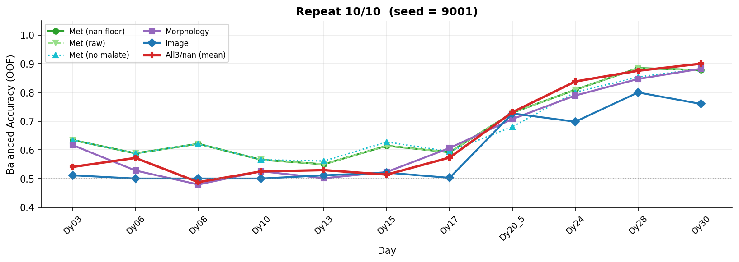
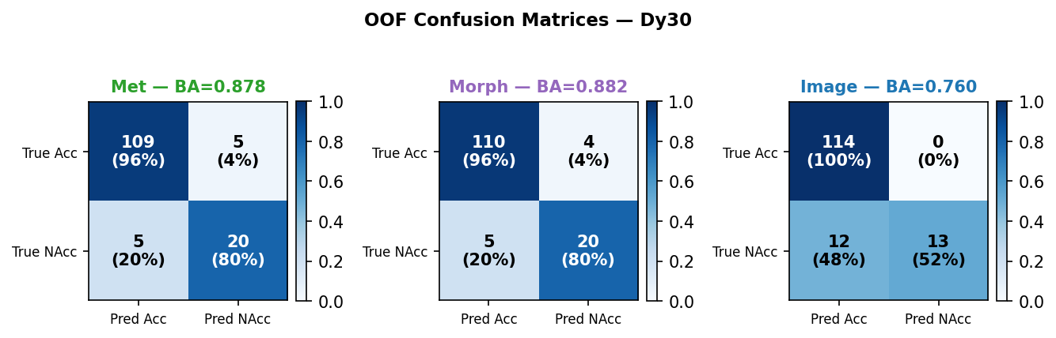
Repeat 10 / 10 — OOF Balanced Accuracy by Day

