Slide 1
Morphology-Based Organoid Quality Classifier
Shape & size features · LightGBM vs Logistic Regression · 5-fold stratified CV
• 7 morphology features derived from segmentation masks (ImageJ/FIJI metrics)
• Evaluated on two cohorts: base (205 organoids, no edge filter) and series_idor (132 organoids, edge-fraction ≤ 0.05 at every timepoint)
• Goal: understand how well shape alone predicts Acceptable vs Not Acceptable quality at day 30
Balanced accuracy = (TPR + TNR) / 2 | Threshold fixed at 0.5

Slide 2
Morphology Features
7 metrics computed per organoid per timepoint from segmentation masks
Column name
Feature
Formula / source
Range
Interpretation
Circ._win
Circularity
4π·Area / Perimeter²
0.32 – 0.87
1 = perfect circle; lower = irregular outline
AR_win
Aspect Ratio
Major axis / Minor axis
1.0 – 2.6
1 = round; higher = elongated
Solidity_win
Solidity
Area / Convex-hull area
0.71 – 0.99
1 = fully convex; lower = lobulated / concave
Complexity_win
Complexity
Convex perimeter / Perimeter
0.15 – 0.44
Lower = more irregular boundary
Feret_win
Max Feret diam.
Longest spanning distance
502 – 4218 µm
Overall organoid size
Area_win
2-D Area
Projected area from mask
0.19 – 5.8 mm²
Size; truncated if organoid hits image edge
Volume_win
3-D Volume
Estimated from 2-D area
9 – 633 × 10⁶ µm³
99 missing values → NaN-handled by LGBM
* Orange = size/growth features (Feret, Area, Volume) — dominant signal at late days. Shape descriptors (Circ, AR, Solidity, Complexity) show near-zero class separation.

Slide 3
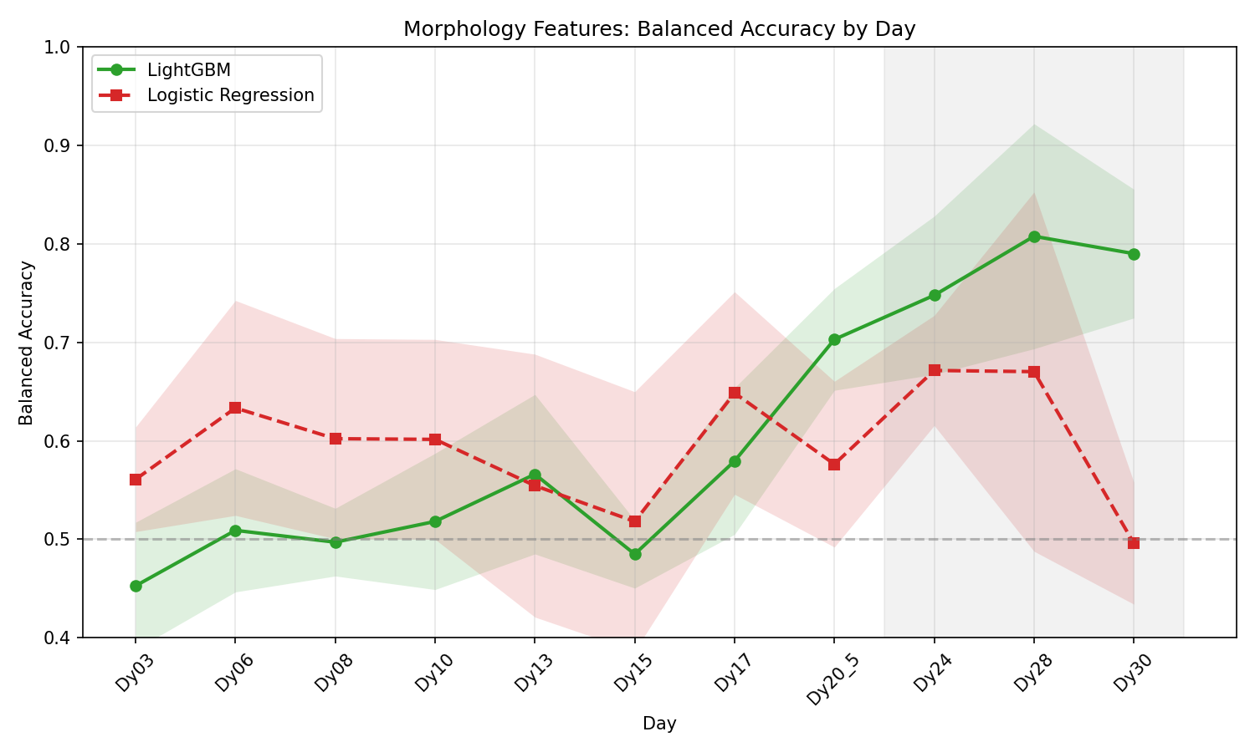
5-Fold CV Results — base cohort (205 organoids)
No edge-fraction filter · area/size measurements may be truncated at late days
LightGBM best 0.81 (Dy28). LogReg collapses to 0.50 at Dy30 — linear boundary breaks under boundary-truncated area values.

Slide 4
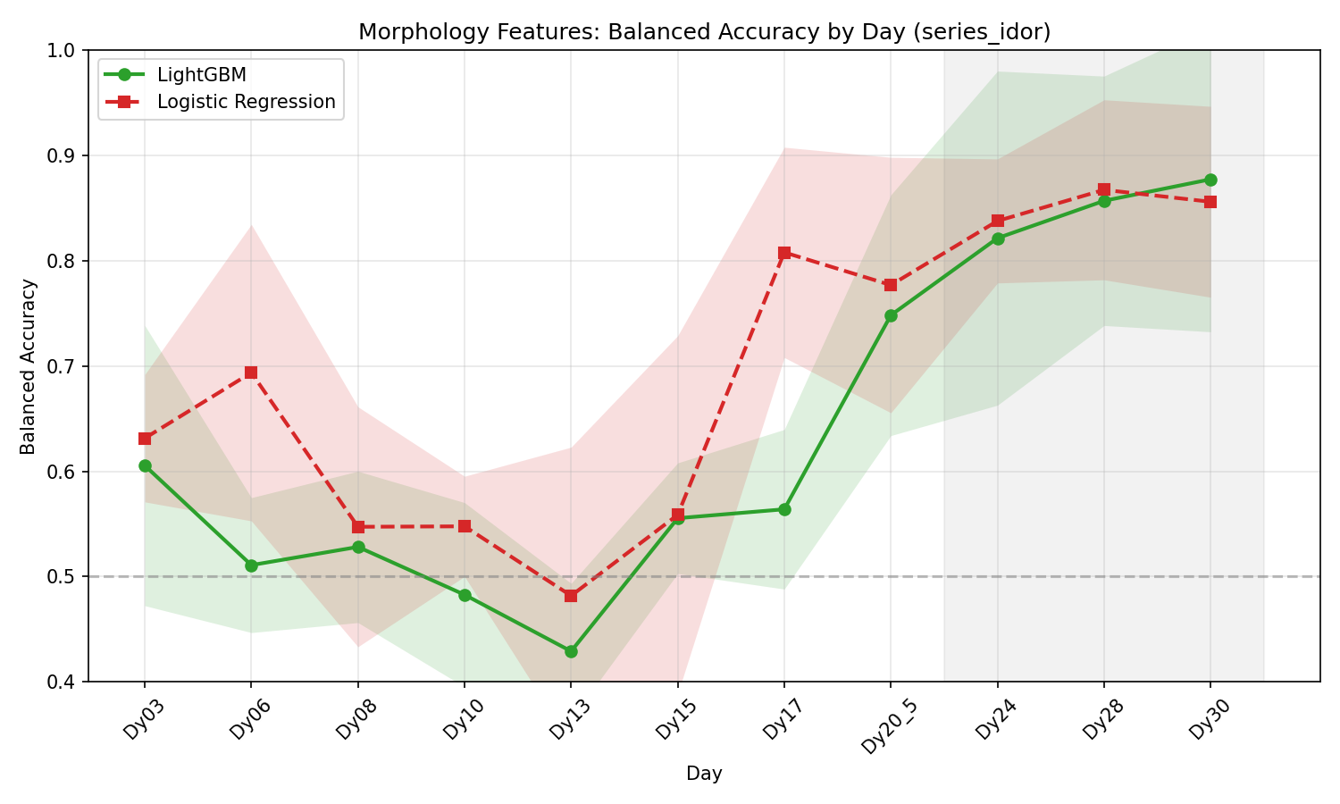
5-Fold CV Results — series_idor cohort (132 organoids)
Edge-fraction ≤ 0.05 enforced at every timepoint · clean size measurements
LightGBM best 0.88 (Dy30). LogReg recovers to 0.87. Both models converge — confirming edge truncation was the root cause.

Slide 5
LightGBM Balanced Accuracy: base vs series_idor
Mean ± Std (5-fold CV) | series_idor enforces edge-fraction ≤ 0.05 at every timepoint
Day
base (205 org.)
series_idor (132 org.)
Δ (idor − base)
Dy03
0.453 ± 0.065
0.605 ± 0.133
+0.153
Dy06
0.509 ± 0.063
0.511 ± 0.064
+0.002
Dy08
0.497 ± 0.034
0.528 ± 0.072
+0.031
Dy10
0.518 ± 0.069
0.483 ± 0.087
-0.035
Dy13
0.566 ± 0.081
0.429 ± 0.065
-0.137
Dy15
0.485 ± 0.035
0.555 ± 0.053
+0.071
Dy17
0.579 ± 0.074
0.564 ± 0.076
-0.016
Dy20_5
0.703 ± 0.052
0.748 ± 0.114
+0.045
Dy24
0.748 ± 0.080
0.821 ± 0.159
+0.074
Dy28
0.808 ± 0.114
0.857 ± 0.118
+0.049
Dy30
0.790 ± 0.065
0.877 ± 0.145
+0.087
Green Δ: idor substantially improves over base. Late-day gains confirm that edge-truncation was depressing base performance.

Slide 6
Key Findings
Size drives performance, shape does not
Circularity, AR, Solidity, and Complexity show near-zero class separation. Feret diameter and 2-D Area carry the discriminative signal — large organoids grow to be Acceptable.
Performance improves monotonically from Day 20.5 onward
Before Dy17 both models hover near chance (0.50–0.63). The late-protocol window (Dy24–Dy30) is where morphology becomes informative.
Edge truncation was masking late-day performance (base cohort)
In the base cohort, 41 / 171 Acceptable organoids at Dy30 had edge-fraction > 0.05 — their area was underestimated, confusing the classifier. Switching to series_idor (ef ≤ 0.05) raised LightGBM Dy30 from 0.79 → 0.88 and LogReg from 0.50 → 0.87.
Best result: LightGBM Dy30 0.88 | LogReg Dy28–Dy30 ~0.87
Both models converge at late days once clean measurements are used. Morphology alone at Dy30 approaches the metabolite classifier performance.

