Slide 1
Organoid Quality Classification: Multi-Modality Results
Metabolite · Morphology · Image | 5-fold stratified CV, threshold 0.5
LightGBM vs Logistic Regression · 195 organoids · 11 days
Balanced accuracy = (TPR + TNR) / 2. Mean ± std across folds shown.

Slide 2
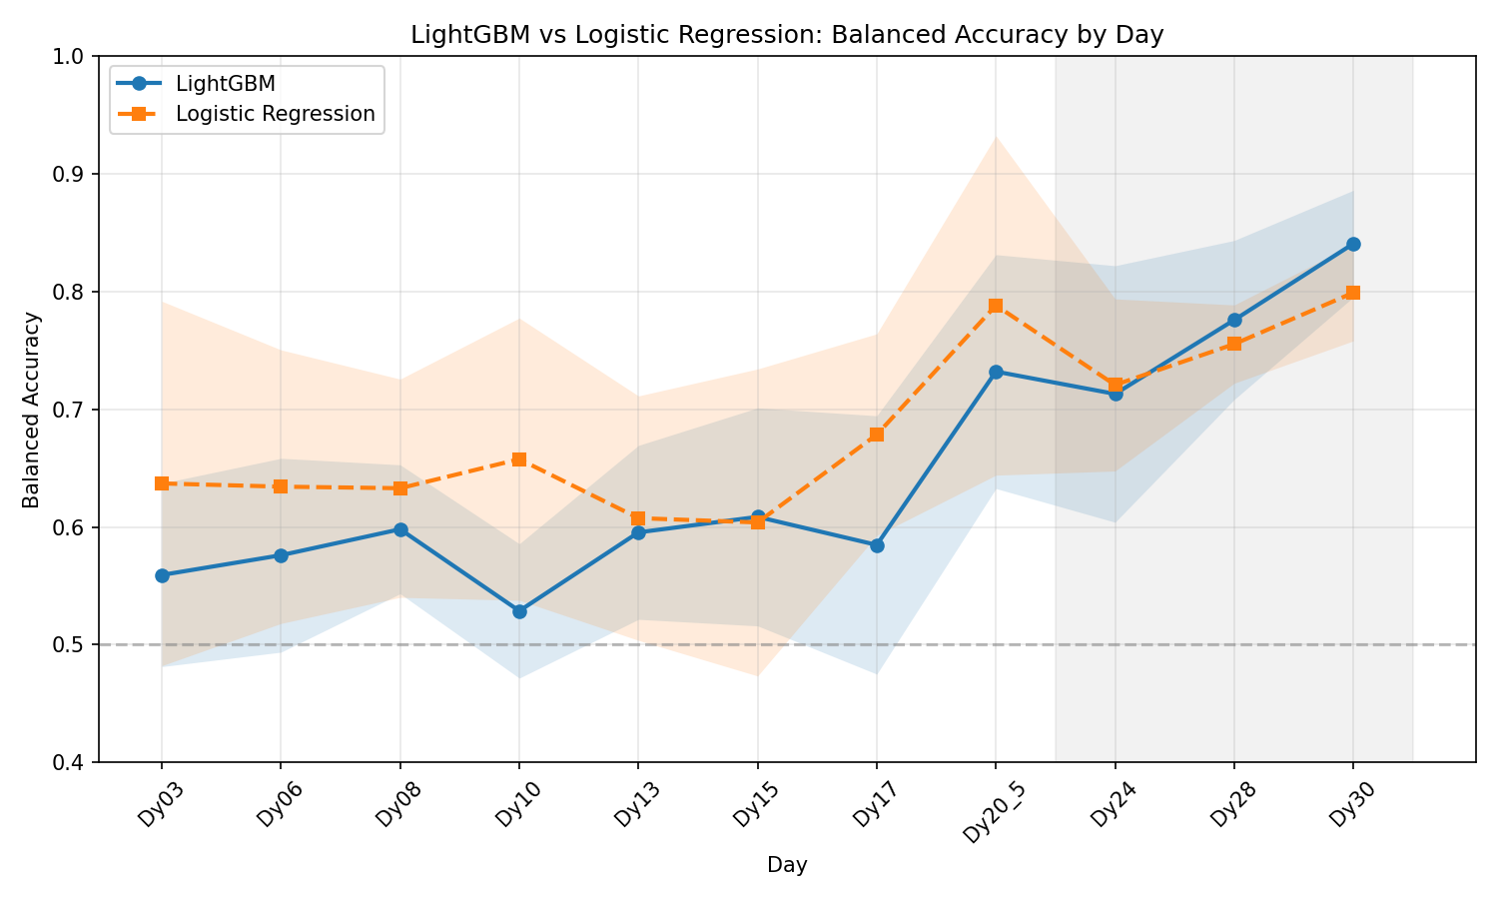
Metabolite Classifier · LightGBM vs Logistic Regression
6 assays + growth deltas | 5-fold stratified CV | 195 organoids × 11 days
LightGBM avg bal-acc 64.7 %, best 84.1 % (Dy30). LogReg avg 68.3 %, best 79.9 % (Dy30).

Slide 3
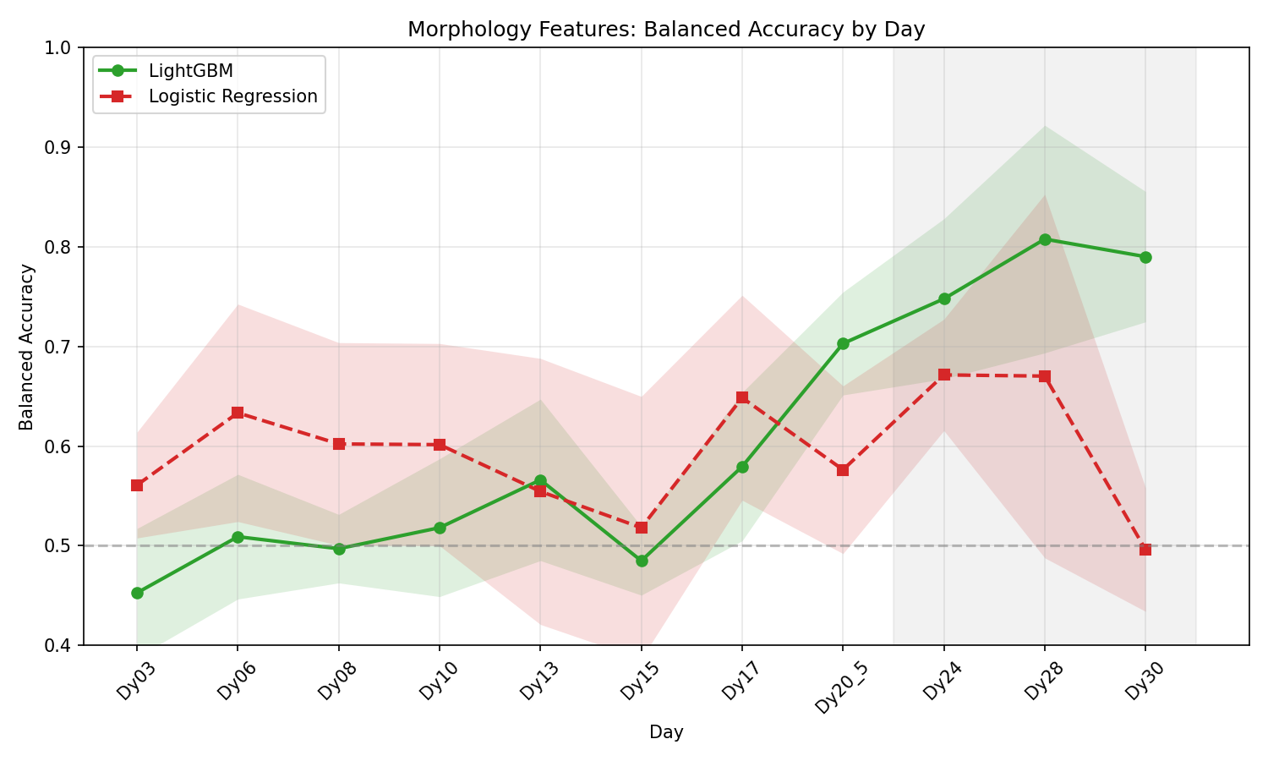
Morphology Classifier · LightGBM vs Logistic Regression
Circ, AR, Solidity, Complexity, Feret, Area, Volume | 5-fold CV | 195 organoids × 11 days
LightGBM avg bal-acc 60.5 %, best 80.8 % (Dy28). LogReg avg 59.4 %, best 67.1 % (Dy24).

Slide 4
Balanced Accuracy Comparison by Day
Mean ± Std (5-fold CV) | Image from corrected-aug run (job 1459514); Combined from job 1489995
Day
Met LightGBM
Met LogReg
Morph LightGBM
Morph LogReg
Dy03
0.559 ± 0.078
0.637 ± 0.155
0.453 ± 0.065
0.561 ± 0.053
Dy06
0.576 ± 0.082
0.634 ± 0.116
0.509 ± 0.063
0.633 ± 0.109
Dy08
0.598 ± 0.055
0.633 ± 0.093
0.497 ± 0.034
0.602 ± 0.102
Dy10
0.529 ± 0.057
0.658 ± 0.120
0.518 ± 0.069
0.511±0.022
0.527
0.595 ± 0.074
0.608 ± 0.104
0.566 ± 0.081
0.554 ± 0.133
Dy15
0.609 ± 0.093
0.604 ± 0.130
0.485 ± 0.035
0.518 ± 0.132
Dy17
0.585 ± 0.110
0.678 ± 0.086
0.579 ± 0.074
0.648 ± 0.103
0.500±0.000
0.732 ± 0.099
0.509
0.703 ± 0.052
0.576 ± 0.084
Dy24
0.713 ± 0.109
0.721 ± 0.073
0.748 ± 0.080
0.671 ± 0.056
Dy28
0.776 ± 0.068
0.755 ± 0.033
0.808 ± 0.114
0.670 ± 0.182
Dy30
0.841 ± 0.045
0.500±0.000
0.790 ± 0.065
0.532
Met = metabolite features (6 assays + deltas). Morph = shape features (Circ, AR, Solidity, Complexity, Feret, Area, Volume).

Slide 5
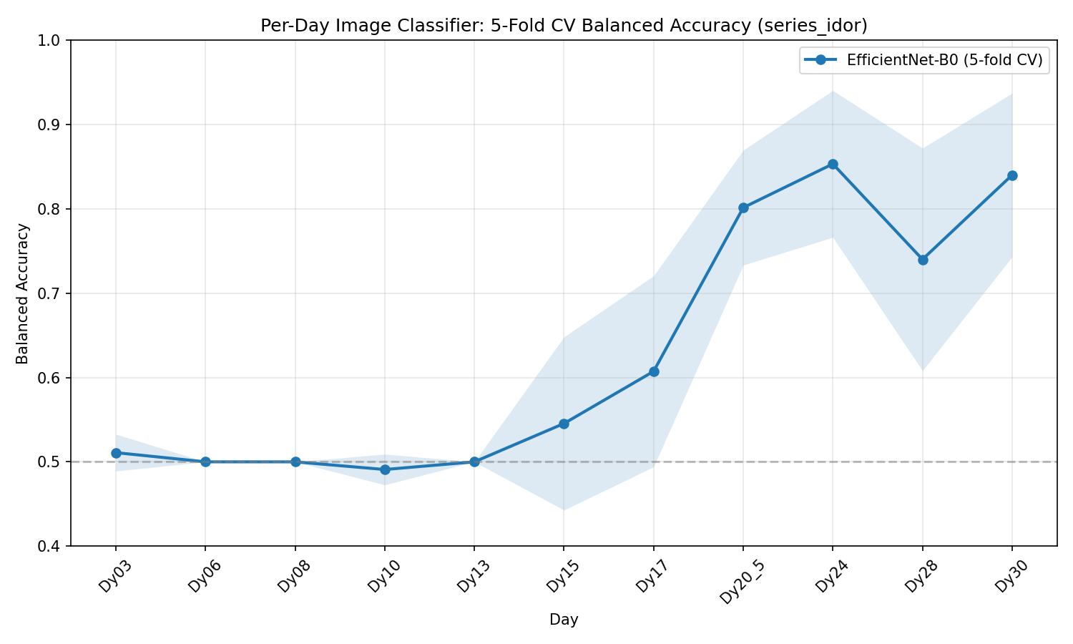
Image Classifier — EfficientNet-B0
series_idor · 5-fold CV (corrected augmentation, job 1459514)

Slide 6
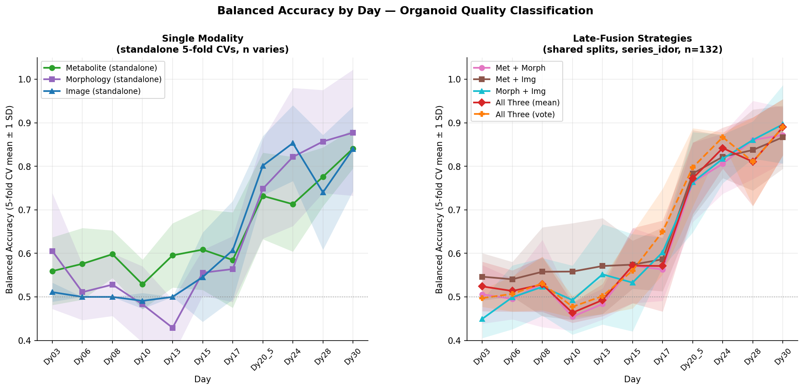
Multi-Modality Fusion — Balanced Accuracy by Day
Left: single modalities · Right: late-fusion combinations · ±1 SD shading

