Slide 1
Image-Based Organoid Quality Classifier
EfficientNet-B0 · 5-Fold Stratified CV · series_idor Cohort
Architecture: EfficientNet-B0 (ImageNet pretrained) → 128-dim → binary logit
Input: cm_image_abs (mean-filled background, [178,178,178])
Evaluation: 5-fold stratified CV, organoid-level; OOF balanced accuracy reported

Slide 2
Architecture & Training Protocol
EfficientNet-B0 with two-phase fine-tuning
Component
Detail
Backbone
EfficientNet-B0 (timm, ImageNet pretrained, frozen initially)
Head
Linear(1280→128) → ReLU → Dropout(0.5) → Linear(128→1)
Input size
384 × 512 px (H × W)
Phase 1 (ep 0–3)
Backbone frozen; head-only Adam lr=5e-4
Phase 2 (ep 4+)
Last 2 EfficientNet blocks + conv_head unfrozen; Adam lr=5e-5
Loss
BCEWithLogitsLoss; pos_weight = n_Acc / n_NAcc
Scheduler
ReduceLROnPlateau (factor=0.5, patience=5 ep)
Early stopping
Patience=15 epochs on val accuracy
Max epochs
100
Batch size
16
Grad clip
1.0
Seed
1 (numpy, torch, cuda)

Slide 3
Data Augmentation Design
Covers all 8 dihedral symmetries without redundant transforms
RandomHorizontalFlip(p=0.5)
Together with full ±180° rotation, covers all dihedral symmetries. VerticalFlip omitted: V-flip = H-flip + 180° rotation (redundant).
RandomAffine(degrees=180, translate=(±10%), fill=[178, 178, 178])
Single interpolation pass for rotation + translation.
Fill colour = [178, 178, 178] matches cm_image_abs background (verified from data).
Translation ±10% enabled for ALL days (post-resize margin ≥113 px at Dy28/Dy30).
ForegroundColorJitter(brightness=0.3, contrast=0.3, saturation=0.2, hue=0.05)
Applies ColorJitter to organoid pixels only; background mask ([178,178,178] ±3) is
saved before and restored after jitter — background never changes colour.
Rotation disabled for Dy28 / Dy30
At late days, organoid fills most of the frame; full ±180° rotation risks clipping it
in the 384×512 (non-square) frame. H-flip and translation remain active.

Slide 4
Dataset & Split
series_idor cohort — 5-fold stratified CV
Cohort
series_idor (ef ≤ 0.05 at every timepoint)
Organoids
132 total (same label across all days)
Labels
Labels derived from Day-30 survey votes (majority)
CV scheme
StratifiedKFold(n_splits=5, seed=1), organoid-level stratification
Per-fold split
~105 train / ~16 val (15% of train) / ~26 OOF test organoids
OOF test
132 organoids total (all 5 folds combined)
Input
cm_image_abs — segmentation-masked, background mean-filled [178,178,178]
Image size
384 × 512 px (aspect-ratio-conserved resize from 575×575)
Independence
Independent model trained per day; same CV splits for all 11 days
Note: label is per-organoid (same label across all days). BalAcc reported as mean ± std across 5 folds AND from OOF aggregated predictions.

Slide 5
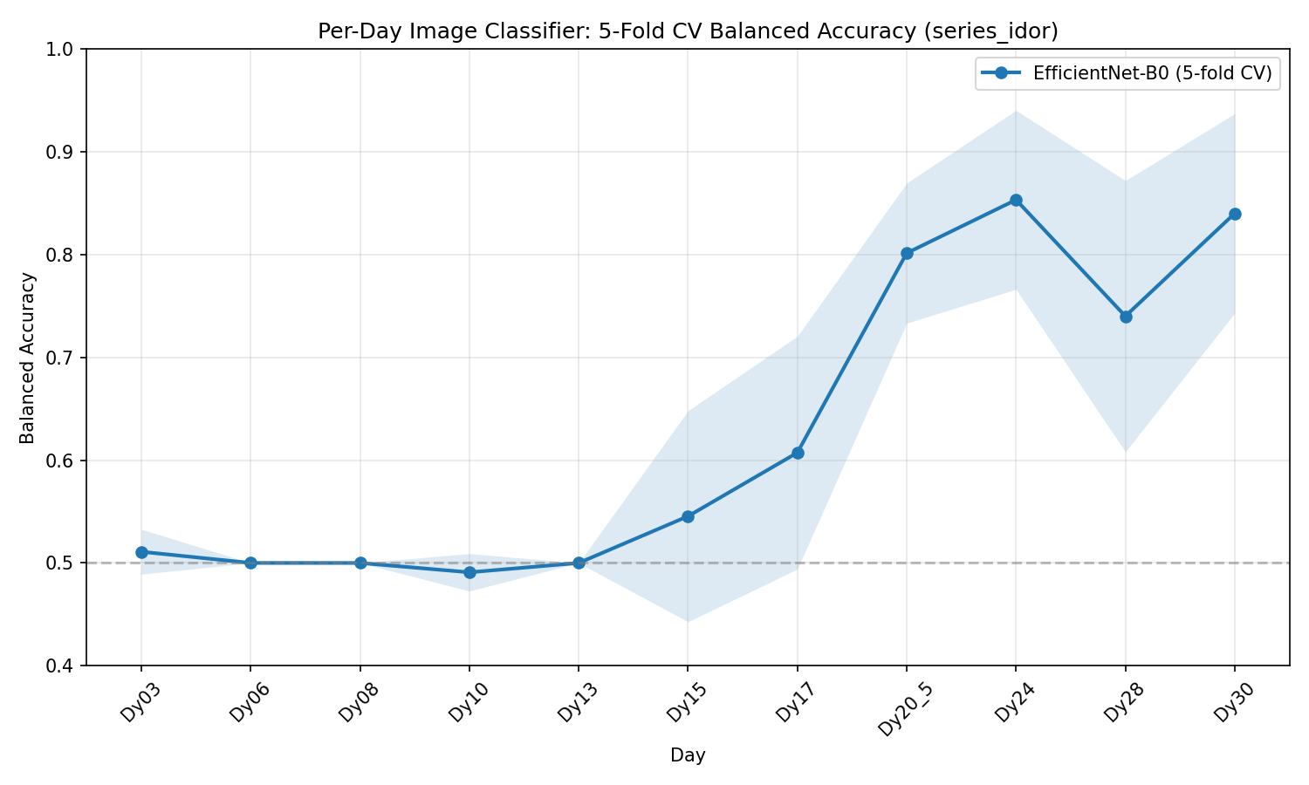
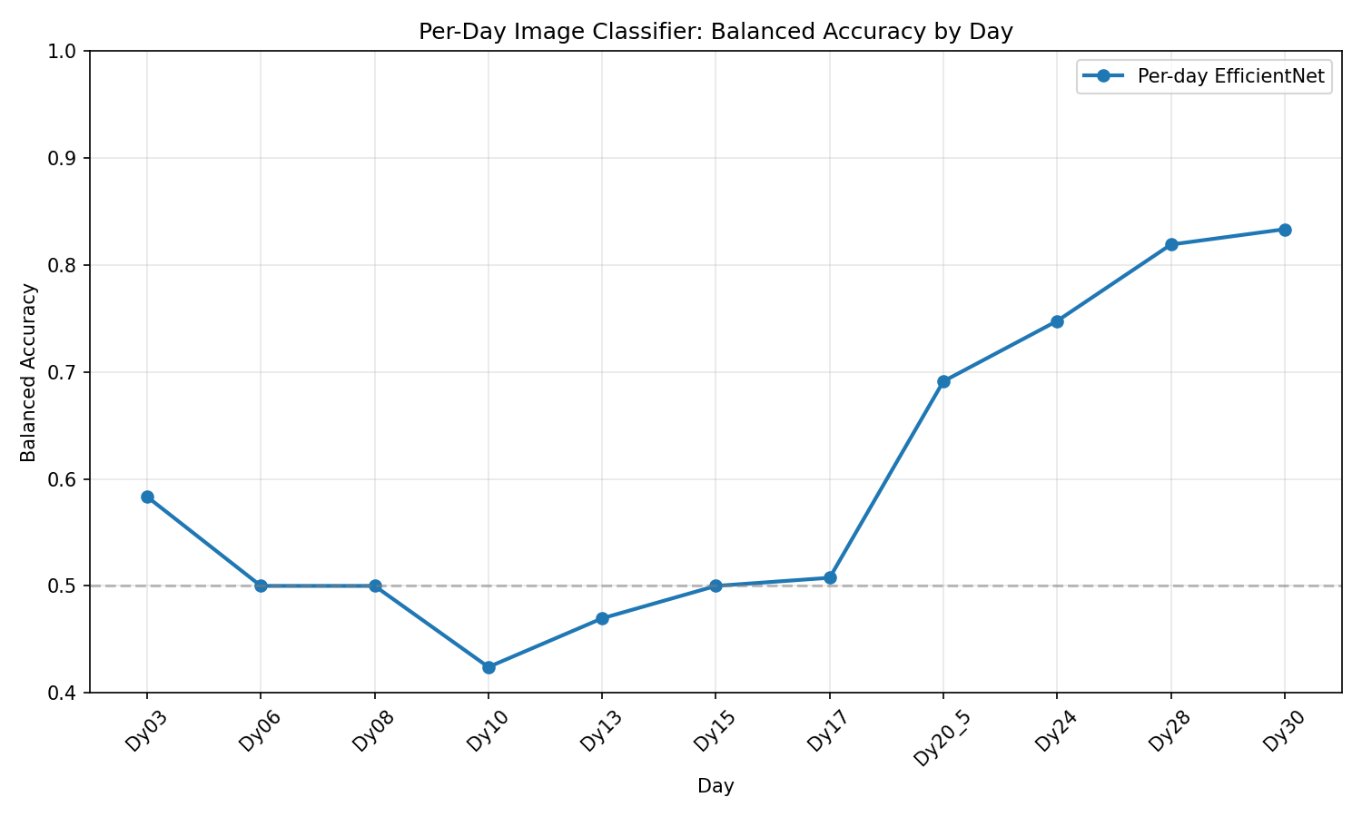
Balanced Accuracy by Day
EfficientNet-B0 · series_idor cohort · 5-fold CV (mean ±1 SD shading)

Slide 6
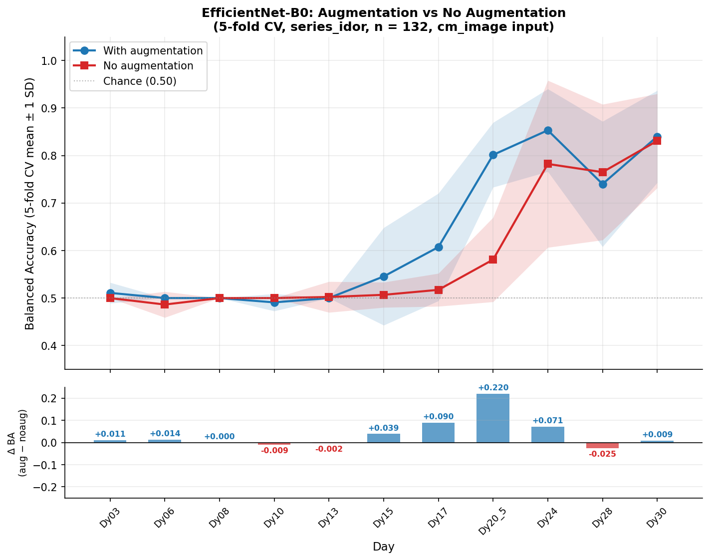
Augmentation Ablation — With vs. Without
series_idor cohort · 5-fold CV (mean ±1 SD shading)

Slide 7
Per-Day Results
EfficientNet-B0 · series_idor · OOF (n=132), balanced accuracy mean ± std
Day
BalAcc
(mean±std)
Sensitivity (recall NAcc)
Specificity (recall Acc)
Acc
AUC
TN
FP
FN
TP
Dy03
0.511±0.022
0.045
0.982
0.826
0.468
108
2
21
1
Dy06
0.500±0.000
0.000
1.000
0.833
0.530
110
0
22
0
Dy08
0.500±0.000
0.000
1.000
0.833
0.469
110
0
22
0
Dy10
0.491±0.018
0.000
0.982
0.818
0.432
108
2
22
0
Dy13
0.500±0.000
0.000
1.000
0.833
0.498
110
0
22
0
Dy15
0.545±0.103
0.091
0.991
0.841
0.565
109
1
20
2
Dy17
0.607±0.113
0.273
0.955
0.841
0.713
105
5
16
6
Dy20_5
0.801±0.068
0.636
0.973
0.917
0.845
107
3
8
14
Dy24
0.853±0.087
0.773
0.936
0.909
0.872
103
7
5
17
Dy28
0.740±0.132
0.500
1.000
0.917
0.862
110
0
11
11
Dy30
0.840±0.097
0.682
1.000
0.947
0.911
110
0
7
15
Green = BalAcc ≥ 0.75 Yellow = 0.60–0.75 Red = < 0.60 Sensitivity = OOF TPR(NAcc) Specificity = OOF TPR(Acc) TN/FP/FN/TP from aggregated OOF predictions (n=132)

Slide 8
Confusion Matrices — Late Days
Dy28 and Dy30 · OOF predictions (n=132: 22 NAcc, 110 Acc)
Dy28 — BalAcc=0.740 Sens=0.500 Spec=1.000
Dy30 — BalAcc=0.840 Sens=0.682 Spec=1.000
Pred: Acc
Pred: NAcc
Pred: Acc
Pred: NAcc
Actual Acc
110
0
Actual Acc
110
0
TN
FP
TN
FP
Actual NAcc
11
11
Actual NAcc
7
15
FN
TP
FN
TP
NAcc = Not Acceptable (label 1, minority class). Green = correct. Orange = error.
Dy28: 0 FP + 11 FN. Dy30: 0 FP + 7 FN. OOF aggregation across 5 folds (n=132 total).

Slide 9
Key Findings
Image-based classification — EfficientNet-B0
Early days (Dy03–Dy15) not discriminative
BalAcc ≤ 0.51 for Dy03–Dy15 (6 of 11 days). Model predicts all-Acceptable at early timepoints; no separable visual phenotype yet.
Signal emerges from Dy17 onward
5-fold OOF BalAcc: 0.61 (Dy17) → 0.80 (Dy20.5) → 0.85 (Dy24) → 0.74 (Dy28) → 0.84 (Dy30). Days with BalAcc ≥ 0.75: Dy20.5, Dy24, Dy30.
Average balanced accuracy: 62.6%
Overall mean (all 11 days) = 62.6%; late days Dy20.5–Dy30 average 80.9%. Corrected augmentation (fill=[178,178,178], ForegroundColorJitter) drove major improvements at Dy20.5 (+23 pp) and Dy24 (+27 pp) vs earlier runs.
5-fold CV provides robust estimates
OOF results on all 132 organoids; fold std ≤ 0.13 at late days. Augmentation reduces variance at early/mid days vs no-augmentation baseline.
Multi-modal fusion adds marginal gain
Morph+Image (mean-prob) reaches 0.896 at Dy30 vs image-only 0.840. Fusion reduces fold variance more than it boosts the mean. See combined_kfold_two_panel_series_idor.png for full comparison.

