Slide 1
Morphology Classifier: LGBM vs LogReg
IDOR-134 set (6 stitched organoids removed) · 10×4-fold CV
Removing stitched organoids reverses the late-day morph LogReg deficit

Slide 2
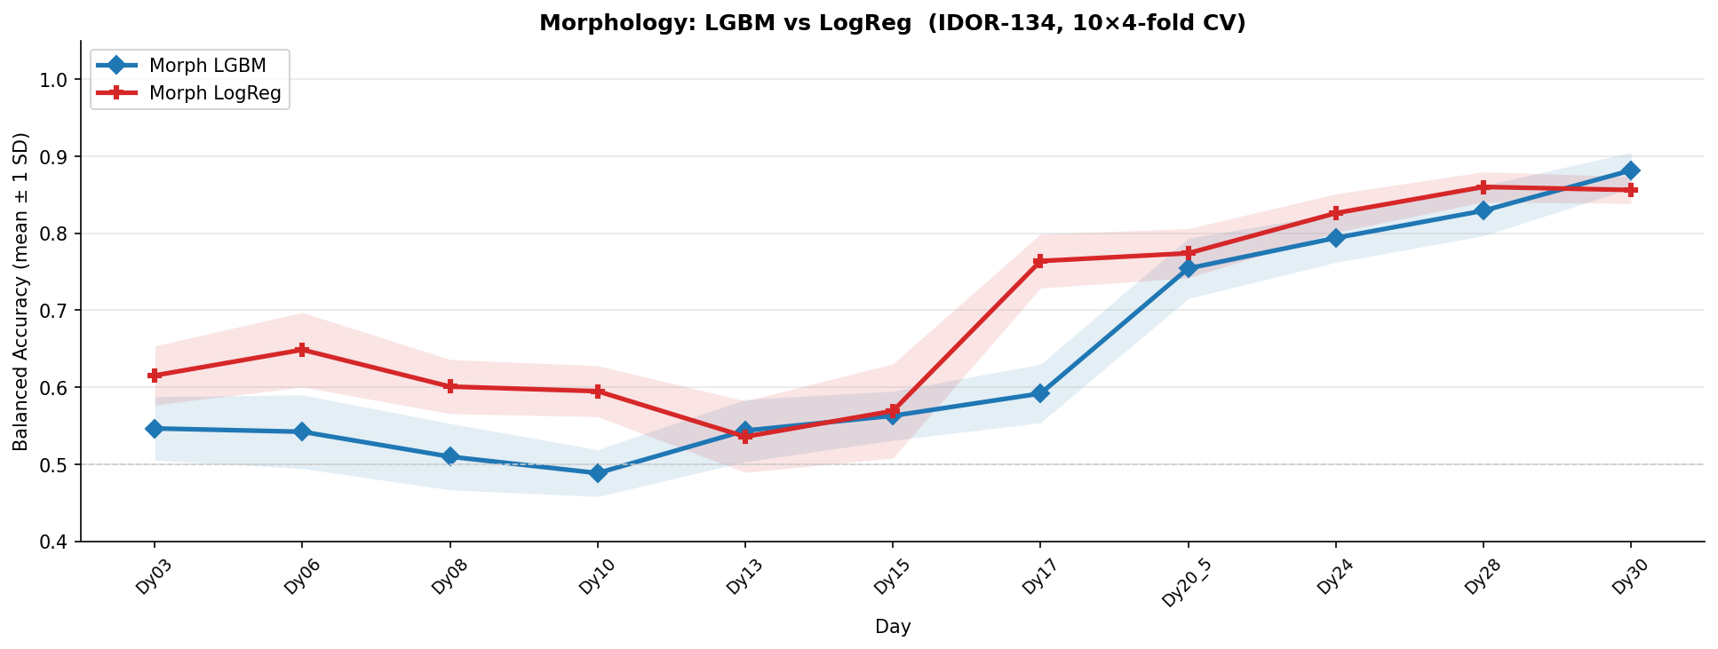
Morph LGBM vs LogReg — IDOR-134 (n=134)

Slide 3
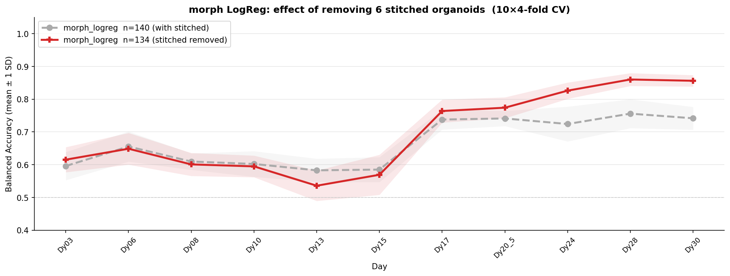
morph LogReg: n=140 (with stitched) vs n=134 (stitched removed)

Slide 4
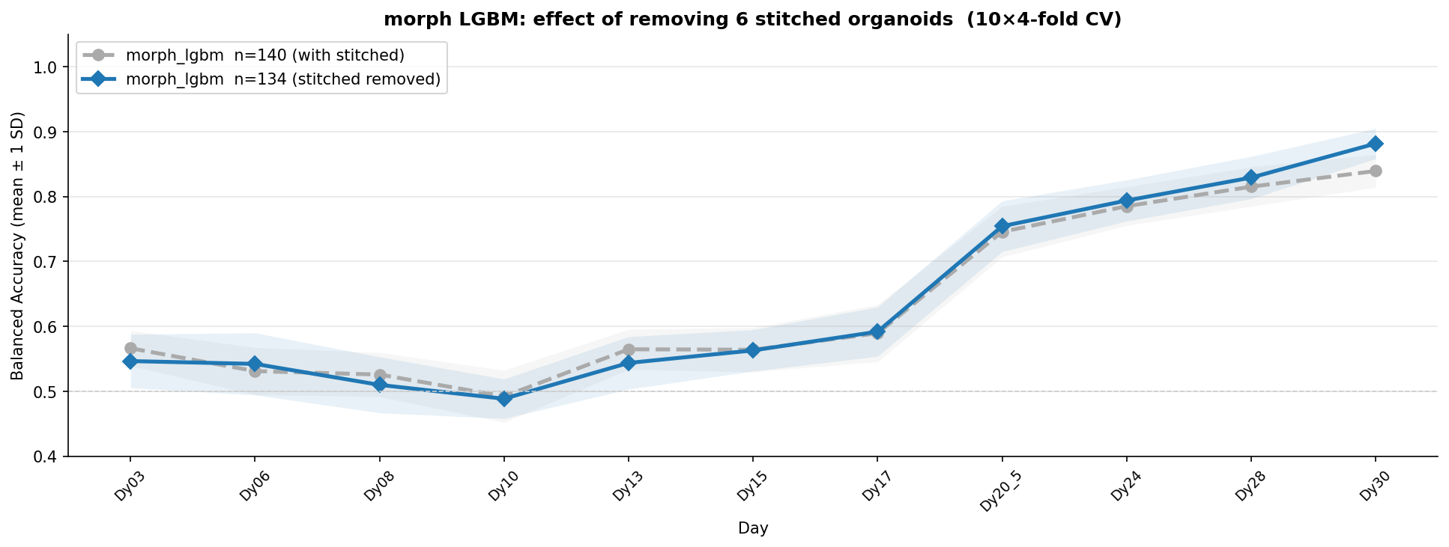
morph LGBM: n=140 vs n=134 — minimal impact

