Slide 1
Metabolite Preprocessing Variants
series_idor · n=139 · 10×4-fold repeated CV
Comparing: nan-floor · raw values · MalateGlo excluded

Slide 2
Three Metabolite Preprocessing Approaches
Background
MalateGlo assay occasionally produces extreme negative concentrations (e.g. −5662 µM)
interpreted as assay failure. The original pipeline replaces values < −500 µM with NaN.
This experiment tests whether that correction matters and whether MalateGlo adds value.
Variant 1 — met_nan (original)
Concentration values below −500 µM → NaN. LightGBM handles NaN natively.
Variant 2 — met_raw
Raw concentration used as-is. No floor applied. Tests whether outlier flagging matters.
Variant 3 — met_no_malate
MalateGlo feature excluded entirely (all 3 MalateGlo columns: concentration, initial,
growth rate). Tests whether MalateGlo adds discriminative signal.
Note: MalateGlo is only present for days > Dy10 (conditional metabolite).
All three variants are trained independently on the same fold splits in every repeat.
Comparison is therefore perfectly controlled for cohort and fold assignments.

Slide 3
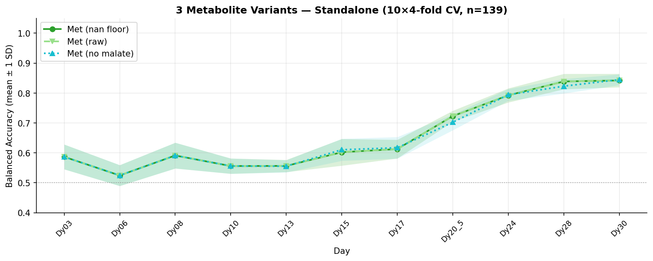
Standalone BA — 3 Met Variants

Slide 4
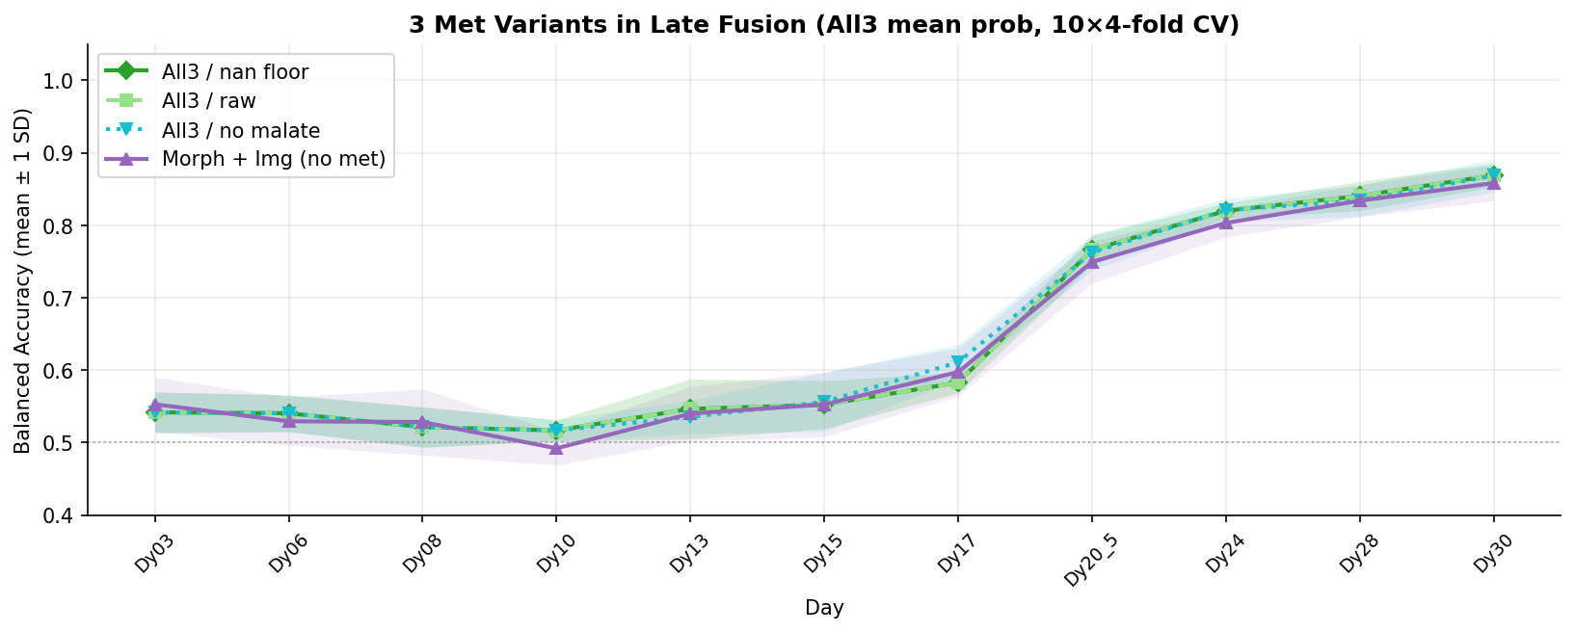
Late-Fusion BA — 3 Met Variants vs Morph+Img Baseline

Slide 5
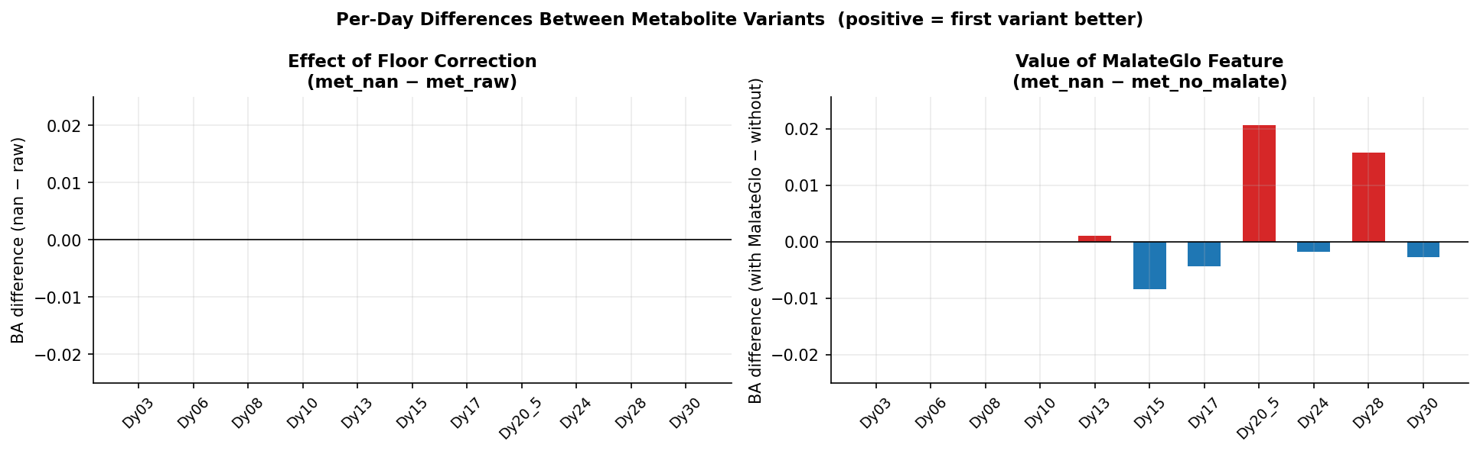
Per-Day Differences Between Variants

Slide 6
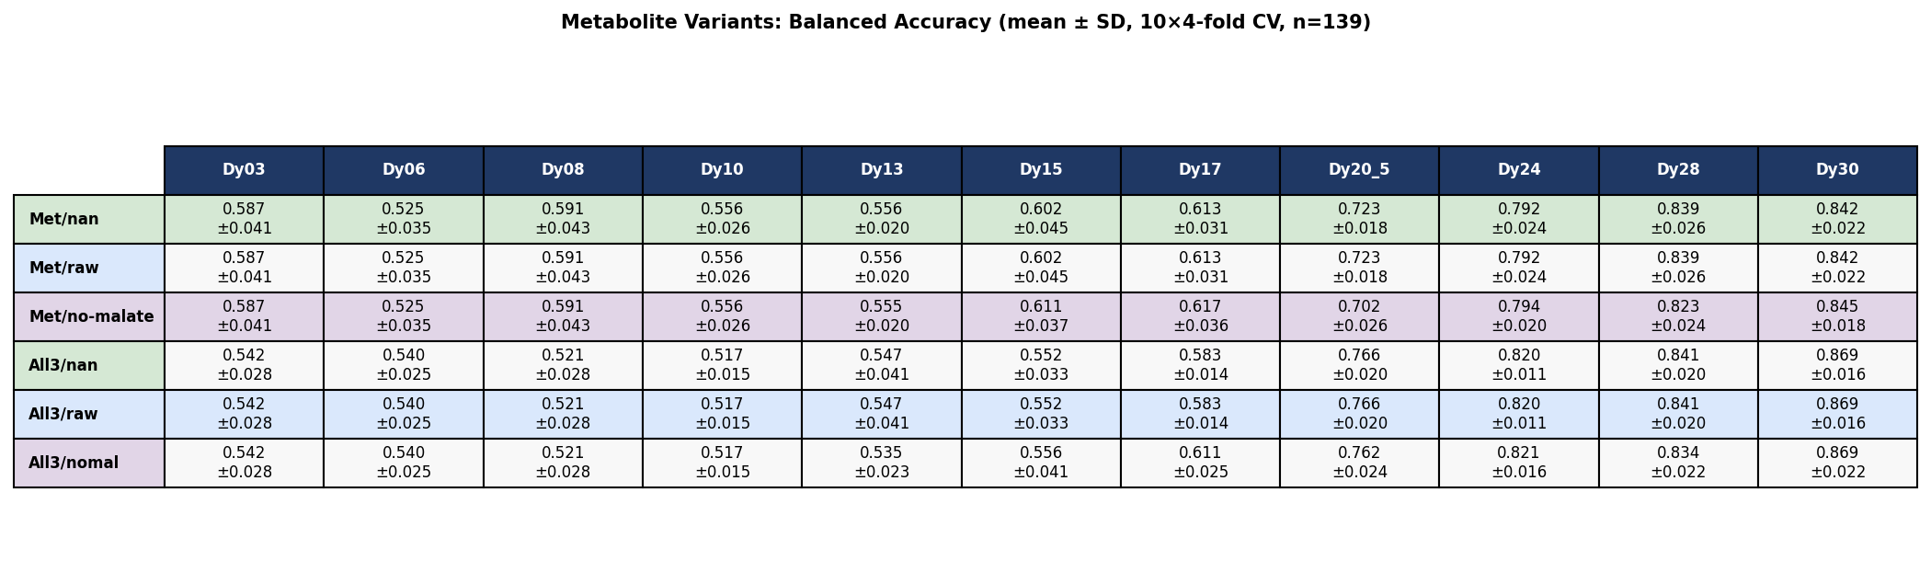
Numeric Summary Table

Slide 7
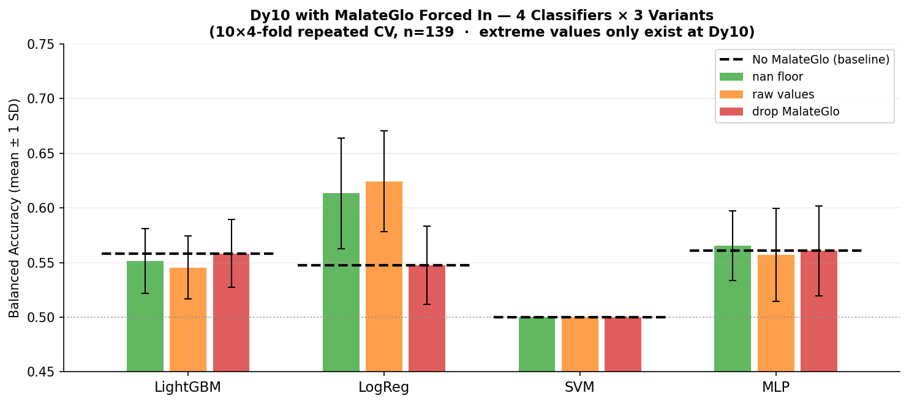
Dy10 Experiment: Forcing MalateGlo In Where Outliers Live
Why this experiment?
Extreme MalateGlo values (e.g. −5662 µM) exist only at Dy10.
MalateGlo is normally excluded for days ≤ Dy10 (conditional metabolite),
so the floor correction never fires in the standard pipeline.
Here we force MalateGlo into Dy10 features to test the correction directly.
Key findings
• nan vs raw: ~0.006–0.011 BA difference — floor correction works but
the effect is tiny, within repeat noise (±0.03–0.05 SD).
• LogReg: nan=0.613 > drop/baseline=0.548 — gains most from keeping
MalateGlo (even with outliers replaced by NaN).
• LGBM/MLP: nan ≈ raw ≈ drop ≈ baseline — insensitive to MalateGlo at Dy10.
• SVM: stuck at 0.500 regardless — features not separable at Dy10.

Slide 8
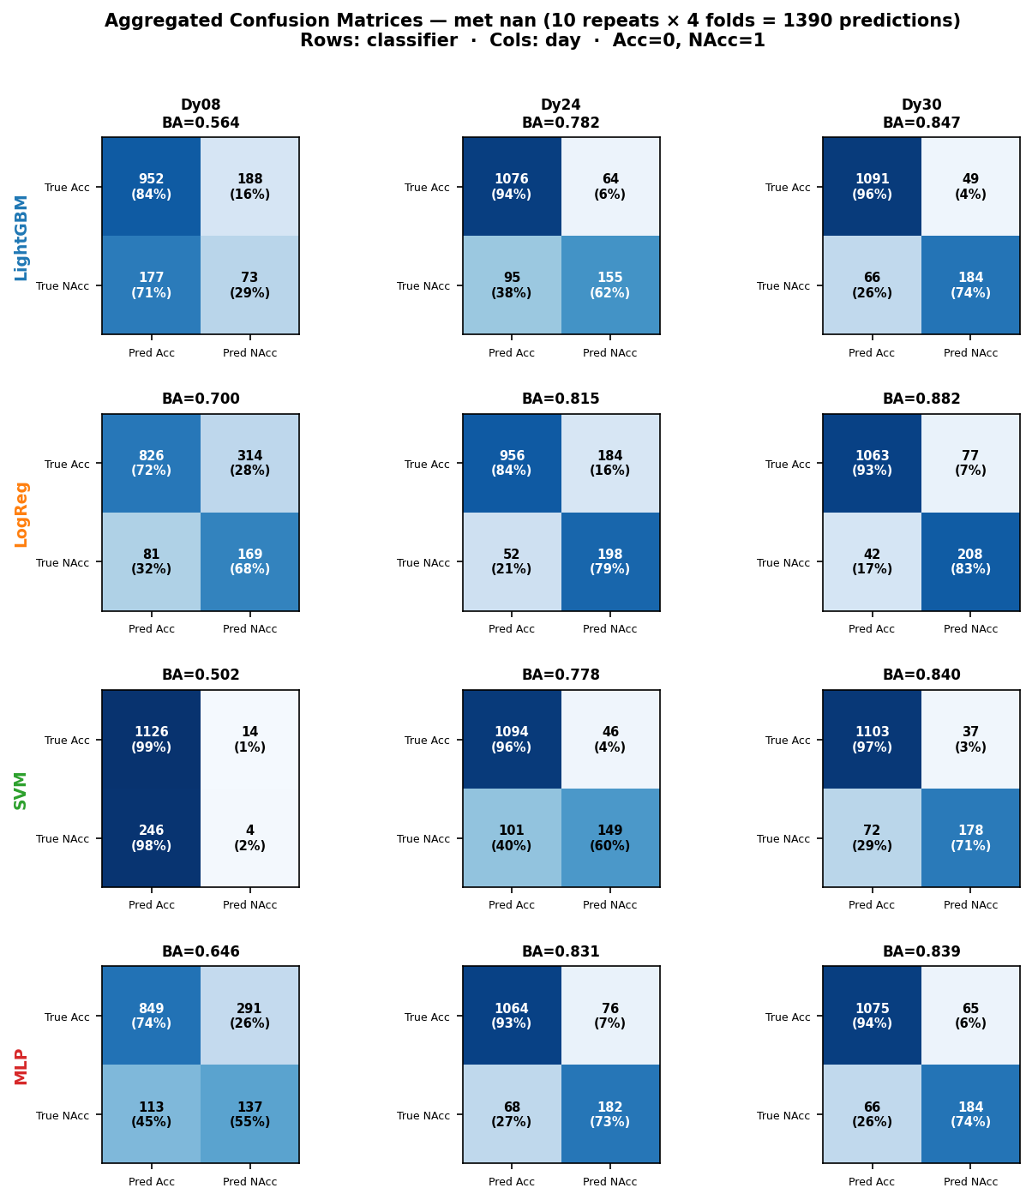
Confusion Matrices — 4 Classifiers × Key Days (met_nan, aggregated 10 repeats)

Slide 9
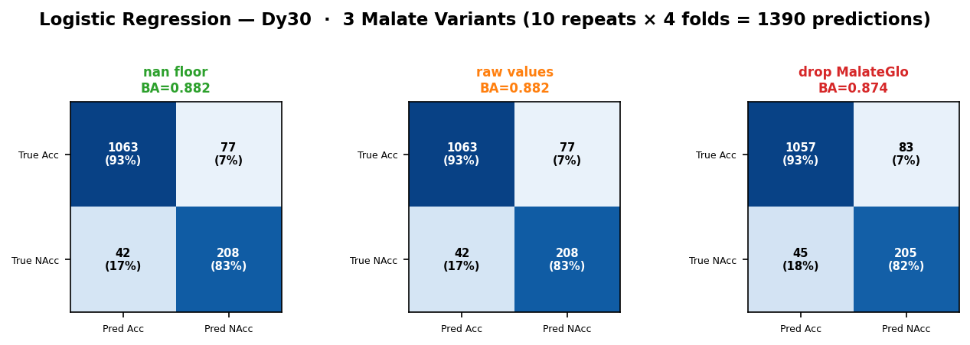
Malate Variant Effect on Confusion Matrix — LogReg at Dy30

Slide 10
Observations & Conclusions
1. Floor correction (met_nan) vs raw values (met_raw)
Max |BA difference| across all days = 0.0000 — exactly zero.
→ Root cause: extreme MalateGlo values (e.g. −5662 µM) exist only at Dy10,
but MalateGlo is a conditional feature excluded for days ≤ Dy10.
At Dy13+, where MalateGlo IS used, all values are > −500 µM — floor never fires.
→ Confirmed by Dy10 forced-inclusion experiment (see next slide).
2. Dropping MalateGlo (met_no_malate) reduces BA at late days:
Dy20_5 (+0.021), Dy28 (+0.016)
→ MalateGlo contributes signal at late time points where malate
metabolism diverges between Acceptable and Not-Acceptable organoids.
3. Metabolite BA improves strongly with organoid age:
Early days (≤Dy17) mean BA = 0.576
Late days (≥Dy20) mean BA = 0.799
→ Metabolic signatures become more discriminative as organoids mature.
4. Late-fusion gain (All3 mean vs Met alone) at late days:
Mean gain = +0.025 over 4 days
→ Combining all three modalities consistently outperforms any single modality.

