Slide 1
10-Repeat 4-Fold Cross-Validation
series_idor · n=139 · Metabolite (LGBM + LogReg) + Morphology + Image
Late fusion: mean probability · majority vote

Slide 2
Study Design
Cohort
• 139 organoids, series_idor (BA1 + BA2), including 6 stitched
• 25 Not-Acceptable / 114 Acceptable · 11 time points: Dy03–Dy30
Why repeated k-fold?
• With 25 NAcc in 139 total, a single 4-fold run puts only 6–7 NAcc in each
test fold — one wrong prediction = ±0.07 BA. High variance.
• 10 independent repeats (different random seeds) halve the SD of the BA
estimate without requiring more data or more GPU time.
Fold structure
• Stratified 4-fold: label ratio preserved in every fold
• Seed for repeat r = 1 + r × 1000 → genuinely independent splits
• All modalities (met, morph, image) use the same fold partition per repeat
→ required for valid late-fusion evaluation
What is stored per repeat
• OOF balanced accuracy (single number per modality)
• OOF probabilities + binary predictions per organoid
• Fold assignment for every organoid (which fold 0–3 it was tested in)
• Confusion matrix [[TN,FP],[FN,TP]] per single modality

Slide 3
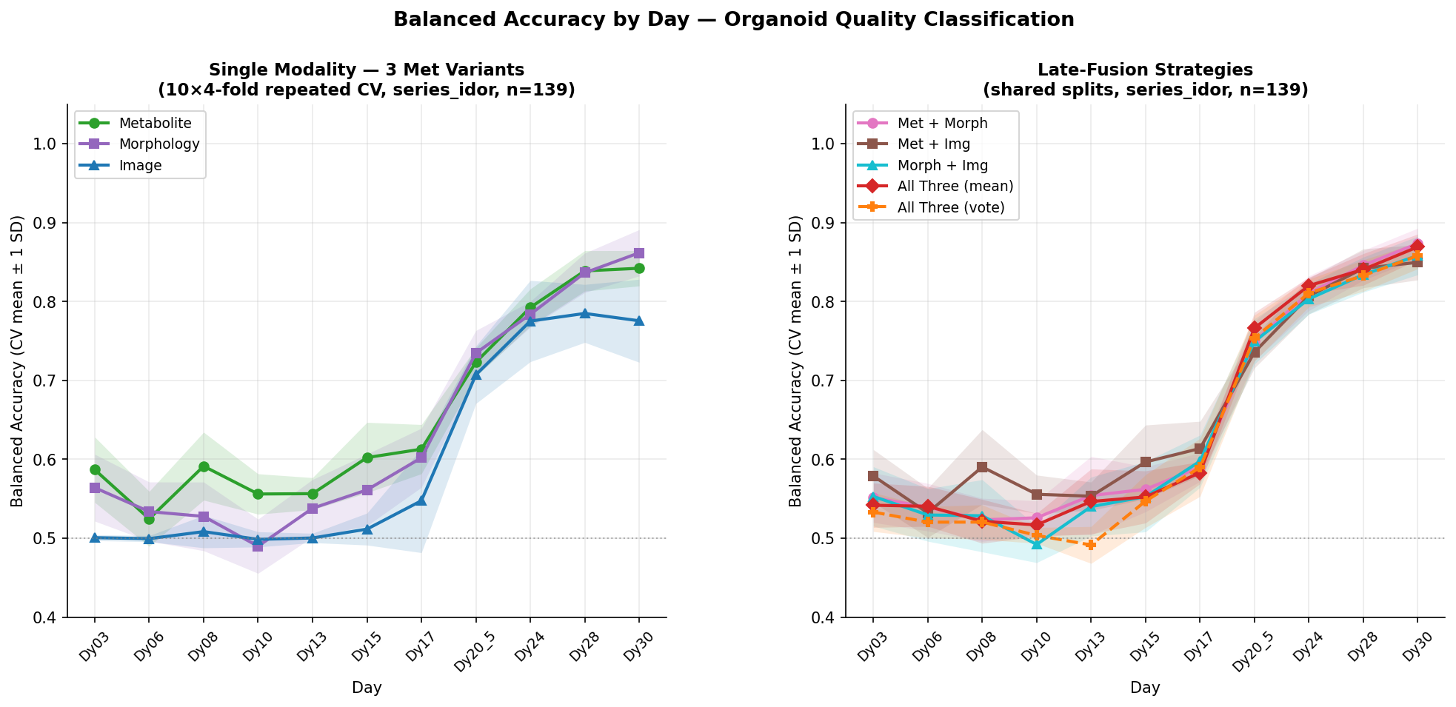
Aggregated Results: Mean ± SD over 10 Repeats

Slide 4
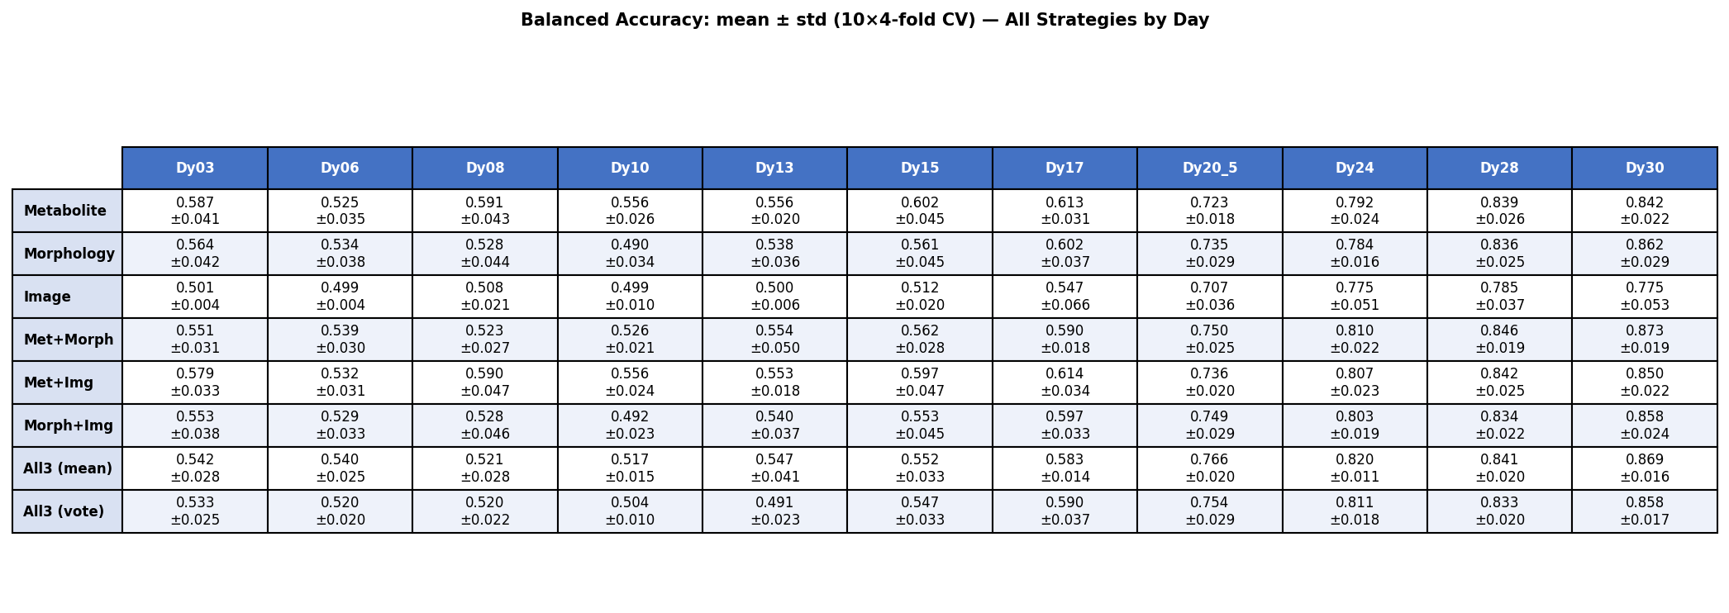
Summary Table: Balanced Accuracy (mean ± SD)

Slide 5
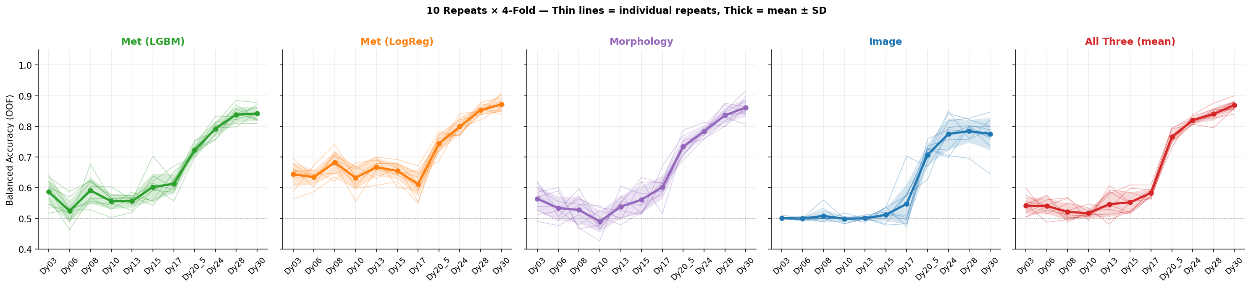
Repeat-Level Variance — 4 Key Strategies

Slide 6
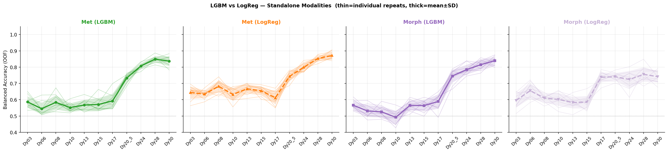
LGBM vs LogReg — Standalone (Met & Morphology)

Slide 7
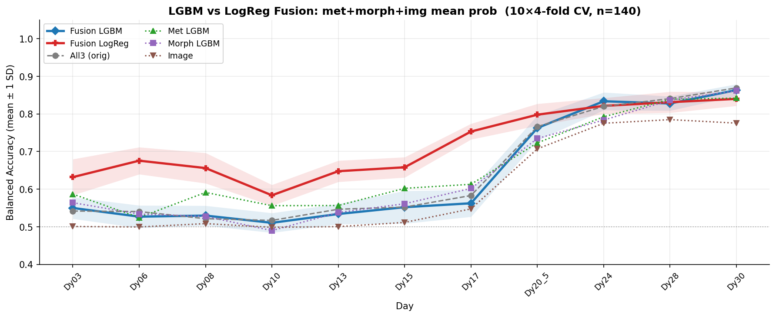
LGBM vs LogReg — Fusion (met + morph + img mean prob)

Slide 8
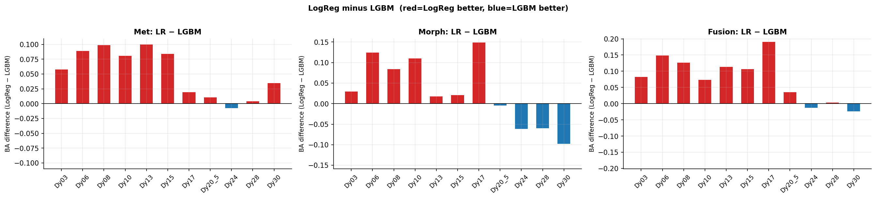
LogReg − LGBM Delta: Where Does Classifier Choice Matter?

Slide 9
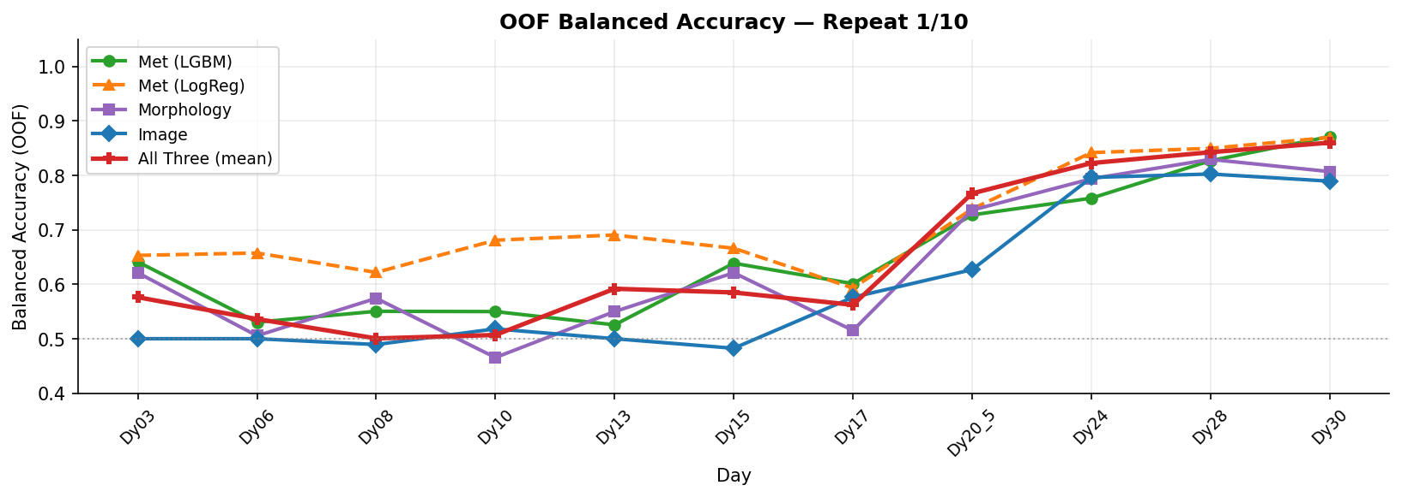
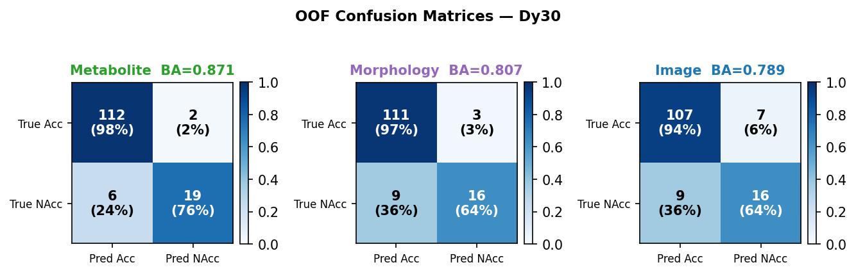
Repeat 1 / 10 (seed = 1)

Slide 10
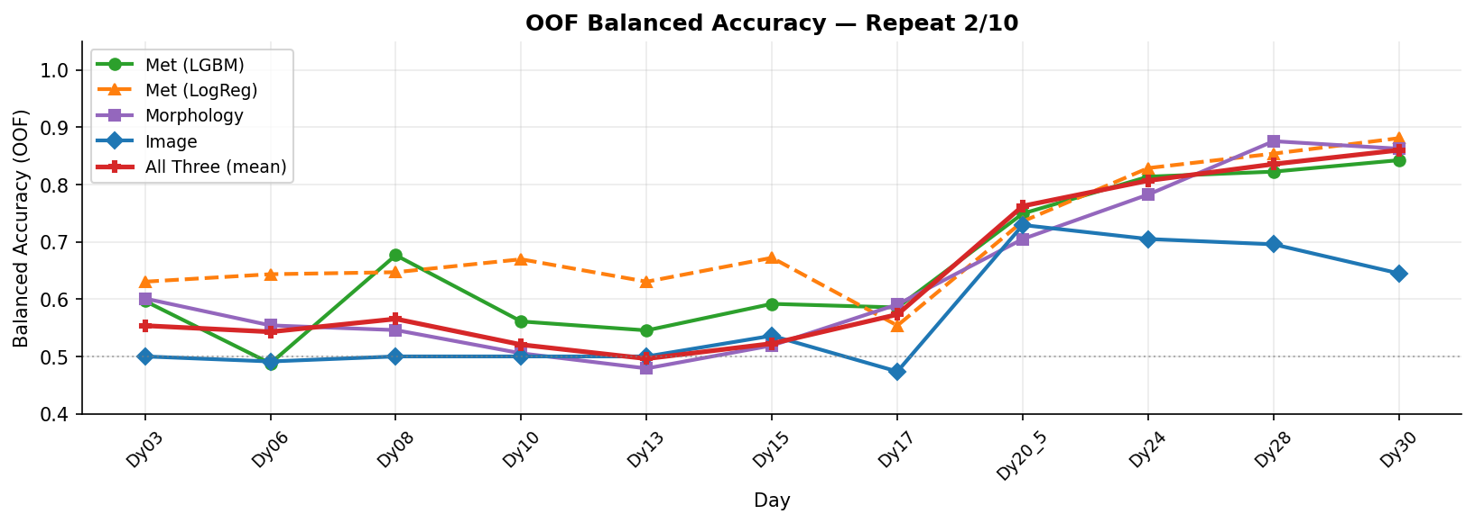
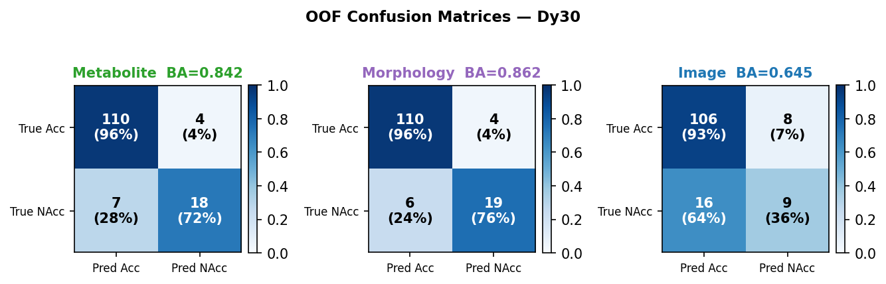
Repeat 2 / 10 (seed = 1001)

Slide 11
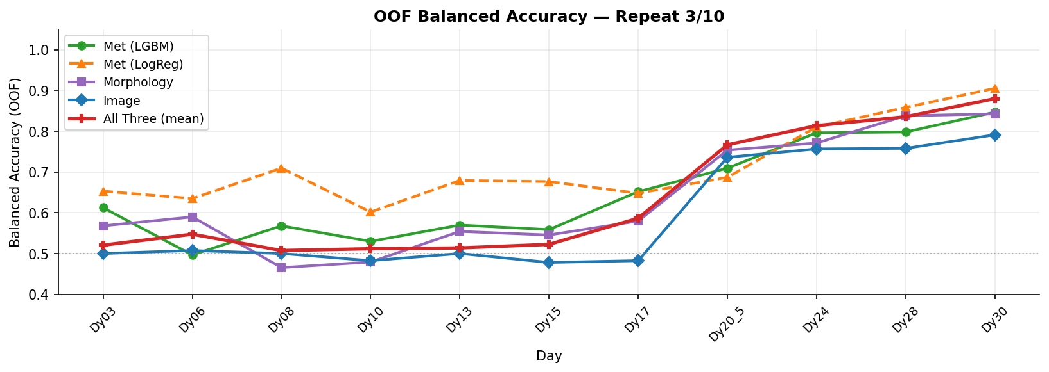
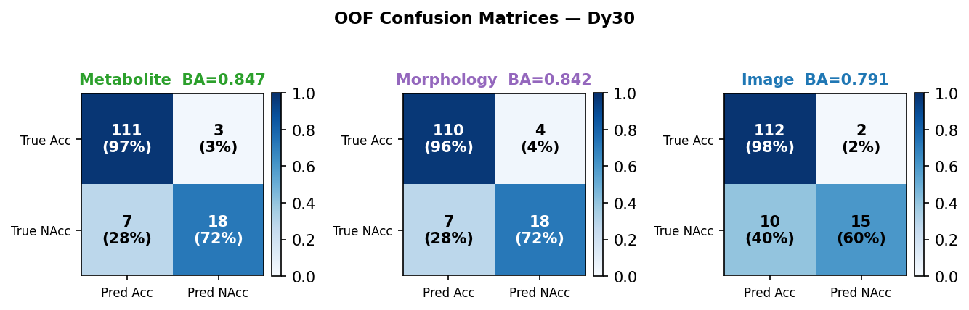
Repeat 3 / 10 (seed = 2001)

Slide 12
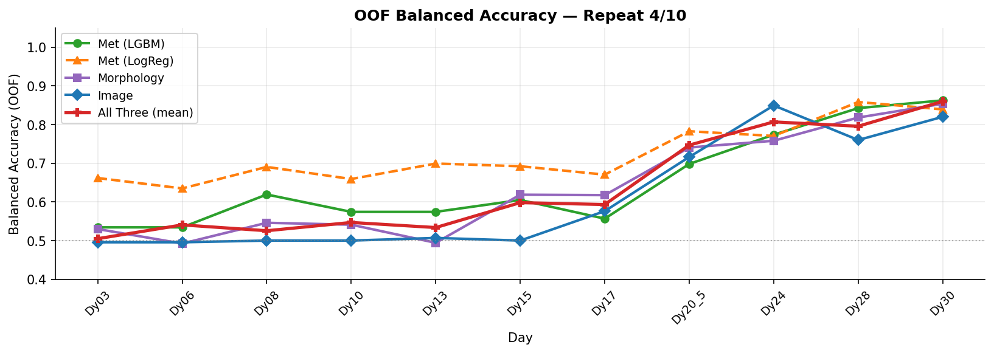
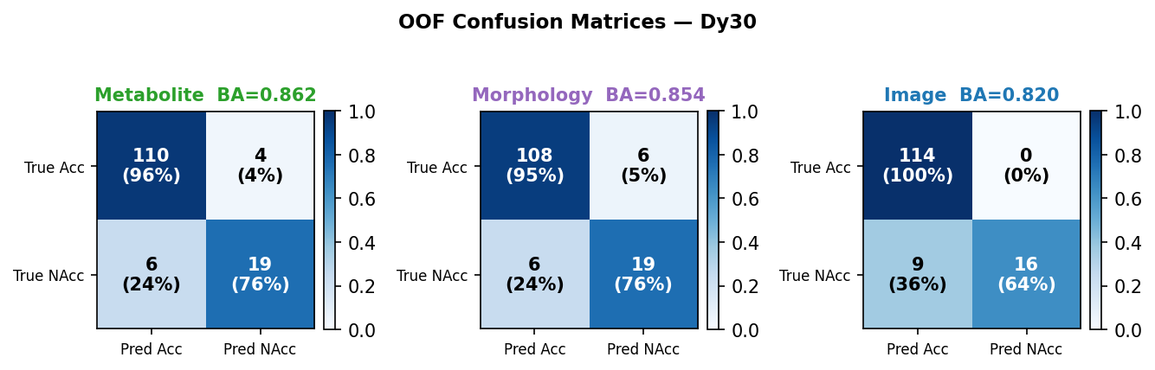
Repeat 4 / 10 (seed = 3001)

Slide 13
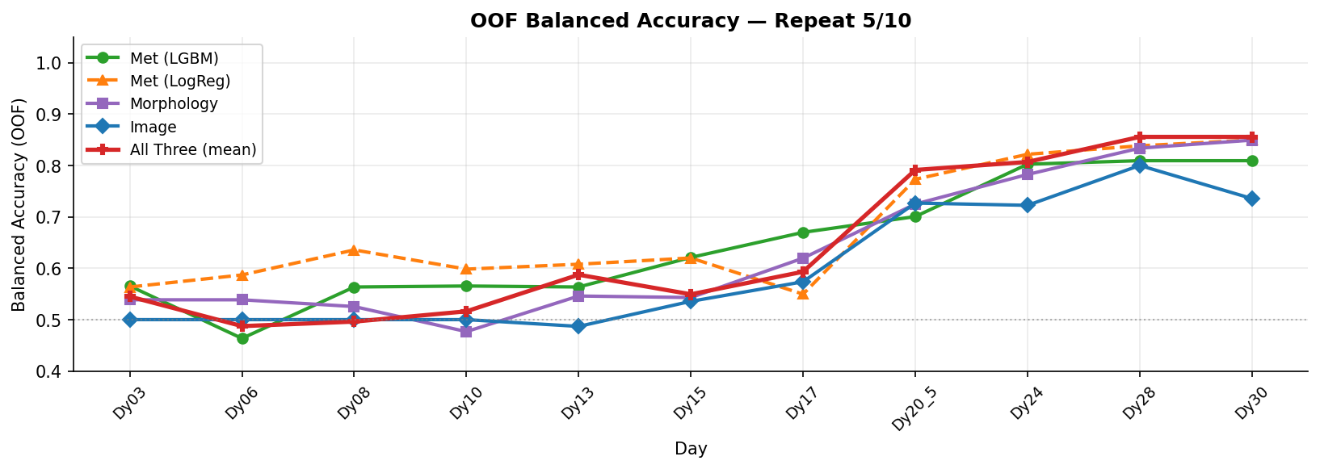
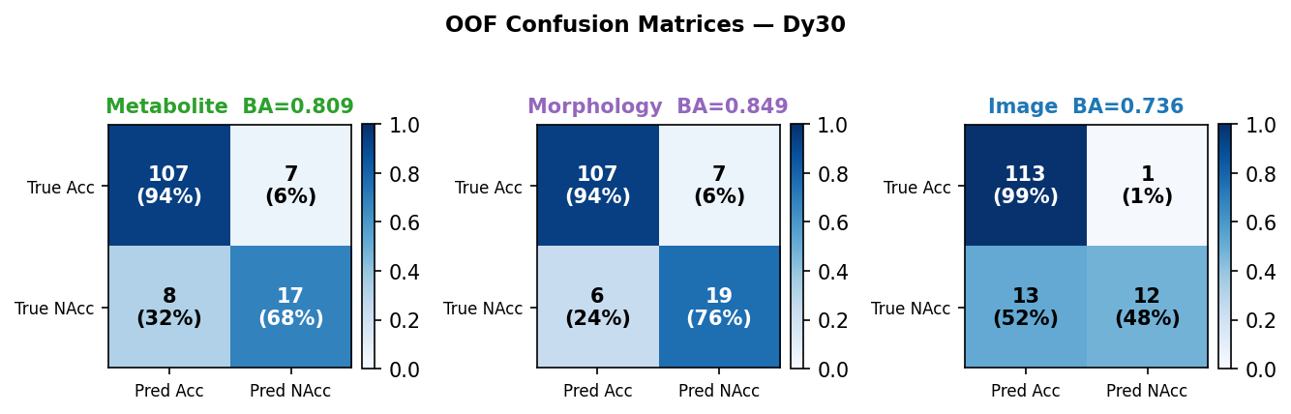
Repeat 5 / 10 (seed = 4001)

Slide 14
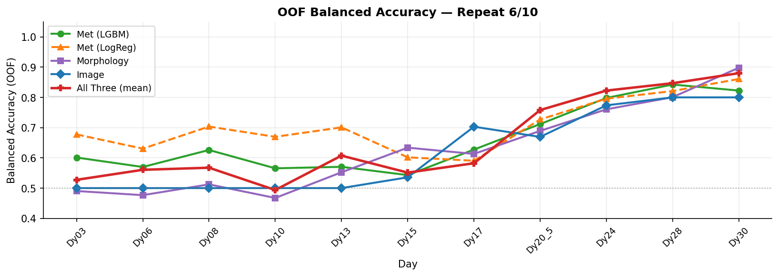
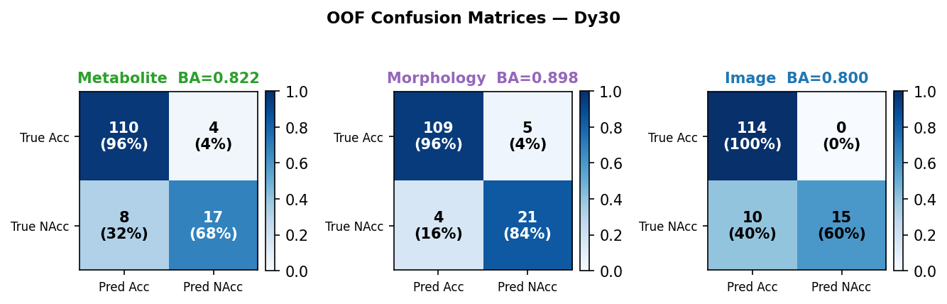
Repeat 6 / 10 (seed = 5001)

Slide 15
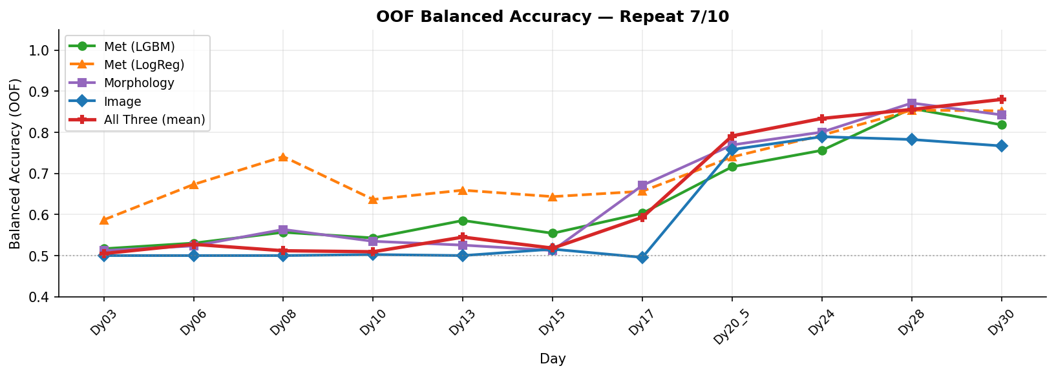
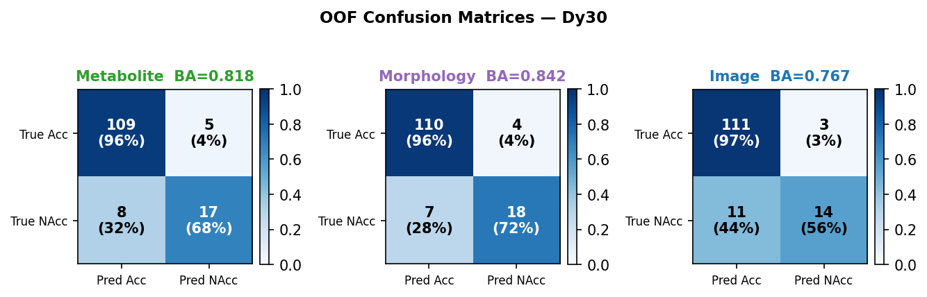
Repeat 7 / 10 (seed = 6001)

Slide 16
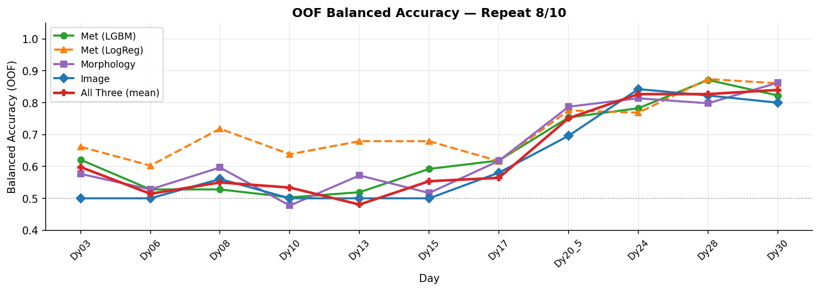
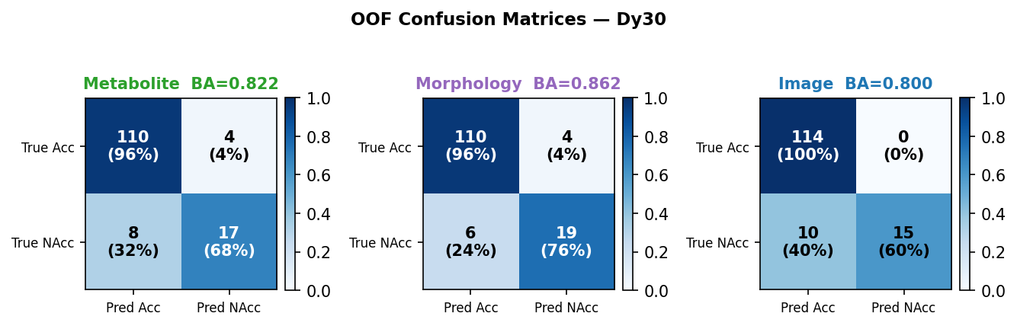
Repeat 8 / 10 (seed = 7001)

Slide 17
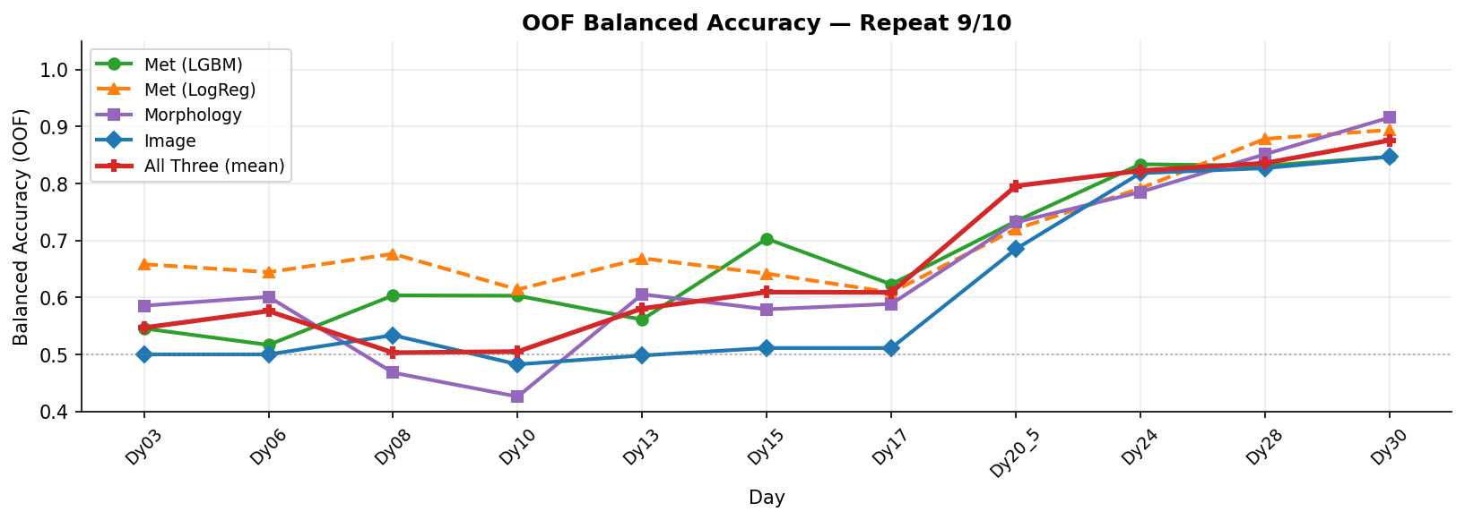
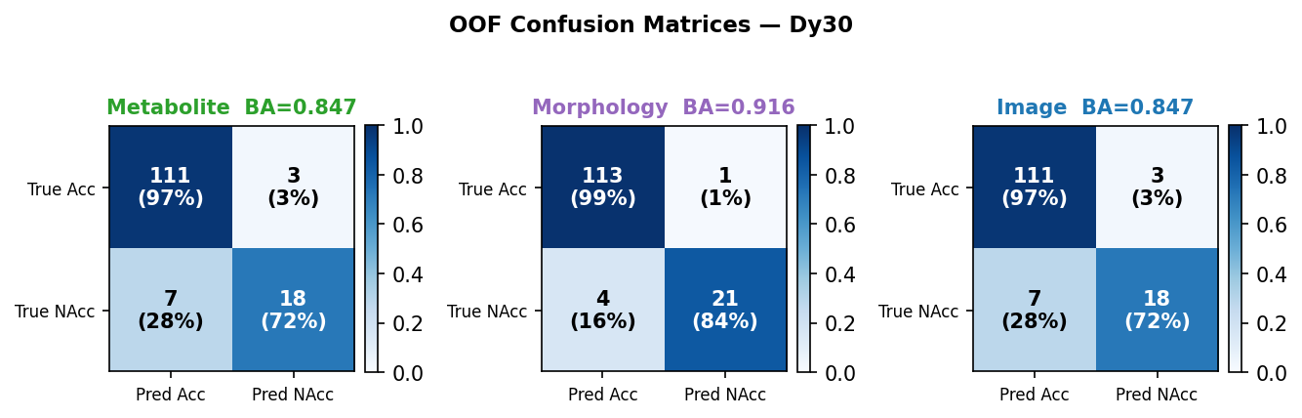
Repeat 9 / 10 (seed = 8001)

Slide 18
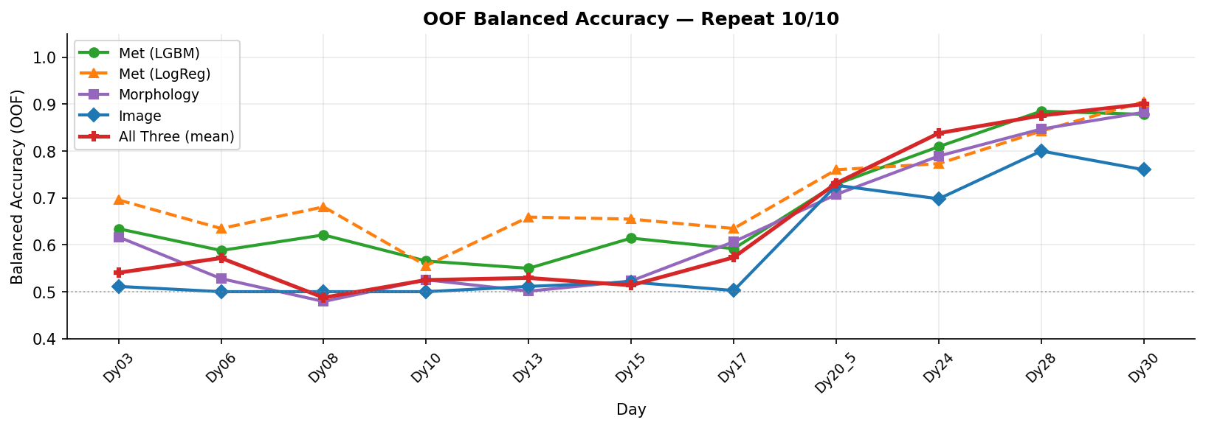
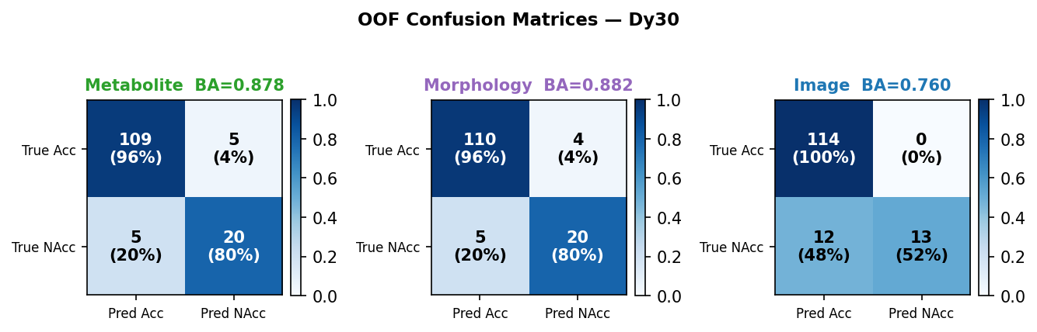
Repeat 10 / 10 (seed = 9001)

