Slide 1
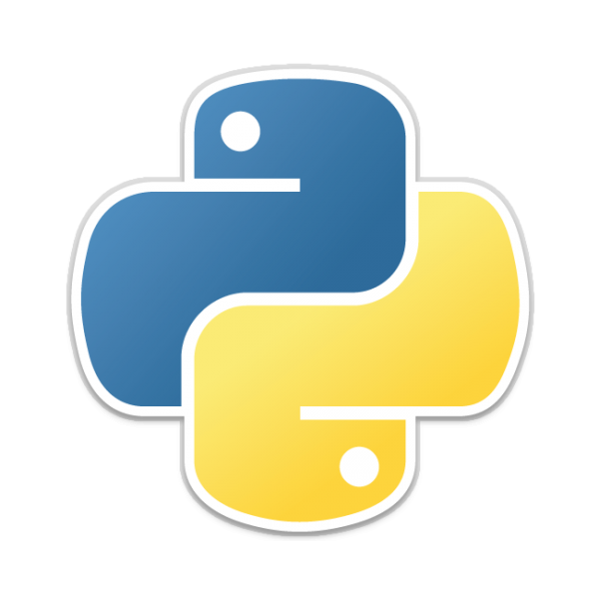
Python Programming
David Siah
MIS Society
November 18th, 2014

Slide 2
Download Python 2.78
On windows 7 download the MSI x64 installer
On OSX (its already installed ☺)
On Unix/Linux distros … we can cross this bridge later.
Pick up a text editor:
Notepad++ for windows users
Sublime, Atom, Text Wrangler, etc.
Python 2.78 Installers

Slide 3



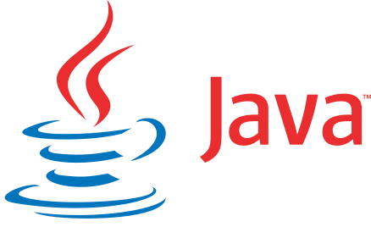

Programming Languages
Purpose
“Dynamic vs. Static” Typed
Compiled or Interpreted
Environment

Slide 4
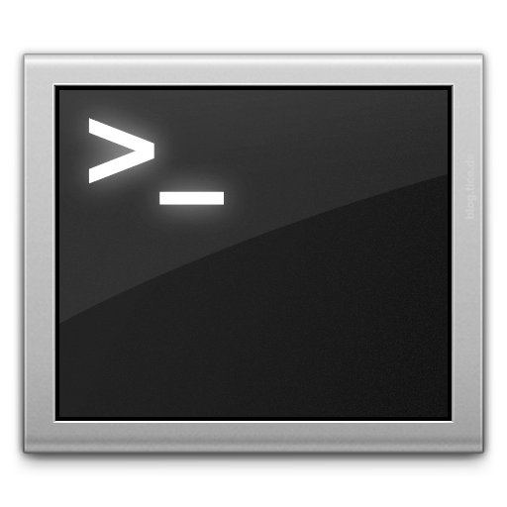
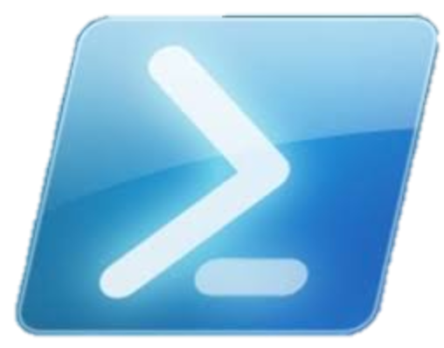
Open your Terminal/Powershell
Couldn’t Install?
http://labs.codecademy.com/#:workspace
Some Commands:
cd [ nameOfDirectory ]– change directory
ls – list contents of current directory
python [ nameOfFile ] – run python file (without a file you can start up the interpreter (Read. Evaluate. Process. Loop.)

Slide 5
Data and Variables
Strings (ex. “hello”)
Integers (ex. -900)
Lists [1, 2, 3, “a b c”] (also known as arrays)
Dictionaries { key: value, key2: value2 }

Slide 6

Control Flow
If / elif / else statements
For Loops / While loops
Defining Functions

Slide 7
Import this & Writing a script
Create a file:
- On the command-line: touch filename.py
- Or create a new file and save it to your directory (make sure file ends with .py extension)
Try importing a library
import this
import random
random.randrange(1,10)

Slide 8
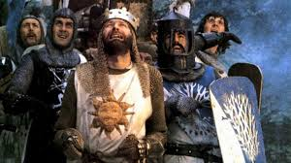
Style & Best Practices
A program could be one script
However we usually split these files + resources into multiple files + folders.
PEP-8
A final note on open source

Slide 9
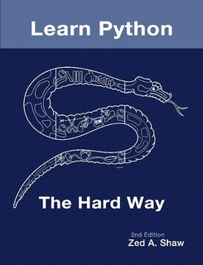
Suggested Reading & Other Cool Sites
Learn Python the Hard Way (Zed Shaw -- its free)
For the more adventurous programmer:
Python Standard Library By Example
Check out:
Using Python

Slide 10
Package Managers **bonus**
People write cool stuff – then then publish them as packages
You can use Package managers to download their work
Quick and Easy
Python Install Package (PIP)
Flask – the simpler way to develop web applications
Turtle – draw with python!
Pygame – create games.
SciPy – scientific utilities/functions in python
Beautiful Soup – web scraping library

