Slide 1
Global Logger
How-to
Dawid Sibiński

Slide 2
What’s that?
Global logger is an Nlog wrapper, which:
wraps Nlog hiding its core logic,
provides different logging methods,
allows to store persistent/volatile properties to be used with logs (using FluentAPI methods),
allows using additional Nlog config files without including them manually.

Slide 3
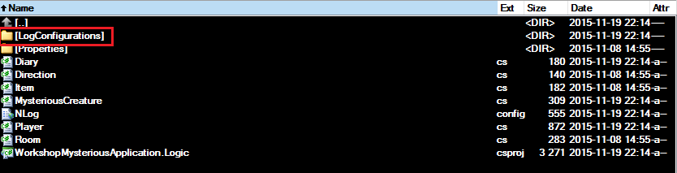

Additional configs
As for standard Nlog usage, additional custom coniguration files can be included into main config file.
Using GlobalLogger it’s enough to place config files with .config extension in /LogConfigurations catalogue of the application, where GlobalLogger is used.
LogConfigurations

Slide 4
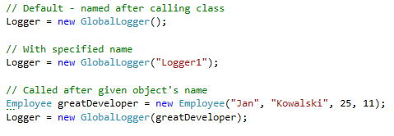
Logger instance (1)
In order to use GlobalLogger, you need to instantiate it:

Slide 5

Logger instance (2)
FluentAPI may be used in place to initialize logger’s persistent/volatile properties:

Slide 6
Logging (1)
Simply use GlobalLogger instance to log ☺
Messages can be logged on the following levels:
Trace
Debug
Info
Warning
Error
Fatal

Slide 7
Logging (2)
It’s just that simple:
Logger.LogTrace("We are tracing errors!");
Logger.LogDebug("Altum is even slower while debugging.");
Logger.LogInfo(„Lot not found. Just for info.");
Logger.LogWarning("[WARNING] Article entity is empty!");
Logger.LogError(„Altum crashed. By itself.");
Logger.LogFatal("This is fatal. Fatal code.");

Slide 8
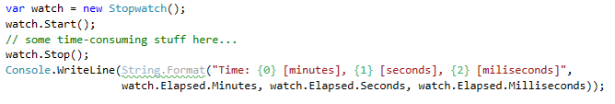

Time measuring
GlobalLogger has the ability to measure the time.
Before, everyone used to do:
Even though we used beautiful, featured String.Format, it looks awful. Those times have passed. The same could be now achieved by:
2015/11/20 00:20:15.475|Logger1|LogHelper.Demo.Exampk|Info >>> Operation time: 9606 [ticks]

Slide 9
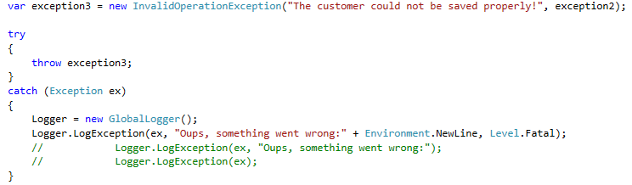
Exceptions logging
GlobalLogger also allows to log caught exceptions:

Slide 10
Examples

Slide 11
Additional sources
Some help for GlobalLogger can be found:
during usage of GlobalLogger – XML doc visible by IntelliSense,
in APIDoc HTML pages.

