Slide 1
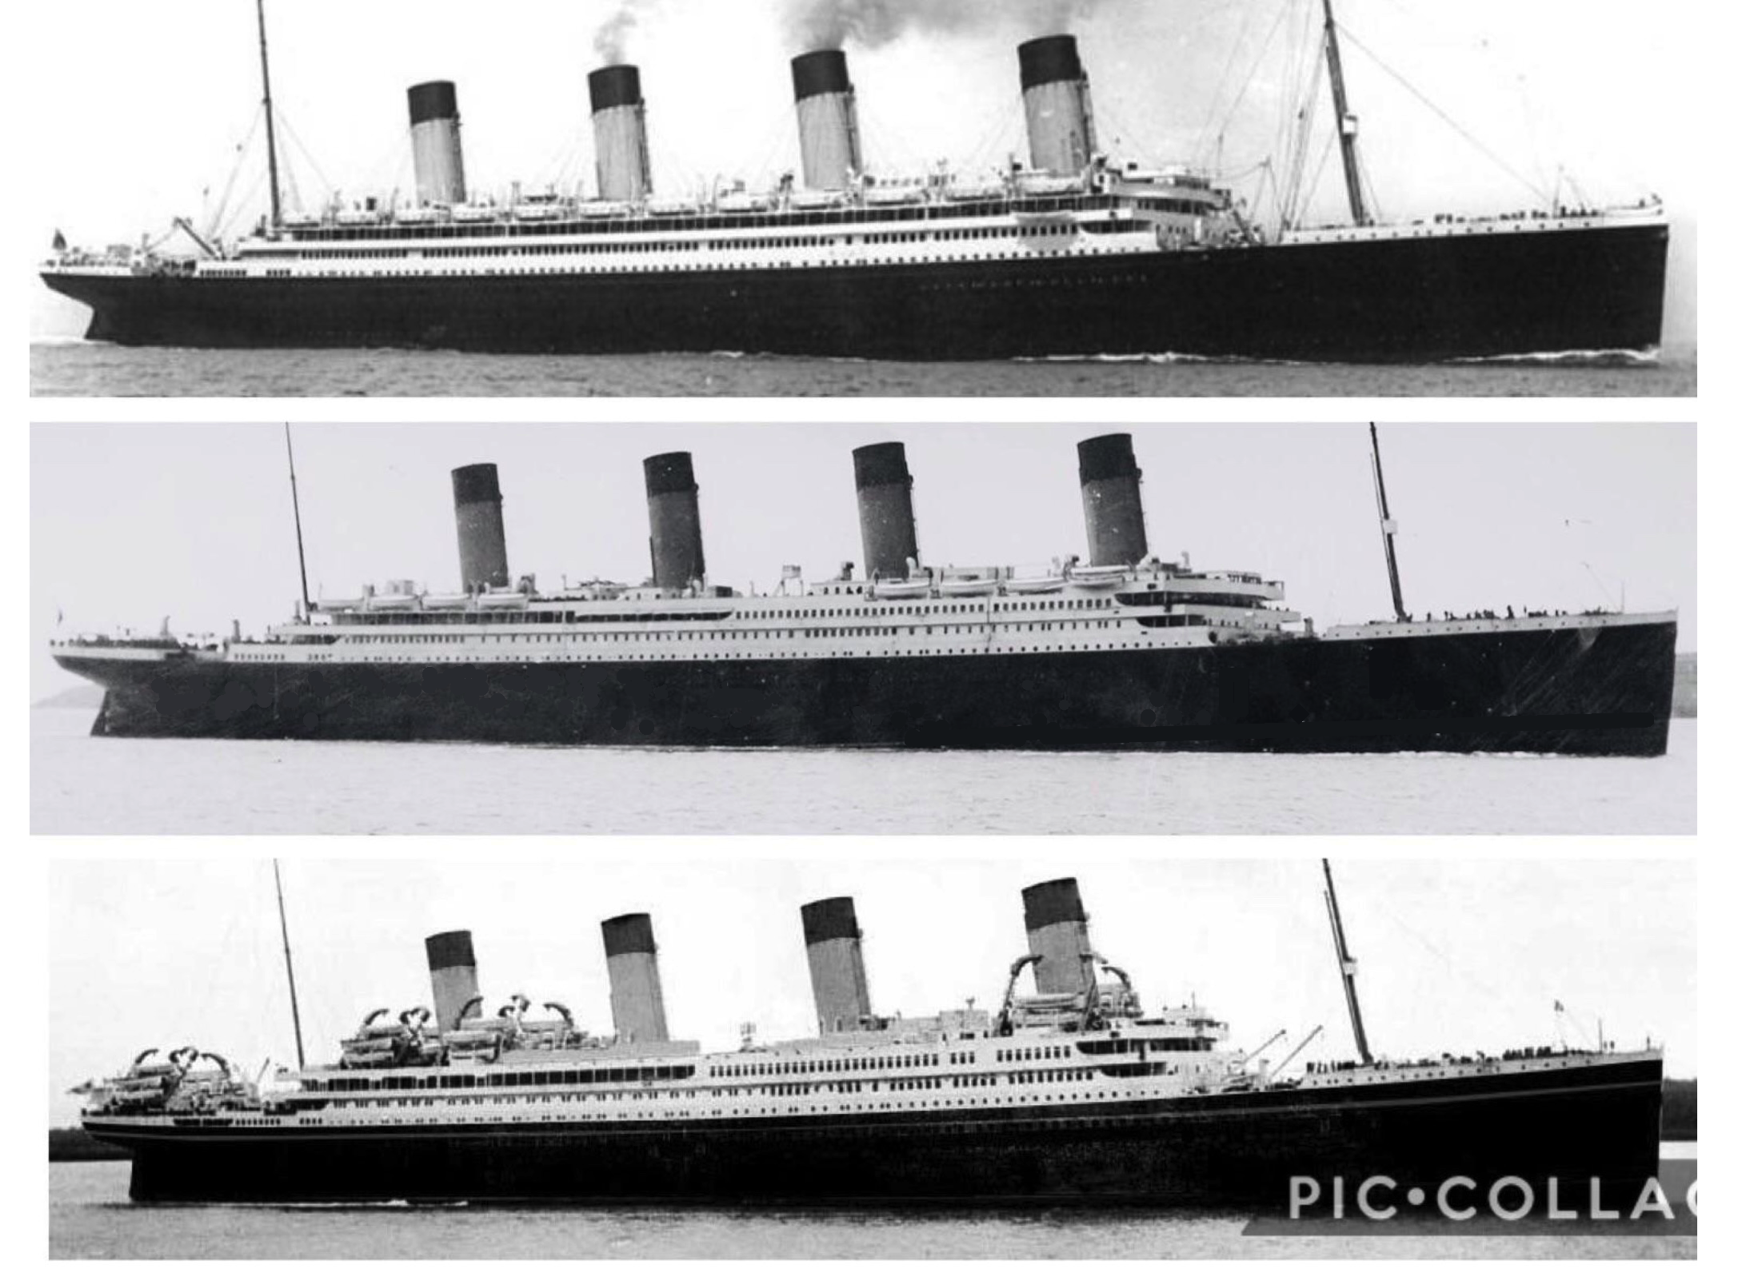
A
B
C
Identify A B & C. Then find the odd man out and why ?

Slide 2
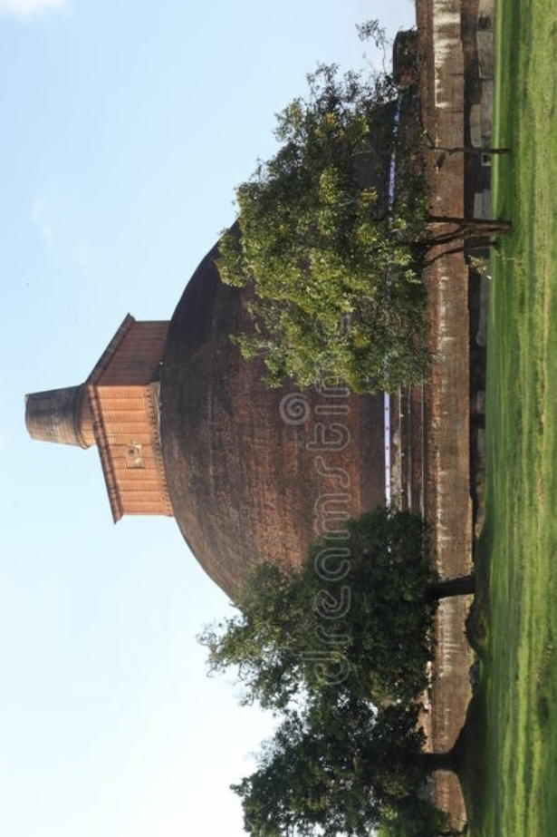
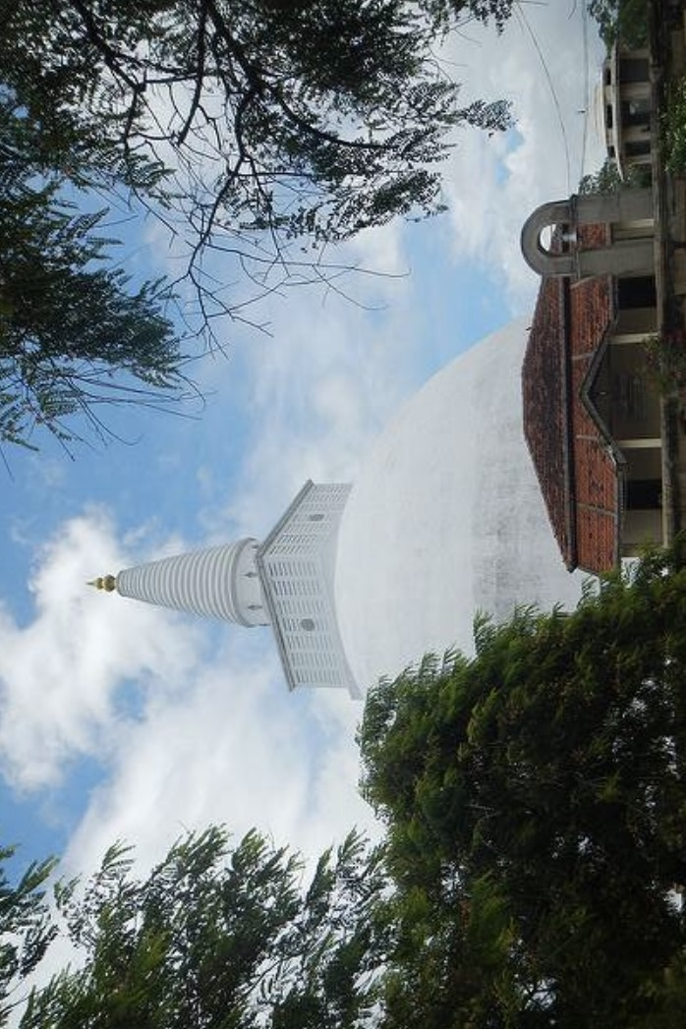
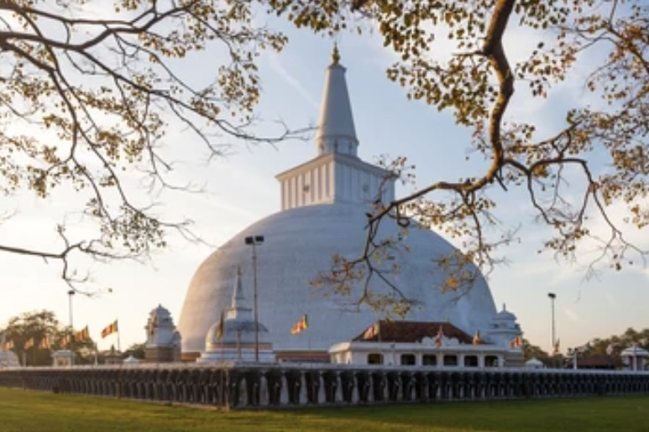
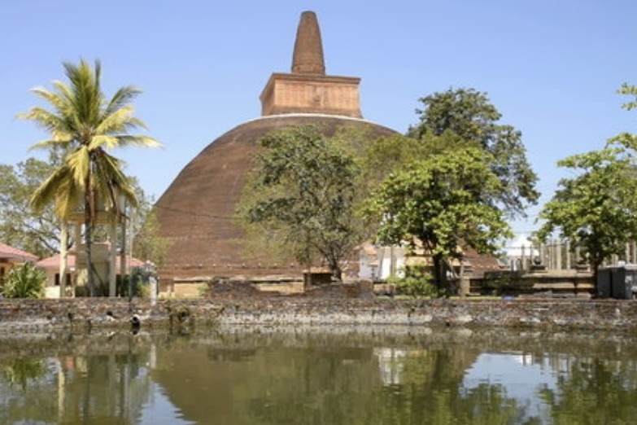
B
Find the ODD MAN OUT and
justify your answer.
D

Slide 3
A
Identify these ancient monuments
A B C & D
C

