Slide 1


When to Use a Database and Which Technologies to Use
Carl G. Stahmer
Director of Data and Digital Scholarship
Associate Director for Humanities, UC Davis Data Science Initiative
www.digitalscholarslab.org
www.datasci.ucdavis.edu
@cstahmer

Slide 2
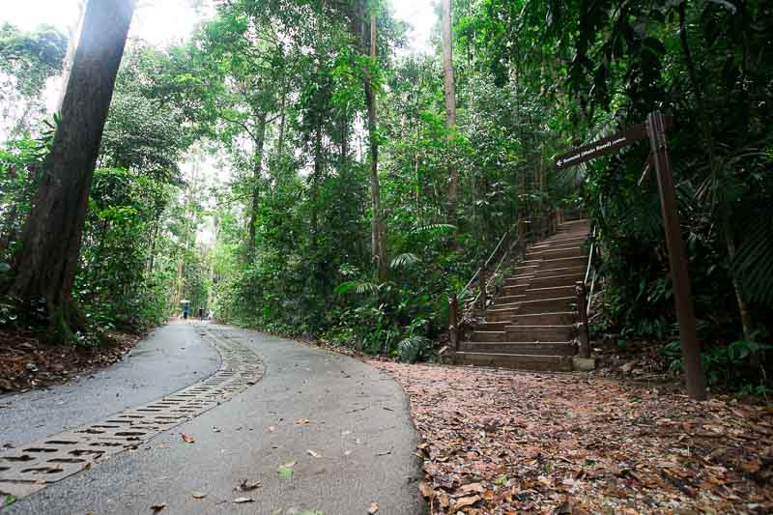
High level rules for determining if, when, and which datastore you might need
Primary Learning Objective

Slide 3
Basic Terminology
SCHEMA: A model for organizing data. Examples include ontologies, taxonomies, table and field organization, row and column definitions, XML document definitions, etc.
STRUCTURED DATA: Data that is organized according to any Schema.
UNSTRUCTURED DATA : Other operations cannot access data during a transaction that has not yet been modified
INDEX: An organized representation of data that facilitates query operations
TRANSACTION: A Request and Response interaction with the database
DEPENDENCY: When the interpretation/meaning of one data element depends on knowledge of another
NORMALIZATION: The process of efficiently organizing data so that redundancy is eliminated and dependencies make sense
@cstahmer
www.carlstahmer.com
Notes:
This is probably the primary determining factor

Slide 4
ACID (RDBMS) vs BASE (NoSQL)
ATOMICITY: all or nothing
CONSISTENCY: Any transaction will take the database from one consistent state to another, with no broken constraints (referential integrity)
ISOLATION: Other operations cannot access data during a transaction that has not yet been modified
DURABILITY: Ability to recover data in the event of system failure
BASIC AVAILABILITY: Access data at any time—no lockouts
SOFT STATE: The state of the system may change, even without a query
Eventual Consistency: The system will eventually become consistent as changes percolate through data
@cstahmer
www.carlstahmer.com
Notes:
This is probably the primary determining factor

Slide 5
Relational, Non-Relational, and Other Data Stores Defined
Relational Databases:
  Also called relational database management systems (RDBMS) or SQL databases
  Most popular are MySQL, PostgreSQL, Microsoft SQL Server, Oracle Database, IBM DB2, Microsoft Access
  Mostly used in enterprise scenarios and as the bases for web-servable data
  Massively Parallel Processing (MPP) and Online Analytical Processing (OLAP) RDBMS such as Teradata and Netezza
Non-Relational Databases
  Also called NoSQL (Not Only SQL) databases
  Popular platforms include MongoDB, DocumentDB, Cassandra, Coachbase, HBase, Redis, Neo4j, Solr/Lucene, ArangoDB
  Usually grouped into four categories: Key-value stores, Wide-column stores, Document stores, and Graph stores.
Spreadsheet
  Long-table data store
  Most popular include Microsoft Excel, Google Sheets, OpenRefine, Open Science Framework
@cstahmer
www.carlstahmer.com
Notes:
Not going to talk directly abut Hadoop or NewSQL

Slide 6
Spread-sheet
Killer App - sortable, summable, operational
RDBMS
Indexable, structured, enforceable
NoSQL
Flexible data structure, extensible, some indexable
Transactional to millions of transactions per day
Limited data storage capability
Transactional to a few thousand transactions per day
@cstahmer
www.carlstahmer.com

Slide 7
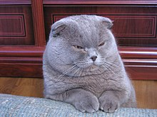
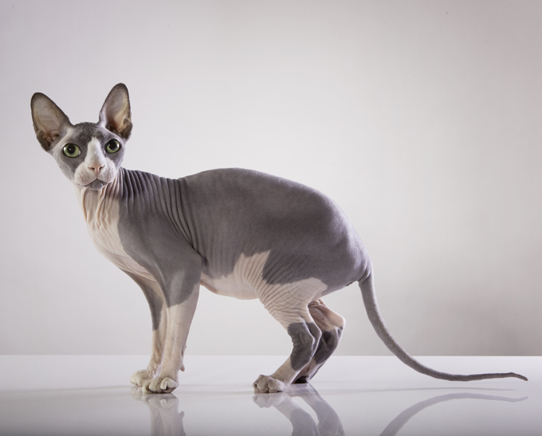
Columnar
ID | NAME | BREED | COLOR | EAR | FUR
1 | Fluffy | Sphynx | Tabby | Large | None
2 | Major Tom | Scottish | Grey | Floppy | Medium
3 | Josie | Sphynx | Tabby | Large | Fuzz
@cstahmer
www.carlstahmer.com

Slide 8
Columnar Data Stores
PROS:
  Fast
  Easy
  Ubiquitous
  GUI
CONS
  Scaling
  Normalization
  Integrity
@cstahmer
www.carlstahmer.com

Slide 9
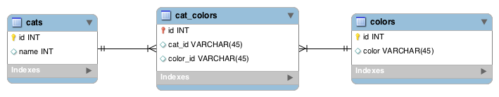
Relational
ID | NAME | BREED | COLOR | EAR | FUR
1 | Fluffy | Sphynx | Tabby | Large | None
2 | Major Tom | Scottish | Grey | Floppy | Medium
3 | Josie | Sphynx | Tabby | Large | Fuzz
@cstahmer
www.carlstahmer.com

Slide 10
Relational Data Stores
PROS:
  Works with Structured Data
  Supports strict ACID (Atomic, Consistent, Isolated, Durable) transactions
  Supports Joins
  Relationships with defined constraints
  Built-in data integrity through normalization and data typing
  Limitless Indexing
  Strong query language
  Large ecosystem
CONS
  Does not scale horizontally (concurrency and data size), only vertically, unless sharding
  Data is normalized, resulting in many joins and loss of speed
  Difficulty working with semi-structured data
  Schema on write
@cstahmer
www.carlstahmer.com

Slide 11
Non-Relational Data Stores
PROS:
  Works with semi-structured data (JSON, XML)
  Horizontal Scaling
  High consistency and Volume
  Random reads and writes
  Massive data stores
  Schema free / schema on read
  Supports documents with different fields
  High availability
  Simplicity of design (no impedance mismatch)
  Finer control over availability
  Speed (do to lack of joins)
CONS
  BASE (Basic Availability, Soft-State, Eventual) as opposed to ACID
  Limited support for joins
  Data is de-normalized
  No built-in support for integrity, validation must be performed programmatically during insert
  No relationship enforcement
  Limited Indexing
  Weak SQL
  Limited transaction support
  Slow, mass indexing
@cstahmer
www.carlstahmer.com

Slide 12
Key:Value
ID | NAME | BREED | COLOR | EAR | FUR
1 | Fluffy | Sphynx | Tabby | Large | None
2 | Major Tom | Scottish | Grey | Floppy | Medium
3 | Josie | Sphynx | Tabby | Large | Fuzz
Josie:
“Breed” = “Sphynx”
“Color” = “Tabby”
“Ear” = “Large”
“Fur” = “Fuzz”
@cstahmer
www.carlstahmer.com

Slide 13
Key:Value
High speed via the least complicated data model—can store anything about anything as long as it has a key:value
Node | Key | Value
Fluffy | Breed | Sphynx
Fluffy | Color | Tabby
Fluffy | Ear | Large
Fluffy | Fur | None
Major Tom | Breed | Scottish
Major Tom | Color | Grey
Major Tom | Ear | Floppy
Major Tom | Fur | Medium
@cstahmer
www.carlstahmer.com

Slide 14
Wide Table
High speed via the least complicated data model—can store anything about anything as long as it has a key:value
Node | Family | Title | Value | Family | Title | Value
Fluffy | 26 | Breed | Sphynx | 33 | Color | Tabby
Node | Key | Value
26 | Breed | Sphynx
26 | Breed | Scottish
26 | Breed | Persian
@cstahmer
www.carlstahmer.com

Slide 15
Document Stores
Inherently Hierarchical, tree-like structures such as JSON and XML
{Josie: [ Breed:Sphynx,
Color: [ Pattern:Tabby,
Spectrum:Orange,
Specturm:Brown],
Ear: [ Shape:Pointy,
Size:Large],
Fur:None]
}
ID | NAME | BREED | COLOR | EAR | FUR
1 | Fluffy | Sphynx | Tabby | Large | None
2 | Major Tom | Scottish | Grey | Floppy | Medium
3 | Josie | Sphynx | Tabby | Large | Fuzz
@cstahmer
www.carlstahmer.com
Notes:
Great for Storage and observational integrity, not for analytics. Gives you a great, complete view of the observation. Push out for analytics.

Slide 16
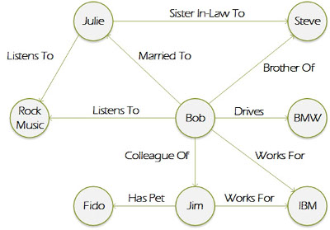
Graph Store
Focus on Relationships between entities. Basic information stored as primarily as properties.
@cstahmer
www.carlstahmer.com
Notes:
Great for Storage and observational integrity, not for analytics. Gives you a great, complete view of the observation. Push out for analytics.

Slide 17
Use Cases for NoSQL
Key-Value Stores:
  Queues
  Caches
  Rapidly changing data
  Blob Data
Wide Column:
  Large and frequent writes
  Real-time random query
  Time series and sensor data
Document Stores:
  Flexible schemas
  Dynamic Queries
  Defined Indexes
  Large Data
Graph Database:
  Networks
  Relationship matters more than properties
  Syntax/Sequencing
@cstahmer
www.carlstahmer.com

Slide 18

Why do you think you need one?
Collection
Management
Analysis
Sharing

Slide 19
CAP Theorem
Impossible for any system to deliver all three of the following at the same time:
CONSISTENCY: Nobody ever gets broken or partial data
AVAILABILITY: Data will be available at all times with no lockouts.
PARTITIONING: If one part of the database is changed, other parts remain unaffected
CONSISTENCY
RESPONSE TIME
RELATIONAL: CA
NON-RELATIONAL : AP
@cstahmer
www.carlstahmer.com
Notes:
Great for Storage and observational integrity, not for analytics. Gives you a great, complete view of the observation. Push out for analytics.

Slide 20
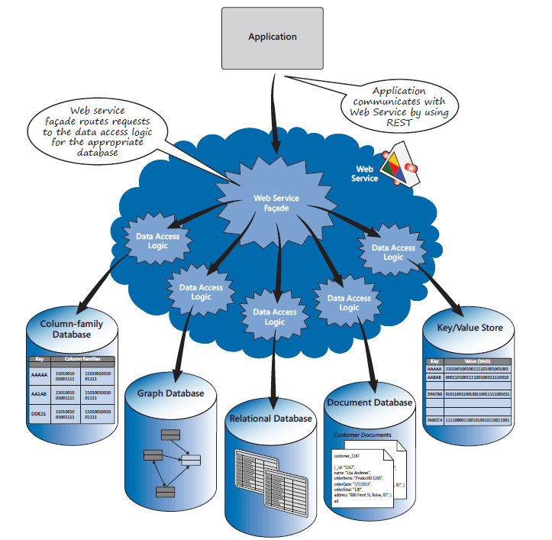
Polyglot Persistence
Right tool for right reason
Probably means using multiple tools and platforms
Primary considerations are size, speed, research question
@cstahmer
www.carlstahmer.com

