Slide 1
South African Identity Federation
Library IT Network Usage Enhancement Workshop

Slide 2
Identity Federations
An introduction

Slide 3
Federated Identity
A federated identity in information technology is the means of linking a person's electronic identity and attributes, stored across multiple distinct identity management systems
https://en.wikipedia.org/wiki/Federated_identity
Notes:
Explain the concepts of identity, attributes, and identity management systems

Slide 4
The problem we’re trying to solve

Slide 5
Federated Identity vs Single Sign-On
Federated Identity
Single Sign-On
Key concept to use the same set of credentials to obtain access to multiple resources
Specifically tries to avoid duplication of credentials
Key concept is to provide credentials once and obtain access to multiple resources
Each system may maintain its own set of credentials (e.g. password synchronisation)
Separate concepts, but a single technology may achieve both goals
Notes:
People sometimes use the terms interchangeably, because it’s common to solve both problems together

Slide 6
Federation Actors
End User
The end user is typically a real person who belongs to one or more organisations, and would like access to one or more resources or services
Notes:
End users have personal information associated with them – their name, address, job title, etc

Slide 7
Federation Actors
Identity Provider
An Identity Provider knows the End User, and can provide information about that user with a high degree of certainty
Typically an organisation to which the End User belongs or works for – e.g. students at a university, staff at a research council
Also known as their Home Organisation
Notes:
Examples of personal information held about a student (name, student number, email address, degree registered for, etc)

Slide 8
Federation Actors
Service Provider
A Service Provider operates a resource the End User wishes to gain access to, and needs/wants information about the End User
Can be a third party (e.g. a publisher or research facility)
Also known as the Visited Organisation
Notes:
Examples of information a service provider might want – display name, email, etc.
Talk about need vs want

Slide 9
Federation Actors
Federation Operator
A Federation Operator acts as a trusted intermediary between the Identity Provider and the Service Provider
Provides the glue (metadata) that makes the federation work
Also known as the Roaming Operator

Slide 10
Academic Identity Federations

Slide 11



Why not just use Google?
All the major social network platforms provide federated identities…
… so why don’t we just use these?
They all have one major drawback – they are self asserted
This means you cannot trust any of the attributes
This is often okay, but…
donald.trump17@gmail.com
Notes:
Would you allow Donald.trump17@gmail.com access to sensitive medical records?

Slide 12
Academic Identity Federations
Academic identity federations exist to solve the trust problem
Your home organisation – university, research council, etc – knows a lot about you
They also know stuff specific to higher education
More importantly, most of this information has been checked and may be subject to audit
This makes them ideal to act as identity providers

Slide 13
Academic Federation Operators
All federations have operators
Facebook Inc operates Facebook Connect
Academic federations are usually operated by the National Research and Education Network
Typically only one per country
63 known academic federations worldwide
International collaboration through REFEDS

Slide 14

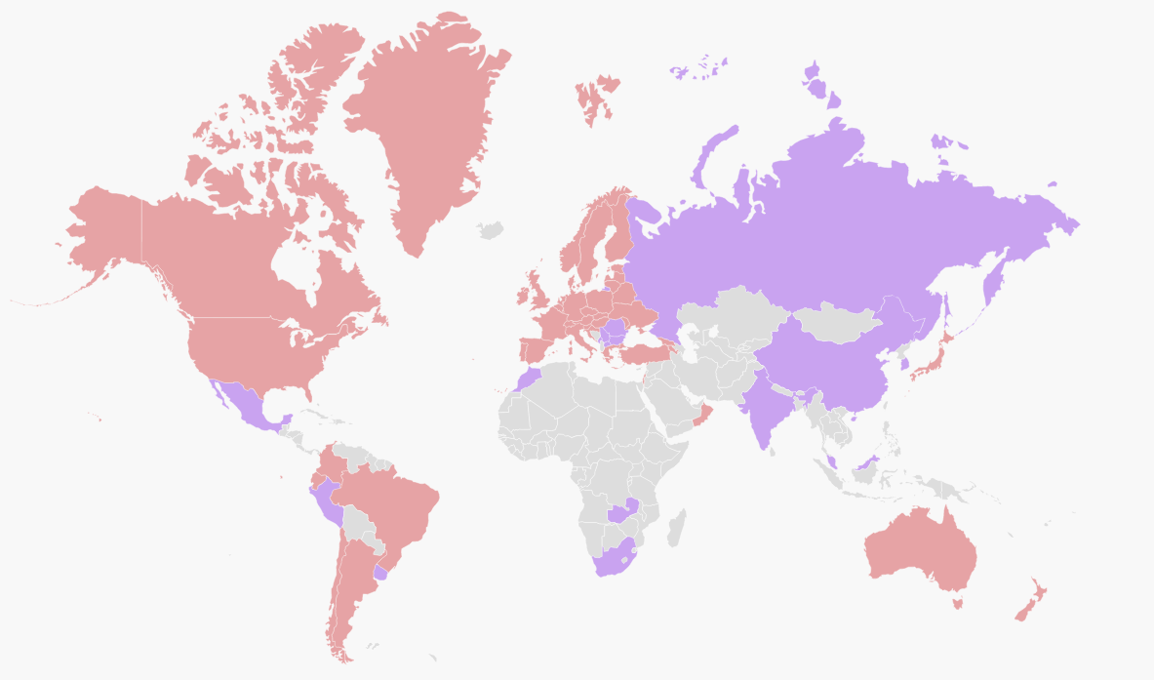
Academic Identity Federations Around the World
https://refeds.org/federations/federations-map

Slide 15

Inter-federation
Inter-federation is the linking of one (academic) federation to another
Through inter-federation we can gain access to services that are not available in our own country
Service providers can gain access to customers

Slide 16

Federation Technologies
Social networks tend to favour OAuth
But OAuth does not lend itself to inter-federation
Academic federations tend to favour SAML2
This is commonly misnamed as Shibboleth
Shibboleth was an early version of the SAML protocol – no longer in use
Shibboleth is also the name of a software vendor who makes SAML2 software

Slide 17
SAFIRE – South African Identity Federation

Slide 18
SAFIRE History
Project started as a pilot 2.5 years ago
Joint project of ASAUDIT, SANReN Competency Area & TENET
Functional pilot, but…
… struggled to gain traction
Eight universities agreed to fund SAFIRE (NWU, RU, SU, UCT, UJ, UKZN, UP, UWC)
TENET nominated as juristic body of record
Appointed a full time project director in April 2016

Slide 19
SAFIRE Status
Policy, practice statements, and other governance documentation has been developed
Technology roadmap available
Covers next ~ 18 months, to full production
First phase of implementation underway
Preparing to join eduGAIN
Had some discussions with ORCID
University IT departments should know all this

Slide 20
Why does all of this matter?
AKA What is in it for us?

Slide 21
Use cases
Many libraries are providing access to electronic resources
Often there’s a demand for off campus access to these
Current mechanisms for doing so are dated and problematic
There may be benefit from supporting more granular licensing structures
What if only academic staff could access it?
Access to electronic resources
Notes:
Talk about the problems with IP based access control, SSL certs, etc. Talk about integration alternatives. Talk about resources already federated.

Slide 22
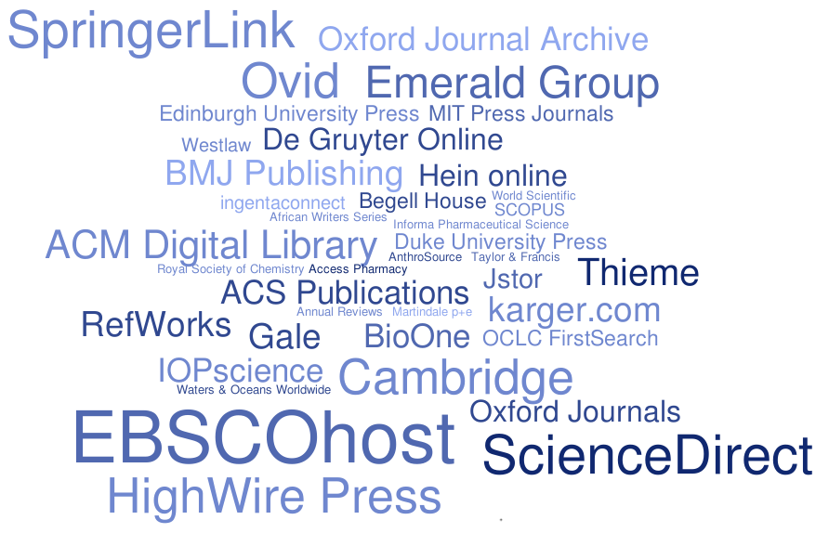
Use cases
Access to electronic resources
Rhodes University Library & eduGAIN MET
Notes:
Scaled by number of federations the publisher is a member of

Slide 23
Use cases
Many universities are making use of shared systems
Libraries have OPACs, repository systems, etc.
But also research management, funding, etc.
Typically these have their own credentials, which leads to confusion for end users
And those identities need to be maintained
Shared systems
Notes:
SEALS, Calico. But also research partnerships.
Mention ORCID

Slide 24
Use cases
Libraries who publish (e.g. journals) may want to become service providers
Get reliable data about end users and affiliations
Makes access control simpler – one mechanism for all participants
Simplify login / sign-up mechanisms
Through eduGAIN you can gain access to international markets
Library publishers

Slide 25
Benefits of federating
Reduced integration costs / economies of scale
Easier access to resources
Fewer data inconsistencies
No / less end user identity management
Improved user experiences
e.g. off campus users

Slide 26
Questions?
safire@tenet.ac.za

