Slide 1

Building a green fields identity federation in South Africa
CHPC National Meeting
December 2016
orcid.org/0000-0002-9388-8592

Slide 2
Introduction
What is an identity federation?
What is SAFIRE?
History / politics / policy / etc.
Technical architecture of SAFIRE
Implementation and deployment
Notes:
Plenty of previous presentations cover the first three, but very few address the technical aspects. So since this is a technical forum, we’ll cover technical issues.

Slide 3
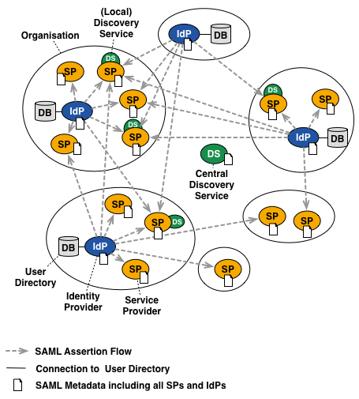
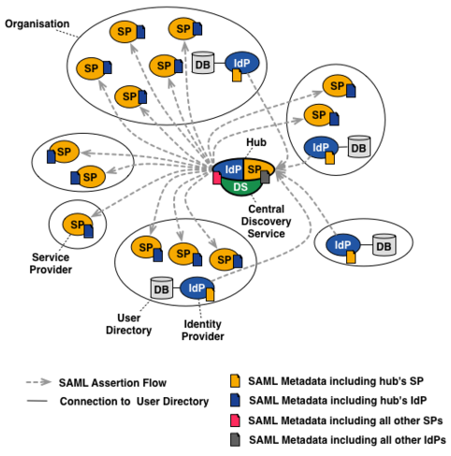
Federation architectures
Full Mesh Federation
Hub & Spoke Federation
More than 80% of the world’s research and education federations do this
So we chose to do this…
Source: https://wiki.edugain.org/Federation_Architecture
Notes:
Two competing architectures. Full mesh means that the federation is only responsible for metadata, and individual participants talk to each other point-to-point. Hub and spoke acts as an SP to IdPs and an IdP to SPs – simpler metadata, centralised everything.

Slide 4

Addressing the elephant in the room
SAFIRE’s architecture: hub & spoke

Slide 5
The elephant in the room Why hub & spoke?
Reduces the barriers to entry, particularly for identity providers
Simplifies configuration
Forgiving of protocol anomalies
Can do protocol translation in future
Reduces the attribute release problem
Centralised consent (read POPI)
tl;dr – seems a better fit for South Africa
Notes:
Wide deployment of AD in SA institutions, hence expect to deal with ADFS
Managing ARPs in a full mesh is a headache
SA institutions have little to no experience with ARP or POPI

Slide 6
The elephant in the room But… There must be cons?!
Creates a single point of failure (hub)
Makes the federation more complicated to implement and deploy
Increases the central infrastructure costs
Centralises control (and particularly ARP)
Double discovery problem :-(
Most federations are evolving into hybrids
Full Mesh
Hybrid
Hub & Spoke
Notes:
Central ARP is a problem if you don’t trust the federation
Double discovery = local discovery (of federation) + central discovery (of IdP)

Slide 7
Building a hub & spoke federation
SAFIRE technology roadmap (as at December 2016)

Slide 8
Building a hub & spoke Phase one – now
Notes:
Full feature hub and spoke federation, but no redundancy or resiliency

Slide 9
Building a hub & spoke Building blocks – metadata aggregator
Based on WAYF’s PHPH
Produces all metadata aggregates – both for internal operations, and for external consumption
Uses a smartcard-based hardware security module to protect metadata signing key
Works like a full mesh would (start of our hybrid)
Because of caching, can go offline for several hours without loss of service
Notes:
Emphasis on the fact that this is no different to full mesh federations
HSM the current holdup

Slide 10
Building a hub & spoke Building blocks – hub
Based on SimpleSAMLphp
Handles central discovery, attribute release and consent
IdP proxies (to make the hub invisible) based on WAYF’s BIRK
Consumes metadata aggregates just like any other IdP/SP
If the hub goes down, people will notice!!
Notes:
IdP proxies introduce separate entities into the hub metadata for each identity provider, making the federation look like a full mesh but still directing traffic through the hub.

Slide 11
Building a hub & spoke Building blocks – database & syslog
Database for consent storage, web site
Logging for entire federation
Only server that contains critical information that needs to be backed up
But! If it goes down, the hub will continue operations
Notes:
Only server that needs real backups

Slide 12
Building a hub & spoke Phase two – 2017
Prioritise protecting the most noticeable component – the hub
Notes:
This is the next priority, because a failed up will be a failed federation. We cannot really be “production” until we can protect this component.

Slide 13
Building a hub & spoke Potential scale out
Notes:
This is to show the potential for scale out if/when we need it

Slide 14
Building a hub & spoke HSMs everywhere
Notes:
This is to show that HSMs and SAML assertion signing have been catered for in the long term road map

Slide 15
Building a hub & spoke Deployment of the federation
Have tried to adopt a dev-ops approach
All components deployed out of Ansible
Complete redeployment of development environment takes about 15 minutes with minimal human involvement
Ansible playbooks stored in Git
more specifically, GitHub private respositories – which addresses some concerns about off-site backups
Playbooks for all components except HAProxy currently exist

Slide 16

Building a hub & spoke Hardware security modules
Federations are like certificate authorities, and the metadata signing certificate is like a CA certificate – the root of trust.
Original plan was to introduce HSMs later, but this was brought forward based on suggestions from the international community
Currently experimenting with a smartcard based HSM, and this is the last thing before the new SAFIRE hub & spoke can go live.
Later this can be replaced by a more traditional stand-alone HSM – if/when 2048 bit keys are compromised, or we want to sign SAML assertions

Slide 17
Questions?

