Slide 1

Identity Federation in South Africa
Sci-GaIA Final Event CSIR International Convention Centre, March 2017
orcid.org/0000-0002-9388-8592

Slide 2
Introducing SAFIRE

Slide 3
Brief history of SAFIRE
The need for an identity federation was identified by the community in 2014
Took a long time to get going – apparently a common story :-)
Eventually a number of universities agreed to provide seed funding, which spurred some motion
Initially piloted as a full-mesh federation, later changed architecture to a hub-and-spoke
Notes:
Original meeting at STIAS, hosted by SCA, ASAUDIT & TENET and attended by most universities.

Slide 4
Current status of identity federation in South Africa
Hub-and-spoke architecture deployed
Transition from pilot underway, mostly completed
Roadmap showing next phases
Supported service with full time staff
South Africa was accepted as a member of eduGAIN in February 2017…
… and published metadata the next day
Notes:
eduGAIN first pulled metadata on 17th February 2017
Also have a collaboration agreement in place with WAYF

Slide 5

Why hub-and-spoke?
The hub-and-spoke architecture was chosen to address two concerns:
Reducing the barriers to entry for identity providers
Increasing access to attributes for service providers
Notes:
This is the elephant in the room for anyone who’s looked at federation architectures, so we need to address it.
Using a hub-and-spoke means we can do things like use Gsuite as an identity provider, that we can fix ADFS weirdness, and allows for protocol bridging later.

Slide 6
Current deployment
Notes:
Current, deployed architecture. All in Cape Town. Has separation between metadata (looks like a full mesh) and hub.

Slide 7
Roadmap to a resilient, fully redundant architecture
Notes:
This architecture splits components between Cape Town and Jo’burg, and uses haproxy as a load balancer. Not all components need to be built – for instance, we probably don’t need to replicate the database.

Slide 8
Pause for reflection
The technology is easy(ish)
The difficult part is getting the governance layer right – policies, contracts, lawyers, etc
However, that time wasn’t wasted – because that’s the bit that eduGAIN cared most about
And it’s also an area where REFEDS has done a lot of work
Notes:
New eduGAIN constitution is technology agnostic, so federation policy is all you’re really evaluated on.
REFEDS policy templates (https://wiki.refeds.org/display/FBP/Federation-Best-Practice+Home)

Slide 9
So what does this all mean for R&E?

Slide 10

One ring identity to rule them all
Source: http://lotr.wikia.com
Notes:
This is probably the ultimate goal of federation, but also an unrealistic one. “fewer identities” is probably more realistic.

Slide 11
For identity providers
Simplified integration = lower costs
Reuse of existing identity information
Standardised attribute release
The hub also helps by adding missing attributes
Mandatory consent
Helps with POPI/privacy legislation
Things university management / IT departments care about, not researchers…
Notes:
https://learn.nsrc.org/fedidm/idfed

Slide 12
For service providers
Access to existing, high quality identity information
Reduced support costs
Password problems go to the IdP’s help desk
Helps comply with privacy and identity laws
Less personal info = reduced risk
Access is revoked when people leave
Improved user experience – easier for people to get started using your service
Things CIOs / IT managers care about, not academics…
Notes:
https://learn.nsrc.org/fedidm/service_providers

Slide 13
For libraries
Provides a new approach to electronic resource management
Better control over who has access to your resources = better compliance with licensing agreements
Allows you to downsize/decommission reverse proxies
Deals with the burgeoning SSL subject alternative name problem
Less confusing for your users
Things library directors care about…

Slide 14

For academic & research staff
Immediate access to a wide range of existing global services via eduGAIN
One username and password to remember
Better control over your personal info
Fosters (global) collaboration
Allows you to forget about identity and focus on teaching & research…
But don’t take my word for it…
Notes:
https://learn.nsrc.org/fedidm/iam_researchers

Slide 15
FIM4R Findings (2012)
Federated technologies are good. Take advantage of them.
The infrastructure needs to be improved to take advantage of federated technologies. Do it.
Relying on older models of local account creation and IP-based ACLs is easier. This is a very limited view. Stop it.
If you can’t fix it all yourself (and you can’t), facilitate the efforts of groups that can. Build relationships, target your spending or funding to make the biggest impact.
Source: http://cds.cern.ch/record/1442597 Via: https://learn.nsrc.org/fedidm/iam_researchers
Notes:
FIM4R is the Federated Identity Management for Researchers working group, comprising researchers from large science projects like CERN, Science & Technology Facilities Council (UK), European Bioinformatics Group, etc. They published findings in 2012, which are summarised on this page. Heather Flannigan expands on them at https://learn.nsrc.org/fedidm/iam_researchers

Slide 16
Questions?

Slide 17
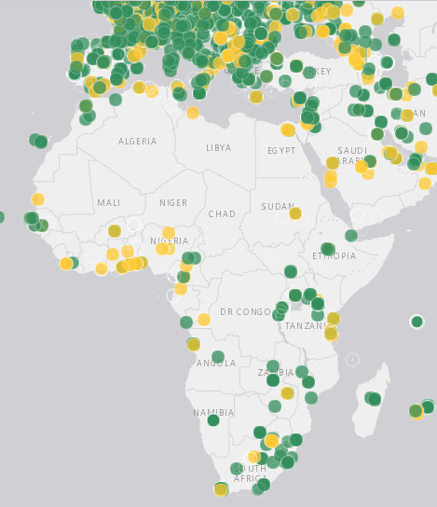

RIPE Atlas Punt
With your help, the RIPE NCC is building the largest Internet measurement network ever made. RIPE Atlas employs a global network of (>10,000) probes that measure Internet connectivity and reachability, providing an unprecedented understanding of the state of the Internet in real time.
https://atlas.ripe.net/

