Slide 1

SAFIRE Workshop @ NATE 2017
Mangosuthu University of Technology, June 2017
orcid.org/0000-0002-9388-8592

Slide 2
A rough outline of what we’d like to cover today
What is federation?
What the use cases?
What do you need?
Attributes
What is SAML?
Participating in SAFIRE
Creating an IdP
Notes:
Lunch break between attributes/what is SAML

Slide 3
What is a federation?

Slide 4

https://learn.nsrc.org/fedidm/idfed

Slide 5
The problem we’re trying to solve
Notes:
The perpetuation of local accounts at individual service providers, and the problems with updating them when stuff changes (e.g. people get married, change name, change title, etc). And the orange one at the end symbolising errors in transcription.

Slide 6
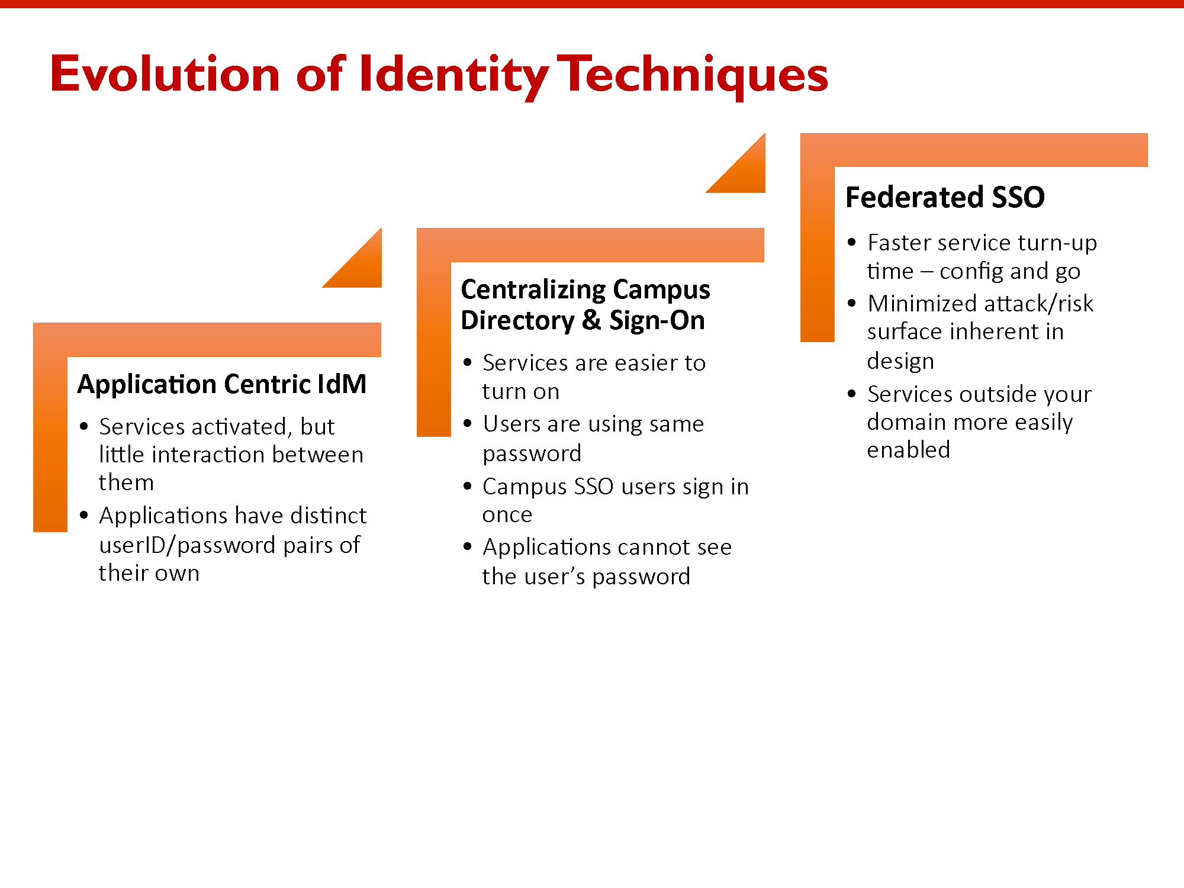

https://collaboration.canarie.ca/elgg/file/download/3173
Notes:
Some slides from a presentation by Chris Philips of Canarie/Canadian Access Federation. These are used to facilitate a discussion around where individual attendees are in terms of their own process and maturity.

Slide 7
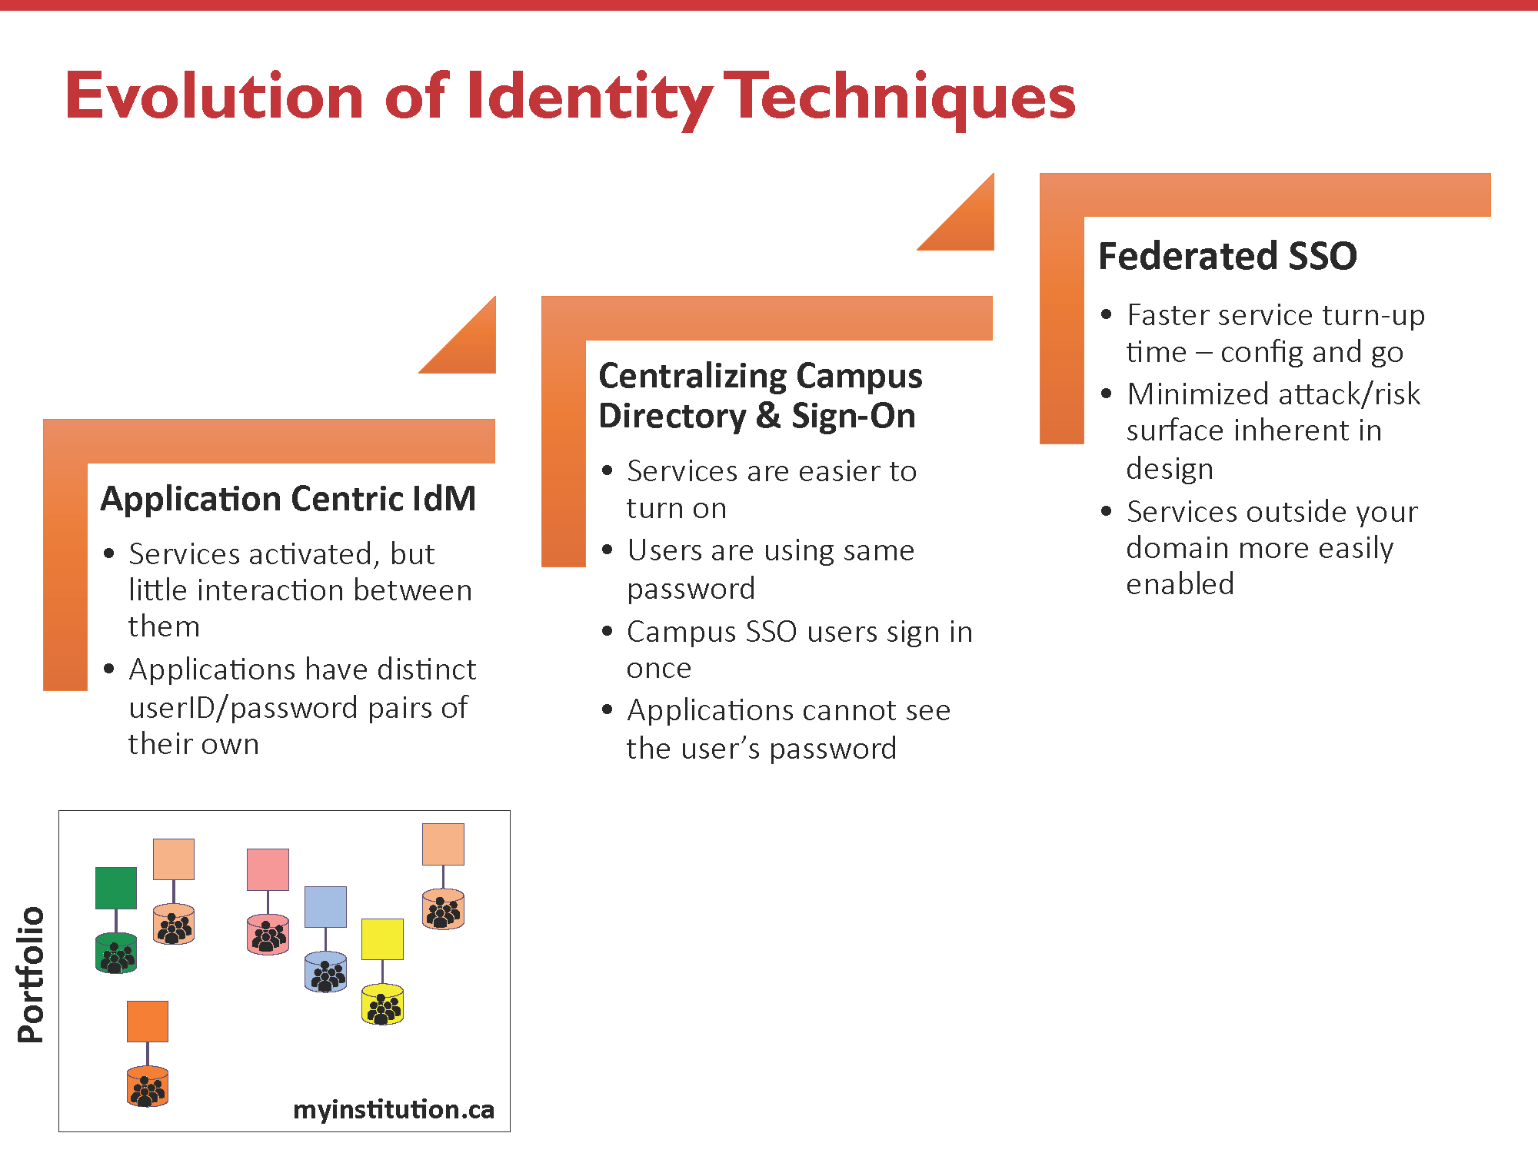

Slide 8
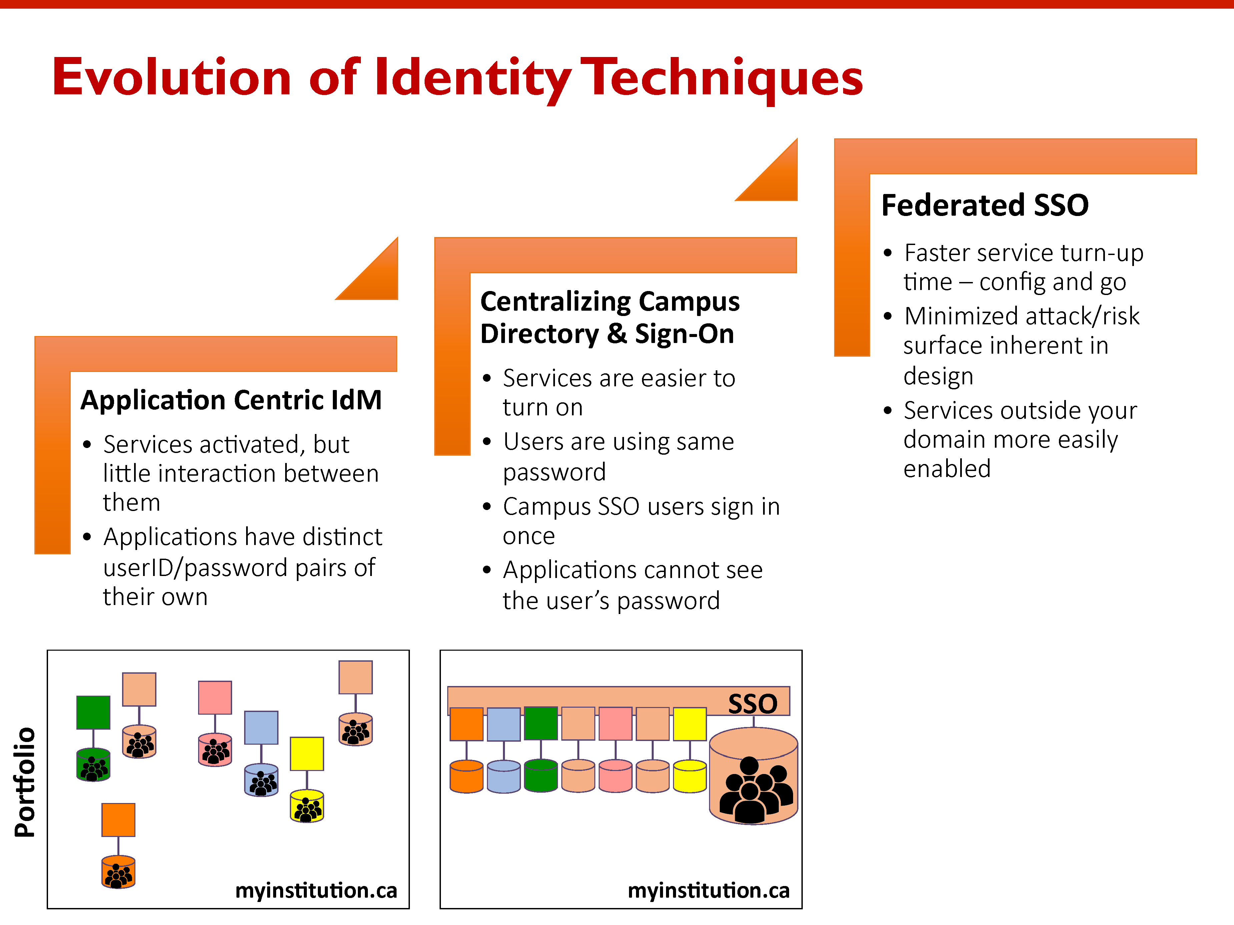

Slide 9
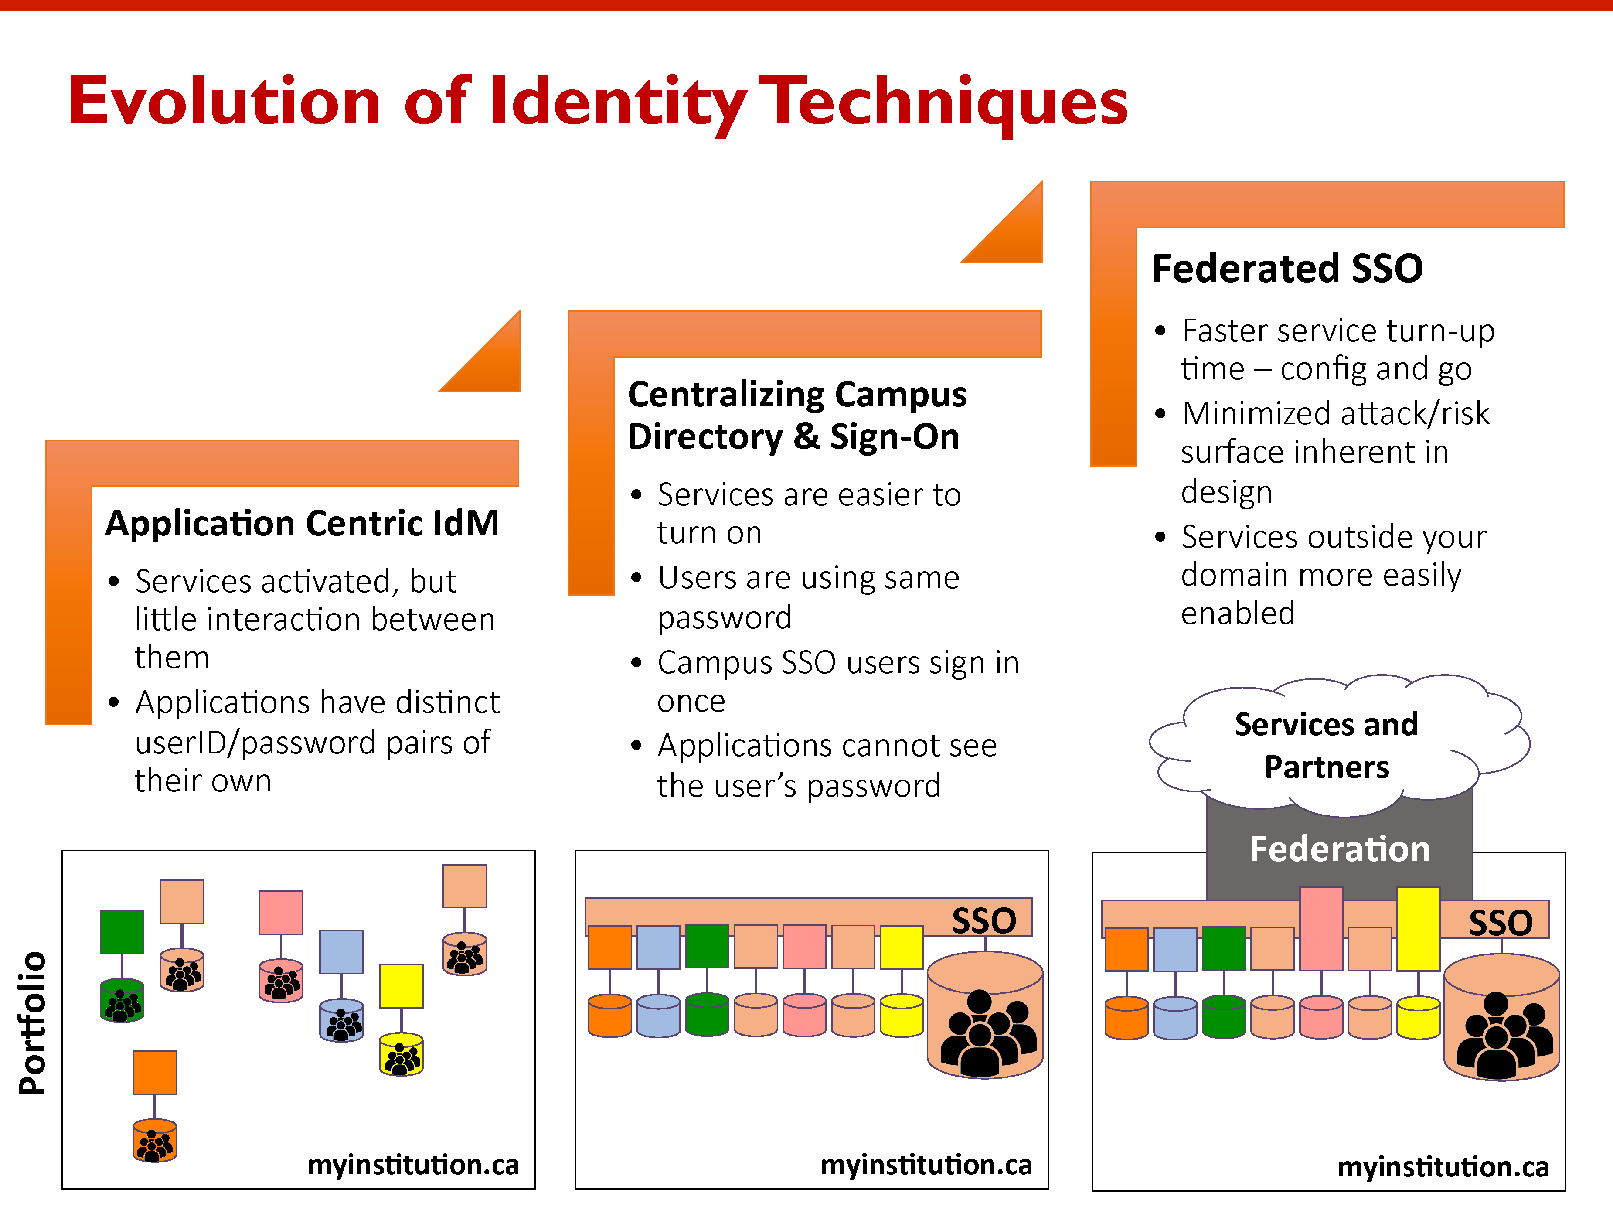

Slide 10
Federated Identity
Identity Providers
(Home Organisations)
Identity Federation
Service Providers’ Web Sites

Slide 11



Why not just use Google?
All the major social network platforms provide federated identities…
… so why don’t we just use these?
They all have one major drawback – they are self asserted
This means you cannot trust any of the information
This is often okay, but…
donald.trump17@gmail.com
Notes:
Would you allow Donald.trump17@gmail.com access to sensitive medical records?

Slide 12
Trust
Notes:
If there’s one thing people take home from this workshop it should be this word. The sort of federations we’re talking about are predominately about building trust, as opposed to donald.trump17@gmail.com which is about providing authentication. (We’ve moved on from SSO.)

Slide 13

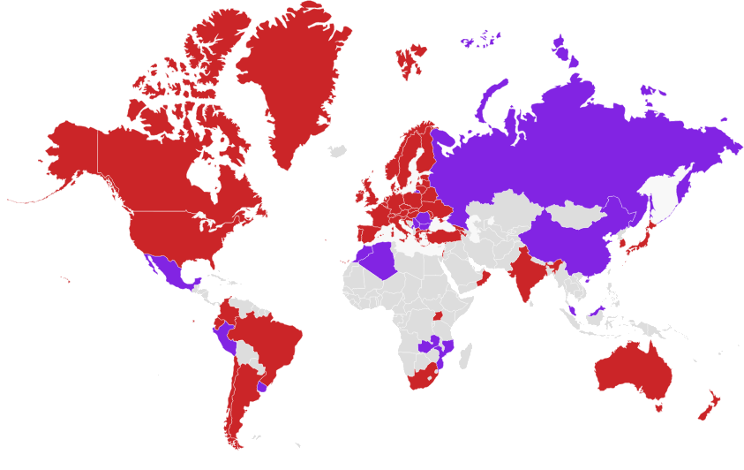
Academic Federations
https://refeds.org/federations/federations-map, May 2017
Notes:
Red are known production federations; purple are pilots. Not all of these are interfederated.

Slide 14
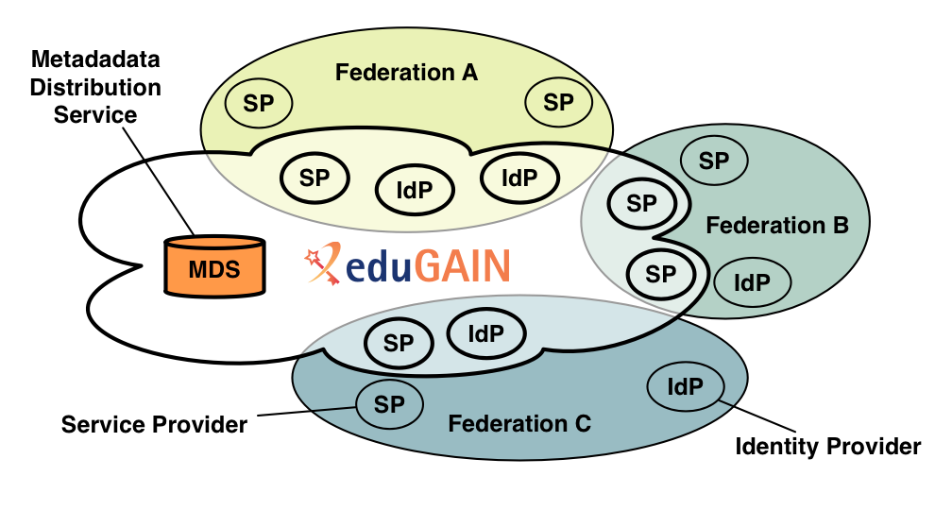
Inter-federation
https://www.geant.org/Services/Trust_identity_and_security/eduGAIN/Pages/About-eduGAIN.aspx
Notes:
A brief pictorial overview of how interfederation works between national federations.

Slide 15
What the use cases?

Slide 16

https://learn.nsrc.org/fedidm/iam_researchers

Slide 17
FIM4R Findings (2012)
Federated technologies are good. Take advantage of them.
The infrastructure needs to be improved to take advantage of federated technologies. Do it.
Relying on older models of local account creation and IP-based ACLs is easier. This is a very limited view. Stop it.
If you can’t fix it all yourself (and you can’t), facilitate the efforts of groups that can. Build relationships, target your spending or funding to make the biggest impact.
Source: http://cds.cern.ch/record/1442597 Via: https://learn.nsrc.org/fedidm/iam_researchers
Notes:
These are the Federated Identity Management 4 Research 2012 findings. Note that they’re now five years out of date, but are still relevant in South Africa – implying we’re about five years behind where we need to be.

Slide 18

FIM4R Findings (2017)
Level of Assurance
?
IdP of Last Resort
Multi-factor Auth
Notes:
So far as I can tell, FIM4R hasn’t released any findings for 2017 (they met in April). However, based on discussions that have traction at the moment amongst the federation operators, we can make some guesses/predictions as to what they might contain.

Slide 19
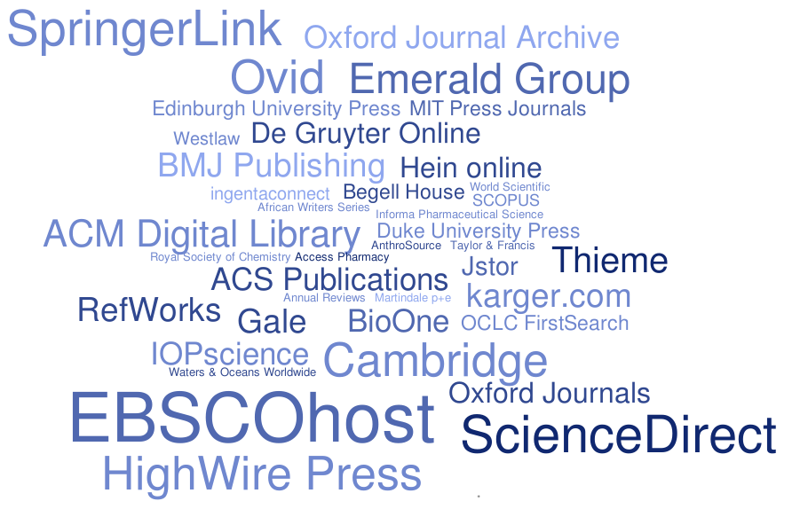
Publishers’ Service Providers
Rhodes University Library & eduGAIN MET, August 2016
Notes:
Tag cloud shows frequency (number of federations) of various academic publishers in eduGAIN metadata

Slide 20
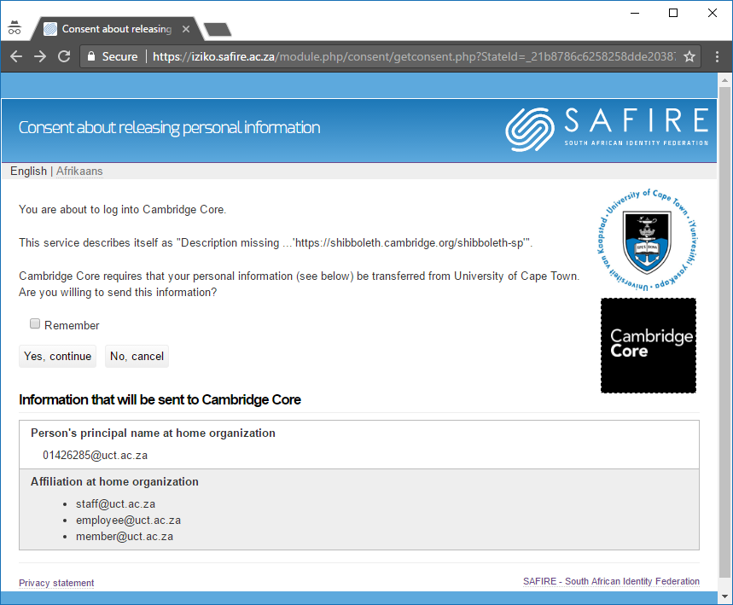

Consent & Privacy
Notes:
Consent interface – mandatory consent helps with POPI compliance
Play on homophones – poppy vs POPI

Slide 21
A universal language?
₥Q₦€¥
Notes:
Stylised “MONEY” made up from the following currency symbols: Mill (1/1000th of US$), Guatemala Quetzal, Nigerian Naira, Euro, Japanese Yen (also Chinese Yuan)

Slide 22
South African research collaboration already using eduGAIN (that we know about)
NIH / NIAID Science Forum
CILogon (ATLAS, LHCONE, Globus, etc)
Sci-GAIA
African Research Cloud
ORCID
But… what’s the latent demand??
SKA (work in progress)
EGI, LIGO, CERN
Notes:
List from SAFIRE’s internal stats and personal knowledge.

Slide 23
What do you need?

Slide 24
What do you need?
A source of identity information
An internal identity management strategy
A technology shim to make this interoperate
Legacy ⇨ LDAP, etc
eduroam ⇨ RADIUS
SAFIRE ⇨ SAML2
etc…
Notes:
A generic view of what’s required for identity federation to work, leading into a discussion of identity sources (AD, eDirectory, etc) and IdM strategies (breaking silos, etc).

Slide 25

Notes:
Presentation on UCT’s IdM history.

Slide 26
Attributes

Slide 27
Minimum attributes required for participation
eduPersonPrincipalName
givenName
sn
Notes:
The minimum set of attributes required for participation. This sets the barrier deliberately very low, so as to allow things like Gsuite to work. However, this set is very limiting and more attributes (particularly mail) are required.

Slide 28
Recommended attributes
displayName (= givenName + sn)
eduPersonAffiliation
mail
Notes:
SAFIRE’s recommended minimum set of attributes. Providing these allows for eduPersonScopedAffiliation to be set, meeting the REFEDS R&S attribute set. This unlocks many international service providers.

Slide 29
eduPerson Affiliation
alum
affiliate
employee (implies member)
faculty (implies employee, member)
library-walk-in
member
staff (implies employee, member)
student (implies member)
https://safire.ac.za/technical/attributes/edupersonaffiliation/
Notes:
Vocabulary of eduPersonAffiliation. The values in bold are widely used and have common meaning amongst many federations. However, the values for student, staff, faculty, and employee are defined in South Africa in terms of the HEMIS data elements as described at https://safire.ac.za/technical/attributes/edupersonaffiliation/

Slide 30
eduPerson Scoped Affiliation
alum@example.ac.za
member@example.ac.za
employee@example.ac.za
student@astrobiology.example.ac.za
faculty@science.example.ac.za
Notes:
Examples of scoped affiliations showing departments/faculties as pseudo-DNS scopes (must end in a valid DNS domain that’s reflected in metadata scope elements). The interpretation of the right-hand-side is not standardised, and probably doesn’t need to be. It must make sense to internal stakeholders (and can be used to reflect internal structure to external stakeholders like library e-resource providers).

Slide 31
Other attributes
eduPersonOrcid
eduPersonPrimaryAffiliation
eduPersonScopedAffiliation
employeeNumber
preferredLanguage
schacHomeOrganization
eduPersonTargetedID
o
schacHomeOrganizationType
https://safire.ac.za/technical/attributes/
Notes:
Remaining SAFIRE attribute set

Slide 32
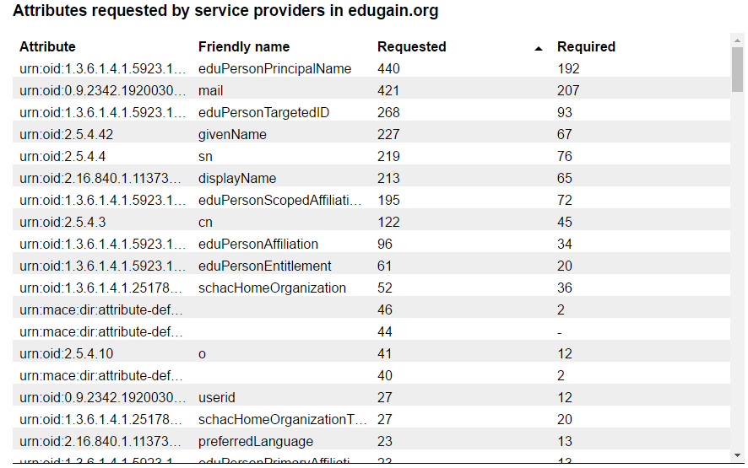
Which ones should we prioritise?
https://phph.safire.ac.za/attribs
Notes:
A snapshot showing the most commonly requested attributes in eduGAIN metadata. From this we learn that new IdPs really need to provide the recommended set, but focusing on that (including eduPersonAffiliation/eduPersonScopedAffiliation) is really a good first step. Other attributes can come later.

Slide 33
What is SAML?

Slide 34
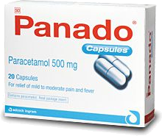
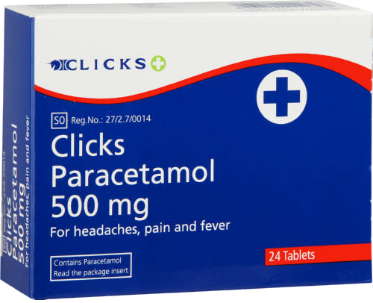
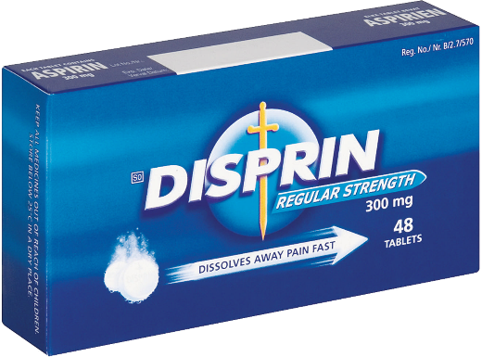
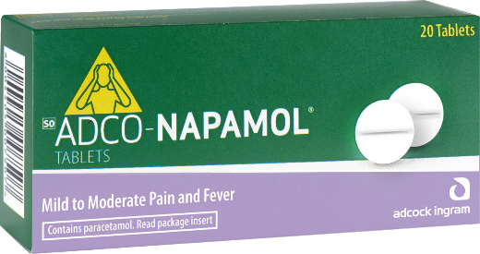
Terminology
Shibboleth is to SAML
as
Panado is to Paracetamol
Disprin
Notes:
Try and reinforce the use of the term “SAML” whilst being aware that libraries, etc know it as “Shibboleth”.

Slide 35
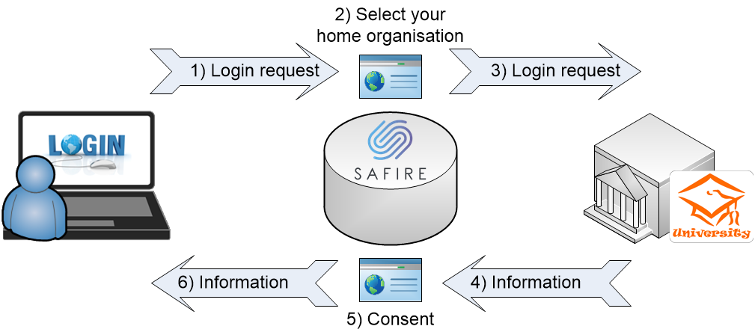
SAML 2.0 WebSSO
Notes:
A schematic view of SAML WebSSO. Importantly, in SAML2 all information is exchanged via the browser – there are no back channels, etc. This reinforces the need for signing. You can view the SAML exchange with a browser plugin such as https://chrome.google.com/webstore/detail/saml-message-decoder/mpabchoaimgbdbbjjieoaeiibojelbhm?hl=en

Slide 36
SAML Metadata
MetaIOP
SAML2int
ADFS
SAFIRE IdP Requirements
MDUI
validator.safire.ac.za
Notes:
Topics for discussion to explore SAML metadata. MetaIOP is the Metadata Interoperability Profile (https://wiki.oasis-open.org/security/SAML2MetadataIOP). SAML2int is the deployment profile we (and most other) federations use (http://saml2int.org/). SAFIRE’s IdP requirements are at https://safire.ac.za/technical/saml2/idp-requirements/, and they require MDUI (metadata user interface) elements such as a logo. You can validate metadata against [most of] SAFIRE’s standards at https://validator.safire.ac.za/.

Slide 37
Participating in SAFIRE

Slide 38
How to join
Sign Participation Agreement
Install an Identity (or Service) Provider
Register metadata
Test

Slide 39
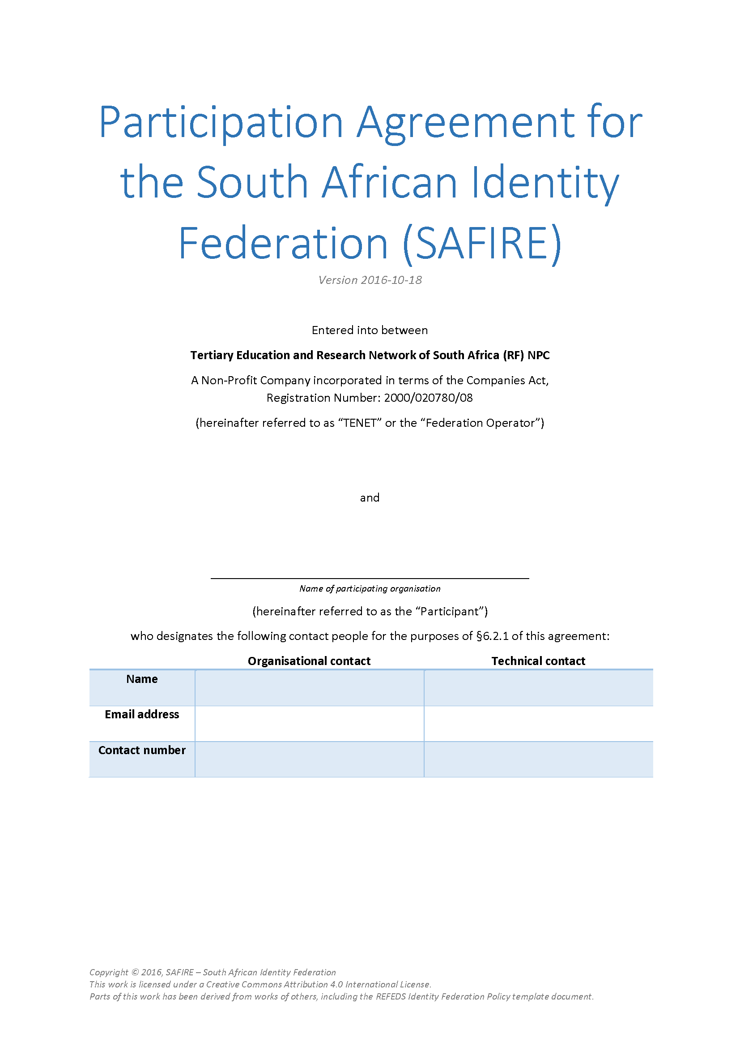
How to join
Sign Participation Agreement
Install an Identity (or Service) Provider
Register metadata
Test
https://safire.ac.za/policy/participation/
Notes:
Signing the Participation Agreement is perhaps the most important – and most complex – part. It defines the trust relationship, and more importantly defines the relationship in terms of the POPI Act. This seems to scare institutions, because POPI is new and complex and we aren’t used to seeing it in contracts. However, what’s in the Participation Agreement is really meant to be good for everyone. There are some notes available to help people understand the Participation Agreement at https://safire.ac.za/safire/policy/practice-note-participation-agreement/.

Slide 40




How to join
Sign Participation Agreement
Install an Identity (or Service) Provider
Register metadata
Test
Notes:
SAFIRE isn’t prescriptive; use whatever software works best for you. If you have an existing ADFS, that may make sense; if you use Gsuite, it’s another quick-and-easy way to connect. Most importantly, understand the limitations/pros/cons of what you choose.

Slide 41
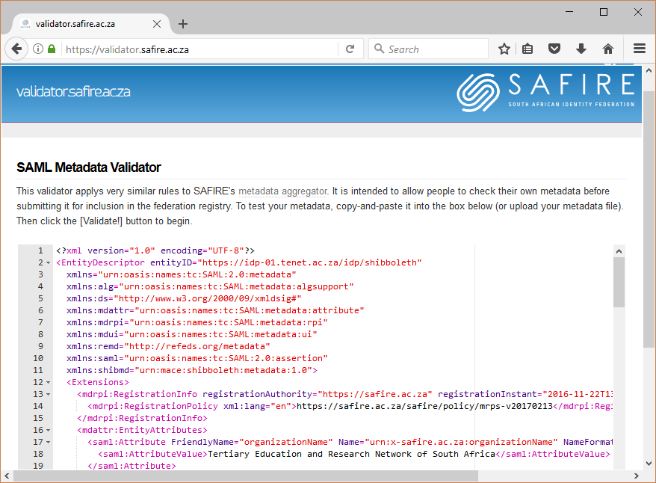
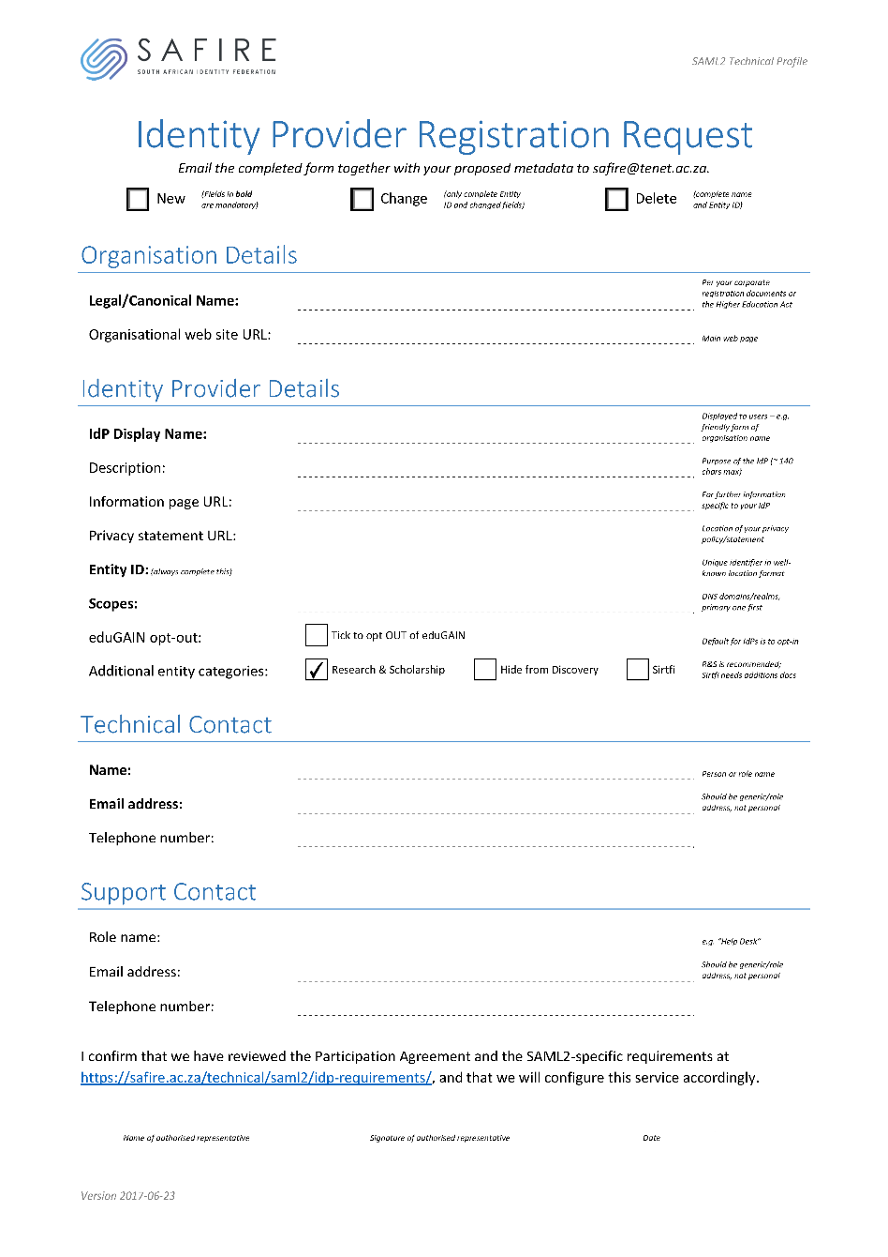
How to join
Sign Participation Agreement
Install an Identity (or Service) Provider
Register metadata
Test
Notes:
Registering metadata involves completing a form and submitting the XML metadata. You can get the form from https://safire.ac.za/technical/saml2/forms/, and you can test your metadata at https://validator.safire.ac.za/.

Slide 42
How to join
Sign Participation Agreement
Install an Identity (or Service) Provider
Register metadata
Test
Notes:
SAFIRE has a test service provider at https://test.safire.ac.za/. This can help you make sure attribute release is working the way you intend.

Slide 43
Other things to start thinking about…
What internal services you might want to expose (your own service providers)
Research & Scholarship
Sirtfi
ORCID
Tracking levels of assurance
Notes:
These are things that are becoming increasingly relevant, and that you should be aware of.

Slide 44
Creating an IdP
Notes:
https://safire.ac.za/technical/resources/ has a lot of notes

Slide 45
https://safire.ac.za/technical/attributes/

