Slide 1
ERD Practice Exercises
Database Design

Slide 2
Exercise 1
Problem
A company database needs to store information about employees (identified by ssn, with salary and phone as attributes), departments (identified by dno, with dname and budget as attributes), and children of employees (with name and age as attributes).

Slide 3
Exercise 1
Problem
Employees work in departments; each department is managed by an employee; a child must be identified uniquely by name when the parent (who is an employee; assume that only one parent works for the company) is known. We are not interested in information about a child once the parent leaves the company.
Draw an ER diagram that captures this information.

Slide 4
Exercise 1
Solution
First, we shall design the entities and relationships.
“Employees work in departments…”
“…each department is managed by an employee…”
“…a child must be identified uniquely by name when the parent (who is an employee; assume that only one parent works for the company) is known.”

Slide 5
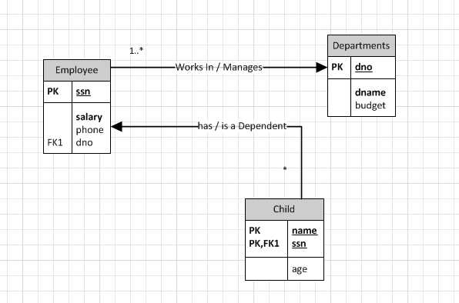
Exercise 1
Solution

Slide 6
Exercise 1
Solution
“…each department is managed by an employee…”
“…a child must be identified uniquely by name when the parent (who is an employee; assume that only one parent works for the company) is known. “
“We are not interested in information about a child once the parent leaves the company.”

Slide 7
Exercise 2
Problem
Although you always wanted to be an artist, you ended up being an expert on databases because you love to cook data and you somehow confused database with data baste. Your old love is still there, however, so you set up a database company, ArtBase, that builds a product for art galleries. The core of this product is a database with a schema that captures all the information that galleries need to maintain.

Slide 8
Exercise 2
Problem
Galleries keep information about artists, their names (which are unique), birthplaces, age,and style of art. For each piece of artwork, the artist, the year it was made, its unique title, its type of art (e.g., painting, lithograph, sculpture, photograph), and its price must be stored. Pieces of artwork are also classified into groups of various kinds, for example, portraits, still lifes, works by Picasso, or works of the 19th century; a given piece may belong to more than one group.

Slide 9
Exercise 2
Problem
Each group is identified by a name (like those just given) that describes the group. Finally, galleries keep information about customers. For each customer, galleries keep that person’s unique name, address, total amount of dollars spent in the gallery (very important!), and the artists and groups of art that the customer tends to like.
Draw the ER diagram for the database.

Slide 10
Exercise 2
Solution
Like before, we begin with the entities and relationships.
“…artists, their names (which are unique), birthplaces, age, and style of art.”
“For each piece of artwork, the artist, the year it was made, its unique title, its type of art … and its price must be stored.”

Slide 11
Exercise 2
Solution
“Pieces of artwork are also classified into groups of various kinds, … Each group is identified by a name (like those just given) that describes the group. “
For each customer, galleries keep that person’s unique name, address, total amount of dollars spent in the gallery (very important!), and the artists and groups of art that the customer tends to like.

Slide 12
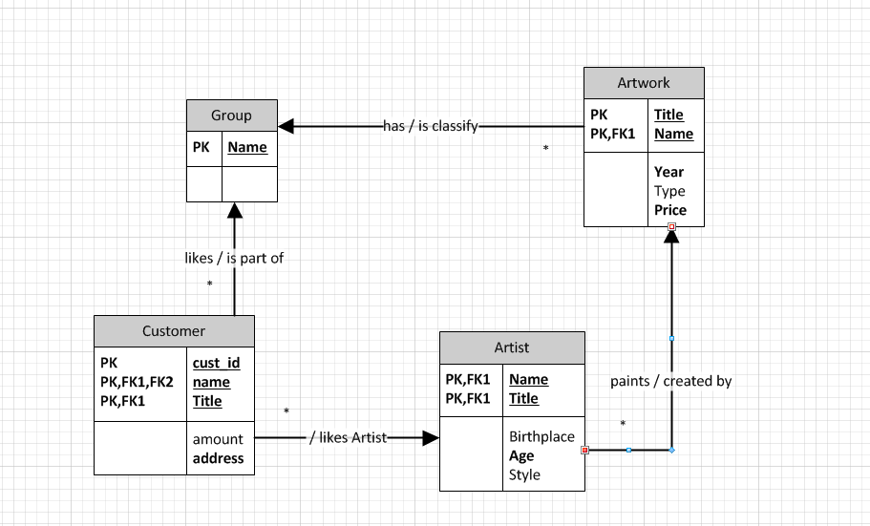
Exercise 2
Solution

Slide 13
Exercise 2
Solution
Now we look at constraints.
Although not explicitly mentioned in the problem, we assume that each piece of artwork had to be painted by an artist.
We also assume that each piece of artwork was created by exactly one artist.

Slide 14
Exercise 2
Solution
Suppose we had several piece of artwork with the same title, and we told them apart by artist?
Example: “What is Love?” by Cheryl D, “What is Love?” by Joe Brown, etc.

