Slide 1
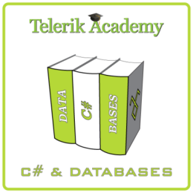

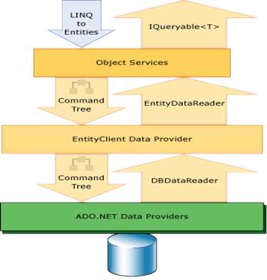
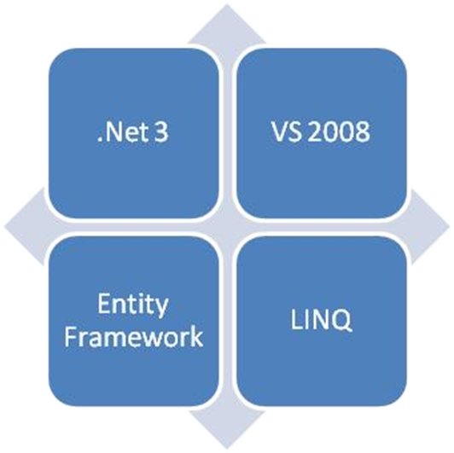
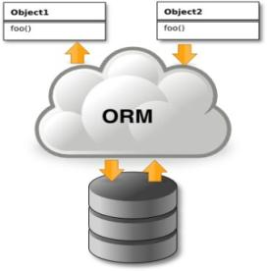

ADO.NET Entity Framework
C# and Databases free course
ORM Concepts, ADO.NET Entity Framework (EF), ObjectContext
Doncho Minkov
Technical Trainer
http://www.minkov.it
Telerik Software Academy
http://academy.telerik.com/

Slide 2

Table of Contents
ORM Technologies – Basic Concepts
Entity Framework
Overview
Printing the native SQL queries
LINQ Components
Entity Files
The Visual Studio Designer
ObjectContext Class and CRUD Operations

Slide 3
Table of Contents (2)
Executing Native SQL Queries
Paramerterless Queries
Parameterized Queries
The N+1 Query Problem
Joining and Grouping Entities
Attaching and Detaching Objects

Slide 4
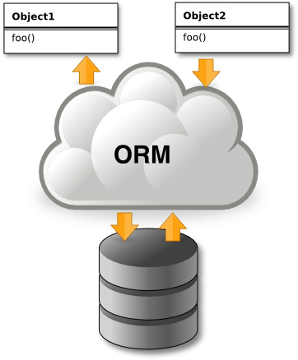
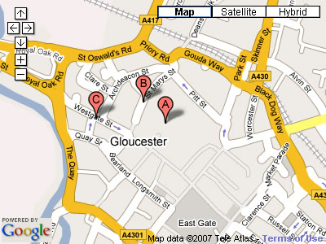


Introduction to ORM
Object-Relational Mapping (ORM) Technologies

Slide 5
ORM Technologies
Object-Relational Mapping (ORM) is a programming technique for automatic mapping and converting data
Between relational database tables and object-oriented classes and objects
ORM creates a “virtual object database“
Which can be used from within the programming language, e.g. C# or Java
ORM frameworks automate the ORM process
A.k.a. object-relational persistence frameworks

Slide 6
ORM Frameworks
ORM frameworks typically provide the following functionality:
Creating object model by database schema
Creating database schema by object model
Querying data by object-oriented API
Data manipulation operations
CRUD – create, retrieve, update, delete
ORM frameworks automatically generate SQL to perform the requested data operations

Slide 7
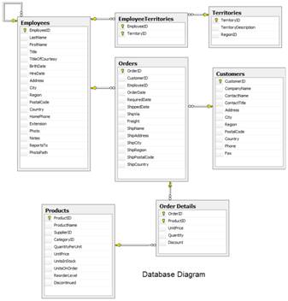
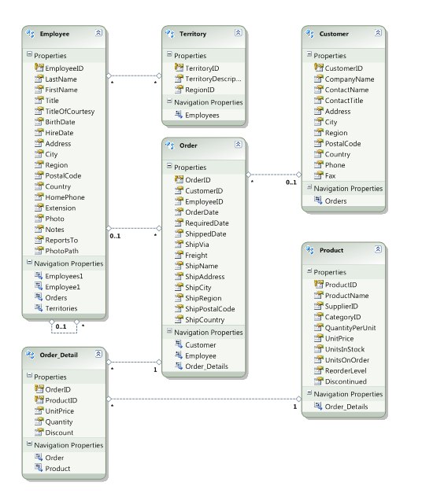




ORM Mapping – Example
Database and Entities mapping diagrams for a subset of the Northwind database
Relational database schema
ORM Entities (C# Classes)
ORM
Framework

Slide 8
ORM Advantages
Object-relational mapping advantages
Developer productivity
Writing less code
Abstract from differences between object and relational world
Complexity hidden within ORM
Manageability of the CRUD operations for complex relationships
Easier maintainability

Slide 9
Approaches to ORM
Template-based code generation vs. entity classes mappings
SQL generation (design time / runtime) vs. mapping existing SQL
Entity classes representation
Entities are just POCO (Plain Old C# Objects)
Entities implement special IPersistent interface or extend PersistentBase class
Configuring mappings
DB schema data vs. XML vs. annotations

Slide 10
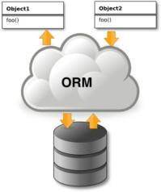
Object Persistence Frameworks
Code generation tools
Generate C#, XML and other files
Source code is compiled and used as API
Can be highly customized
Object-relational mapping tools
Mappings are described in XML files or built in the classes as attributes
No source code generation
Use of single standard API

Slide 11
ORM Frameworks in .NET
Built-in ORM tools in .NET Framework and VS
ADO.NET Entity Framework
LINQ-to-SQL
Both combine entity class mappings and code generation, SQL is generated at runtime
Third party ORM tools
NHibernate – the old daddy of ORM
Telerik OpenAccess ORM

Slide 12


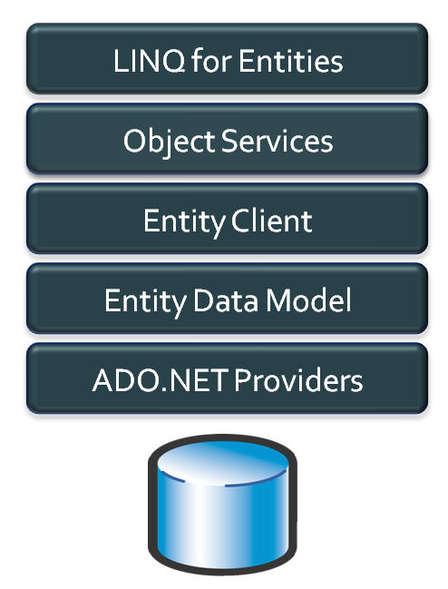
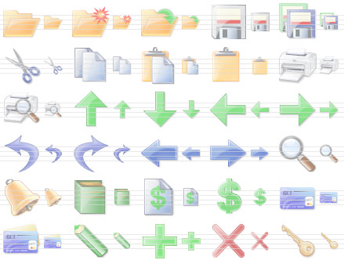
ADO.NET Entity Framework
Object Relation Persistence Framework

Slide 13
Overview of ADO.NET EF
Entity Framework (EF) is a standard ORM framework, part of .NET
Provides a run-time infrastructure for managing SQL-based database data as .NET objects
The relational database schema is mapped to an object model (classes and associations)
Visual Studio has built-in tools for generating Entity Framework SQL data mappings
Data mappings consist of C# classes and XML
A standard data manipulation API is provided

Slide 14
Overview of ADO.NET EF (2)
Entity Framework provides an application programming interface (API)
For accessing data stored in database servers
Built on the top of ADO.NET and LINQ
LINQ to Entities is Microsoft’s entry-level LINQ-enabled ORM implementation for database servers
Works with SQL Server and SQL Server Express
Could work with MySQL, SQLite, Oracle, etc.
Maps tables and one-to-many and many-to-many relationships

Slide 15
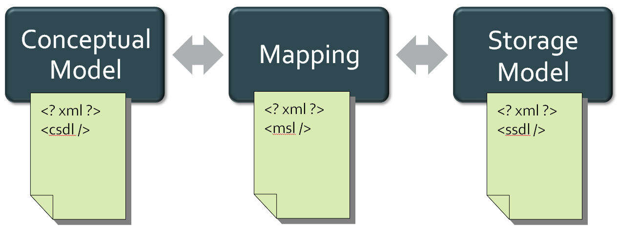
Entity Data Model
The Entity Data Model (EDM) is a schema language for entities, consisting of:
Conceptual model (CSDL)
Mapping (MSL)
Storage Model (SSDL)

Slide 16
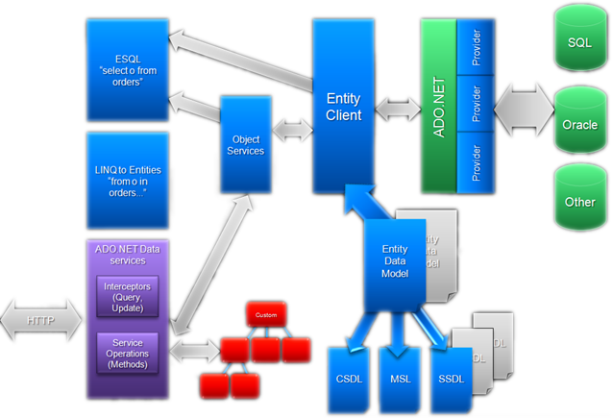
Entity Framework Architecture

Slide 17
Entity Framework Features
Entity Framework (EF) standard features:
Maps tables, views, stored procedures and functions as .NET objects
Provides LINQ-based data queries
Executed as SQL SELECTs on the database server
CRUD operations – Create/Read/Update/Delete
Create compiled queries – for executing the same parameterized query multiple times
Creating or deleting the database schema

Slide 18

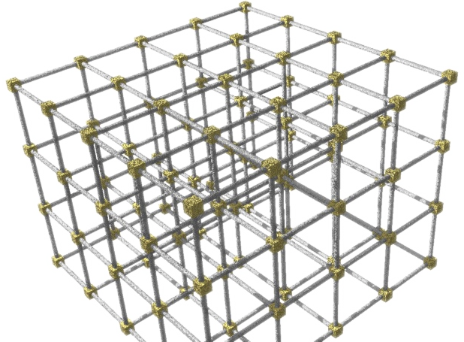
Entity Framework Lifecycle
When the application starts
EF translates into SQL the language-integrated queries in the object model
Sends them to the database for later execution

Slide 19
Entity Framework Lifecycle (2)
When the database returns the results
Entity Framework translates the database rows back to .NET objects
The database server is transparent, hidden behind the API
LINQ is executed over IQueryable<T>
At compile time a query expression tree is emitted
At runtime SQL is generated and executed

Slide 20
EF Components
The ObjectContext class
ObjectContext holds the database connection and the entity classes
Provides LINQ-based data access
Implements identity tracking, change tracking, and API for CRUD operations
Entity classes
Each database table is typically mapped to a single entity class (C# class)

Slide 21
EF Components (2)
Associations
An association is a primary key / foreign key based relationship between two entity classes
Allows navigation from one entity to another, e.g. Student.Courses
Concurrency control
Entity Framework uses optimistic concurrency control (no locking by default)
Provides automatic concurrency conflict detection and means for conflicts resolution

Slide 22
LINQ to Entity Files (.edmx)
Visual Studio has built-in Entity Framework data designer and code generator
Mappings are stored in .edmx files (Entity Data Model XML)
<database>.edmx is an XML file
Holds metadata representing the database schema (CSDL, MSL and SSDL models)
<database>.Designer.cs file contains the C# entity classes and the ObjectContext class
One entity class for each mapped database table

Slide 23
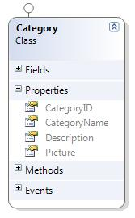
LINQ to Entity Files – Example
EDMX mapping for the Categories table from Northwind database in SQL Server
<EntityType Name="Categories">
<Key>
<PropertyRef Name="CategoryID" />
</Key>
<Property Name="CategoryID" Nullable="false"
Type="int" StoreGeneratedPattern="Identity" />
<Property Name="CategoryName" Type="nvarchar"
Nullable="false" MaxLength="15" />
<Property Name="Description" Type="ntext" />
<Property Name="Picture" Type="image" />
</EntityType>
Entity class Category

Slide 24
The ObjectContext Class
The ObjectContext class is generated by the Visual Studio designer
ObjectContext provides:
Methods for accessing entities (object sets) and creating new entities (AddTo… methods)
Ability to manipulate database data though entity classes (read, modify, delete, insert)
Easily navigate through the table relationships
Executing LINQ queries as native SQL queries
Create the DB schema in the database server

Slide 25
Using ObjectContext Class
First create instance of the ObjectContext:
In the constructor you can pass a database connection string and mapping source
ObjectContext properties
Connection – the SqlConnection to be used
CommandTimeout – timeout for database SQL commands execution
All entity classes (tables) are listed as properties
e.g. ObjectSet<Order> Orders { get; }
NorthwindEntities northwind = new NorthwindEntities();

Slide 26
Reading Data with LINQ Query
Executing LINQ-to-Entities query over EF entity:
Customers property in the ObjectContext:
NorthwindEntities context = new NorthwindEntities();
var customers =
from c in context.Customers
where c.City == "London"
select c;
The query will be executes as SQL command in the database
public partial class NorthwindEntities : ObjectContext
{
public ObjectSet<Customer> Customers
{
get { … }
}
}

Slide 27
Logging the Native SQL Queries
To print the native database SQL commands executed on the server use the following:
var query = context.Countries;
Console.WriteLine((query as ObjectQuery).ToTraceString());
This will print the SQL native query executed at the database server to select the Countries
Can be printed to file using StreamWriter class instead of Console class

Slide 28
Creating New Data
To create a new database row use the method AddObject(…) of the corresponding collection:
// Create new order object
Order order = new Order()
{
OrderDate = DateTime.Now, ShipName = "Titanic",
ShippedDate = new DateTime(1912, 4, 15),
ShipCity = "Bottom Of The Ocean"
};
// Mark the object for inserting
context.Orders.AddObject(order);
context.SaveChanges();
This will execute an SQL INSERT
SaveChanges() method call is required to post the SQL commands to the database

Slide 29
Creating New Data (2)
Creating new row can also be done by using the AddTo + The_Entity_Name method directly on the ObjectContext
This method is depricated
Better use the other one
// Mark the object for inserting
context.AddToOrders(order);
// Post changes to database (execute SQL INSERTs)
context.SaveChanges();

Slide 30
Cascading Inserts
We can also add cascading entities to the database:
Country spain = new Country();
spain.Name = "Spain";
spain.Population = "46 030 10";
spain.Cities.Add( new City { Name = "Barcelona"} );
spain.Cities.Add( new City { Name = "Madrid"} );
countryEntities.Countries.AddObject(spain);
countryEntities.SaveChanges();
This way we don't have to add each City individually
They will be added when the Country entity (Spain) is inserted to the database

Slide 31
Updating Existing Data
ObjectContext allows modifying entity properties and persisting them in the database
Just load an entity, modify it and call SaveChanges()
The ObjectContext automatically tracks all changes made on its entity objects
Order order = northwindEntities.Orders.First();
order.OrderDate = DateTime.Now;
context.SaveChanges();
This will execute an SQL UPDATE
This will execute an SQL SELECT to load the first order

Slide 32
Deleting Existing Data
Delete is done by DeleteObject() on the specified entity collection
SaveChanges() method performs the delete action in the database
Order order = northwindEntities.Orders.First();
// Mark the entity for deleting on the next save
northwindEntities.Orders.DeleteObject(order);
northwindEntities.SaveChanges();
This will execute an SQL DELETE command

Slide 33

Executing Native SQL Queries
Parameterless and Parameterized

Slide 34
Executing Native SQL Queries
Executing a native SQL query in Entity Framework directly in its database store:
Example:
Examples are shown in SQL Server but the same can be done for any other database
ctx.ExecuteStoreQuery<return-type>(native-SQL-query);
string query = "SELECT count(*) FROM dbo.Customers";
var queryResult = ctx.ExecuteStoreQuery<int>(query);
int customersCount = queryResult.FirstOrDefault();

Slide 35
Executing Native SQL Queries (2)
Native SQL queries can also be parameterized:
NorthwindEntities context = new NorthwindEntities();
string nativeSQLQuery =
"SELECT FirstName + ' ' + LastName " +
"FROM dbo.Employees " +
"WHERE Country = {0} AND City = {1}";
object[] parameters = { country, city };
var employees = context.ExecuteStoreQuery<string>(
nativeSQLQuery, parameters);
foreach (var emp in employees)
{
Console.WriteLine(emp);
}

Slide 36
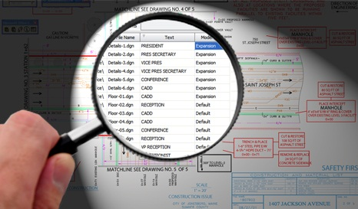
The N+1 Query Problem
What is the N+1 Query Problem and How to Avoid It?

Slide 37
The N+1 Query Problem
What is the N+1 Query Problem?
Imagine a database that contains tables Customers and Orders
A customer has multiple orders (one-to-many relationship)
We want to print each Customer and its Orders:
foreach (var cust in context.Customers)
{
Console.WriteLine(cust.CompanyName + "\nOrders:");
foreach (var order in cust.Orders)
{
Console.WriteLine("{0}", order.OrderID);
}
}

Slide 38
The N+1 Query Problem (2)
A single query to retrieve the countries
This code will execute N+1 DB queries:
foreach (var cust in context.Customers)
{
Console.WriteLine(cust.CompanyName + "\nOrders:");
foreach (var order in cust.Orders)
{
Console.WriteLine("{0}", order.OrderID);
}
}
Additional N queries to retrieve the cities in each country
Imagine we have 100 countries in the database
That's 101 SQL queries → very slow!
We could do the same with a single SQL query

Slide 39
Solution to the N+1 Query Problem
Fortunately there is an easy way in EF to avoid the N+1 query problem
Using Include(…) method only one SQL query with join is made to get the child entities
foreach (var country in
countriesEntities.Countries.Include("Cities"))
{
foreach (var city in country.Cities)
{
Console.WriteLine(" {0}", city.CityName);
}
}
No additional SQL queries are made here for the child entities

Slide 40



Joining and Grouping Tables
Join and Group Using LINQ

Slide 41
Joining Tables in EF
In EF we can join tables in LINQ or by using extension methods on IEnumerable<T>
The same way like when joining collections
northwindEntities.Customers.
Join(northwindEntities.Suppliers,
(c=>c.Country), (s=>s.Country), (c,s)=>
new {Customer = c.CompanyName, Supplier =
s.CompanyName, Country = c.Country });
var custSuppl =
from customer in northwindEntities.Customers
join supplier in northwindEntities.Suppliers
on customer.Country equals supplier.Country
select new {
CustomerName = customer.CompanyName,
Supplier = supplier.CompanyName,
Country = customer.Country
};

Slide 42
Grouping Tables in EF
Grouping also can be done by LINQ
The same ways as with collections in LINQ
Grouping with LINQ:
Grouping with extension methods:
var groupedCustomers =
from customer in northwindEntities.Customers
group customer by Customer.Country;
var groupedCustomers =
northwindEntities.Customers.GroupBy(
customer => customer.Country);

Slide 43

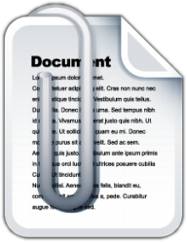
Attaching and Detaching Objects

Slide 44
Attaching and Detaching Objects
In Entity Framework, objects can be attached to or detached from an object context
Attached objects are tracked and managed by the ObjectContext
SaveChanges() persists all changes in DB
Detached objects are not referenced by the ObjectContext
Behave like a normal objects, like all others, which are not related to EF

Slide 45
Attaching Detached Objects
When a query is executed inside an ObjectContext, the returned objects are automatically attached to it
When a context is destroyed, all objects in it are automatically detached
E.g. in Web applications between the requests
You might late attach to a new context objects that have been previously detached

Slide 46
Detaching Objects
When an object is detached?
When we obtain the object from an ObjectContext and the Dispose it
Manually: by calling Detach(…) method
Product GetProduct(int id)
{
using (NorthwindEntities northwindEntities =
new NorthwindEntities())
{
return northwindEntities.Products.First(
p => p.ProductID == id);
}
}
Now the returned product is detached

Slide 47
Attaching Objects
When we want to update a detached object we need to reattach it and the update it
Done by the Attach(…) method of the context
void UpdatePrice(Product product, decimal newPrice)
{
using (NorthwindEntities northwindEntities =
new NorthwindEntities())
{
northwindEntities.Products.Attach(product);
product.UnitPrice = newPrice;
northwindEntities.SaveChanges();
}
}

Slide 48





Using Transactions in EF
Just Use the TransactionScope Class

Slide 49
Using Transactions in EF
To perform transactional logic, just use the TransactionScope class
You may need to add reference to System.Transactions.dll
using (TransactionScope scope = new TransactionScope())
{
NorthwindEntities context = new NorthwindEntities();
// Perform a series of changes in the context
context.SaveChanges();
scope.Complete();
}

Slide 50
ADO.NET Entity Framework
http://academy.telerik.com

Slide 51
Exercises
Using the Visual Studio Entity Framework designer create a ObjectContext for the Northwind database
Create a DAO class with static methods which provide functionality for inserting, modifying and deleting customers. Write a testing class.
Write a method that finds all customers who have orders made in 1997 and shipped to Canada.
Implement previous by using native SQL query and executing it through the ObjectContext.
Write a method that finds all the sales by specified region and period (start / end dates).

Slide 52
Exercises (2)
Create a database called NorthwindTwin with the same structure as Northwind using the features from ObjectContext. Find for the API for schema generation in MSDN or in Google.
Try to open two different data contexts and perform concurrent changes on the same records. What will happen at SaveChanges()? How to deal with it?
By inheriting the Employee entity class create a class which allows employees to access their corresponding territories as property of type EntitySet<T>.

Slide 53
Exercises (3)
Create a method that places a new order in the Northwind database. The order should contain several order items. Use transaction to ensure the data consistency.
Create a stored procedures in the Northwind database for finding the total incomes for given supplier name and period (start date, end date). Implement a C# method that calls the stored procedure and returns the retuned record set.

Slide 54
Exercises (4)
Create a database holding users and groups. Create a transactional EF based method that creates an user and puts it in a group "Admins". In case the group "Admins" do not exist, create the group in the same transaction. If some of the operations fail (e.g. the username already exist), cancel the entire transaction.

Slide 55


Free Trainings @ Telerik Academy
"C# and Databases " course @ Telerik Academy
academy.telerik.com/…csharp-databases
Telerik Software Academy
academy.telerik.com
Telerik Academy @ Facebook
facebook.com/TelerikAcademy
Telerik Software Academy Forums
forums.academy.telerik.com

