Slide 1
GSM – Hadoop 1 Day Workshop
Welcome back!

Slide 2

Running Hadoop on Azure

Slide 3
Running Hadoop on Azure
HDInsight (Windows)
Managed Hadoop framework using Microsoft Azure instances and storage
Pay-as-you-go

Slide 4
Running Hadoop on Azure
Pre-requisite:
Microsoft Azure Subscription

Slide 5
Running Hadoop on Azure
# PRACTICE 1 - Sign in
https://manage.windowsazure.com/
Sign in to the Portal

Slide 6
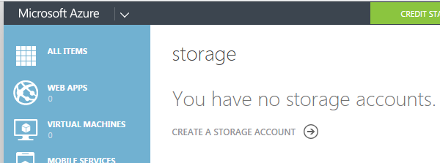
Running Hadoop on Azure
# PRACTICE 2 – Create a Storage Account
URL: gmshadoopworkshop
Location: East US
Replication: Locally Redundant

Slide 7
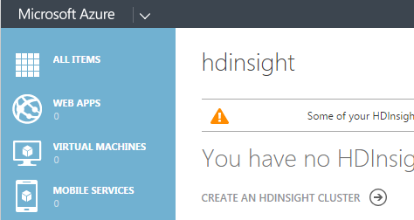
Running Hadoop on Azure
# PRACTICE 3 - Create HDInsight Cluster
Cluster Name: Same as Storage Account
Cluster Size: 4 nodes
Password: (see rules)
Storage Account: (previously created)

Slide 8
Running Hadoop on Azure
# PRACTICE 4 – Install Microsoft Tools
1. Visual Studio Community 2015 with Microsoft Azure SDK

Slide 9
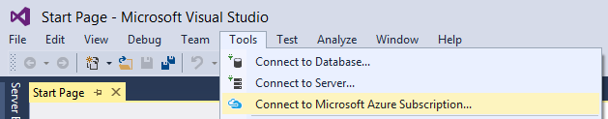
Running Hadoop on Azure
# PRACTICE 5 – Connect to your subscription
Tools > Connect to Microsoft Azure Subscription

Slide 10
Running Hadoop on Azure
# PRACTICE 7 – Powershell Equivalent
> Add-AzureAccount
> Use-AzureHDInsightCluster dsikargmshadoopworkshop
# Check
> Get-AzureAccount
> Get-AzureSubscription

Slide 11
Running Hadoop on Azure
# PRACTICE 8 – Run Hive example
# Local
> Invoke-Hive "select country, state, count(*) as records from hivesampletable group by country, state order by records desc limit 5"

Slide 12
Running Hadoop on Azure
# PRACTICE 9 – Run Streaming example
# as per given example (error)
# Local
$jarFile = "/example/jars/hadoop-examples.jar"
$className = "wordcount"
$statusDirectory = "/samples/wordcount/status"
$outputDirectory = "/samples/wordcount/output"
$inputDirectory = "/example/data/gutenberg"
$wordCount = New-AzureHDInsightMapReduceJobDefinition \ -JarFile $jarFile -ClassName $className -Arguments \ $inputDirectory, $outputDirectory -StatusFolder $statusDirectory

Slide 13
Running Hadoop on Azure
# PRACTICE 10 – Debug Streaming example
# REMOTE
1. Test on shell
2. Write hadoop streamin command line equivalent

Slide 14
Running Hadoop on Azure
# PRACTICE 10 – Debug Streaming example
# solution (one of many)
> hadoop jar C:\apps\dist\hadoop-2.6.0.2.2.7.1-34\share\hadoop\tools\lib\hadoop-streaming-2.6.0.2.2.7.1-34.jar -input /example/data/gutenberg -output /example/data/output9 -mapper cat -reducer wc -file cat.exe -file wc.exe

