Slide 1

The Apache Software Foundation

Slide 2
The Apache Software Foundation
- Charity funded by individual donations and corporate sponsors
- 350+ leading Open Source projects, including Apache HTTP Server -- the world's most popular Web server software

Slide 3
From the documentation
What Is Apache Hadoop?
The Apache™ Hadoop® project develops open-source software for reliable, scalable, distributed computing.
(...)

Slide 4
Hadoop Modules
Hadoop Common: The common utilities that support the other Hadoop modules.
Hadoop Distributed File System (HDFS™): A distributed file system that provides high-throughput access to application data.
Hadoop YARN: A framework for job scheduling and cluster resource management.
Hadoop MapReduce: A YARN-based system for parallel processing of large data sets.

Slide 5
Hadoop related projects
(…)
HBase™: A scalable, distributed database that supports structured data storage for large tables.
Hive™: A data warehouse infrastructure that provides data summarization and ad hoc querying.
Pig™: A high-level data-flow language and execution framework for parallel computation.
Spark™: A fast and general compute engine for Hadoop data. Spark provides a simple and expressive programming model that supports a wide range of applications, including ETL, machine learning, stream processing, and graph computation.
(...)

Slide 6
Hadoop related projects
Hue
Ganglia
Mahout
Oozie

Slide 7
How Do They Work Together?
Hadoop provides the infrastructure that related projects use e.g.
Cluster Management
Scalability
Availability

Slide 8
Hadoop – where did it all begin?
Google paper:
MapReduce: Simpliﬁed Data Processing on Large Clusters
Dean and Ghemawat 2004

Slide 9
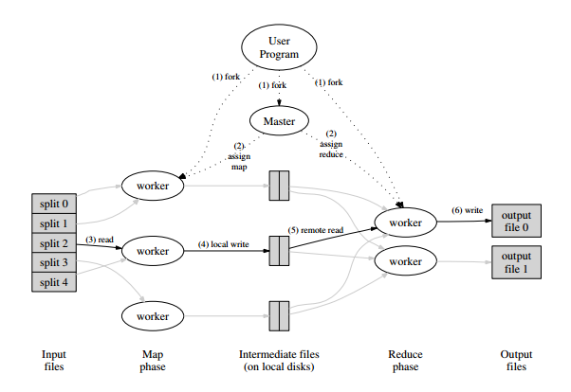
Hadoop – where did it all begin?

Slide 10
Hadoop
Open Source Implementation of Google MapReduce by Doug Cutting
HDFS – Open Source Implementation of Google DFS

