Slide 1
GMS Hadoop 1 Day Workshop
Welcome back!

Slide 2

Running Hadoop on AWS

Slide 3
Running Hadoop on AWS
Amazon EMR (Elastic MapReduce)
Managed Hadoop framework using AWS instances and storage (S3).
Pay-as-you-go

Slide 4
Running Hadoop on AWS
Pre-requisite:
AWS user account

Slide 5
Running Hadoop on AWS
# PRACTICE 1 - Sign in
https://aws.amazon.com/console/
Sign in to the Console

Slide 6
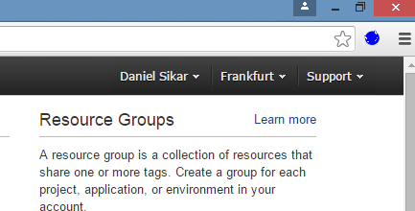
Running Hadoop on AWS
# PRACTICE 2 - Change to nearest Region

Slide 7
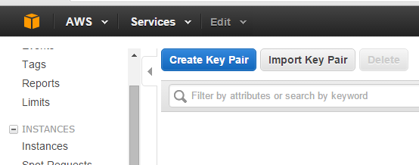
Running Hadoop on AWS
# PRACTICE 3 - Create Key Pair
Services > EC2 > Key Pairs

Slide 8
Running Hadoop on AWS
A Note About AWS Regions:
Resources are contained within Regions.
Change Regions and your recently created Key Pair will not be there.
# PRACTICE 4 – Try it

Slide 9
Running Hadoop on AWS
A Note About Key Pairs:
If accessing AWS Instances (Virtual Machines) through Linux SSH, GMSHadoopWorkshop.pem will do, otherwise create .ppk file with puttygen and access with putty.
More to follow...

Slide 10
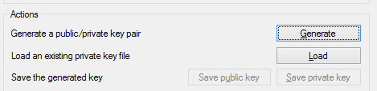
Running Hadoop on AWS
# PRACTICE 5 – Converting Key Pair
Using puttygen.exe, load the private key (Key Pair) file and “Save private key”

Slide 11
Running Hadoop on AWS
# PRACTICE 6 – Save both .pem and ppk file to:
(…)\Documents\GSMHadoopWorkshop\.ssh

Slide 12
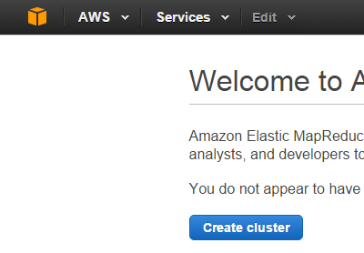
Running Hadoop on AWS
# PRACTICE 7 – Create Hadoop Cluster
> Services > EMR > Create Cluster

Slide 13

Running Hadoop on AWS
# PRACTICE 7 cont. – Configure Cluster
Cluster Name: <My Name> GMS Hadoop Cluster
Instance Type: m3.xlarge ($0.315 instance/hour)
EC2 key pair: GMSHadoopWorkshop

Slide 14
Running Hadoop on AWS
A Note About Pricing:
https://aws.amazon.com/ec2/pricing/
Cluster with 3 x m3.xlarge instances:
Aproximate hourly cost 3 x $0.315 ~ 1 USD
Annual Cost (1 USD X 24 X 365) ~ 8.7k USD
DON'T FORGET TO TERMINATE YOUR CLUSTER

Slide 15
Running Hadoop on AWS
# PRACTICE 8 – SSH into Master Node
# with putty (Auth ~ .ppk)
# ssh
>ssh -i .ssh\<my key pair>.pem hadoop@<public dns>

Slide 16
Running Hadoop on AWS
# PRACTICE 9 – SSH into Slave Node
Add SSH rule then SSH as per PRACTICE 8.
# PRACTICE 10 – assert HDFS works
# as per HDFS Practice

Slide 17
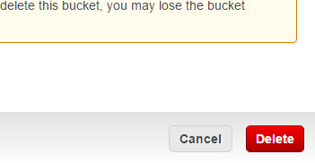
Running Hadoop on AWS
# PRACTICE 11 – Terminate Cluster and delete S3 storage (bucket)
Services > S3 > Actions > Delete Bucket
Tip: Copy Bucket Name from Properties.

