Slide 1


Lightning talk 10 | School of Science and Technology
Hackathons as a Medium for Disseminating Agentic AI in Research
Daniel Sikar and Dave Muir
How hackathons can disseminate agentic AI in research, education and workforce upskilling, illustrated through the Clinical AI Hackathon.
Clinical AI Hackathon: A collaboration with the St George’s Hospital Imaging Research Group
Dr Anita Wale, Hitesh Patel, Eleanor Hickey, Dr George Hammerton & Mukisa Scarinzi
AI Research Day | Lightning talks

Slide 2


Lightning talk 10 | Daniel Sikar and Dave Muir
Agentic AI, where did it all begin?
School of Science and Technology | Hackathons as a Medium for Disseminating Agentic AI in Research
AI Research Day | Lightning talks

Slide 3
Lightning talk 10 | Daniel Sikar and Dave Muir
Agentic AI, where did it all begin?​
Paper
ArXiv - [Submitted on 12 Aug 2024 (v1), last revised 1 Sep 2024]
https://arxiv.org/abs/2408.06292
Company website
SakanaAI - https://sakana.ai/
News
“Japan’s NVIDIA-backed Sakana AI raises $214m”
https://www.techinasia.com/news/japans-nvidiabacked-sakana-ai-raises-214m
School of Science and Technology | Hackathons as a Medium for Disseminating Agentic AI in Research
AI Research Day | Lightning talks

Slide 4
Lightning talk 10 | Daniel Sikar and Dave Muir
What is the AI Scientist?​
Purpose: The AI Scientist is designed to be the first comprehensive system for fully automated scientific discovery
Functionality: It can generate novel research ideas (via Semantic Scholar API queries), write code (Aider, same backbone as Coder), execute experiments (via Python), visualize results, and author full scientific papers, complete with peer review, all autonomously.
Templates: Provides three foundational templates for research in different domains: NanoGPT for transformer-based tasks, 2D Diffusion for generative model performance, and Grokking for studying generalization in neural networks.
System Requirements: Designed for Linux with NVIDIA GPUs using CUDA and PyTorch. CPU-only operation in theory is not feasible for the current templates due to computational demands. I ran it on Intel i5 processor.
Usage: Users can run experiments by setting up the environment, preparing data, and executing scripts through command line interfaces. It supports various models like GPT-4o and Claude Sonnet 3.5, requiring respective API keys and pre-paid credits.
Safety and Deployment: The project includes a Docker image for safer execution.
School of Science and Technology | Hackathons as a Medium for Disseminating Agentic AI in Research
AI Research Day | Lightning talks

Slide 5

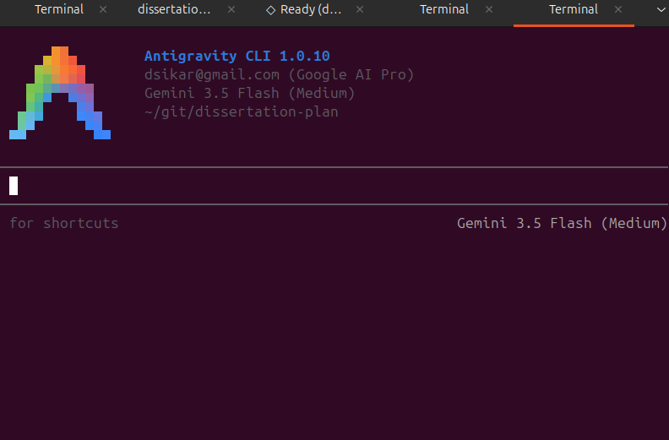
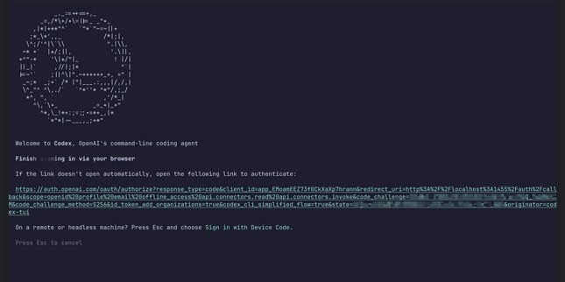
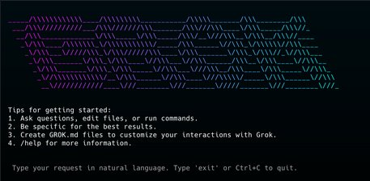
Lightning talk 10 | Daniel Sikar and Dave Muir
Agentic AI – 2025/2026
Provider | AI Agent
Anthropic | Claude Code
Google | Antigravity CLI
OpenAI | Codex
xAI | Grok CLI
Mistral | Mistral Vibe CLI
School of Science and Technology | Hackathons as a Medium for Disseminating Agentic AI in Research
AI Research Day | Lightning talks

Slide 6
Lightning talk 10 | Daniel Sikar and Dave Muir
AI Workflow <= 2024
Copilot Browser-based AI Chatbot
# Comment Prompt
Code Output
CTRL-C CTRL-V
Local file
School of Science and Technology | Hackathons as a Medium for Disseminating Agentic AI in Research
AI Research Day | Lightning talks

Slide 7
Lightning talk 10 | Daniel Sikar and Dave Muir
Agentic AI Workflow >= 2024
Actions
Literature Survey, Experiment Design, Execution, Evaluation, Write-up
Context/Planning
Queues e.g. FIFO, prompt history, log, memory
Tools
Semantic Scholar/ArXiv API/MCP Python/Bash Latex
Safety Net
Regex, grep – check GenAI/LLM text/string exist in source
Agent Agnostic
Well established workflow that works with any provider
Coder becomes Manager (Industry trend)
Directs agents to write, queue and execute prompts
School of Science and Technology | Hackathons as a Medium for Disseminating Agentic AI in Research
AI Research Day | Lightning talks

Slide 8
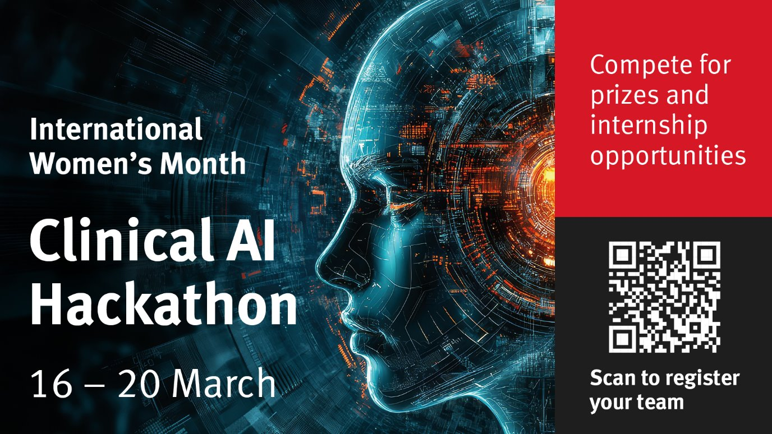

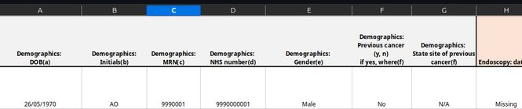

Lightning talk 10 | Daniel Sikar and Dave Muir
Case Study – Clinical AI Hackathon
Delivered in collaboration with the St George’s Hospital Imaging Research Group
MOD/NHS Clinical pain point
Structure semi-structured medical notes
Training and baseline solution provided
To be improved, with the use of AI Agents, by participating teams
Numbers
76 sign-ups (majority PG), 32 finalists, 9 teams
Outcomes
Generated two research placements at St George's NHS Foundation Trust
School of Science and Technology | Hackathons as a Medium for Disseminating Agentic AI in Research
AI Research Day | Lightning talks

Slide 9
Lightning talk 10 | Daniel Sikar and Dave Muir
Research Projects at St George's NHS Foundation Trust
Monitoring AI for Performance Drift: Developing an independent quality assurance framework to identify when radiology AI performance changes over time, enabling early detection of reliability issues in clinical practice.
Evaluating Subgroup Bias: Developing an independent assessment framework to identify whether radiology AI performs differently across patient groups, supporting fair, safe, and accountable clinical deployment.
School of Science and Technology | Hackathons as a Medium for Disseminating Agentic AI in Research
AI Research Day | Lightning talks

Slide 10
Lightning talk 10 | Daniel Sikar and Dave Muir
Clinical AI Hackathon – Lessons learnt
Healthcare is highly-regulated
Solutions are much easier to write than to deploy (certification)
Solutions inspired higher trust in Generative AI
Clinicians confident enough to agree on further deployment of Agentic AI in research
The sky is the limit
"I think entrepreneurs should be more ambitious about the problems they're going after. If the AI capability you need doesn't exist today, there's a reasonable chance it will in three to six months. So the limiting factor really shouldn't be what the technology can do right now."
Dario Amodei
School of Science and Technology | Hackathons as a Medium for Disseminating Agentic AI in Research
AI Research Day | Lightning talks

Slide 11
Scaling Hackathons Across Disciplines and Domains for Research
Hackathons build skills
CSG University of Practice
AI upskilling, rapid fast
Inline with Worldskills Pressure Test approach.
Solutions been tested, Industry standards leading to Research, Data
Join us in quest to keep up with pace of AI change
So far Clinical, Electrical, next …..

Slide 12
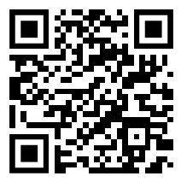
Lightning talk 10 | Daniel Sikar and Dave Muir
What happens next​
ElectroAI Hackathon
City St George's, University of London 07-10.04.2026
British Computer Society-backed AI Levelling-up Hackathon
City St George's, University of London 30.06-01.07.2026
Learning at City St George’s Conference 2026 – Snap Circuits Workshop
City St George's, University of London 30.06.2026
Slides, contacts
Please scan QR code or visit
https://github.com/dsikar/csg-ai-research-day-2026
School of Science and Technology | Hackathons as a Medium for Disseminating Agentic AI in Research
AI Research Day | Lightning talks

