Slide 1

Face Recognition In The Wild
Brought to you by:
Data Science Society
City, University of London
Daniel Sikar
MSc Data Science – PT2
© Data Science Society, City, University of London
Notes:
Welcome to the Face Recognition In the Wild Workshop, brought to you by City’s Data Science Society and me, Daniel Sikar a year two MSc Data Science Student.
So could we have a quick show of hands, are there any students here today currently enrolled in courses offered by the School of Mathematics, Computer Science and Engineering?
And anyone not from STEM disciplines?
Ok, just to get an idea and maybe adapt and filter the jargon.
So this session is about my learning experience here at City so far, and trying to apply the theory to practice, by deploying computer vision to an actual device, face recognition being my “Hello World”

Slide 2
What we will cover
Computer Vision deployment – demo
Motivation
The hardware
Face recognition algorithms
Training a model
Another demo
Ethical issues
Questions
Notes:
In the programme today, what we will cover.
First a quick demo of a working system.
Then my motivation for getting involved with computer vision.
The hardware, what you would need to build a similar system of your own.
Some of the algorithms that are out there, and what we will be using here.
Training a so called “model” to recognise faces
Another demonstration, with the new trained model.
Ethical issues with computer vision in public spaces.
And a Q a A session. So let’s get started.

Slide 3
DEMONSTRATION
Computer Vision/Face Recognition algorithm running an a Linux embedded device
Notes:
We’ll switch over to our embedded device.
The engine has been warmed up and is running, so I point the camera to myself, wait for a few seconds, as it is a resource-limited environment and the latency is quite high. There might be ways of optimising it, but I am not at that stage yet. So it works out there is a face, puts a rectangle around it and labels it as a known name, it case it is close enough to a known pattern, or unknown, if it is not.
So this is my “Hello World”, the first time I have actually deployed computer vision to a device. I have done some already here at City, by the way.

Slide 4
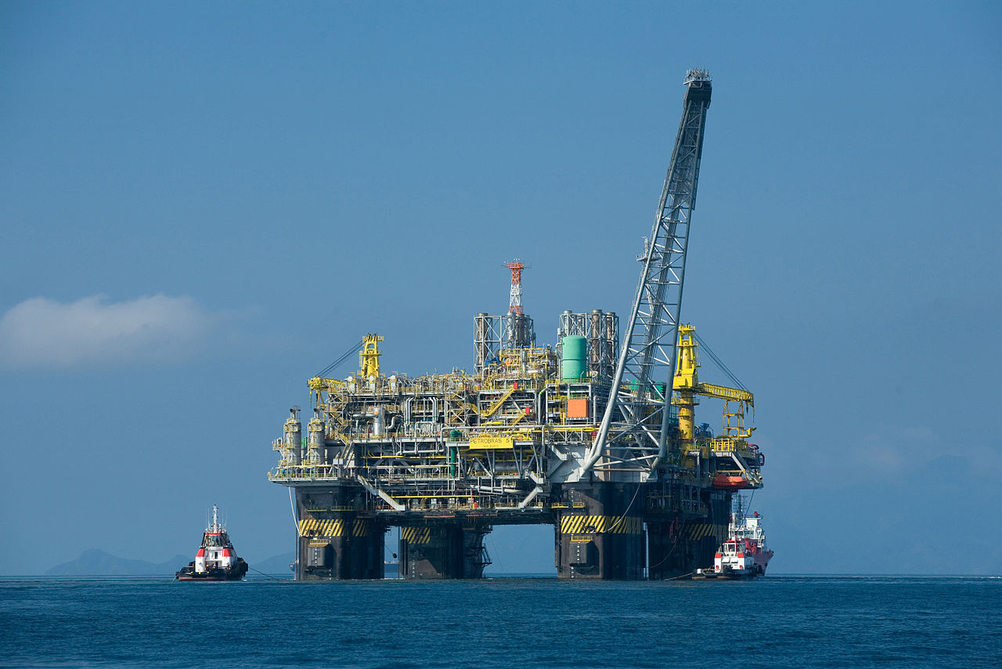
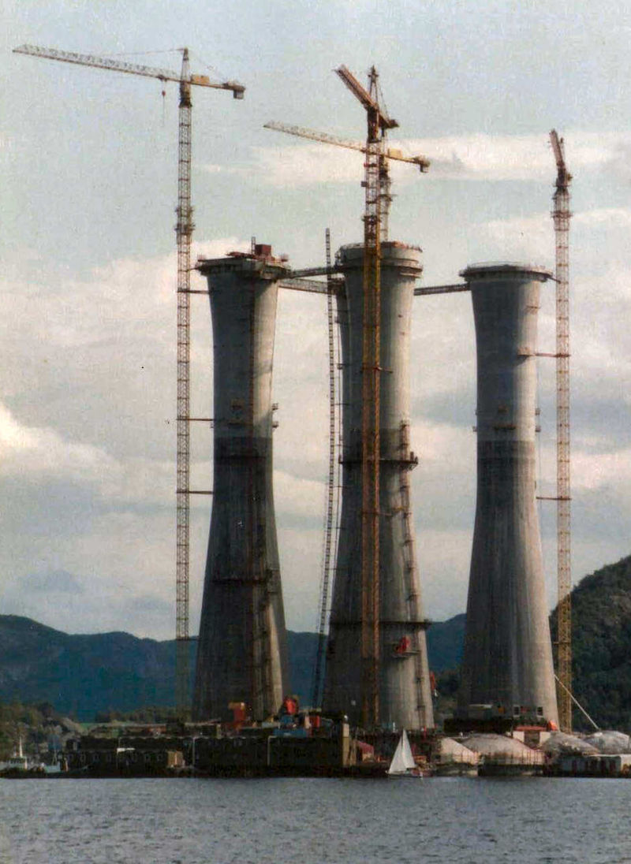
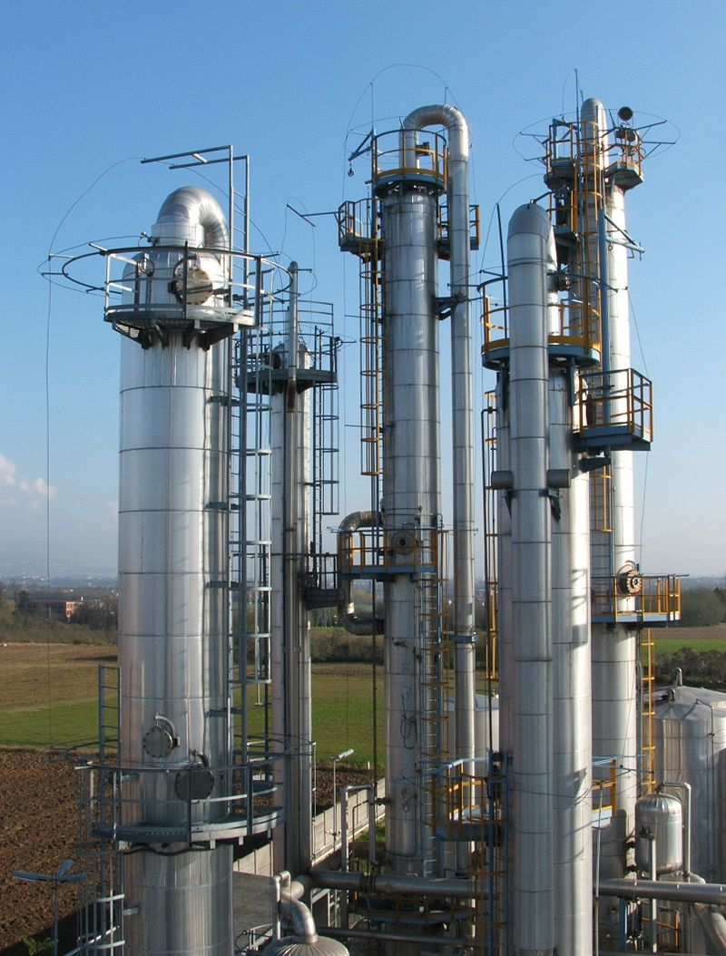
Motivation
Apply computer vision to flame detectors in hazardous areas
https://en.wikipedia.org/
Notes:
I am a part-time student here at City, I work the rest of the time as an embedded software developer. The main product I work on, develop and maintain is embedded software for flame detectors in hazardous environments such as oil and gas rigs, chemical plants and refineries. So, some of the motivating factors for learning about computer vision are applying it in my day to day job. By the way, I’ve never been to these places.

Slide 5
Motivation
Harnessing computer vision for
Flame detectors
Signal processing
Move away from (or have the option to):
“Rules-based” programming
Thresholds
Counts
Exceptions to the rules
Notes:
So I am going to talk a little bit about me attempting this transition from rules-based computing to using machine-learning models.
So what does that mean. The “traditional way” in quotes, to develop software is you have a set of rules that come from a product specification, and describe how the product should work.
Then we, as software developers, implement those rules. And typically, that could turn into a bunch of if then statements, for loops, counts and so forth.

Slide 6
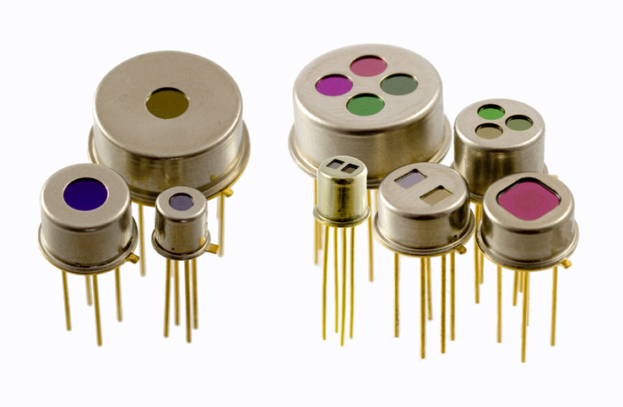
Motivation
What I use at the moment - Pyroelectric sensors
https://upload.wikimedia.org/wikipedia/commons/b/b9/Pyroelectric_detectors_from_InfraTec.jpg
Notes:
So I am going to talk a little bit about me attempting this transition from rules-based computing to using machine-learning models.
So what does that mean. The “traditional way” in quotes, to develop software is you have a set of rules that come from a product specification, and describe how the product should work.
Then we, as software developers, implement those rules. And typically, that could turn into a bunch of if then statements, for loops, counts and so forth.

Slide 7
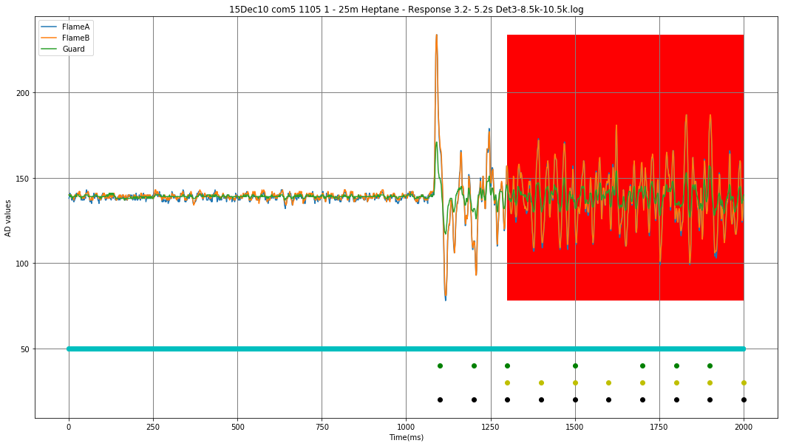
Detecting a flame – the traditional way
© Data Science Society, City, University of London
Notes:
What we are seeing here is a plot with three signal, two from the pyroelectric sensors set to detect flame. Those are the blue and orange traces, and one pyroelectric sensor set to detect so called black body heat sources, such as a red hot wire you would find in an infrared heater.
By the way

Slide 8
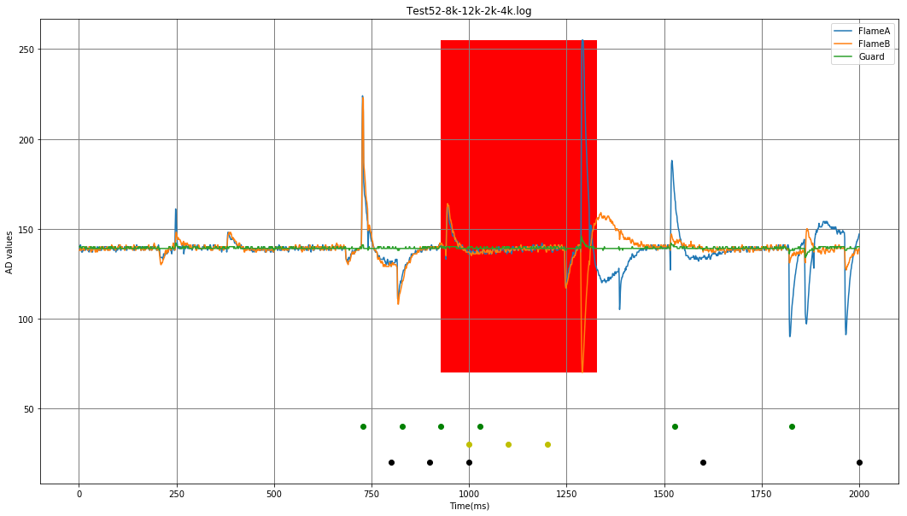
Detecting a flame – false alarm (EMI)
© Data Science Society, City, University of London
Notes:
What we are seeing here is a plot with three signal, two from the pyroelectric sensors set to detect flame. Those are the blue and orange traces, and one pyroelectric sensor set to detect so called black body heat sources, such as a red hot wire you would find in an infrared heater.
By the way

Slide 9
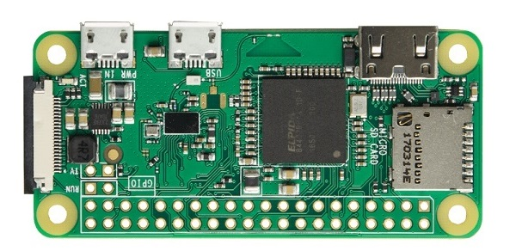
Raspberry Pi Zero W
Notes:
So this is the Rpi Zero W,
Broadcom 1GHz single-core CPU
512 MB RAM
Integrated Graphics Cards
802.11bng wireless
Bluetooth 4.1
CSI (camera serial interface) camera connector

Slide 10

Raspberry Pi Zero W – Memory Card
Notes:
So this is the Rpi Zero W,
Broadcom 1GHz single-core CPU
512 MB RAM
Integrated Graphics Cards
802.11bng wireless
Bluetooth 4.1
CSI (camera serial interface) camera connector

Slide 11
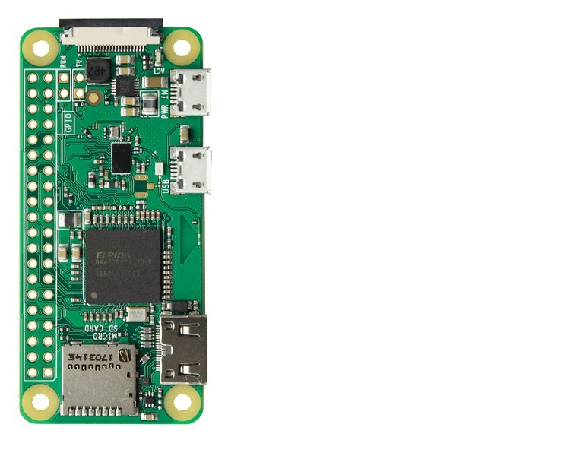
Raspberry Pi Zero W - Connections 1

Slide 12
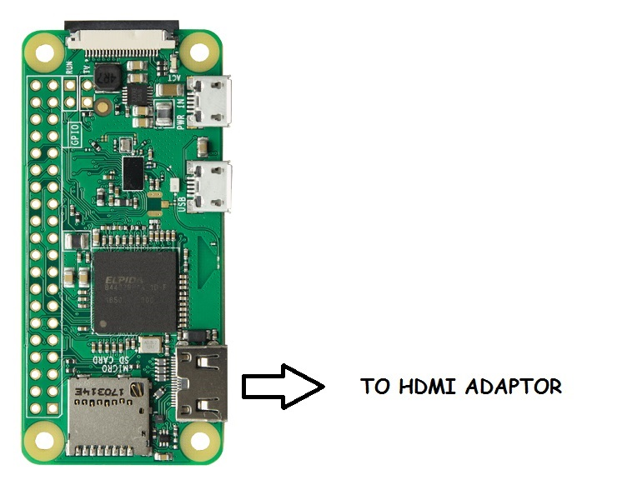
Raspberry Pi Zero W - Connections 1

Slide 13
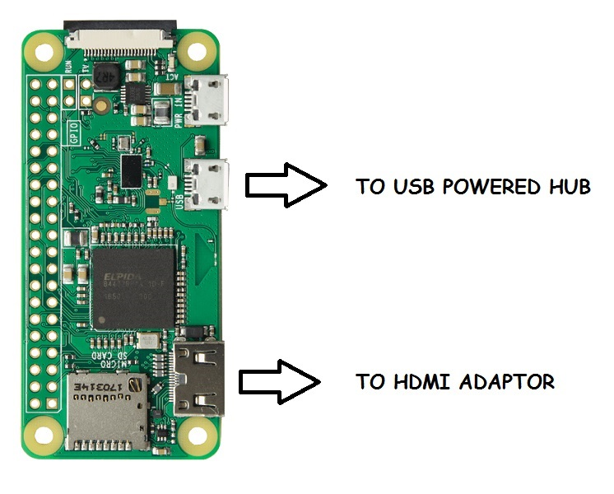
Raspberry Pi Zero W - Connections 1

Slide 14
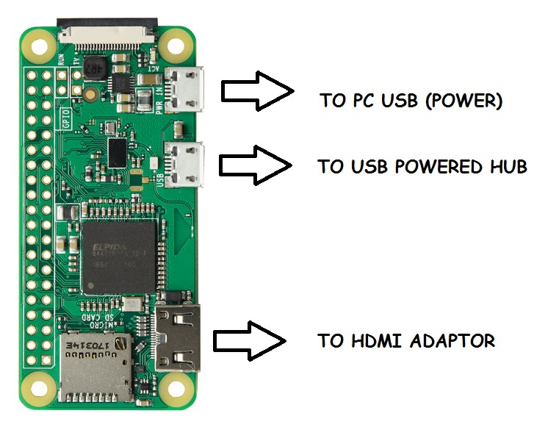
Raspberry Pi Zero W - Connections 1

Slide 15
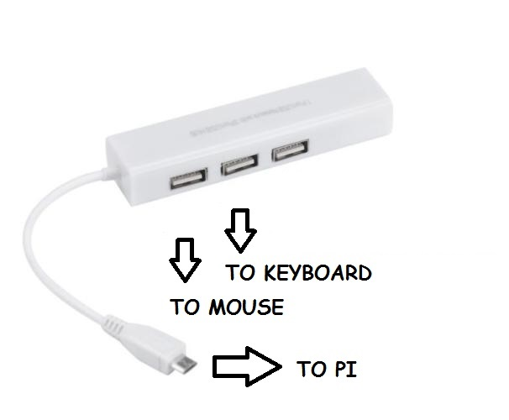
Raspberry Pi Zero W - Connections 2

Slide 16
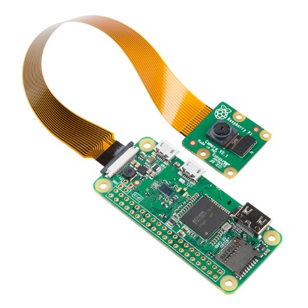
Raspberry Pi Zero W - Connections 3

Slide 17
Inside the box – getting this thing to work 1
Install
Libraries
Models
Training
Running

Slide 18
Computer Vision / Machine Learning
Training the model
5 photos

Slide 19
How do we implement such a system?
Hardware BOM
Software

Slide 20
Computer Vision - Ethical Aspects
Long Term Care
Who is making the decision?
Inferring gender, sexual orientation, ethnicity, age
Privacy?
arXiv:1905.12487

Slide 21
Computer Vision - Ethical Aspects
Part of the broader discussion of the Ethics of Artificial Intelligence
Ethical research
How “transparent” is the algorithm - explainability
Can decision-making be delegated to intelligent machines?
Do algorithms discriminate?
Notes:
About explainability, that’s a hot topic in Machine Learning today, judging by my modules so far. Ethics is much talked about.

Slide 22
Computer Vision - Ethical Aspects - @ City
Department of Computer Science – Research Ethics Review Form: Bsc, MSc and MA projects
Part A: Establishes the kind of approval that is required
Part B: Allows fully documented projects that are identified as being of of MINIMAL risk through Part A to be approved, either provisionally or fully
Failure to obtain approval for research that requires it would mean that you were not covered by the University's indemnity. It would result likely in you failing your project and may result in disciplinary action.
Notes:
We, as Department of Computer Science post-graduate students, must operate within the University’s Research Ethics Framework. Final year projects need to comply. Failure to obtain approval for research that requires it means that you will not be covered by the University’s indeminity. Likely to result in you failing your project and may result in disciplinary action.
Then we need to submit, together with our project proposal which will become our dissertation, a Research Ethics Review Form, to establish the kind of approval required for the project.

Slide 23
Research Ethics Review Form: Questions (A)
Will you recruit participants who fall under the auspices of the Mental Capacity Act?
Will you recruit any participants who are currently under the auspices of the Criminal Justice System
Does your project involve participants disclosing information about special category or sensitive subjects?
Does your research involve adults who are vulnerable because of their social, psychological or medical circumstances (vulnerable adults)?
Notes:
Let’s see what this form looks like, what kind of (YES/NO) questions you need to answer.
So these are some of the questions one would find in the Research Ethics Review Form, Part A:
Mental Capacity Act: Such research needs to be approved by an external ethics committee such as NRES or the Social Care Research Ethics Committee - http://www.scie.org.uk/research/ethics-committee/
Criminal Justice System: Such research needs to be authorised by the ethics approval system of the National Offender Management Service.
Disclosing information: For example, but not limited to: racial or ethnic origin; political opinions; religious beliefs; trade union membership; physical or mental health; sexual life; criminal offences and proceedings
This includes adults with cognitive and / or learning disabilities, adults with physical disabilities and older people.

Slide 24
Research Ethics Review Form: Questions (B)
Will you ensure that participants taking part in your project are fully informed about the purpose of the research?
Will consent be obtained from the participants in your project?
Have you made arrangements to ensure that material and/or private information obtained from or about the participating individuals will remain confidential?
Notes:
And some of the question from part B, the Ethics Proportionate Review Form, based on answers to Part A, so you might not need to complete this part, depending on nature of research:
Consent: must attach drafts of the participant information sheet(s) and consent form(s)

Slide 25
Computer Vision - Ethical Aspects - @ City
How “transparent” is the algorithm – explainability
Anna Annissimova – MSc Data Science 2018/2019
Dissertation – medical imaging
Less accurate and more explainable classifiers chosen over more accurate and less explainable classifiers
Notes:
So Anna is one of the full-time students that started in the same year as me. She did her final year dissertation based around medical imaging. Now computer vision is an area where a lot of research is happening and we see this by the number of papers submitted to conferences, and their content. So there are competitions such as ImageNet - Large Scale Visual Recognition Challenge. So let’s look at these highly accurate image classifiers…

Slide 26
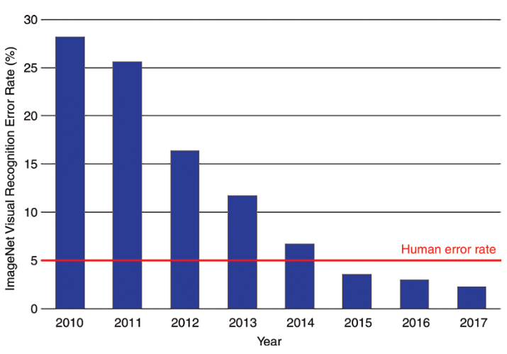
ImageNet Large Scale Visual Recognition Challenge
https://www.researchgate.net/figure/Error-rates-on-the-ImageNet-Large-Scale-Visual-Recognition-Challenge-Accuracy_fig1_332452649
Notes:
So we can see that based on the error rates from the ImageNet Challenge, from 2015, this specific type of algorithm, called a Neural Network, from 2015 can classify images better than humans.

Slide 27
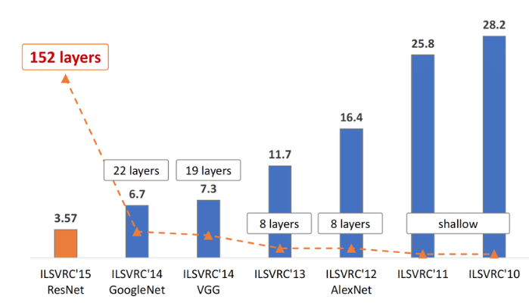
ImageNet Large Scale Visual Recognition Challenge
https://www.researchgate.net/figure/The-evolution-of-the-winning-entries-on-the-ImageNet-Large-Scale-Visual-Recognition_fig1_321896881
Notes:
If we look at the evolution of the winning entries from 2010 to 2015, so called Convolutional Neural Networks have outperformed hand-crafted descriptors and shallow networks by a large margin.

Slide 28
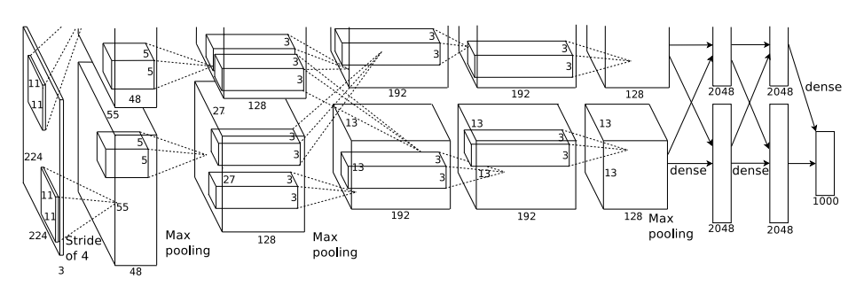
AlexNet architeture
https://papers.nips.cc/paper/4824-imagenet-classification-with-deep-convolutional-neural-networks.pdf
Notes:
So this is the architecture of the 2012 ImageNet Challenge winner, the AlexNet convolutional neural network, which is a so called deep network, with many so-called hidden layers. For further details please refer to the original paper. Suffice to say the network has 60 million parameters, nine layers and the images are being filters up till the sixth layer with so called convolutions, so an operation with two vectors where you convolve a filter with the signal, which in this case is the image. So somehow, the decision to label a cat, a cat, and a dog, a dog, somehow that decision is encoded in the middle of a model that was trained using this network.

Slide 29

Support Vector Machine
https://www.javatpoint.com/machine-learning-support-vector-machine-algorithm
Notes:
Now let’s look at another classifier known as a Support Vector Machine or SVM. In this case it is a binary classifier and can only distinguish between two classes. So let’s say our green dots are our cats and our blue squares are our dogs. Let’s just look at the dividing line and try to work out what kind of equation would represent that line, and let’s say that equation is y = -x + 5, so the slope is equal to -1 and the intercept on the y axis is 5, and that x (x1) represents weight and y (x2) represents height.
If we put this equation in the form x + y – 5 = 0, and plug in, say values 1 for x and 1 for y, we can -3 which is less than zero, so that tells us if the creature weights 1 unit of weight and if one using of height tall, than our classifier says that creature is a cat. Now if we plug in say, x = 3 and y = 5, the result is positive 1, which is greater than zero, so our classifier says that creature is a dog, and that would be a crude comparison (because with the previous neural network we are dealing with images) but a start in the discussion about explainability, and that the SVM classifier is explainable, because we can explain how the decision was made, whereas with the CNN, is it harder to make that kind of statement.
So in the case of medical imaging, where you want to be able to say why your classifier is making a decision, maybe that is the choice you, like Anna, will have to make.
Ok, so that’s a brief discussion on explainability, next, more ethical aspects…

Slide 30
Computer Vision - Ethical Aspects
Who is making the decision?
Ethical implications around user perceptions of trust in the underlying technology should be considered and supported
Long Term Care Sector (caring for the elderly)
Computer Vision system for tracking resident food and fluid intake
Decision making rests with humans
The tracking system is a decision-making aid
arXiv:1905.12487
Notes:
So these bullet points are based on the arquive X article quoted here, “Food for thought: Ethical considerations of user trust in computer vision”
In Canada, food and fluid intake tracking are mandated in LTC for those at risk for malnutrition. Existing methods rely on restrospective methods, so you look at someone and figure out if that person has been eating enough and is well hydrated. So the idea is to harness computer vision, using techniques such as image segmentation, and try to work out what the intake was like.
So the authors of this study emphasize that “it must be clear that decision making rests with humans and reinforce that the AFINI-T system is a decision-making aid.”

Slide 31
Do algorithms discriminate?
Notes:
So the final topic from our bullet points, do algorithms discriminate – quick show of hands, how many people here believe the algorithms, these decision making processes being made by computers, using some form of machine learning, which is turn falls under Artificial Intelligence, do these algorithms discriminate?
Now what could these fabled algorithms be doing, in those cold data centres, processing all our personal data and making decisions about mortgages, loans, health insurance, credit rating, risk, etc. It’s a bit crazy what is going on, specially when we talk about big data, and the amount of our data that the internet giants hold, and are able to cross-reference, to make inferences about us, who we are and how we behave.

Slide 33
Closing remarks
Bringing a product to market (regulated vs. unregulated)
Questions ???
Contact details
Thank you!

