Slide 1

Face Recognition In The Wild
Brought to you by:
Data Science Society
City, University of London
Daniel Sikar
MSc Data Science – PT2
Notes:
Welcome to the Face Recognition In the Wild Workshop, brought to you by City’s Data Science Society and me, Daniel Sikar a year two MSc Data Science Student.
So Jacob, Nik, Ben, would you like to say a word or two about the Society?
Thanks. And about me…

Slide 2
What we will cover
Computer Vision deployment – demo
Motivation
The hardware
Face recognition algorithms
Training a model
Another demo
Ethical issues
Questions
Notes:
In the programme today, what we will cover.
First a quick demo of a working system.
Then my motivation for getting involved with computer vision.
The hardware, what you would need to build a similar system of your own.
Some of the algorithms that are out there, and what we will be using here.
Training a so called “model” to recognise faces
Another demonstration, with the new trained model.
Ethical issues with computer vision in public spaces.
And a Q a A session. So let’s get started.

Slide 3
Why computer vision?
Cases
Quick demo

Slide 4
My take
Flame detectors
Signal processing
“Rules-based”
Thresholds
Counts
Exceptions to the rule (e.g. 5G interference)
Notes:
So I am going to talk a little bit about my transition from rules-based computing to using machine-learning models.
So what does that mean. The “traditional way” in quotes, to develop software is you have a set of rules that come from a product specification, and describe how the product should work.
Then we, as software developers, implement those rules. And typically, that could turn into a bunch of if then statements.

Slide 5
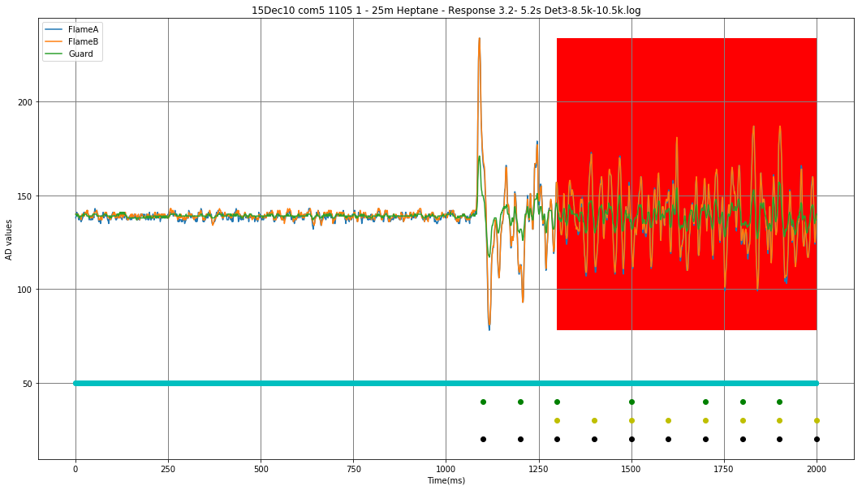
Detecting a flame – the traditional way
Notes:
What we are seeing here is a plot with three signal, two from the pyroelectric sensors set to detect flame. Those are the blue and orange traces, and one pyroelectric sensor set to detect so called black body heat sources, such as a red hot wire you would find in an infrared heater.
By the way

Slide 6
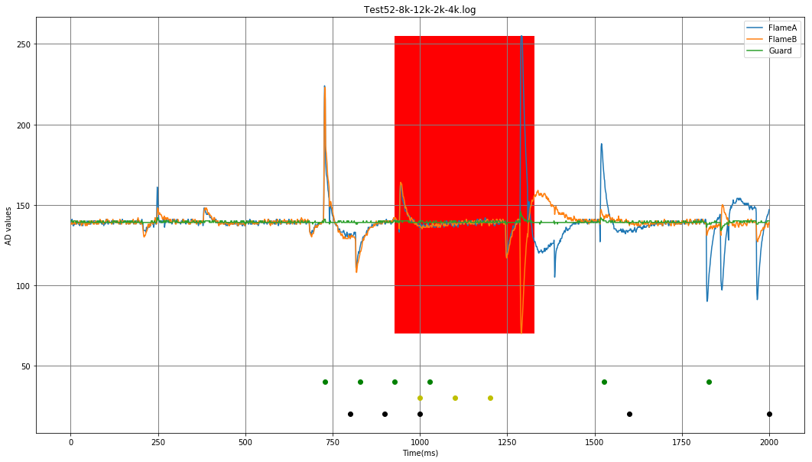
Detecting a flame – false alarm (EMI)
Notes:
What we are seeing here is a plot with three signal, two from the pyroelectric sensors set to detect flame. Those are the blue and orange traces, and one pyroelectric sensor set to detect so called black body heat sources, such as a red hot wire you would find in an infrared heater.
By the way

Slide 7
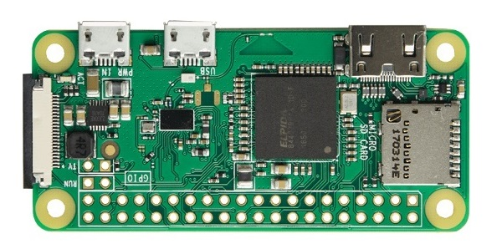
Raspberry Pi Zero W
Notes:
So this is the Rpi Zero W,
Broadcom 1GHz single-core CPU
512 MB RAM
Integrated Graphics Cards
802.11bng wireless
Bluetooth 4.1
CSI (camera serial interface) camera connector

Slide 8
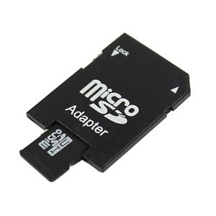
Raspberry Pi Zero W – Memory Card
Notes:
So this is the Rpi Zero W,
Broadcom 1GHz single-core CPU
512 MB RAM
Integrated Graphics Cards
802.11bng wireless
Bluetooth 4.1
CSI (camera serial interface) camera connector

Slide 9
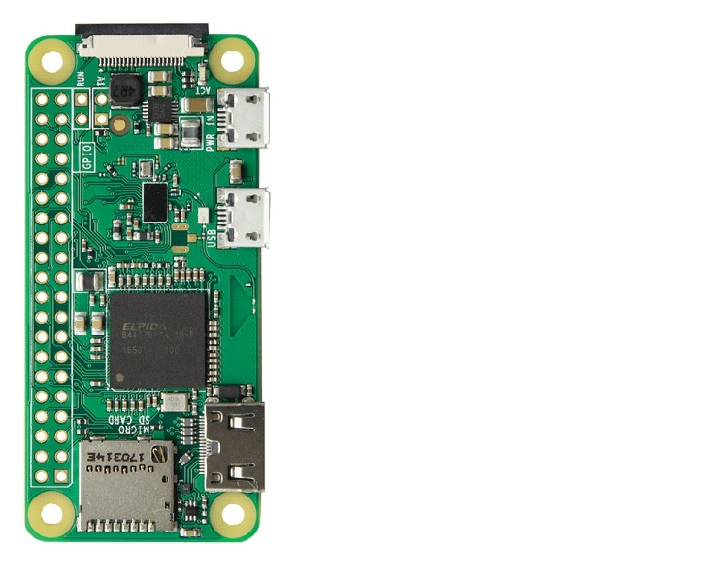
Raspberry Pi Zero W - Connections 1

Slide 10
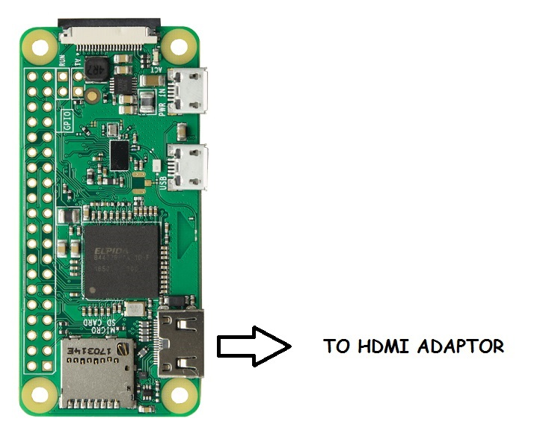
Raspberry Pi Zero W - Connections 1

Slide 11
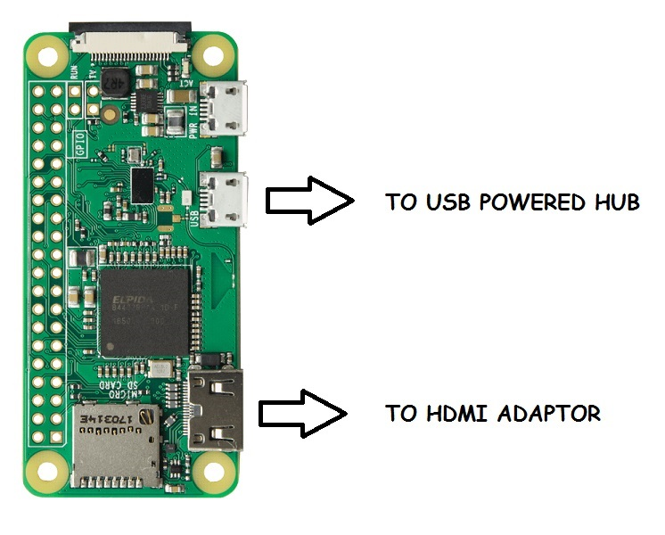
Raspberry Pi Zero W - Connections 1

Slide 12
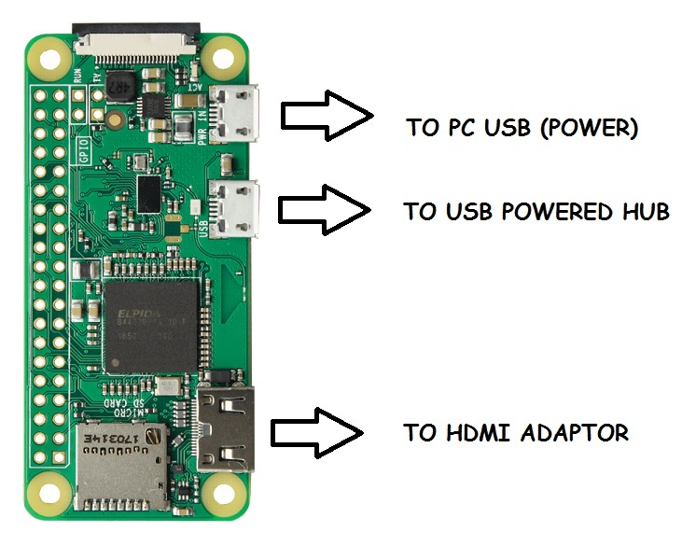
Raspberry Pi Zero W - Connections 1

Slide 13
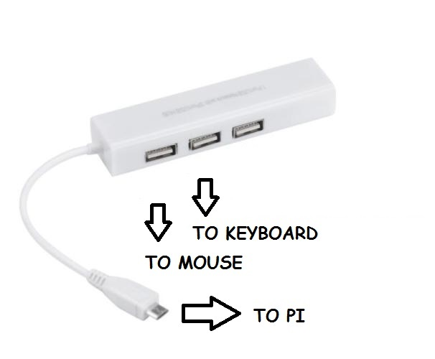
Raspberry Pi Zero W - Connections 2

Slide 14
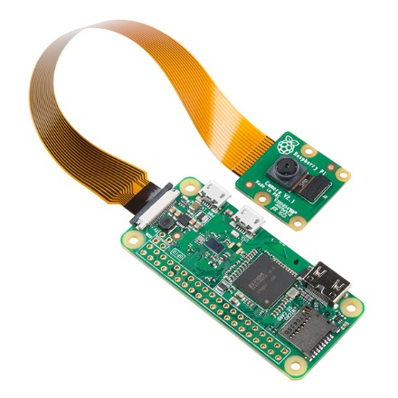
Raspberry Pi Zero W - Connections 3

Slide 15
Inside the box – getting this thing to work 1
Install
Libraries
Models
Training
Running

Slide 16
Computer Vision / Machine Learning
Challenges (low power)

Slide 17
How do we implement such a system?
Hardware BOM
Software

Slide 18
Ethical Aspects
Long Term Care
How is making the decision?
Inferring gender, sexual orientation, ethnicity, age
Privacy?

Slide 19
Closing remarks
Bringing a product to market (regulated vs. unregulated)
Questions ???
Contact details
Thank you!

