Slide 1
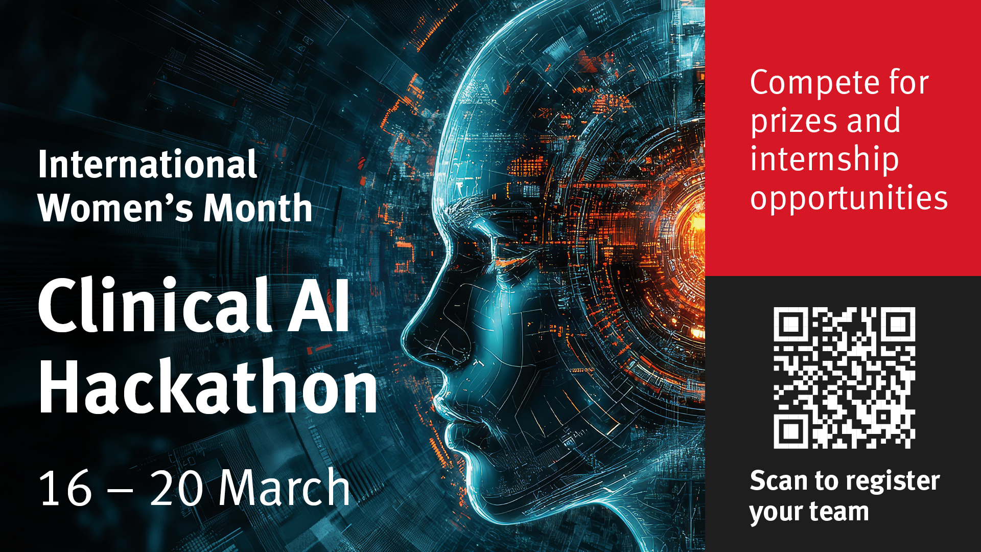
CLINICAL AI HACKATHON

Slide 2
02
CLINICAL AI HACKATHON
-
City St George's University of London
-
16-20 March 2026
-
74 signed up
-
32 finalists - 8 teams
-
Majority MSc students
-
20 March coincided with Eid - a poor date choice
CLINICAL AI HACKATHON / 16-20 MARCH 2026

Slide 3
03
REAL-WORLD PROBLEM
-
Set by MOD and NHS clinicians
-
50 synthetic MDT records provided by the NHS
-
Multidisciplinary Team (MDT) discussions record cancer-treatment decisions in unstructured documents
-
Task: extract patient history and decisions into an Excel row to inform the next step in treatment
CLINICAL AI HACKATHON / 16-20 MARCH 2026

Slide 4
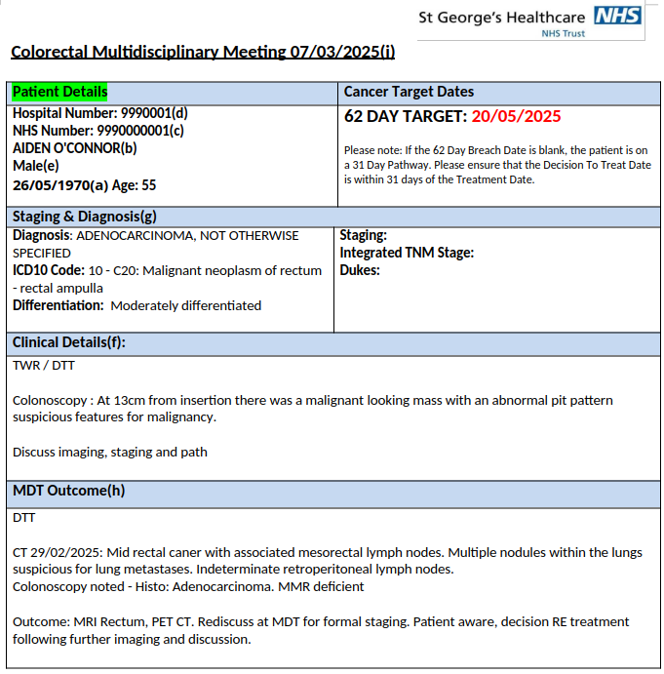
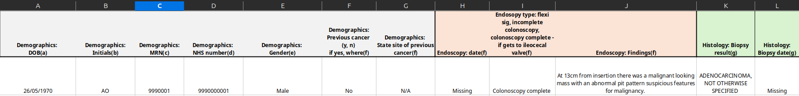
04
THE CHALLENGE: SOURCE AND OUTPUT
MDT RECORD
EXCEL OUTPUT ROW
CLINICAL AI HACKATHON / 16-20 MARCH 2026

Slide 5
05
REAL-WORLD PROBLEM, CONTINUED
-
Success criterion: the spreadsheet accurately reflects the history in the source MDT documents; unknown fields remain empty
-
Winning categories: Best solution, Best understanding, Overall winner
-
The strongest work combined technical implementation with understanding of clinical context
CLINICAL AI HACKATHON / 16-20 MARCH 2026

Slide 6
06
LESSONS LEARNT
-
Best results came from teams that used AI agents effectively: Gemini, Claude Code and Codex
-
For non-subscribers, the best experience relied on the free Gemini student subscription; this was no longer available in October 2026
-
The solution is easier to build than to deploy: NHS deployment requires consideration of DTAC and DCB0129/DCB0160
-
A practical solution less dependent on regulation may have greater immediate value for the NHS
CLINICAL AI HACKATHON / 16-20 MARCH 2026

Slide 7

07
CLINICAL AI HACKATHON
THANK YOU
QUESTIONS?
daniel.sikar@citystgeorges.ac.uk
sevinj.teymurova@citystgeorges.ac.uk
teymurs@richmond.ac.uk
CLINICAL AI HACKATHON / 16-20 MARCH 2026

