Slide 1
Announcements Monday 9/16
Problem Set 2 due Wed 9/18 in class.
Lab tomorrow in Dana 325—Model fitting & Discussion of Big Necessity.
Trying to figure out a time to have Dr. Heavner’s visit.
Problem Set 1

Slide 2
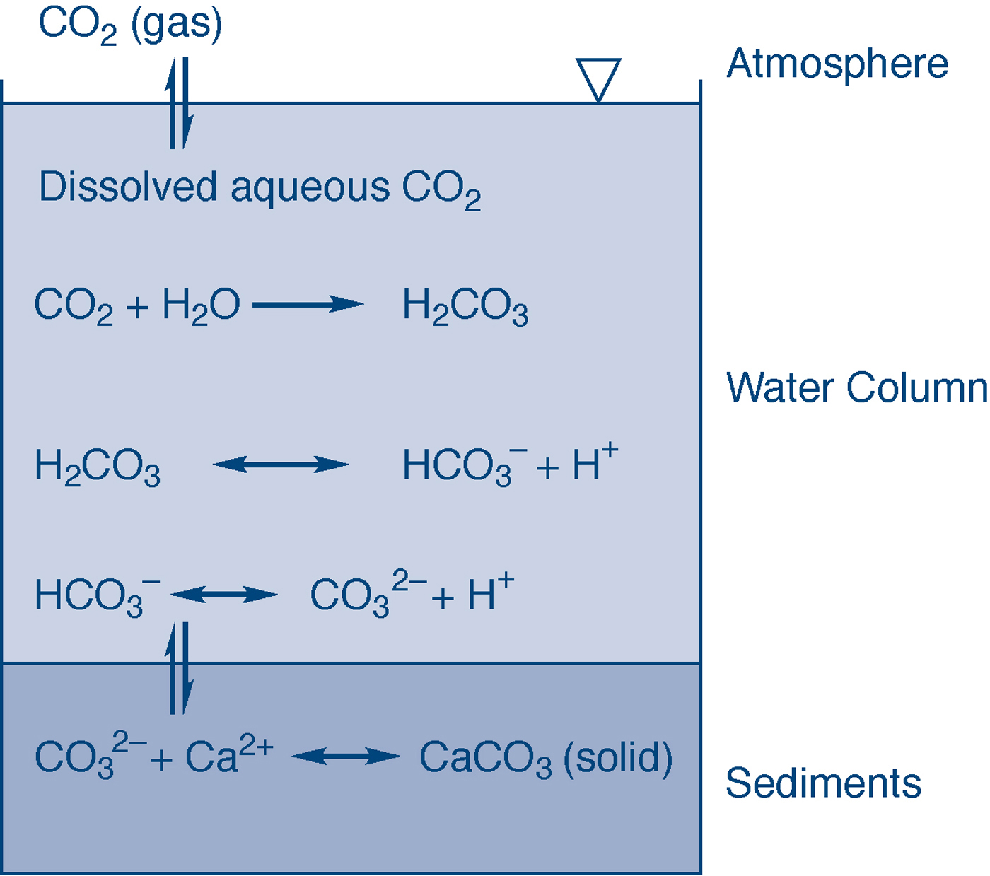
fig_03_06
fig_03_06

