Slide 1
Announcements Wednesday 9/18
Problem Set 3 posted; due Wed 9/25 in class.
Graded PSets in mailboxes
Will announce time(s) for meeting with Dr. Heavner on Friday. Please fill out Doodle Poll if you haven’t.
Midterm course evaluations on Monday

Slide 2
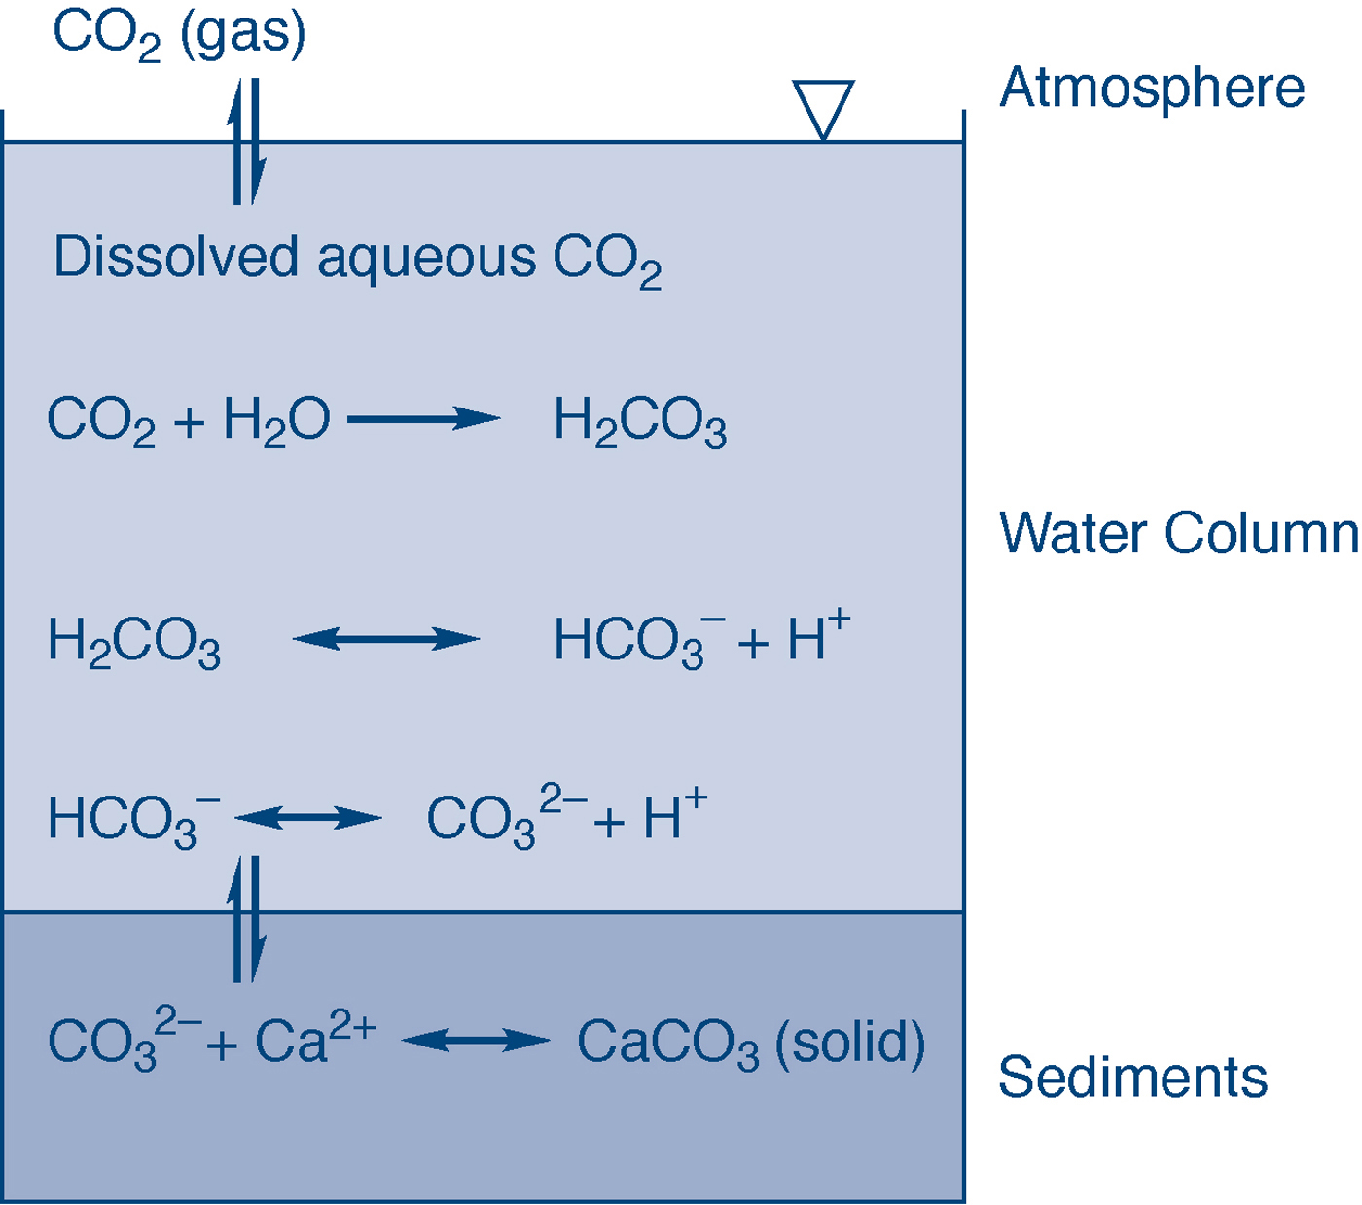
fig_03_06
Acid-Base
Carbonate System
fig_03_06

Slide 3
Alkalinity
Alkalinity (eq/L) = [HCO₃⁻] + 2[CO₃²⁻] + [OH⁻] – [H⁺],
where [ ] refer to concentrations in moles/L
Alkalinity is the ability of a water to neutralize acid.
In most waters, only carbonate species contribute signinficantly
Between pH 6 to 8, primarily [HCO₃⁻]

