Slide 1
Announcements Mon 11/25
Individual Lab Reports due Tuesday by 5pm. Only use your data.
Compare BOD values you obtained to “typical values” presented in the table in the first lab handout (“Lab 10” folder on Moodle)

Slide 2
Announcements cont.
Field Trip to a Solid Waste Management Facility tomorrow: only 8am and 10am.
Final two labs: Role Playing: handout to start reading. I’ll email you your roles tonight.

Slide 3
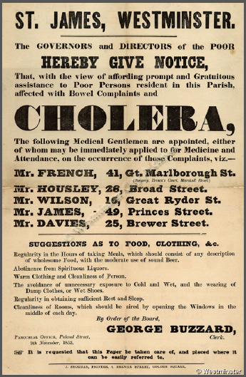
London 1854: Cesspits, Cholera and Conflict over the Broad St. Pump

Slide 4
Your Tasks over two class periods
Give a 1 to 2 minute speech introducing your character & “your” perspective on cholera
Debate and vote on removing the handle of the Broad St. pump.
Revise and amend language of the handbill
Achieve your secret objective

Slide 5
Next Tuesday—First Period
Introduction—Roberts Rules of Order
40 minutes of prep time in factions (anti-contagionists, contagionists, undecided.)
One hour of opening statements on the nature and origin of the disease outbreak

Slide 6
Cultural Competency
Ethnocentric Behavior is “characterized by the attitude that one’s own group is superior.”
What do we ask ourselves when we hear about a custom like open defecation, or work with a community to set up improved sanitation?
What experiences have you had when you’ve been judged for your culture based on generalizations and stereotypes?

