Slide 1
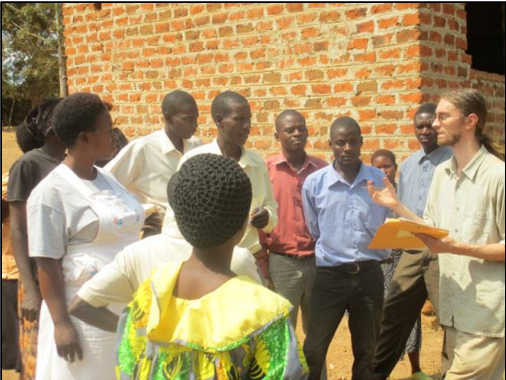
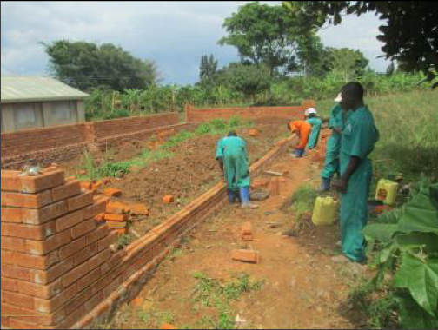
PEACE CORPS TALK!
Thursday, December 5
Noon, Dana 117
FREE PIZZA
JOHN TRIMMER, ‘10
Department of Civil and Environmental Engineering
Master’s International Program, USF
United States Peace Corps Volunteer
Kalisizo, Uganda
HOSTED BY ENGINEERS FOR SUSTAINABLE DEVELOPMENT & ASCE

Slide 2
Announcements
Problem Set due next Monday by 5pm
Quizz on Friday, coverage—this week’s lectures
Role Playing:
8am—Great Job—anticontagionists (Mr. Buzzard) leading,
10am– Mr. Downes is leading!!! But people are dying, and contagionists need to wake up,
1pm—Excellent job all factions: Mr. Snow will attend your board meeting

Slide 3
Role Playing Next Week
Present some kind of analysis of the data
Revise and amend language of the handbill
Achieve your secret objective
Debate and vote on removing the handle of the Broad St. pump.

Slide 4
Next Tuesday—First Period
Introduction—Roberts Rules of Order
40 minutes of prep time in factions (anti-contagionists, contagionists, undecided.)
One hour of opening statements on the nature and origin of the disease outbreak

