Slide 1
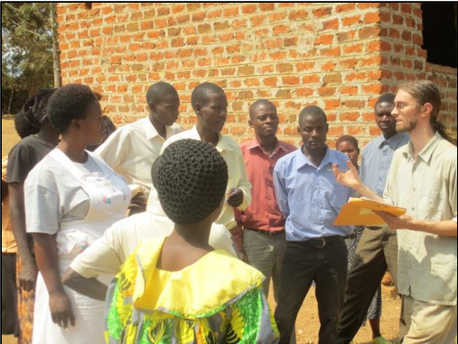
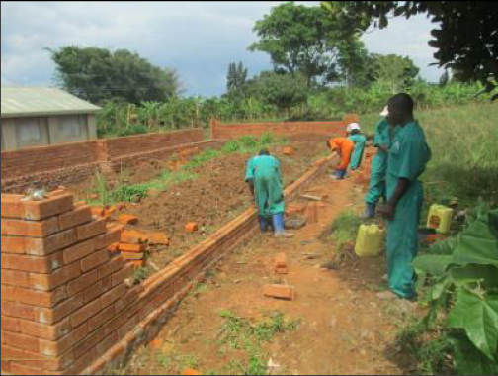
PEACE CORPS TALK!
Thursday, December 5
Noon, Dana 117
FREE PIZZA
JOHN TRIMMER, ‘10
Department of Civil and Environmental Engineering
Master’s International Program, USF
United States Peace Corps Volunteer
Kalisizo, Uganda
HOSTED BY ENGINEERS FOR SUSTAINABLE DEVELOPMENT & ASCE

Slide 2
Announcements
Problem Set 10 posted and due next Monday by 5pm
Quizz on Friday, coverage—this week’s lectures

Slide 3
Role Playing Objectives
Revise and amend language of the handbill
Debate and vote on removing the handle of the Broad St. pump.
Achieve your secret objective

Slide 4
Tuesday (tomorrow)—First Period of Role Playing
Introduction—Roberts Rules of Order
40 minutes of prep time in factions (anti-contagionists, contagionists, undecided.)
One hour of opening statements
Introduce your character
Discuss the the nature and origin of the disease outbreak
Discuss what should be down to address the cholera outbreak

