Slide 1
Announcements
Problem Set 4 due tomorrow afternoon (10/3).
Chemistry problem solving session tonight; Dana 134.
Problem Set 3 in your mail boxes—they look awesome!
Lab Reports almost done (today)—look good for the most part
Part I and Part 2—worth equal amounts. Lab3 grade is average of the two
In some cases, I made comments but took off only a few points
This will change and more points will be taken off as semester progresses

Slide 2
Announcements cont.
Exam next Wednesday 10/9. I am leaving town on Saturday:
My cell number: 607-277-5609; Skype: deborahsills
I am only very busy on Sunday and Wednesday
Please call me with questions.
I’ve added Office Hours which can be scheduled on Thursday and Friday
Created a Chemistry Guide Document--posted on website under “Exam Materials.”
Exam Blueprint finished and posted

Slide 3
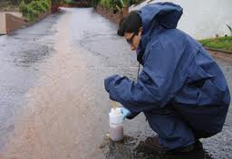
Gretchen Heavner:
Get a job, then go to grad school
As an engineer you will do a lot of writing
“Water chemistry is important for everything!”

