Slide 1
Exam
Mean: 79
Low: 41
High: 100

Slide 2
Announcements
Blog response due tonight
Next Pset due Oct. 23
Next Lab due Oct 22
Quizz next week on Friday—short reading quizz—reading for next week posted on website
Weekly quizzes on most Fridays from here on.

Slide 3
Rest of Course
Drinking Water Treatment--design
Biological aspect of natural water systems, and pollution--evaluation
Wastewater treatment--design
Risk assessment/Life Cycle Assessment– I hope.
Check out schedule on website

Slide 4
My Research
Life cycle assessment & economic modeling—current & need a student
Anaerobic sewage treatment—small scale for underserved communities—should be started by next semester.

Slide 5
Life Cycle Assessment of Biofuel Production from Algae
Deborah Sills
Bucknell University

Slide 6
Energy Return on Energy Invested (EROI) for Algal Biofuel
0
1
2
3
4
EROI (MJ biofuel produced per MJ input)

Slide 7
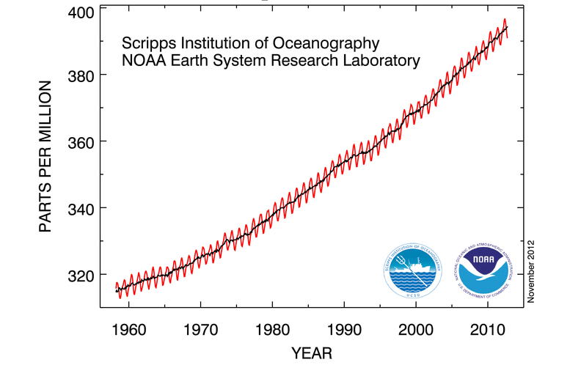
Atmospheric Concentrations of CO₂
Keeling et al., 2005

Slide 8
Why liquid fuels?
diesel
gasoline
lithium ion
ethanol
NiMH
propane
NiCd
lead acid
vanadium bromide
batteries
compressed air
vanadium redox
Slide prepared by Jeff Tester

Slide 9
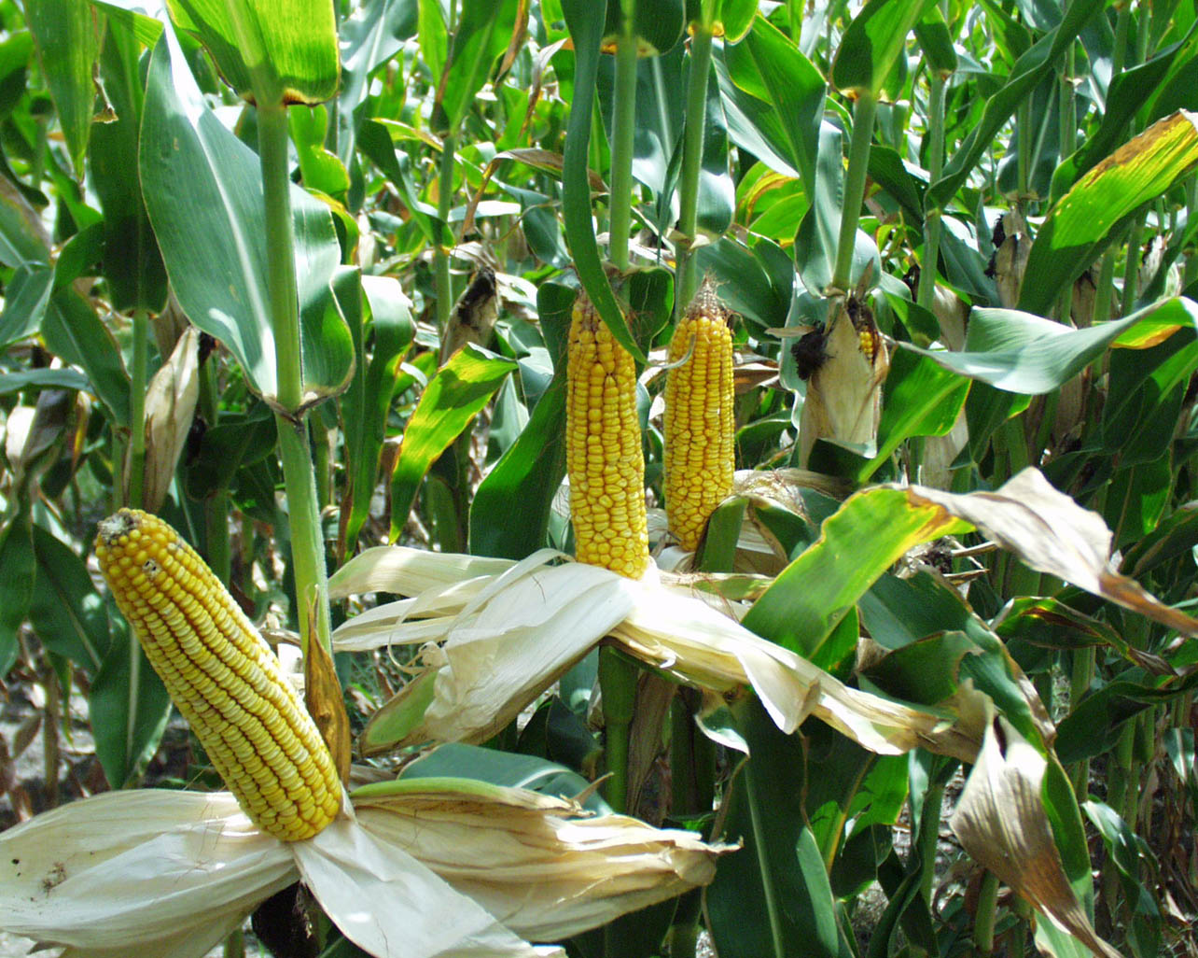
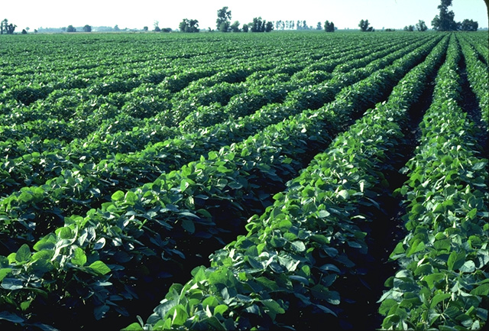
Feedstocks for Liquid Biofuels First Generation
Notes:
US uses 140 billion gallons gasoline, 40 billion gallons road diesel, 20 billinon gallons jet fuel

Slide 10
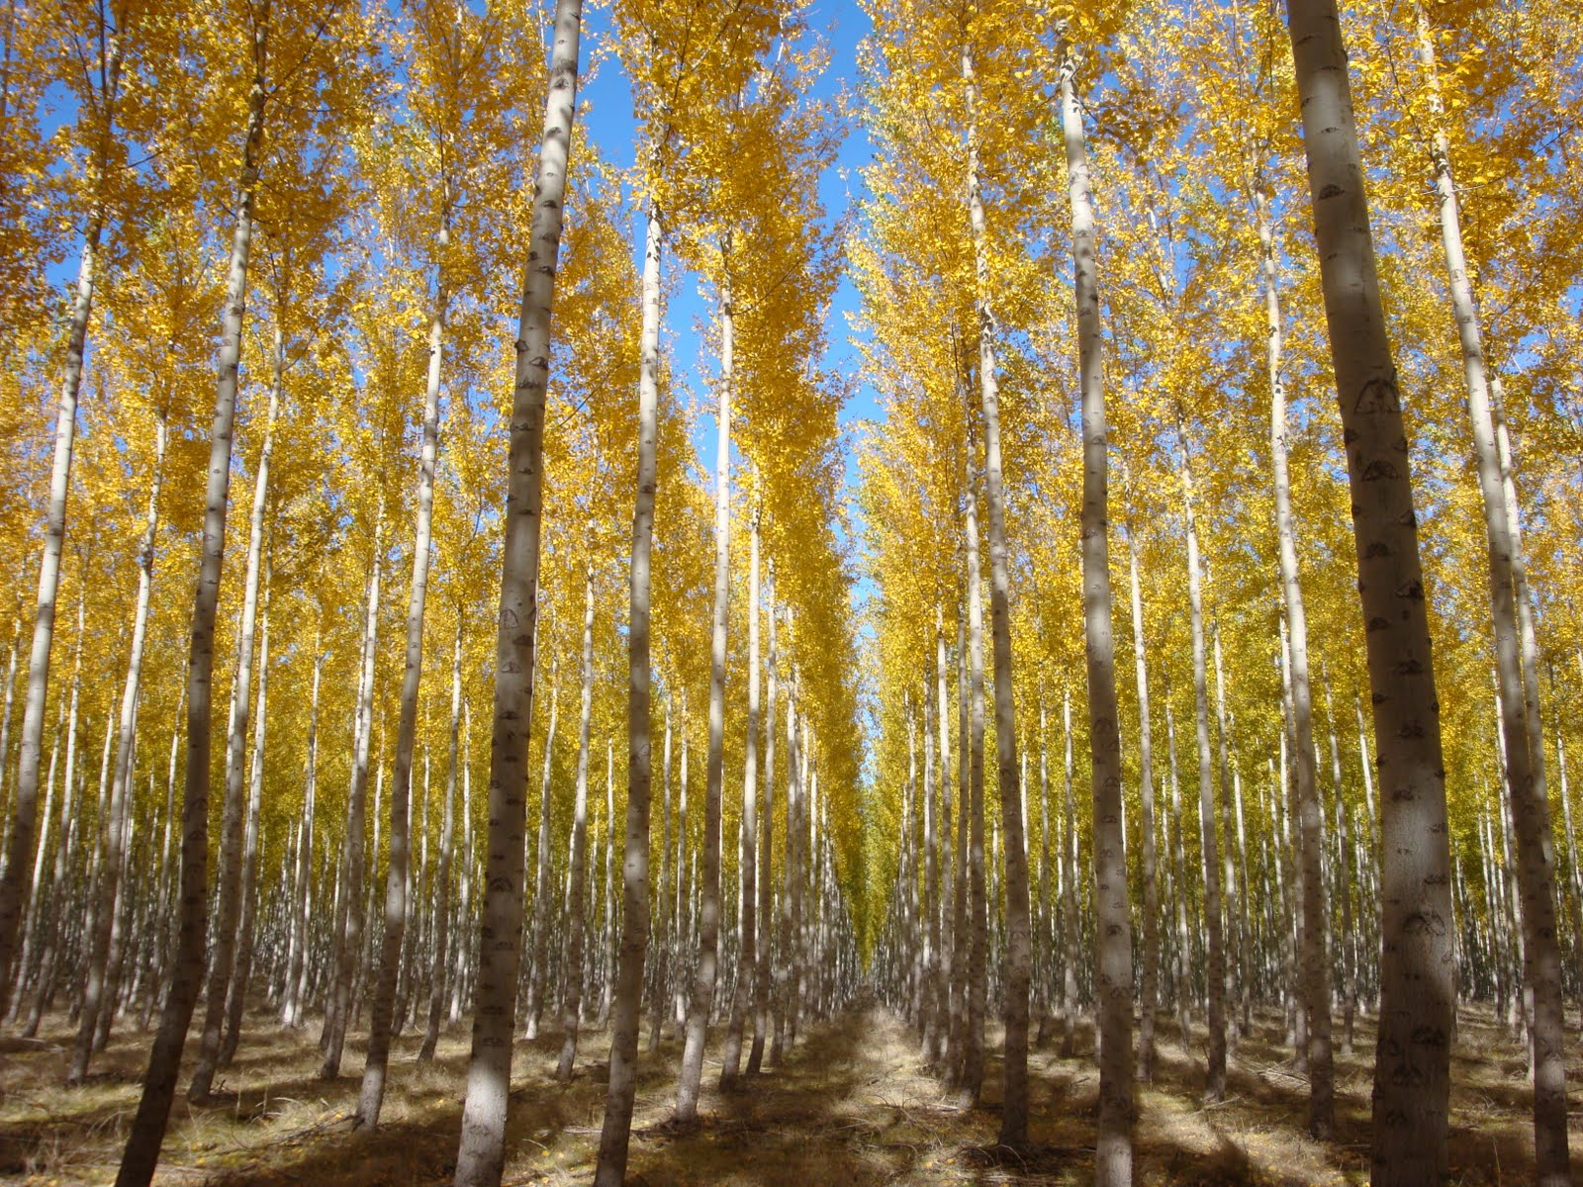

Feedstocks for Liquid Biofuels Second Generation
Notes:
US uses 140 billion gallons gasoline, 40 billion gallons road diesel, 20 billinon gallons jet fuel

Slide 11
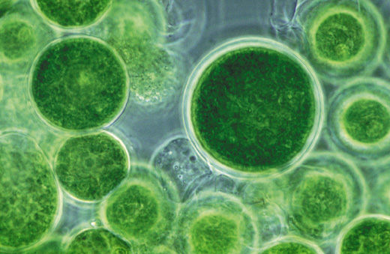
Feedstocks for Liquid Biofuels Third Generation
Notes:
US uses 140 billion gallons gasoline, 40 billion gallons road diesel, 20 billinon gallons jet fuel

Slide 12
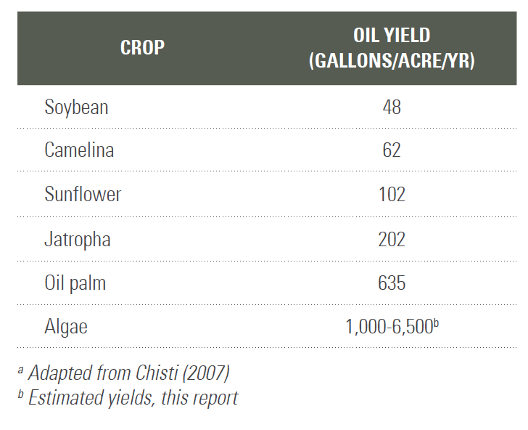
Why Algae?
Algal Biofuels Roadmap (DOE, 2010)

Slide 13
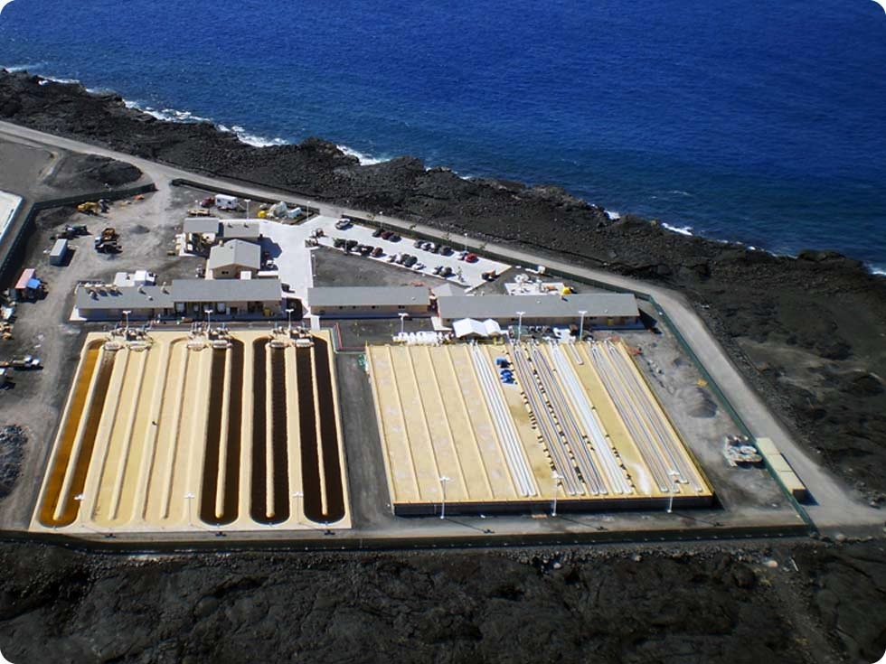
Why Algae cont.

Slide 14
Life Cycle Assessment (LCA) is needed

Slide 15
Sustainability Balancing issues for supplying energy
Economics
Pollution
Environ-
ment
Society
Denuding land
Poverty
Moving dirty
production offshore
Slide created by Jeff Tester

Slide 16
Life Cycle Assessment
Emissions
Energy
Production of
Raw Materials
Manufacturing
Process
Use of
Product
Disposal
Wastes
Wastes
Wastes
Recycle Wastes
Attributes: Costs, Resource use, Emissions, Wastes
Sum cumulative attributes over total life cycle of product to compare net impacts
Slide created by Jeff Tester

Slide 17
Evaluating environmental impacts
Human Health
Ecosystem Health
Social
Equity
Respiratory
diseases
Extinction
of species
Reduced
resource
base
Seawater
level
Dying
forests
cancer
Carcinogen
Ozonelayer
Acidification
Nutriphication
Radiation
Land-use
Ecotoxicity
Minerals
Fossil fuel
Smog
Climate
Life cycle inventory of environmental flows – CO2 NOx Pb, land ect
http://www.pre-sustainability.com/simapro-lca-software

Slide 18
Life Cycle Assessment (LCA) is needed
Global Warming Potential
Energy Demand
Energy Return on Energy Invested (EROI)

Slide 19
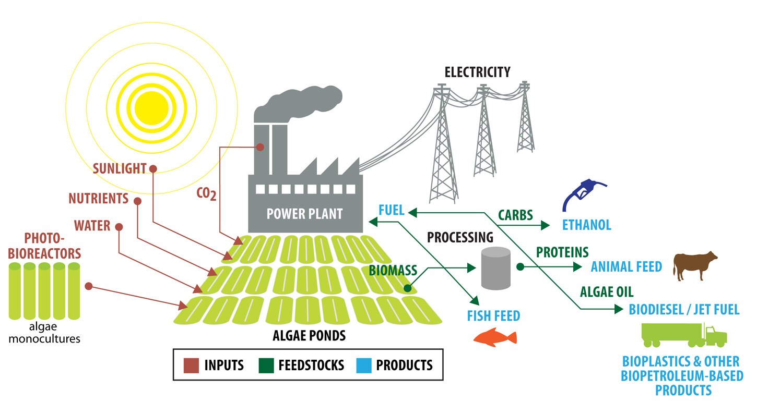
Algae Biorefinery
Cellana Biorefinery Model. Retrieved from http://cellana.com/production-facilities/

Slide 20
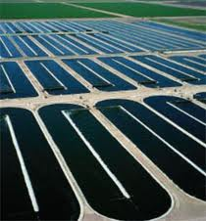


LCA of Algal Biofuels
Cultivation
&
Harvesting
Product Use
Biomass Conversion
Inputs
Outputs
Inputs
Outputs
Inputs
Outputs
Calculate energy and natural resource inputs and emission outputs throughout the entire system per “functional unit” = 1 MJ of liquid biofuel

Slide 21

Research Objective
Couple comprehensive uncertainty analysis with LCA
Parameters input to model as probability distribution functions
Monte Carlo sampling techniques
Parameter 1
Parameter 2
Parameter n
. . .
Output
Monte Carlo Simulations

Slide 22
Energy Return on Energy Invested
Notes:
Low Productivity: 3–18 g/m2/day
Base Productivity: 19–33 g/m2/day
High Productivity: 34–55 g/m2/day
Wet Extraction: belt filter press, hydrothermal liquefaction, hydrotreating, anaerobic digestion
Dry Extraction: centrifuge, thermal drying, hexane extraction, transesterefication, anaerobic digestion

Slide 23
EROI for Algal Biofuel
(a) Literature Values
Worst Case
(b) Cornell Study
Best Case
EROI (MJ of biofuel produced per MJ input )

Slide 24
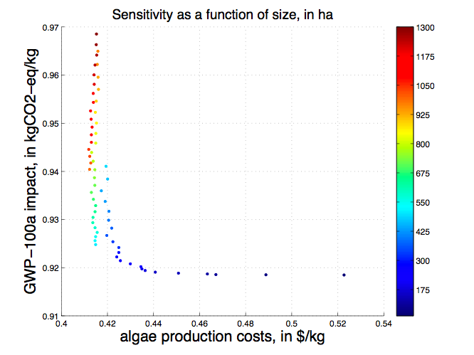
Environomics: Current Work
Environomic sensitivity to facility scale (50-1300 ha as ponds)
Cost per barrel
of algal oil:
min: 166 $/bbl
max: 209 $/bbl
Crude oil: 103 $/bbl
Notes:
Effect of scale on production costs of algae and GWP per kg of algae can be seen on this graph (this is a sensitivity, not a pareto curve, since it shows as well suboptimal solutions!). While the scale increases up to ~ 1000 ha of ponds, the costs tend to decrease. For the impacts, the trend is opposite: impacts decrease when scale decreases down to ~200 ha. There is therefore a trade-off between costs and impacts, and a non-linearity due to the economics of scale and impact scaling of process equipment. An optimal range of scales would thus be [200-1000] ha of ponds (base case of 748 is therefore in the optimal range). To analyze what parts of the process drive the costs and the impacts, let’s analyze 3 points at different scales...

Slide 25
Interested in Doing Research?
Credit or paid.
During the semester and/or in the summer.
Need to be willing to learn to code in Matlab—no experience with Matlab is fine.
Start out modeling algae systems, but if you’re interested in modeling a different energy system or product, we can do that!

