Slide 1
Announcements
Memo for Lab 6 due Tuesday (Oct 22) before lab via email.
Pset 5 due Wednesday (Oct. 23) by 5pm
First part—midterm self reflection
I will respond to each of you
Blog Post 3 due Friday Oct 25 by 11:59pm
Quizz on Friday—on water quality and lecture content from M and W this week
Students only receive credit for a quiz if they take it during their assigned class period
Engineering Alumni Dinner this Saturday!

Slide 2
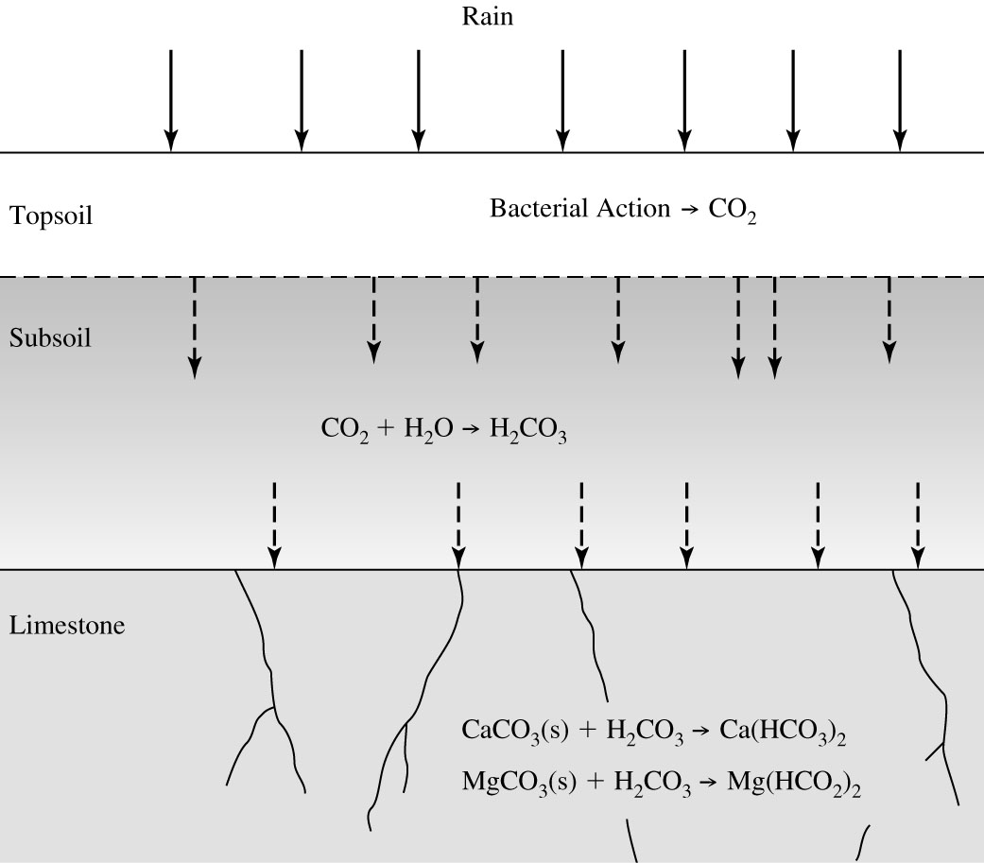
Natural Sources of Hardness Dissolved CO₂ combines with limestone to form soluble Ca(HCO₃)₂, Mg(HCO₃)₂ , CaSO₄, MgSO₄
From Introduction to Environmental Engineering by Cornwall and Davis

Slide 3
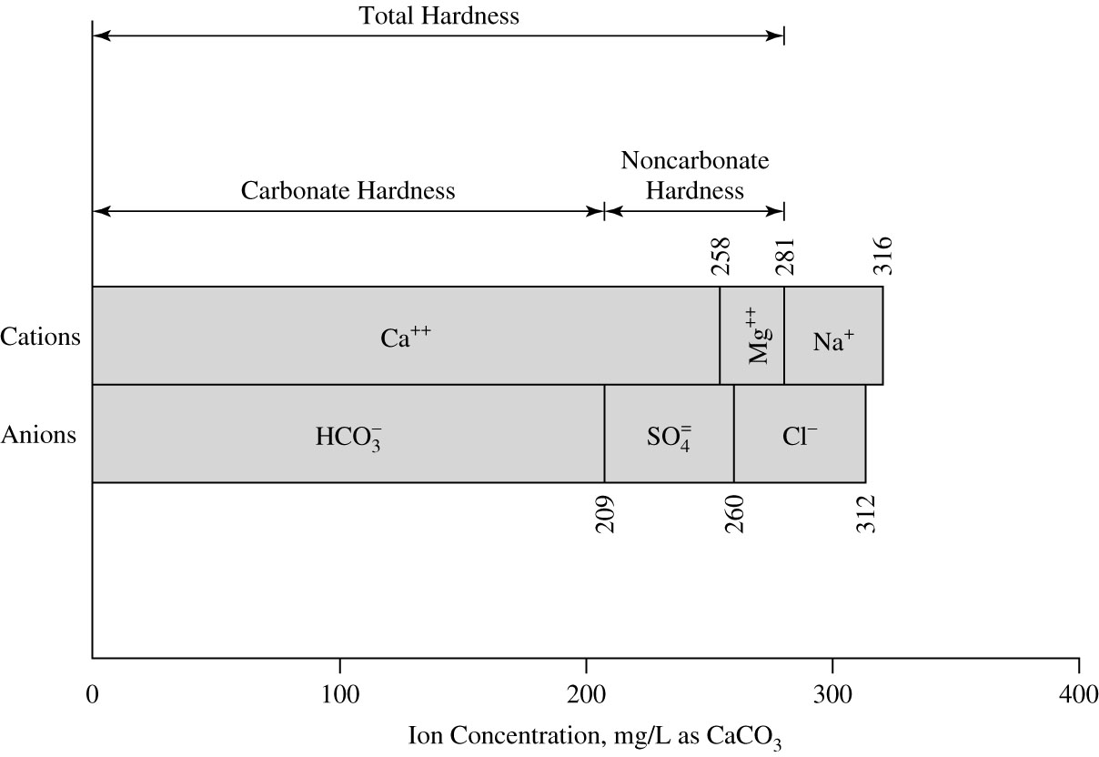
Bar Graph of Hard Water Constituents
From Introduction to Environmental Engineering by Cornwall and Davis

Slide 4
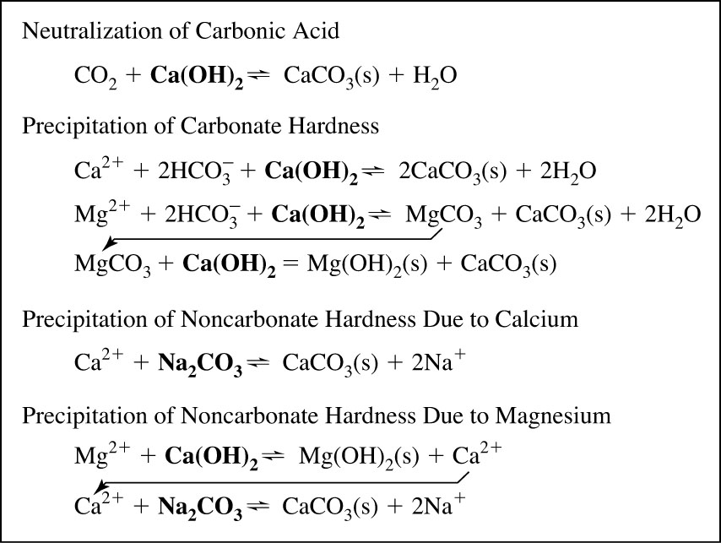
Summary of Softening Reactions Hardness removed by raising pH
Lime in Rxns: Ca(OH)₂, but lime purchased as CaO.
1 eq of Ca(OH)₂ per eq of CO₂
1 eq of Ca(OH)₂ per eq Ca²⁺ that is CH
2 eq of Ca(OH)₂ per eq Mg²⁺ that is CH
1 eq Na₂CO₃ per eq Ca²⁺ that is NCH
1 eq Na₂CO₃ + 1 eq of Ca(OH)₂
per eq Mg²⁺ that is NCH
Chemical that is added is in bold
From Introduction to Environmental Engineering by Cornwall and Davis

Slide 5
Summary of Softening Reactions Hardness removed by raising pH
From Introduction to Environmental Engineering by Cornwall and Davis

