Slide 1
Quiz 3 Grade Distribution
Mean: 8
Low: 2.6
High: 10

Slide 2
Announcements
Memo for Lab 6 due Tuesday (Oct 22) before lab via email.
Pset 5 due Wednesday (Oct. 23) by 5pm
First part—midterm self reflection
I will respond to each of you
Blog Post 3 due Friday Oct 25 by 11:59pm
Quizz on Friday—on water quality
Students only receive credit for a quiz if they take it during their assigned class period

Slide 3
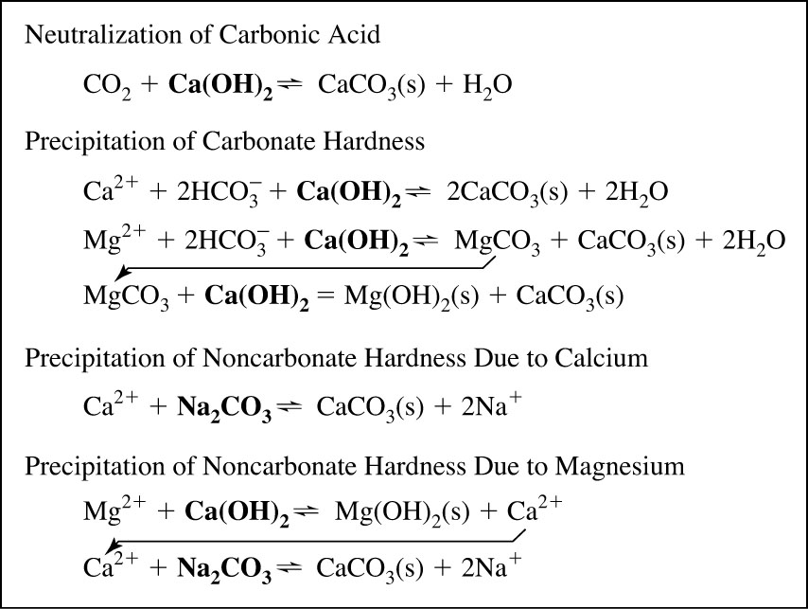
Summary of Softening Reactions
From Introduction to Environmental Engineering by Cornwall and Davis

