Slide 1
Announcements Monday 9/16
Lab tomorrow in Dana 325—Model fitting, Kinetics & Discussion of Big Necessity.
Problem Set 2 due Wed 9/18 in class.
Halfway through responding to blog responses
PSet1 Graded
Quizz Prep Extra Credit ( should be graded by tWed)
Trying to figure out a time to have Dr. Heavner’s visit. Afternoon/evening in place of class on Oct. 7

Slide 2
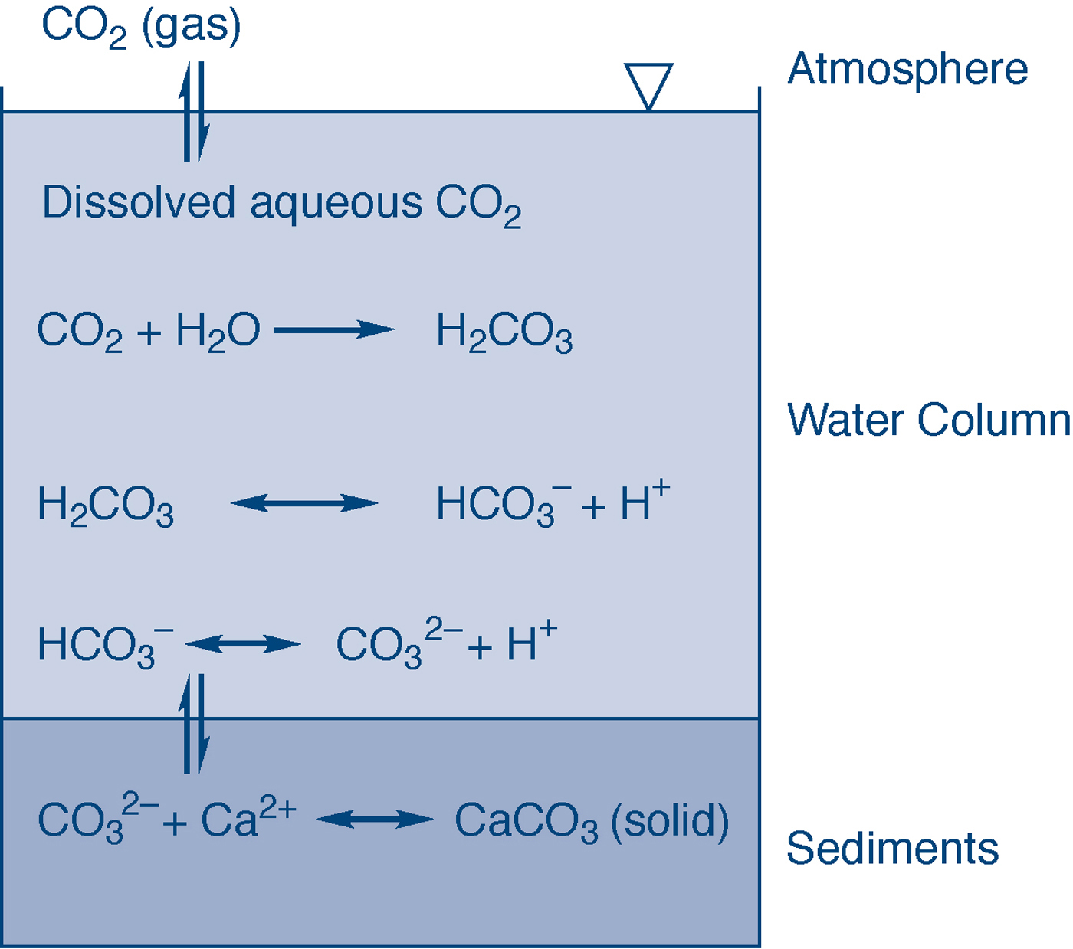
fig_03_06
Acid-Base
Carbonate System
fig_03_06

Slide 3
Alkalinity
Alkalinity (eq/L) = [HCO₃⁻] + 2[CO₃²⁻] + [OH⁻] – [H⁺],
where [ ] refer to concentrations in moles/L
Alkalinity is the ability of a water to neutralize acid.
In most waters, only carbonate species contribute signinficantly
Between pH 6 to 8, primarily [HCO₃⁻]

