Slide 1
Announcements Monday 9/2
Labs Tomorrow—no open-toes shoes
Quiz on Wednesday, beginning of class—bring calculators!
Blog post 1 due Friday at 11:59pm
Problem set (PS)1 due Monday 9/9 in class –it’s posted online, and it’s short.
Mid-term 2 on Wed Nov 20th (not Mon Nov 18th)
Dr. Gretchen Heavner “visiting” class on 9/13g

Slide 2
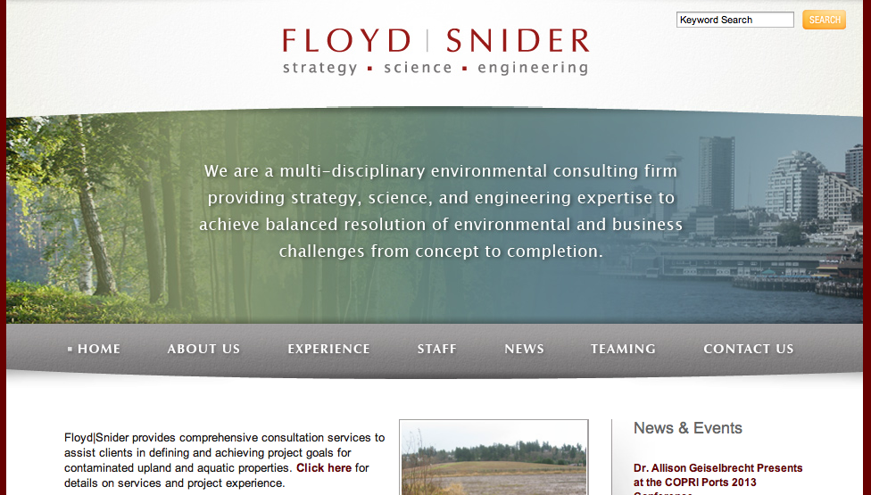
What do environmental engineers do?

Slide 3
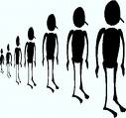

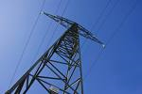


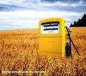
State of the Planet
population
water supply & quality
energy
climate change
food production & demand

Slide 4
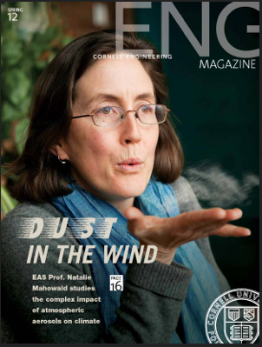
Prof. Natalie Mahowald, climate scientist, member of the IPCC:
Very likely humans have caused 1950s to present increase in temperatures with CO2
Very likely future higher CO2 levels will cause higher temperatures: how high is still uncertain
Many uncertainties: policy and value judgment what the right level of mitigation is.

Slide 5
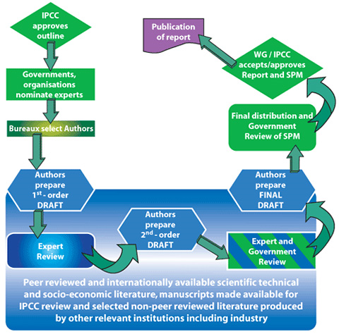
Notes:
Spm = summary for policy makers

Slide 6
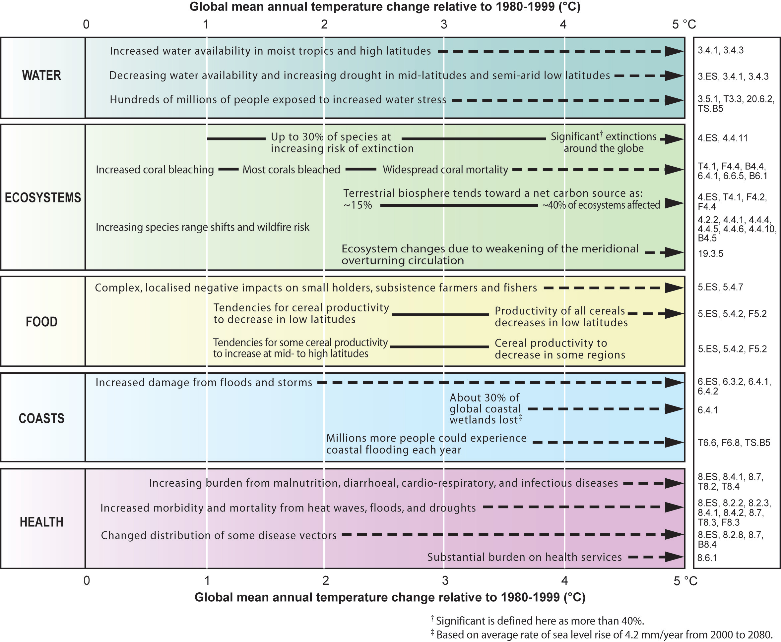
IPCC,
2007

Slide 7








UN Millennium Goals

Slide 8
State of the Planet
population
water supply & quality
energy
climate change
food production & demand

