Slide 1
Announcements Wednesday 9/4
Buy an approved calculator for next quiz/exam, you’ll need it for the FE Exam!
Blog post 1 due Friday at 11:59pm
Twenty two students are registered for the blog. Where are the other twenty three?
Problem set (PS)1 due Monday 9/9 in class –it’s posted online, and it’s short and fairly painless.
Exam blueprint, in preparation, Quizz solution will be posted online tonight.

Slide 2
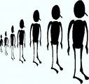

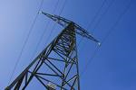


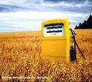
State of the Planet
population
water supply & quality
energy
climate change
food production & demand

Slide 3
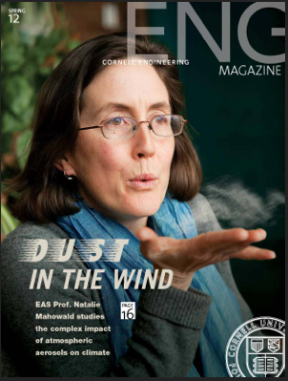
Prof. Natalie Mahowald, climate scientist, member of the IPCC:
Very likely humans have caused 1950s to present increase in temperatures with CO2
Very likely future higher CO2 levels will cause higher temperatures: how high is still uncertain
Many uncertainties: policy and value judgment what the right level of mitigation is.

Slide 4
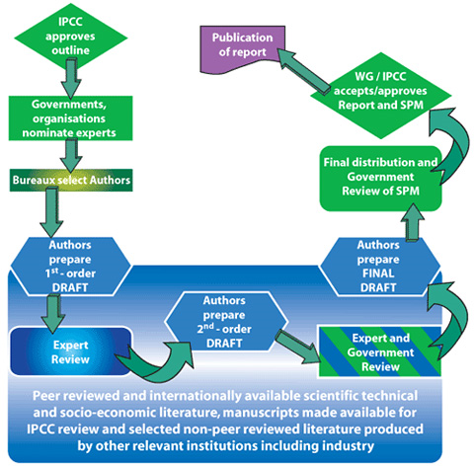
Notes:
Spm = summary for policy makers

Slide 5
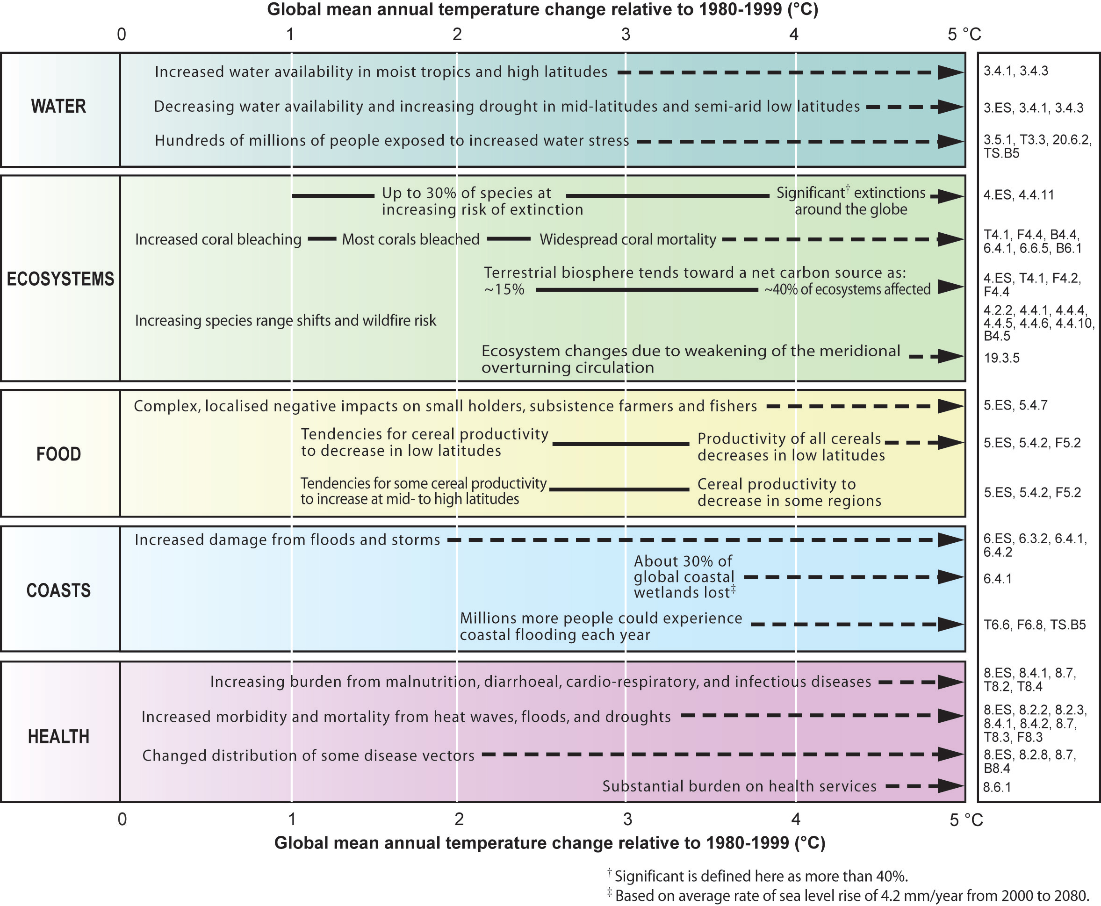
IPCC,
2007

Slide 6








UN Millennium Goals

Slide 7
State of the Planet
population
water supply & quality
energy
climate change
food production & demand

