Slide 1
A real world simulation of fish ecology and hunting
Presented by:
Veera Supraja Koppisetty

Slide 2
Contents
Problem Description
Purpose or Goals
Developed Model
Experimental setup an code flow
Experimental results, Analysis
Future Work

Slide 3
Problem Description
It is a predator prey kind of simulation model with fishes as preys , hunters as predators and a food source that reproduces continuously.
What’s New and Different from the same old Model?
Major differences are :
Hunters can only hunt when it is a Fishing Season and Hunting is allowed.
If pollution is on , all fishes will be dead and hunters go to the reserves to get re-energized and the system halts.
Also, if it is a fishing season and if any catastrophes occur suddenly, i.e. bad weather is on, boats are not allowed to carryout fishing.
Also, if the hunting is off even if it is fishing season and no catastrophes, it’s energy reduces and boats can’t fish.
System also halts if the count of fishes drops to 0.
Fishes can escape from the hunters.

Slide 4
Goal of the Project:
This model attempts to simulate the real time dynamics of the fish hunting and tries to find out a balanced ecology in doing so.
This can be achieved by several switches like checking if it is a fishing season or not, pollution is on or not, bad weather is predicted or not

Slide 5
Developed Model:
This model consists of two breeds : 1.Fishes 2.Hunters
The initial population of both of them can be controlled using sliders.
Also, initially there are many switches that can be set on or off.
The switches that are included are: fishing-season,Option-Escape,Hunt, Pollution,BadWeather .
fishes are colored pink and boats yellow and reserve is colored red, food source is colored blue.
Speed of the fish and hunter can also be controlled via sliders.
Numerical values shown are : count of deaths of fishes, mean of hunter energies, count of fishes.
Plot shows how the energy levels of fishes and hunters vary in different
scenarios.

Slide 6
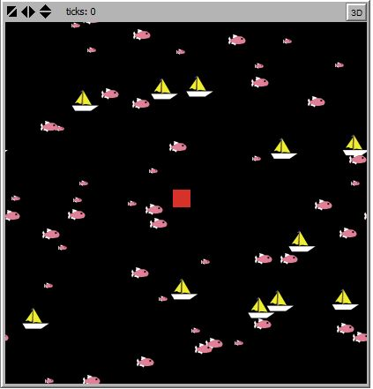
On setup ,model looks like:

Slide 7
Experimental setup and code flow:
What happens in Setup?
Fishes, Hunters are created.
Reserve is created.
Count of fishes is set to the fish population
Hunters count is also set to it’s population
All the other counts like mean energy, fish death count are set to 0.
What happens when go is clicked?
We have different scenarios:
When fishing option is on and hunting option is on:
Hunters i.e. boats will search for fishes and if it comes into it’s range ,it kills the fish.

Slide 8
When fishing option is on and hunting option is off:
Hunters will just move but don’t kill the fishes.
When fishing option is on and bad weather is on:
Even though hunting is on or off, no hunter is allowed to fish.
When fishing option is off:
Boats are not allowed to enter.
When escaping option is on:
Fishes deflect from the hunters.
When pollution is on:
Whatever may be the option that is on:
Fishes will die, the dead fish are represented with red color and hunters come to reserve fill up their fuel and as hunters can’t hunt, system halts.

Slide 9
What happens at every tick of go?
For the very first tick:
If hunters are allowed to hunt and pollution is not sensed:
Fishes and boats move forward
If hunters aren’t allowed:
Only Fishes move
If pollution is sensed:
All fishes die
System halts.

Slide 10
In the next ticks:
food source will be produced in their 8 neighborhood.
fishes and boats starts to move in different directions in search of food and fishes respectively.
Whenever a fish encounters a food source, it eats it and if it encounters a hunter depending on the scenario selected it may escape or just move or all the fishes may die if it is polluted.
Whenever a fish encounters a hunter and if it deflects, it’s energy will be reduced .
Whenever it eats a food source it’s energy will be reduced y the rate of digestion and it also gains energy that it gets through the food source.
Also, if a hunter hunts a fish, it’s energy will also get reduced due to the effort put.
Plots keep on continually plotting the energy levels of both fishes and hunters separately.

Slide 11
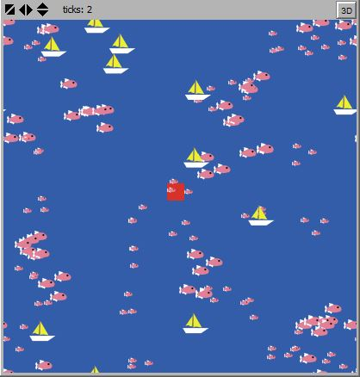
Screenshot after two ticks: (Fishing season is on)

Slide 12
Experimental results , Analysis:
Multiple runs of the model gives different results.
Depending on the scenario selected,
when no hunters, fish death count doesn’t increase
when escape option is on, fish death rate is decreased.
When fishing season is off, though there are hunter boats fishes can’t be killed so it’s count keep on increasing and fishes energy also keeps increasing.
When hunting is off though fishing season is on, hunters just move and their mean energies decrease.
If pollution is on, fishes count goes to 0 and hunters just come to reserve and their energy is constant and system comes to halt-> no plotting.
Note: All the experiment results are included in project documentation

Slide 13
Future Work
A danger zone can be implemented as an extension of this model.
If a hunter crosses that zone the boat will drown.

Slide 14

Any Queries?

Slide 15
Thank you!

