Slide 1
Bootstrap
Introduction to Bootstrap
Notes:
Add instructor notes here.

Slide 2

Lesson Objectives
Introduction to Bootstrap
Why Bootstrap?
Bootstrap Advantages
LESS Introduction
Creating Bootstrap page
Notes:
Add instructor notes here.

Slide 3
1.1: Introduction Bootstrap Introduction
Bootstrap is a open source, responsive design framework to build static websites and dynamic web applications.
Bootstrap is the most popular HTML, CSS, and JS framework for developing responsive, mobile first projects on the web.
We can design the front end for a website with a little knowledge of HTML and CSS.
Bootstrap 3 has been re-build to have a mobile-first approach
Bootstrap was developed by Mark Otto and Jacob Thornton at Twitter. It was released as an open source product in August 2011 on GitHub.
getbootstrap.com is the Official Website of Twitter Bootstrap.
Notes:
Mobile first approach uses the grid system in particular is to layout designs first on small screens, such as those that come on a mobile phone and then it can be scaled up the size of those designs to larger and larger environments.
Prior to Bootstrap 3 It doesn't support mobile first approach and as a optional feature it supports Responsive web design.
Add instructor notes here.

Slide 4
1.1: Introduction Why Bootstrap?
We can design the front end for a website with a little knowledge of HTML and CSS. i.e. Developers can easily create professional WebPages like a web designers
Bootstrap's responsive design adjusts to Desktops, Tablets and Mobiles
Bootstrap provides scaffolding feature by providing a basic structure with Grid System, link styles, background.
Provides a clean and uniform solution for building an interface for developers.
Bootstrap contains a dozen built-in reusable components and to provide iconography, dropdowns, navigation, alerts, popovers, and much more
It also provides custom jQuery plugins
It is supported by all popular browsers.
Notes:
Add instructor notes here.

Slide 5
1.1: Introduction Bootstrap Advantages
Cross-browser support: Bootstrap works on all the latest desktop and mobile browsers. While older browsers may display Bootstrap differently with respect to styles, it is still fully functional in legacy browsers such as Internet Explorer 8.
Easy to customize: Bootstrap is easy to customize, especially with the use of LESS.
Encourages using LESS: Bootstrap is written in LESS, a dynamic style sheet language that is compiled into CSS, which gives it a lot of flexibility. We can take advantage of this if we use LESS to write your styles.
Notes:
Less is a CSS pre-processor, meaning that it extends the CSS language, adding features that allow variables, mixins, functions and many other techniques that allow us to make CSS more maintainable, themable and extendable.
Add instructor notes here.

Slide 6
1.1: Introduction Bootstrap Advantages
Supports useful jQuery plugins: Bootstrap comes with many useful jQuery plugins that can come handy in many situations. Many custom jQuery plugins available: There is a wide range of jQuery plugins that extend Bootstrap, for example, X-editable, Wysihtml5, and the jQuery File Upload.
Mobile-first: Bootstrap has been mobile-first since Version 3.0. This means that the grid starts out stacked and is floated using media queries when the screen width grows.
Notes:
Add instructor notes here.

Slide 7
1.1: Introduction Less Introduction
LESS is a dynamic style sheet language that is compiled into CSS.
LESS compiler written in JavaScript and is quite fast compared to its alternatives, SASS and Stylus.
LESS comes with a wide range of useful features that are not available in traditional CSS, such as variables, mixins, nested rules, functions, and operators.
The easiest way to compile LESS files is to install Node.js and use its package manager NPM to install RECESS.
We can also compile LESS online via http://lesstester.com
Notes:
We can install RECESS by running the following command:
npm install -g recess
This will install RECESS globally on your system. Now that you have RECESS installed, its time to create your first LESS file. Create a new folder named less in the project root and then create a file named styles.less in it. Add the following code to your newly created file:
@font-family: Arial;
@text-color: red;
body {
font-family: @font-family;
color: @text-color;
}
To compile the file, navigate to your project root and run the following command:
recess styles.less --compile > styles.css
You can also compress the style by running RECESS with the --compress option in the following way:
recess styles.less --compress > styles.css
This will produce the following output:
body{font-family:Arial;color:#f00}
Add instructor notes here.

Slide 8
Demo
Online LESS Compiler using lesstester.com
Notes:
WinLess is a Windows GUI for LESS.js we can download it from winless.org
Add instructor notes here.

Slide 9
1.1: Introduction What's new in Bootstrap 3?
Mobile-first approach
Single(responsive) grid system
Dropping support for IE7 and FF 3.6
Supporting IE 8 and higher
Font icons, instead of old PNG image sprites
Notes:
Add instructor notes here.

Slide 10
1.1: Introduction Mobile First Strategy
Bootstrap 3 is mobile first in the sense that the code for Bootstrap starts by targeting smaller screens like mobile devices, tablets, and then "expands" components and grids for larger screens such as laptops, desktops.
Following points need to be considered for mobile first strategy
Content : Determine what is most important.
Layout : Design to smaller widths first. i.e. Base CSS address mobile device first. media queries address for tablet and desktops
Progressive Enhancement : Add elements as screen size increases
Notes:
Add instructor notes here.

Slide 11
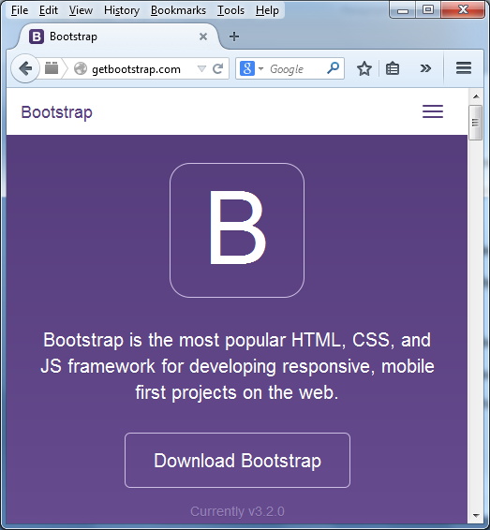
1.2: Getting Started with Bootstrap Bootstrap home page
Notes:
Add instructor notes here.

Slide 12
1.2: Getting Started with Bootstrap Downloading Bootstrap
We can work with Bootstrap using two ways
By downloading compiled and minified CSS, JavaScript, and fonts.
By using CDN links.
We can also download Bootstrap source code includes the precompiled CSS, JavaScript, and font assets, along with source Less, JavaScript, and documentation.
We can also customize Bootstrap's components, Less variables, and jQuery plugins to get our own version by clicking customize link (getbootstrap.com/customize)
Notes:
Add instructor notes here.

Slide 13
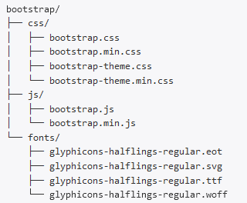
1.2: Getting Started with Bootstrap Bootstrap pre-compiled folder structure
Notes:
Bootstrap source code – Folder Structure
The less/, js/, and fonts/ are the source code for CSS, JS, and icon fonts (respectively).
The dist/ folder includes everything listed in the precompiled download section above.
The docs/ folder includes the source code for documentation, and examples/ of Bootstrap usage
Add instructor notes here.

Slide 14
1.2: Getting Started with Bootstrap Bootstrap Global Styles
Bootstrap provides us the following default styles to webpage which is included in is included in the bootstrap.css file.
margin has been removed from the body, and content will snug up to the edges of the browser window.
background-color: white is applied to the body
Bootstrap is using the @baseFontFamily, @baseFontSize, and @baseLineHeight attributes as our typographic base. This allows the height of headings and other content around the site to maintain a similar line height.
Bootstrap sets the global link color via @linkColor and applies link underlines only on :hover
Notes:
Add instructor notes here.

Slide 15
1.2: Getting Started with Bootstrap Responsive Design
To turn on the responsive features of Bootstrap, we need to add a <meta> tag to the <head> of your web page.
It represents mobile specific meta data.
<!DOCTYPE html>
<html lang="en">
<head>
<title>Creating Sample website</title>
<!-- Mobile Specific Meta -->
<meta name="viewport" content="width=device-width, initial-scale=1, maximum-scale=1">
<!-- Latest compiled and minified CSS -->
<link href="../bootstrap-3.2.0-dist/css/bootstrap.min.css" rel="stylesheet">
</head>
<body></body>
</html>
</html>
Notes:
Add instructor notes here.

Slide 16
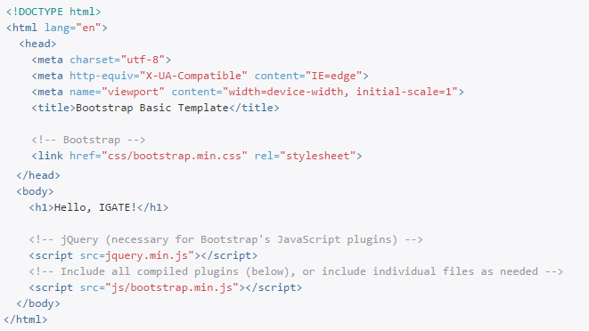
1.2: Getting Started with Bootstrap Bootstrap basic template
Notes:
Add instructor notes here.

Slide 17
Demo
Basics
Notes:
Add instructor notes here.

Slide 18

Summary
Using bootstrap we can design the front end for a website with a little knowledge of HTML and CSS.
Bootstrap is supported by all popular browsers
Bootstrap 3 has been re-build to have a mobile-first approach.
LESS is a dynamic style sheet language that is compiled into CSS
Notes:
Add the notes here.
Add instructor notes here.

