Slide 1
Bootstrap
Bootstrap Basics
Notes:
Add instructor notes here.

Slide 2

Lesson Objectives
*
Notes:
Add instructor notes here.

Slide 3
2.1: Bootstrap grid system Grid System in Bootstrap
Grid systems are used for creating page layouts through a series of rows and columns to wrap the site content.
Primarily grids are about providing structure. For web designers a grid defines the horizontal and vertical guidelines for arranging content and enforcing margins.
Grids also define an intuitive structure for viewers because it's easy to follow a left to right or a right to left flow of content moving down the page.
The grid won't be visible with border like table, but it exists behind the scenes to provide order alignment and consistency.
Bootstrap includes a grid system amongst its features.
Notes:
Mobile first approach uses the grid system in particular is to layout designs first on small screens, such as those that come on a mobile phone and then it can be scaled up the size of those designs to larger and larger environments.
Prior to Bootstrap 3 It doesn't support mobile first approach and as a optional feature it supports Responsive web design.
Add instructor notes here.

Slide 4
2.1: Bootstrap grid system Bootstrap grid system
Bootstrap includes a responsive, mobile first fluid grid system that appropriately scales up to 12 columns as the device or viewport size increases.
Every row in Bootstrap consists of 12 columns.
Rows must be placed within a .container class for proper alignment and padding.
Use rows to create horizontal groups of columns.
Content should be placed within columns, and only columns may be immediate children of rows.
Predefined grid classes like .row and .col-xx-4 are available for quickly making grid layouts.
Notes:
Mobile first approach uses the grid system in particular is to layout designs first on small screens, such as those that come on a mobile phone and then it can be scaled up the size of those designs to larger and larger environments.
Prior to Bootstrap 3 It doesn't support mobile first approach and as a optional feature it supports Responsive web design.
Add instructor notes here.

Slide 5
2.1: Bootstrap grid system Bootstrap grid system – Contd…
Grid columns are created by specifying the number of twelve available columns you wish to span. For example, three equal columns would use three .col-xx-4.
Columns create gutters (gaps between column content) via padding. That padding is offset in rows for the first and last column via negative margin on .rows.
Grid has 4 sizes
lg : indicates that the large grid displaying. The grid stacks horizontally < 1200px.
md : indicates that the medium grid displaying. The grid stacks horizontally < 992px.
sm : indicates that the small grid displaying. The grid stacks horizontally < 768px.
xs : indicates that the extra small grid displaying. This grid is always horizontal.
Notes:
Mobile first approach uses the grid system in particular is to layout designs first on small screens, such as those that come on a mobile phone and then it can be scaled up the size of those designs to larger and larger environments.
Prior to Bootstrap 3 It doesn't support mobile first approach and as a optional feature it supports Responsive web design.
Add instructor notes here.

Slide 6
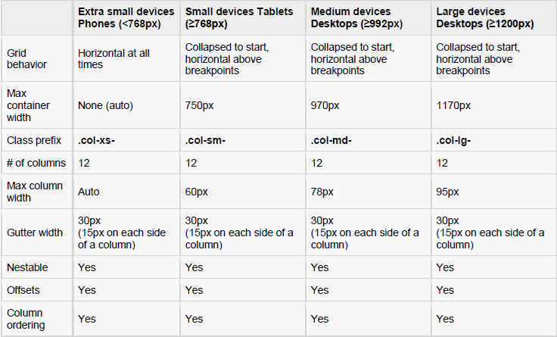
2.1: Bootstrap grid system Grid Options
Notes:
Mobile first approach uses the grid system in particular is to layout designs first on small screens, such as those that come on a mobile phone and then it can be scaled up the size of those designs to larger and larger environments.
Prior to Bootstrap 3 It doesn't support mobile first approach and as a optional feature it supports Responsive web design.
Add instructor notes here.

Slide 7
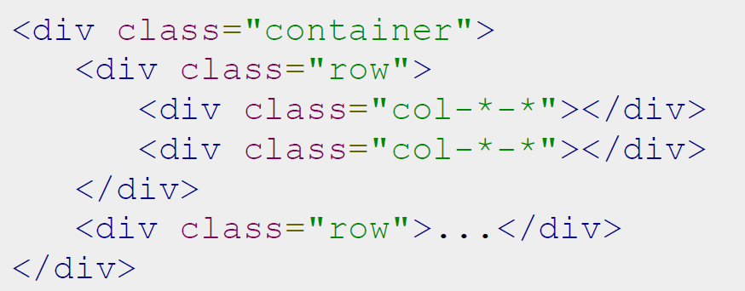
2.1: Bootstrap grid system Basic Grid Structure
Notes:
Mobile first approach uses the grid system in particular is to layout designs first on small screens, such as those that come on a mobile phone and then it can be scaled up the size of those designs to larger and larger environments.
Prior to Bootstrap 3 It doesn't support mobile first approach and as a optional feature it supports Responsive web design.
Add instructor notes here.

Slide 8
2.1: Bootstrap grid system Bootstrap grid sizes
.col-xx-6 |  |  |  | .col-xx-6
.col-xx-4 |  |  | .col-xx-4 |  | .col-xx-4
.col-xx-3 |  | .col-xx-3 |  | .col-xx-3 |  | .col-xx-3
.col-xx-2 | .col-xx-2 |  | .col-xx-2 | .col-xx-2 | .col-xx-2 |  | .col-xx-2
Notes:
Mobile first approach uses the grid system in particular is to layout designs first on small screens, such as those that come on a mobile phone and then it can be scaled up the size of those designs to larger and larger environments.
Prior to Bootstrap 3 It doesn't support mobile first approach and as a optional feature it supports Responsive web design.
Add instructor notes here.

Slide 9
Demo
GridSizes
Notes:
Add instructor notes here.

Slide 10
2.1: Bootstrap grid system Bootstrap grid sizes – using Offset
.col-xx-10 |  |  |  |  |  |  |  |  |  | .col-xx-2
 |  | .col-xx-8 .col-xx-offset-2
.col-xx-6 |  |  |  |  |  |  |  | .col-xx-3 .col-xx-offset-2
.col-xx-3
Note: Offset will be added to the left.
Notes:
Mobile first approach uses the grid system in particular is to layout designs first on small screens, such as those that come on a mobile phone and then it can be scaled up the size of those designs to larger and larger environments.
Prior to Bootstrap 3 It doesn't support mobile first approach and as a optional feature it supports Responsive web design.
Add instructor notes here.

Slide 11
Demo
GridSizes-Offset
Notes:
Add instructor notes here.

Slide 12
2.1: Bootstrap grid system Multiple Grid
.col-md-8 .col-xs-12 | .col-xs-6 .col-md-4
Notes:
Mobile first approach uses the grid system in particular is to layout designs first on small screens, such as those that come on a mobile phone and then it can be scaled up the size of those designs to larger and larger environments.
Prior to Bootstrap 3 It doesn't support mobile first approach and as a optional feature it supports Responsive web design.
Add instructor notes here.

Slide 13
Demo
MultipleGrid
Layout
Notes:
Add instructor notes here.

Slide 14
2.2: Bootstrap Basic Components Helper Classes & Responsive Utilities
Close Icon : It is used to dismiss models and alerts
<button type="button" class="close" aria-hidden="true">&times;</button>
Carets : : It is used to indicate dropdown functionality
<span class="caret"></span>
Quick floats : To float an element left or right with a class
<div class="pull-right">Right Aligned</div>
<div class="pull-left">Left Aligned</div>
Showing and hiding content
<div class="show">Show</div>
<div class="hidden">Hidden</div>
Notes:
Mobile first approach uses the grid system in particular is to layout designs first on small screens, such as those that come on a mobile phone and then it can be scaled up the size of those designs to larger and larger environments.
Prior to Bootstrap 3 It doesn't support mobile first approach and as a optional feature it supports Responsive web design.
Add instructor notes here.

Slide 15
2.2: Bootstrap Basics Helper Classes & Responsive Utilities
Work with Images : We can apply simple styles to images like rounded corners, circle images & padding with gray border which fits all sizes
<img src="images/image.jpg" alt="Image" class="img-rounded"/>
<img src="images/image.jpg" alt="Image" class="img-circle"/>
<img src="images/image.jpg" alt="Image" class="img-thumbnail"/>
<img src="images/image.jpg" alt="Image" class="img-responsive"/>
Center content blocks : To set an element to center
<div class="center-block" style="width:150px;">Centered-Content</div>
Responsive utilities : It is used for showing and hiding content by device via media query combined with large, medium, small & extra small devices
<div class="visible-md"><h1>Visible at Medium Mode</h1></div>
<div class="hidden-md"><h1>hidden at Medium Mode</h1></div>
Notes:
Mobile first approach uses the grid system in particular is to layout designs first on small screens, such as those that come on a mobile phone and then it can be scaled up the size of those designs to larger and larger environments.
Prior to Bootstrap 3 It doesn't support mobile first approach and as a optional feature it supports Responsive web design.
Add instructor notes here.

Slide 16
Demo
HelperClasses-ResponsiveUtilities
Notes:
Add instructor notes here.

Slide 17

2.2: Bootstrap Basics Working with Buttons
We can use <a>, <button> or <input type="button"/> with 'btn' class to create a bootstrap button.
<a class="btn" href="#">Link Button</a>
<button class="btn">Button</button> <!-- recommended for browser consistency -->
<input type="button" class="btn" value="button"/>
Notes:
Mobile first approach uses the grid system in particular is to layout designs first on small screens, such as those that come on a mobile phone and then it can be scaled up the size of those designs to larger and larger environments.
Prior to Bootstrap 3 It doesn't support mobile first approach and as a optional feature it supports Responsive web design.
Add instructor notes here.

Slide 18
2.2: Bootstrap Basics Working with Buttons
Bootstrap provides following options to apply styles to the button
<button class="btn btn-default">Default</button>
<button class="btn btn-primary">Primary</button>
<button class="btn btn-success">Success</button>
<button class="btn btn-info">Info</button>
<button class="btn btn-warning">Warning</button>
<button class="btn btn-danger">Danger</button>
<button class="btn btn-link">Link</button>
Notes:
Mobile first approach uses the grid system in particular is to layout designs first on small screens, such as those that come on a mobile phone and then it can be scaled up the size of those designs to larger and larger environments.
Prior to Bootstrap 3 It doesn't support mobile first approach and as a optional feature it supports Responsive web design.
Add instructor notes here.

Slide 19
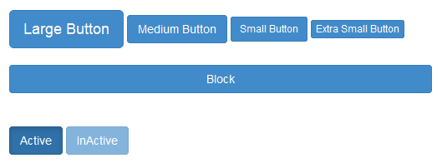
2.2: Bootstrap Basics Working with Buttons
Button has following sizes and states
<button class="btn btn-primary btn-lg">Large Button</button>
<button class="btn btn-primary btn-md">Medium Button</button>
<button class="btn btn-primary btn-sm">Small Button</button>
<button class="btn btn-primary btn-xs">Extra Small Button</button>
<button class="btn btn-primary btn-block">Block</button>
<button class="btn btn-primary btn-md active">Active</button>
<button class="btn btn-primary btn-md disabled">InActive</button>
Notes:
Mobile first approach uses the grid system in particular is to layout designs first on small screens, such as those that come on a mobile phone and then it can be scaled up the size of those designs to larger and larger environments.
Prior to Bootstrap 3 It doesn't support mobile first approach and as a optional feature it supports Responsive web design.
Add instructor notes here.

Slide 20
Demo
Buttons
Notes:
Add instructor notes here.

Slide 21


2.2: Bootstrap Basics GLYPHICONS
GLYPHICONS is a library of precisely prepared monochromatic icons and symbols, created with an emphasis on simplicity and easy orientation.
It is nothing but icon fonts which can be found under fonts folder as glyphicons-halflings-regular with eot, svg, ttf & woff formats from Bootstrap 3.x version.
We have around 200 free bootstrap glyphicons which is listed under getbootstrap.com/components/#glyphicons
<div>
<span class="glyphicon glyphicon-search"></span>
<button class="btn btn-primary">
<span class="glyphicon glyphicon-refresh"/> Refresh
</button>
</div>
Notes:
Mobile first approach uses the grid system in particular is to layout designs first on small screens, such as those that come on a mobile phone and then it can be scaled up the size of those designs to larger and larger environments.
Prior to Bootstrap 3 It doesn't support mobile first approach and as a optional feature it supports Responsive web design.
Add instructor notes here.

Slide 22
Demo
Glyphicons
Notes:
Add instructor notes here.

Slide 23

2.2: Bootstrap Basics List
Bootstrap provides following options to apply styles to the List
Use the class .list-unstyled to remove numbering / bullet in the <ol> or <ul> element
Use the class .list-inline to place all the items on a single line
To create a list group use the class .list-group to <ul> and .list-group-item <li> element
To add a badge component to any list group item which gets automatically position on the right by adding the <span class="badge"> with in the <li> element
We can add custom content to the list group using the following code snippet
<div class='list-group'><a href='#' class='list-group-item active'>
<h4 class='list-group-item-heading'>IGATE Corporate University</h4>
<p class='list-group-item-text'/>IGATE Training Division</p></a></div>
Notes:
Mobile first approach uses the grid system in particular is to layout designs first on small screens, such as those that come on a mobile phone and then it can be scaled up the size of those designs to larger and larger environments.
Prior to Bootstrap 3 It doesn't support mobile first approach and as a optional feature it supports Responsive web design.
Add instructor notes here.

Slide 24
Demo
List
Notes:
Add instructor notes here.

Slide 25
2.2: Bootstrap Basics Tables
Bootstrap provides a clean layout for building tables. Following classes can be used to apply styles over the table.
table : To create a basic Bootstrap style table which takes 100% of the width of its container, and it also adds in some horizontal dividers.
table-striped : Provides a striping effect for the alternate rows in a table.
table-bordered : Provide a border to the table
table-hover : To add a slight hover effect as the mouse moves over a table row.
table-condensed : It removes most of the cell padding and make the table a little more streamlined.
table-responsive : It makes the table scroll horizontally to view the contents in small devices
Contextual classes : active, success, warning and danger is used to apply background color for the table rows or individual cells.
Notes:
Mobile first approach uses the grid system in particular is to layout designs first on small screens, such as those that come on a mobile phone and then it can be scaled up the size of those designs to larger and larger environments.
Prior to Bootstrap 3 It doesn't support mobile first approach and as a optional feature it supports Responsive web design.
Add instructor notes here.

Slide 26
Demo
Tables
Notes:
Add instructor notes here.

Slide 27
2.2: Bootstrap Basics Forms
Bootstrap provides 3 form layouts
Vertical Form (default)
Inline Form
Horizontal Form
Vertical Form
Add a role form to the parent <form> element
Add the class .form-control to form elements and wrap labels and controls in a <div> with class .form-group
Inline Form
Add the class .form-inline to the <form> elements
Add the class .form-control to form elements and wrap labels and form elements in a <div> with class .form-group
Add the class .sr-only to hide the labels of the inline forms
Notes:
Mobile first approach uses the grid system in particular is to layout designs first on small screens, such as those that come on a mobile phone and then it can be scaled up the size of those designs to larger and larger environments.
Prior to Bootstrap 3 It doesn't support mobile first approach and as a optional feature it supports Responsive web design.
Add instructor notes here.

Slide 28
2.2: Bootstrap Basics Forms
Horizontal form
Add the class .form-horizontal to the <form> elements
Add the class .form-control to form elements and wrap labels and form elements in a <div> with class .form-group
Add the class . control-label to the labels.
Use Bootstrap's predefined grid classes to align label and groups of form controls in a horizontal layout.
Validation States : Bootstrap includes validation styles for error, warning and success message. To use add the classes .has-error, .has-warning, .has-success respectively.
Help Text : Use .help-block class to have block level help text for the form input controls.
Notes:
Mobile first approach uses the grid system in particular is to layout designs first on small screens, such as those that come on a mobile phone and then it can be scaled up the size of those designs to larger and larger environments.
Prior to Bootstrap 3 It doesn't support mobile first approach and as a optional feature it supports Responsive web design.
Add instructor notes here.

Slide 29
Demo
Forms
Notes:
Add instructor notes here.

Slide 30
2.2: Bootstrap Basics Typography
Using typography feature of Bootstrap we can create headings, paragraphs, lists and other inline elements.
All html headings(h1 to h6) are styled in bootstrap.
By adding .lead class to the paragraph, we can have a larger font size, lighter weight, and a taller line height.
<em> tag emphasizes a text in italics and <strong> tag makes the text bold
<small> tag sets text at 85% the size of the parent
<abbr> styles the element with a light border along the bottom and reveals the full text on hover
<address> styles the contact information on web page. We need to use line breaks to break the lines because <address> default to display:block
text-left, text-center, text-right, text-muted, text-primary, text-success, text-info,
text-warning and text-danger class used to apply the styles to the text
Notes:
Mobile first approach uses the grid system in particular is to layout designs first on small screens, such as those that come on a mobile phone and then it can be scaled up the size of those designs to larger and larger environments.
Prior to Bootstrap 3 It doesn't support mobile first approach and as a optional feature it supports Responsive web design.
Add instructor notes here.

Slide 31
Demo
Forms
Notes:
Add instructor notes here.

Slide 32

Summary
*
Notes:
Add the notes here.
Add instructor notes here.

