Slide 1
Coverage of Police Use of Force and Excessive Force Incidents in the New York Times: 1980 - 2021
Dylan Simburger (dsimburger@arizona.edu)
Ph.D. Student, Dept. of Sociology
INFO521 Final Project Presentation

Slide 2
Police Use of Force
Police use of force incidents are events that the U.S. media covers quite regularly.
There are several incidents that are easily recalled that demonstrate this: the Rodney King beating, the shooting of Michael Brown and Philando Castile, and the recent deaths of Breonna Taylor and George Floyd.
An interesting question is whether we are seeing an increase in these events or an increase in coverage of these events by U.S. media.

Slide 3
Police Use of Force
Lawrence’s (2000) research demonstrates the importance of the U.S. media in framing the public’s knowledge and perception of police violence.
Examined ~500 articles from New York Times and L.A. Times using content analysis .
While ~500 articles sampled, only 50 were randomly sampled and heavily coded for analysis.
Content analysis is a time intensive, by-hand coding process, so finding a way to use machine learning to yield comparable results would be worthwhile.

Slide 4
Research Question
Has coverage of police use of force incidents been increasing in the U.S. media over time?
We can try to answer this question with the machine learning approach of structural topic modeling.
Hypothesis: Coverage of police use of force in the U.S. media has increased over time.

Slide 5
Sample
726 articles from the New York Times downloaded from NexisUni database.
Search Terms Entered: police AND “United States” AND “use of force” OR “excessive force” yielded ~2,800 results
Further cleaning of search results removed mentions of the Iraq War, the 2019-2020 Hong Kong protests, European countries/provinces, and other international places/events to yield 731 articles (5 articles removed because no date of publication provided).
Sample not perfect: a few articles remain on Israel/Palestine conflict and international police use of force incidents generally associated with United Nations’ efforts.

Slide 6
Methods
Structural Topic Modeling (STM): Supervised Machine Learning method that iteratively analyzes a corpus of documents to produce a user-selected number (K) of common word associations (i.e., topics) between documents conditioned on metadata about each document.
Analyze 726 articles using STM conditioned on the date of the article’s publication.
Look for topics that discuss police use of force in politicized, critical, or graphic ways per Lawrence’s (2000) original content analysis codes to increase over time.

Slide 7
Methods (Step-by-Step)
Download sample of articles from NexisUni.
Read sample into R using LexisNexisTools package.
Process articles into an n-grammed (1-3), stemmed, tokenized corpus with stop words, punctuation, numbers, and symbols removed suitable for STM using quanteda R package.
Perform topic selection, model diagnostics, and analysis using R package stm.
Plots generated using ggplot2 and internal plotting functions from stm.

Slide 8
RESULTS

Slide 9
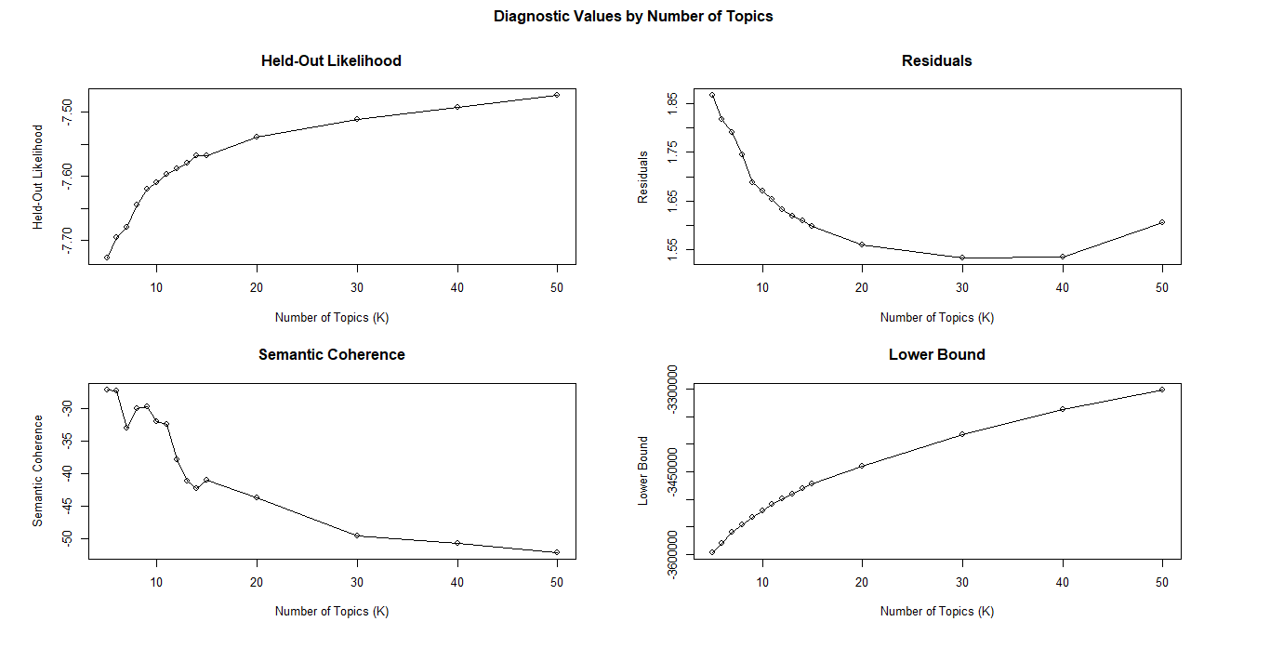

Slide 10
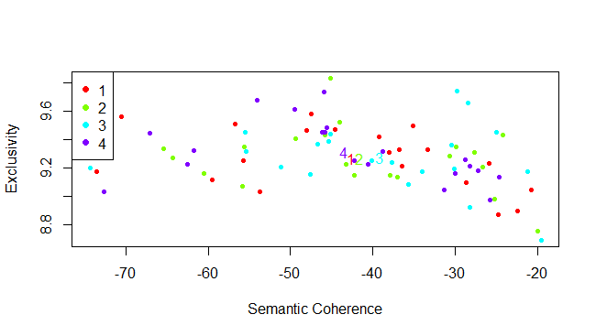

Slide 11
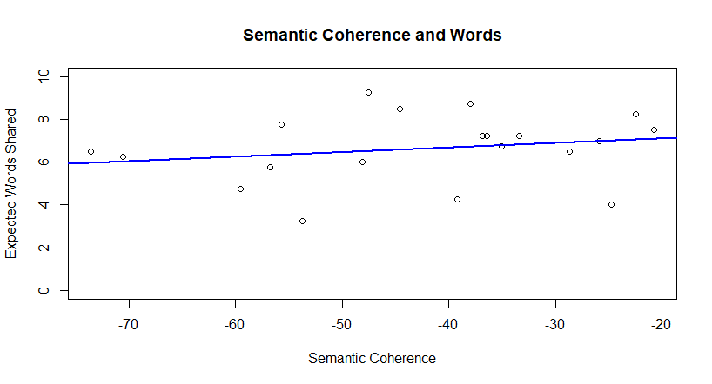
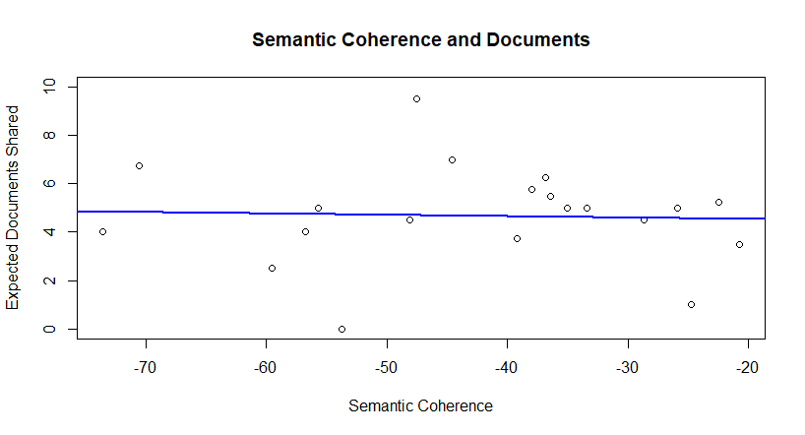

Slide 12
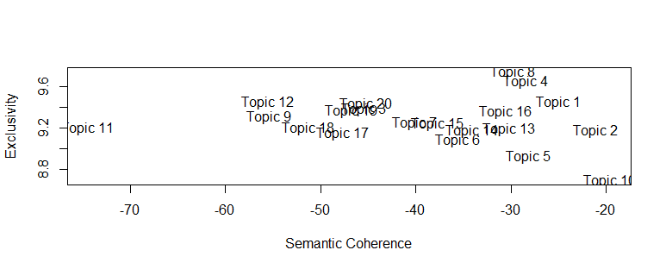

Slide 13
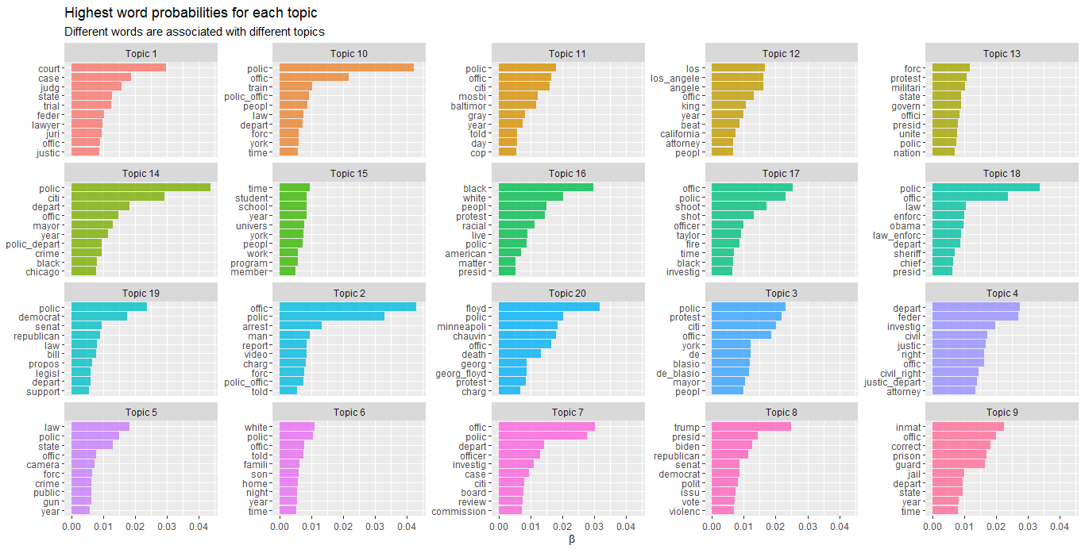

Slide 14
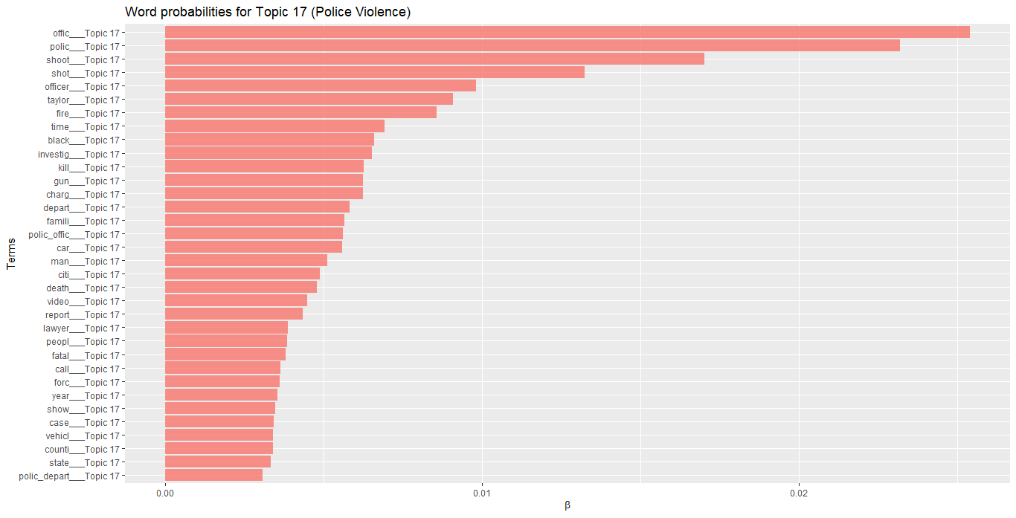

Slide 15
Example Headlines
“When Police Call a Car a Weapon” (2021)
“Kenosha Police Detail Run-Up To Encounter” (2020)
“Police Officer Charged With Murder in Killing of Handcuffed Suspect in Maryland” (2020)
“Victim Posed No Threat To Police, Family Says” (2016)

Slide 16
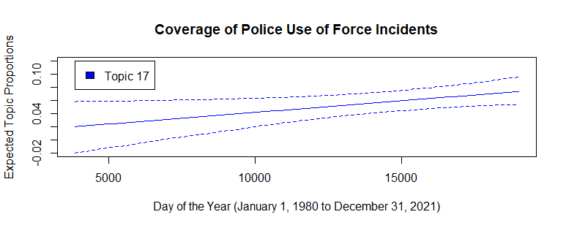

Slide 17
Discussion and Conclusion
STM provides useful tools to examine themes within documents similar to content analysis.
Provided preliminary evidence that: coverage of police use of force incidents in U.S. media has increased over time.
Content analysis provides a more human-validated and interpreted set of results that are not to be discounted.

Slide 18
Limitations
Sample not perfect: still contained some international incidents (Topic 13) and coverage of prison-guard violence (Topic 9).
Only one news source: New York Times
Search results heavily favored more recent incidents, so the results are partially a function of the sample. However, the increase in search results at later times might also support the results.

Slide 19
THANK YOU! dsimburger@arizona.edu

