Slide 1
iPython
Pradeep Gowda
Data Science Indy
Dec 19, 2013

Slide 2
DSIndy meetup notes
Started in April 2013.
7th Meetup
140 registered members
Avg attendance 20+ every meetup
Presentation slide decks and code at – https://github.com/dsindy
Planning to hold future meetups here at Launch Fishers.

Slide 3
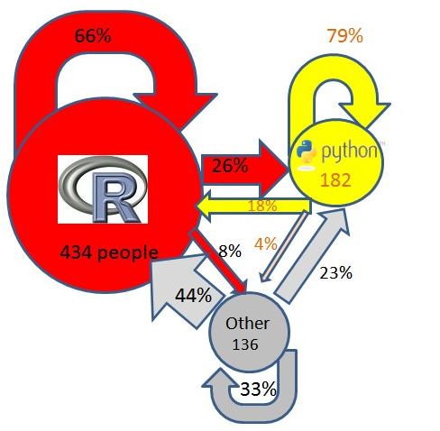
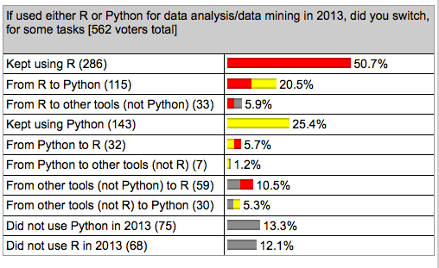
But, why now?
The rise of Python as a “Data Science” language
http://www.kdnuggets.com/2013/12/poll-results-r-leading-python-gaining.html

Slide 4
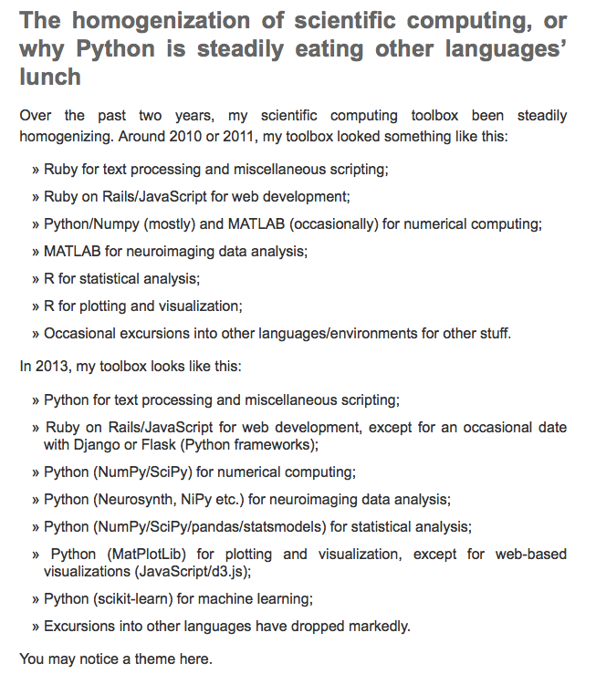
All many roads lead to Python
http://www.talyarkoni.org/blog/2013/11/18/the-homogenization-of-scientific-computing-or-why-python-is-steadily-eating-other-languages-lunch/

Slide 5
Why Python?
Lowers the barrier for entry
General purpose language vs domain specific language
Plays well with others (R, C)
The lifecycle of an “idea”
  Shorten it
  Self contained
  Reduce gaps in workflow

Slide 6
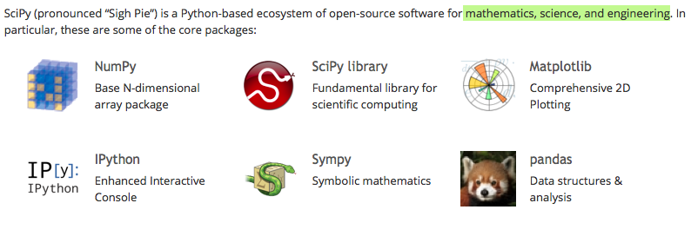
What Python brings to the table?

Slide 7
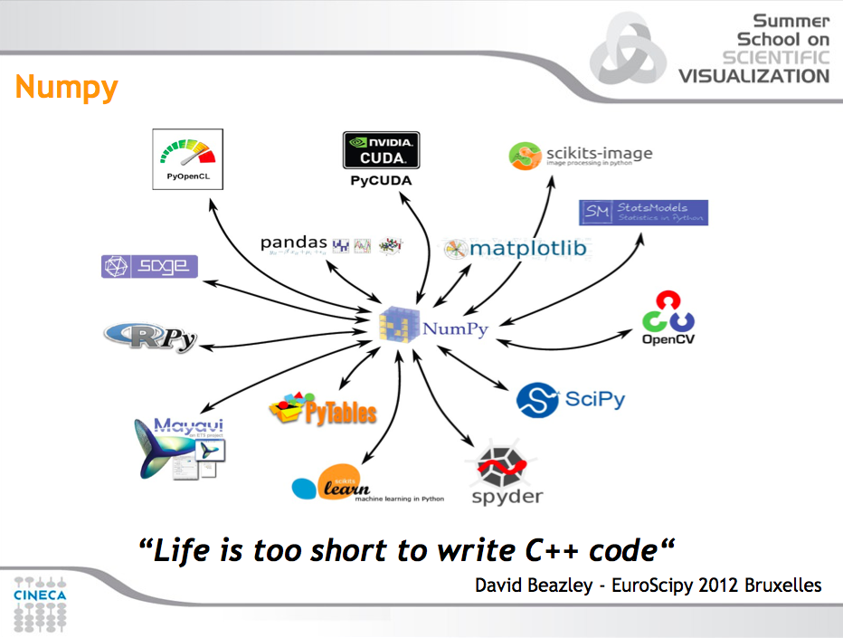

Slide 8
Fine... But how do I...
iPython

Slide 9
What is iPython?
Ipython started out as “interactive” python – an improvement over the standard python interpreter (2002)
Ipython was and still is a definite improvement over the standard interpreter.

Slide 10
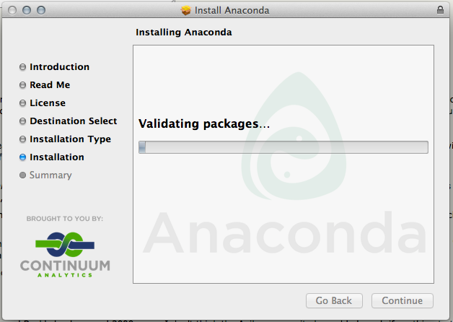
Installation
Packaged sollution: http://www.continuum.io/downloads
Using homebrew install deps:
  brew install zmq
pip/virtualenv:
  pip install tornado ipython
  pip install pandas
  Etc.,

Slide 11
Ipython demo
History
Shell
?
%history 1-10
%magic
%timeit
%pastebin
%save
%load

Slide 12
Ipython notebook
“extends the console-based approach to interactive computing”
Web based user interface to ipython
Execute code from within the browser
Embed code, visuals, data
Save your work as a notebook
Share with others. Viewable using nbviewer.ipython.org
Important for “reproducibility”
Literate programming

Slide 13
Explore iPython
Start with ipython notebook --pylab inline
Toolbar
Keyboard shortcut (help: Ctrl-m h)

Slide 14
Seeing is believing
http://nbviewer.ipython.org/

