Slide 1
Introduction to TensorFlow
Andrew Hoblitzell
July 2016

Slide 2

What is TensorFlow?
Google: “TensorFlow is an open source software library for numerical computation using data flow graphs.”
Others: TensorFlow is an open source software library for machine learning in various kinds of perceptual and language understanding tasks. Mostly known for usage in deep learning.

Slide 3
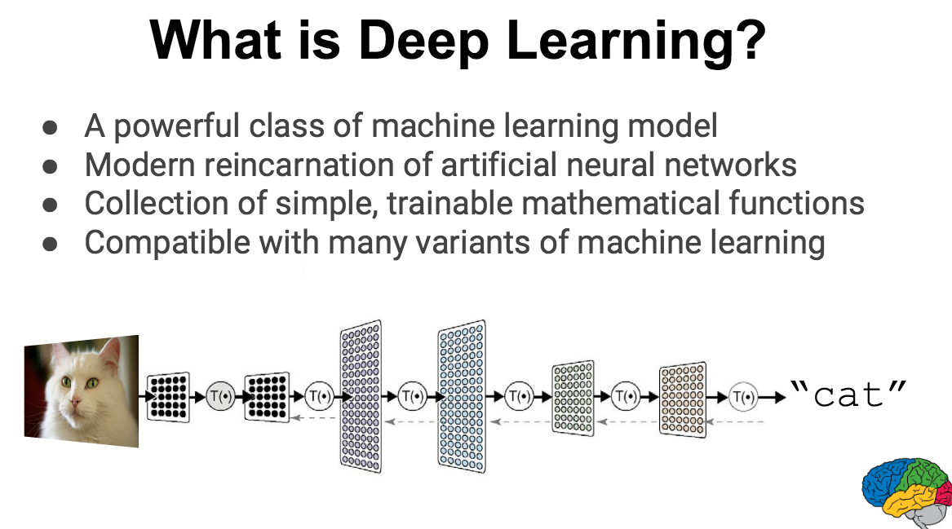

Slide 4
The Neural Net Strikes Back
An artificial neural network is inspired by the central nervous system
Work started in the 1940s and developed through the 1960s
Became popular in the 1980s under the "connectionist" label
Fizzled in the 1990s due to the popularity of simpler classifiers such as support vector machines (SVMs)
Neural nets became popular again at the end of the 2000s thanks to Deep Learning

Slide 5
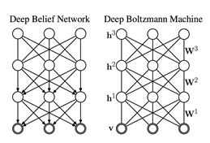
Deep Learning: What is it?
Deep Learning tries to model abstractions in data (image, etc.) by using architectures composed of multiple non-linear transformations. Some examples of these include:
deep neural networks
convolutional deep neural networks
deep belief networks (coined by Hinton)
It has seen application in language processing, speech recognition, computer vision, etc.
Rapidly evolving

Slide 6
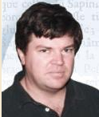
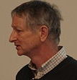
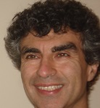

Some active researchers
Yann LeCun – NYU Professor who moved to head Facebook’s AI Lab
Geoffrey Hinton – Distinguished Professor at University of Toronto, Distinguished Researcher at Google (winner of ImageNet 2012 and more challenges)
Yoshua Bengio – Professor at University of Montreal
Andrew Ng – Professor at Stanford and co-founder of Coursera
Jeff Dean, Samy Bengio, Jeff Hawkins, Quoc Le, Kai Yu, Jason Weston, …

Slide 7
Common issues to watch for
Lack of causal reasoning (integration with other methods)
“Black box” approach (integration with other methods)
Domain tuning (leads to new techniques like max pooling, local receptive fields ICA, sparse coding, autoencoder, Dropout (averaging many neural networks, then drop), etc.)
Overfitting (early stop, L1 and L2 regularization, etc.)
Time to train (somewhat solved with lots of GPUs)
Complexity (somewhat solved with convolutional deep neural networks)
Potential lack of optimality with contrastive divergence (gradient descent/acceptance of non-optimality)

Slide 8
Where are they headed
Scaling up
Distribution/Parallelization over GPUs for handling more data
Speeding up
Convolutional Networks-Ng, Yu
Tiled Networks-Hinton, Ng
Randomized/Fast parameter search-Dicarlo,Ng
Massive embedding models-Bengio,Hinton
GPU, FPGA, and ASIC Implementations-Dean,Ng

Slide 9
Why TensorFlow?
Google:
Deep Flexibility to express any computation and API for Deep Learning
Portability, run on a phone or GPU cluster
Write for research and instantly deploy to production
Auto-differentiation, gradients handled for you
Language options – Python or C++
Scala/Spark*, R* (via Python), …
Maximize performance

Slide 10
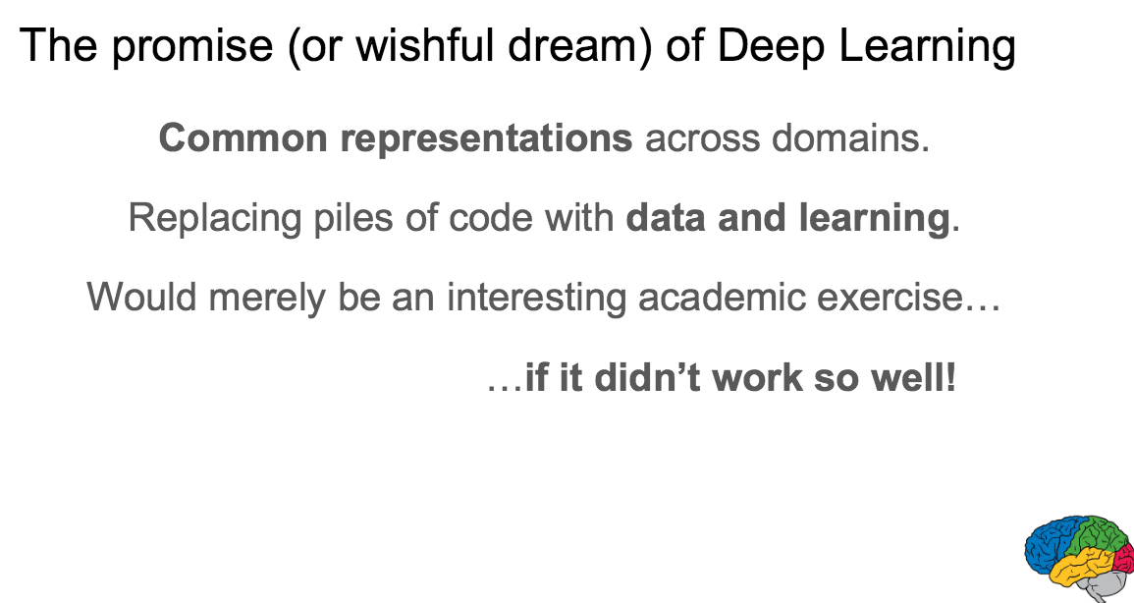

Slide 11
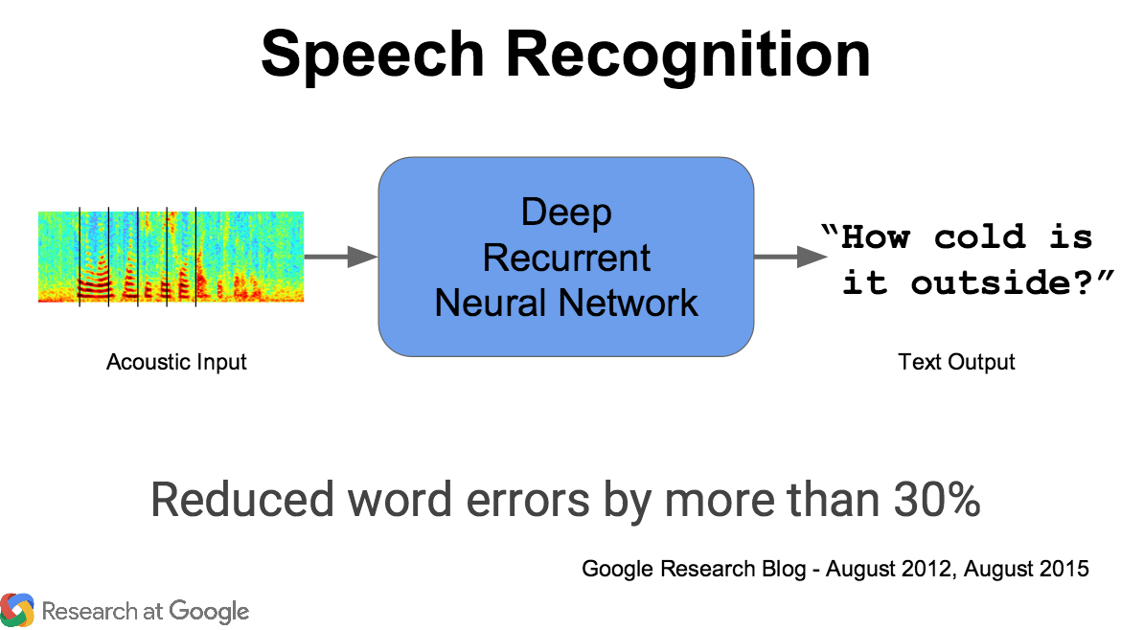

Slide 12
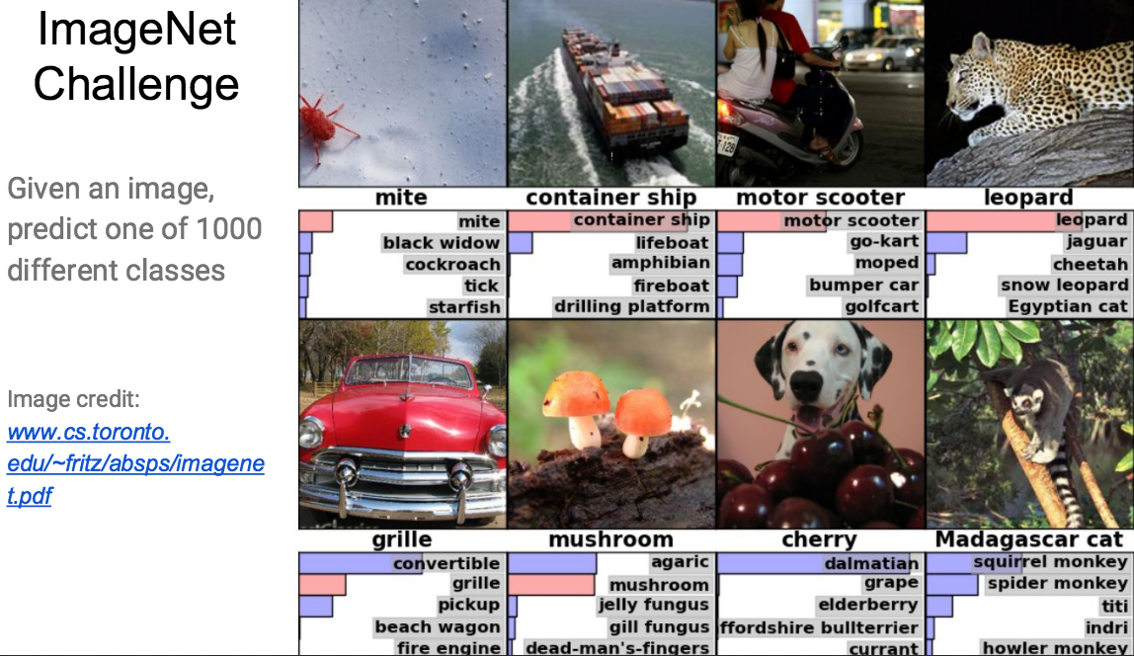

Slide 13
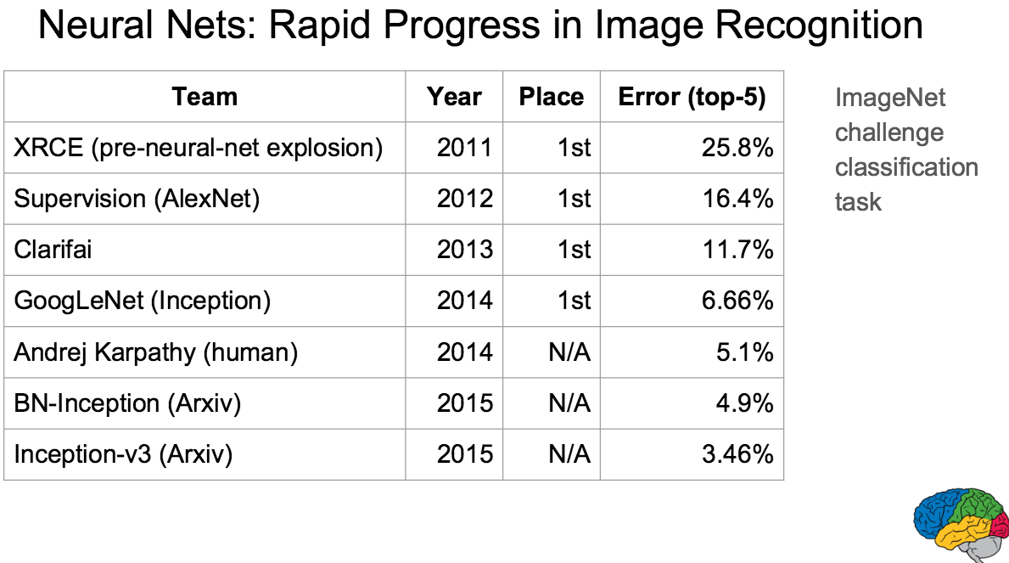

Slide 14
History of TensorFlow
In 2011, Google Brain built DistBelief as their first-generation, proprietary, machine learning system.
Geoffrey Hinton and Jeff Dean, simplified DistBelief in to application-grade library which became TensorFlow; 25% reduction in error for Google Voice queries
As of June 2016, there are currently 1500 repositories on GitHub which mention TensorFlow, of which 5 are from Google

Slide 15
Google’s internal usage
Running models on mobile phones to large-scale training of hundreds of billions of parameters on hundreds of billions of example records using hundreds of machines
Dozens of teams, including:
Advertising/search
Google Images
Google Maps
Google Translate
YouTube
...

Slide 16
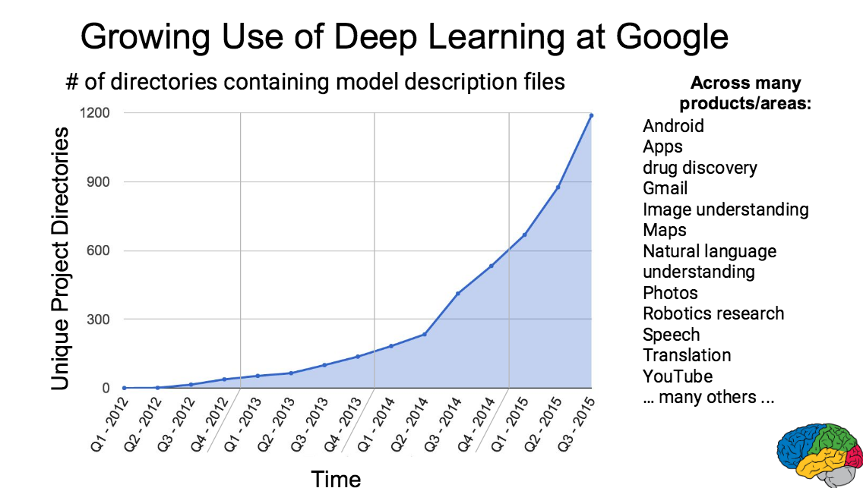

Slide 17
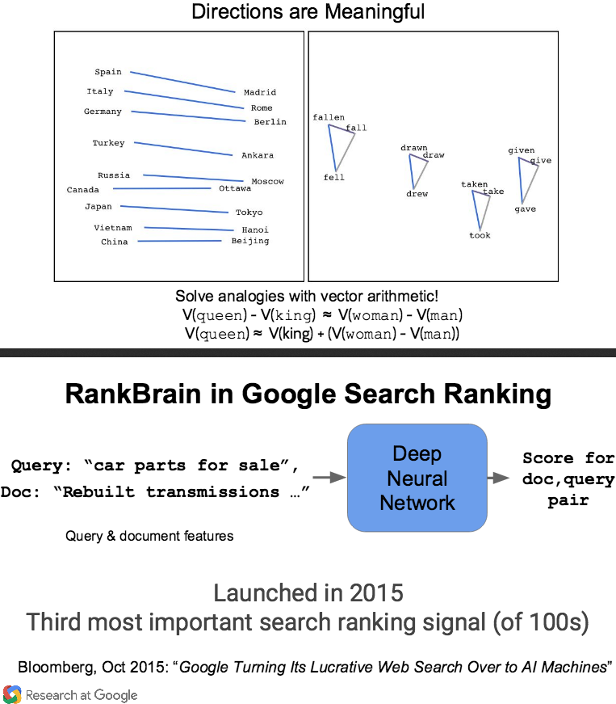
Usage of TensorFlow@Google

Slide 18
Initial reception to open source version
Much fanfare and inertia
Lackluster documentation? (Rapidly being addressed)
Inability to run in a distributed fashion (addressed)
No Python3 support (addressed)

Slide 19
Vocabulary
dataflow graph- described by a directed graph, which is composed of a set of nodes (operations) and edges (tensors/data flows)
control dependency- special edge on graph which helps to control execution timing (for operation ordering, looping, memory management, etc.)
operation- abstract computation with a name (e.g. add, matrix multiply)
kernel- implementation of an operation for a particular device (e.g. CPU, GPU)
session- execution of a graph or dataflow
variable- persistent mutable tensor which survives across sessions
device- implementation of CPU, GPU, etc.
tensor- a typed multi-dimensional array

Slide 20
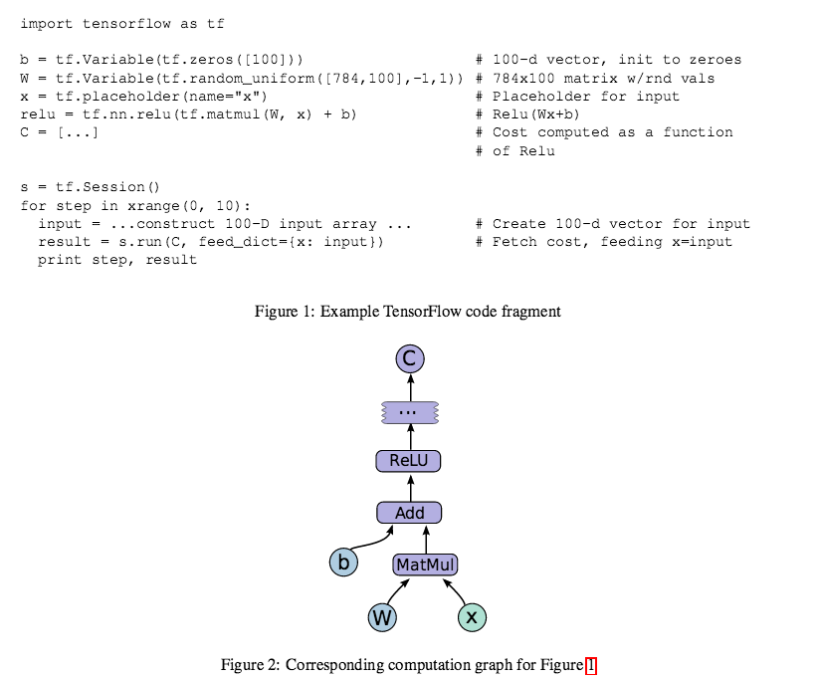
Example code

Slide 21
Distributed execution
Client/master model
Node placement is handled by a cost estimator and simulator
Cross-device communication with send and receives (TCP, RDMA, etc.)
Fault-tolerance- restart from scratch if send/receive fails or health checks fail. Variables which persist across sessions are checkpointed

Slide 22
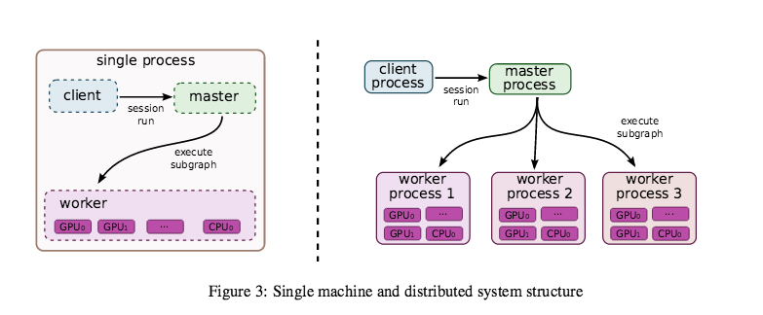
Client/Master Architecture

Slide 23
Optimizations
Common subexpression elimination-runs over computation graph to canonicalize identical subgraphs
Controlling data communication and memory usage-scheduling algorithms reduce time for results in main memory, which is particularly important on GPUs; example: using control dependency to get lazy evaluation of nodes
Asynchronous kernels- non-blocking kernels for dealing with the memory issues of many active threads
Usage of optimized libraries for kernel implementations- Thin wrappers around optimized libraries to ensure performance (e.g. cuda-convnet for convolutional neural net implementation)
Lossy compression-using 16 bit floating points as opposed to 32 bit when converting for communication

Slide 24
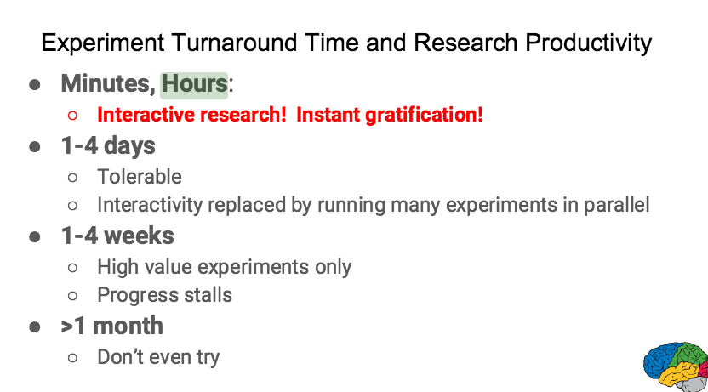

Slide 25
Lessons Learned
Build tools to gain insight into the exact number of parameters in a given model
Start small and scale up
Ensure the objective function matches between systems and with your goal
Debug local before distributed
Guard against numerical errors (overflow, NaN, etc.)
Analyze a network and understand the magnitude of numerical error (compare across machines)

Slide 26
Supported configurations
New Python 3 support.
Following recommended configurations:
Ubuntu/Linux 64-bit, CPU only, Python 2.7
Ubuntu/Linux 64-bit, GPU enabled, Python 2.7 Requires CUDA toolkit 7.5 and CuDNN v4.
Ubuntu/Linux 64-bit, CPU only, Python 3.4
Ubuntu/Linux 64-bit, GPU enabled, Python 3.4 Requires CUDA toolkit 7.5 and CuDNN v4.
Ubuntu/Linux 64-bit, CPU only, Python 3.5
Ubuntu/Linux 64-bit, GPU enabled, Python 3.5 Requires CUDA toolkit 7.5 and CuDNN v4.
Mac OS X, CPU only, Python 2.7:
Mac OS X, CPU only, Python 3.4 or 3.5

Slide 27
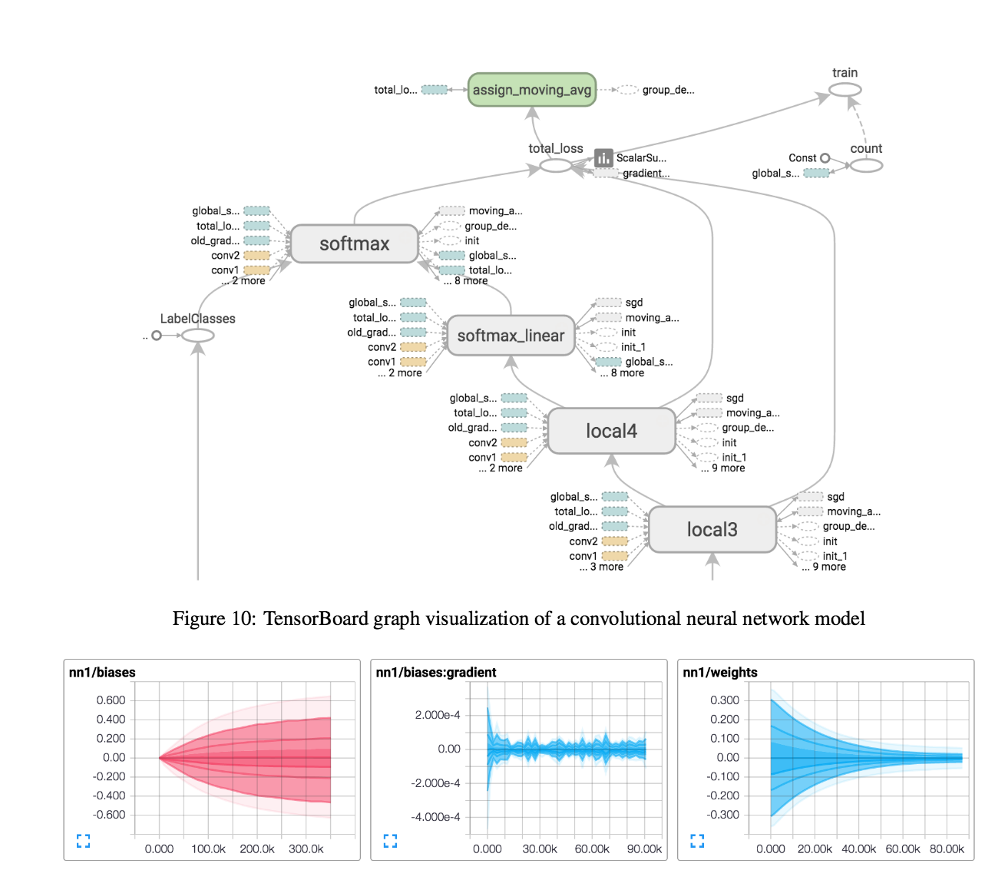
TensorBoard Visualization

Slide 28
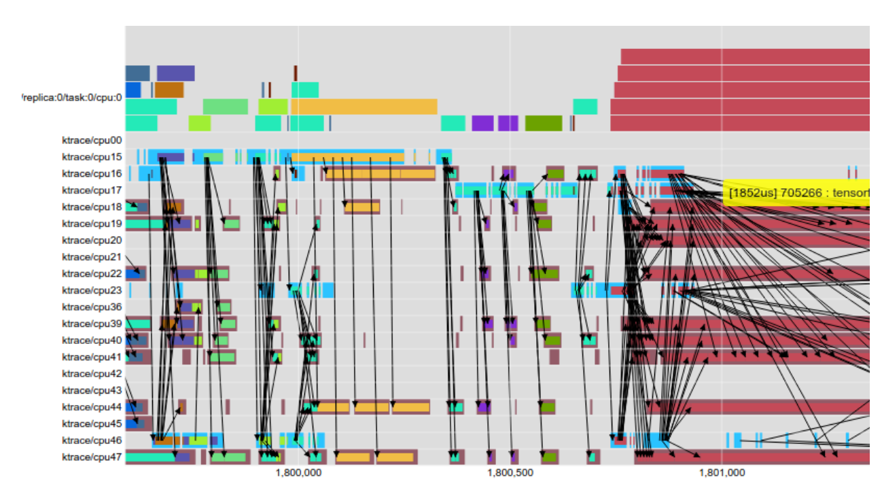
EEG Performance Visualization

Slide 29
Roadmap
Better C++ only support
API changes for easier distributed jobs
Performance/benchmark improvements
Support for
OpenCL
Windows
Mesos, HDFS, Yarn, etc.

Slide 30
Highlights of outstanding features
Outstanding: L2 regularization and dropout
Reinforcement learning very slow
Open source profiler
Support more image formats
Implement FFT operations
C# API, Swift API, R API
Java/.NET interfaces

Slide 31
Similar libraries
Caffe - Berkeley Vision and Learning Center
CNTK – Microsoft
Deeplearning4j – Adam Gibson et al.
H2O Deep Learning – H20.ai
SystemML – IBM Research
Theano – University of Montreal
Torch – Collobert et al.

Slide 32
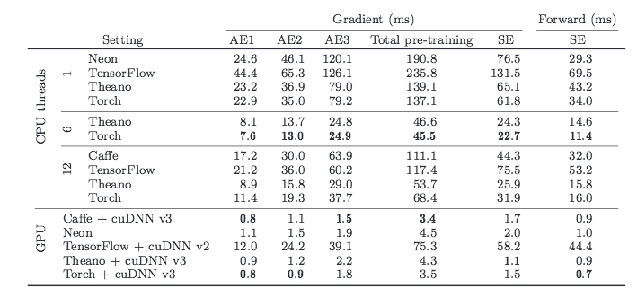
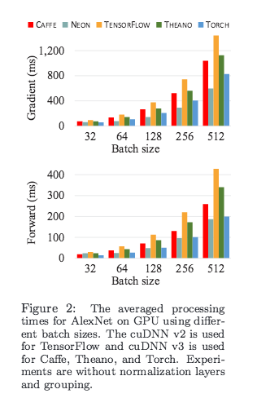
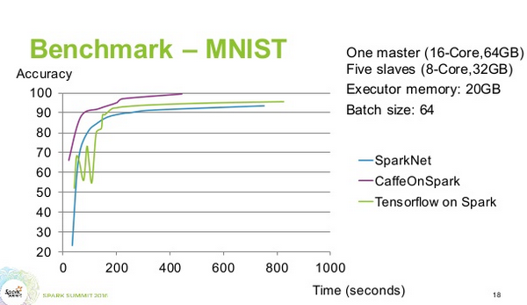
Performance Comparison

Slide 33
Feature comparison
Library | Interface | OpenMP | OpenCL | CUDA | Pretrained models | Recurrent | Convolutional | DeepBelief
Caffe | C++/Python/Matlab | N | 3rdParty | Y | Y | Y | Y | N
CNTK | C++/Python/.NET (soon) | Y | N | Y | N | Y | Y | ?
Deeplearning4j | Java/Scala/C | ? | N | Y | Y | Y | Y | Y
H20 | Python/R | Fork/Join | N | N | N | N | N | ?
TensorFlow | C++/Python | N | Roadmap | Y | N | Y | Y | Y
Theano | Python | Y | Development | Y | Y | Y | Y | Y
Torch | Lua, C, library for C++ | Y | 3rdParty | Y | Y | Y | Y | Y
KDD Usage Poll
Pylearn2 (55 users)
Theano (50)
Caffe (29)
Torch (27)
Cuda-convnet (17)
Deeplearning4j (12)
Other Deep Learning Tools (106)

Slide 34
Other considerations
Does not support so-called “inline” matrix operations
Google’s acknowledged goal with TF seems to be recruiting
TensorFlow is not commercially supported
TensorBoard for visualization
Data AND model parallelism
Slower than other frameworks
Not many pretrained models
Computational graph is pure Python, so slow

Slide 35
References
https://www.tensorflow.org/
https://github.com/tensorflow/tensorflow
http://arxiv.org/abs/1603.04467
http://static.googleusercontent.com/media/research.google.com/en//pubs/archive/44921.pdf
http://download.tensorflow.org/paper/whitepaper2015.pdf
http://www.kdnuggets.com/2015/05/poll-r-rapidminer-python-big-data-spark.html
https://en.wikipedia.org/wiki/Comparison_of_deep_learning_software
http://deeplearning4j.org/compare-dl4j-torch7-pylearn.html

Slide 36
