Slide 1
Thinking Bayesian
part 1 of n
Pradeep Gowda
Data Science Indy
April 10, 2014

Slide 2
The unreasonable effectiveness of data
eponymous paper at IEEE intelligent systems
research.google.com/pubs/archive/35179.pdf
Lecture by Norvig (co-author):
  https://www.youtube.com/watch?v=yvDCzhbjYWs
“given enough data, often the choice of mathematical model stops being as important”
  ie., "simple models and a lot of data trump more elaborate models based on less data."
  caveats apply

Slide 3
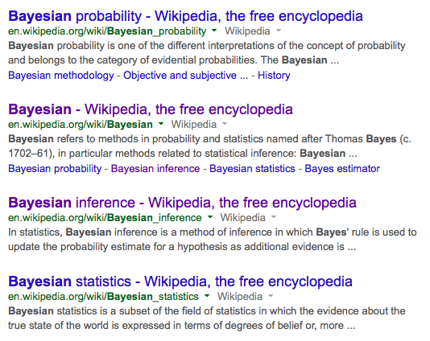
So, Bayesian?
Not to forget bayesian {networks, belief networks, regression, classification}

Slide 4

Bayesian...
ZZZ.....

Slide 5
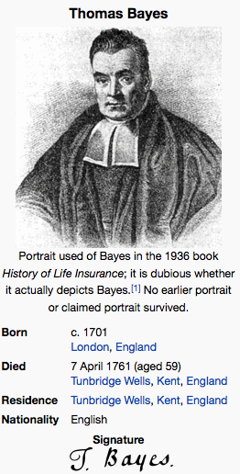
Bayes

Slide 6
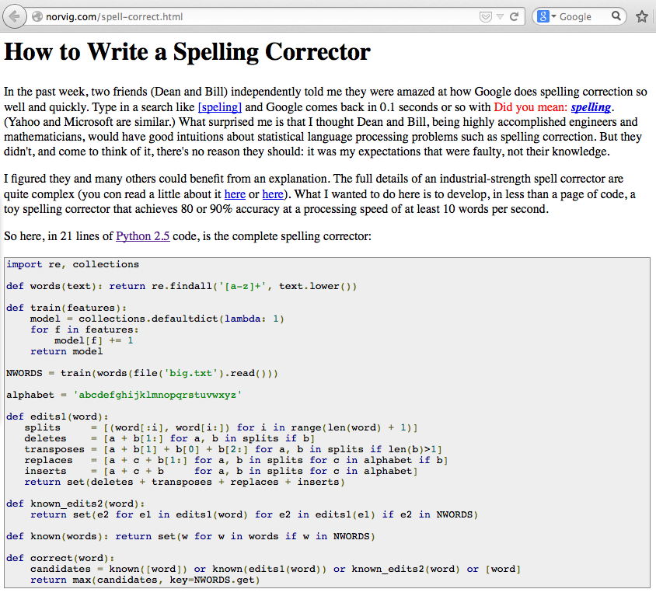
Spelling corrector
http://norvig.com/spell-correct.html

Slide 7
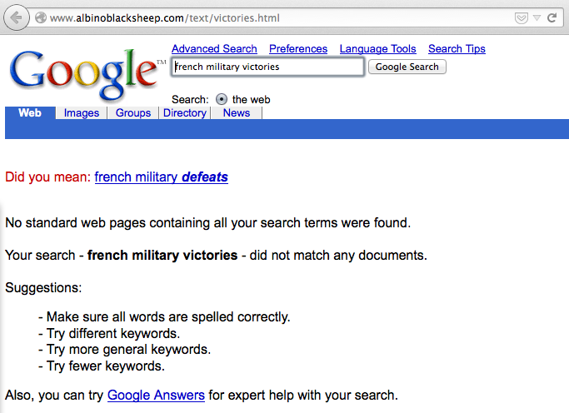
Google bomb
http://en.wikipedia.org/wiki/Google_bomb

Slide 8
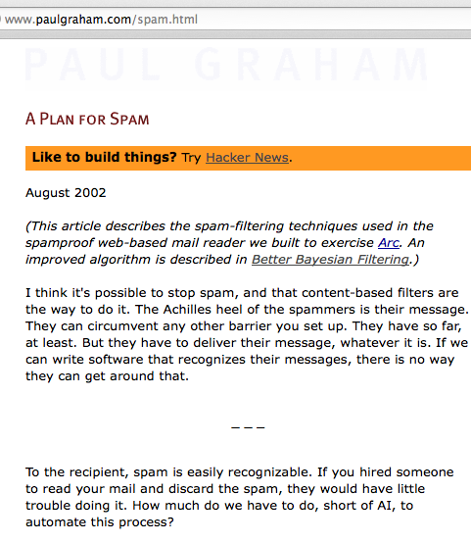
A plan for spam
http://www.paulgraham.com/spam.html

Slide 9
Bayesian Inference
Use of Bayes' theorem to update probabilities as new evidence is available
This is valuable to analyze trends as we collect data over time
This provides a rational method for updating “BELIEFS”

Slide 10
However,
1% of women at age forty who participate in routine screening have breast cancer. 80% of women with breast cancer will get positive mammographies. 9.6% of women without breast cancer will also get positive mammographies. A woman in this age group had a positive mammography in a routine screening. What is the probability that she actually has breast cancer?
http://yudkowsky.net/rational/bayes

Slide 11
10,000 women undergo
checkups
99% = 9900 DON'T have BC
1% = 100 have BC
D
A
C
B
80 get +ve M.gr
20 get -ve M.gr
950 get +ve M.gr
8950 get -ve M.gr
1030 get +ve Mammography
A+B+C+D = 10,000
= (80/1030)
or
= 7.8%
80 really have BC

Slide 12
Using the Bayes Theorem
p(c) = probability of cancer
p(posm) = probability of +ve mammogram
p(c|posm) = prob. Of cancer given a +ve m.gr
p(posm|c) = prob of a +ve m.gr given patient has cancer
p(c|posm) = p(c|posm) p(c)
--------------------
p(posm)
= 80x100/1030

Slide 13
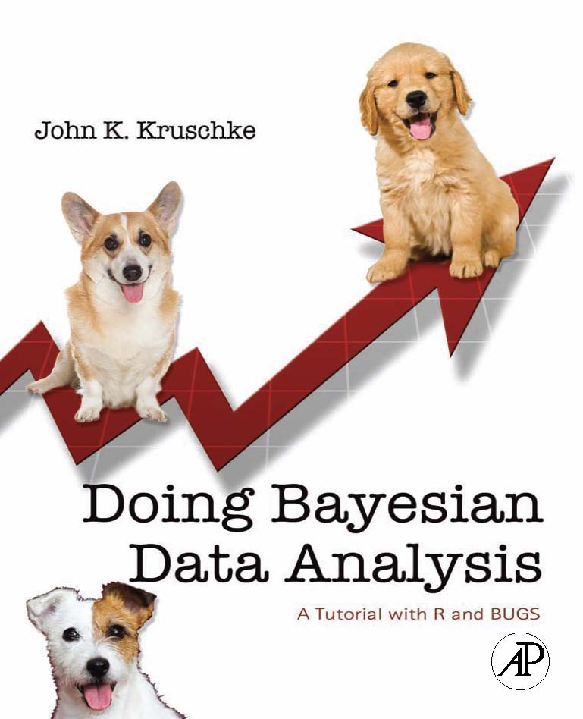
References
http://jakevdp.github.io/blog/2013/10/26/big-data-brain-drain/
http://yudkowsky.net/rational/bayes
http://www.greenteapress.com/thinkbayes/
http://www.indiana.edu/~kruschke/DoingBayesianDataAnalysis/

