Slide 1


Slide 2
Contents:
Introduction
Laws of Motion
Equations of Motion
Speed
Velocity
Types of Motion

Slide 3
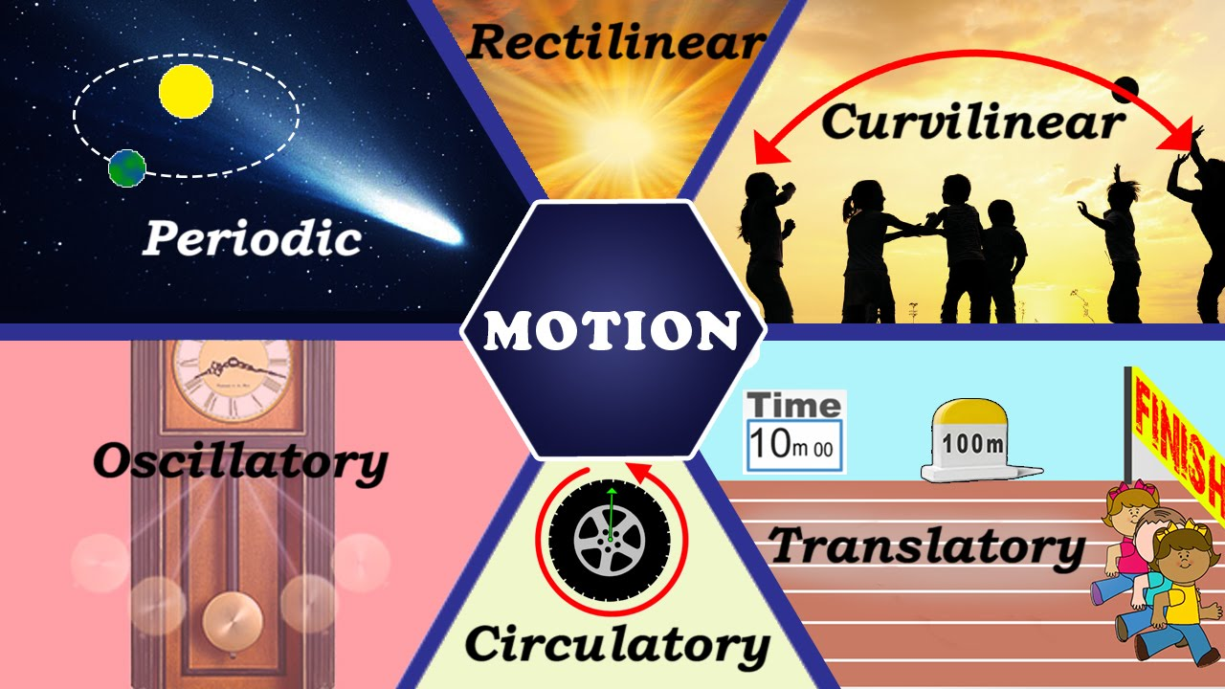
Introduction
In physics, motion is the change in position of an object with respect to its surroundings in a given interval of time.

Slide 4
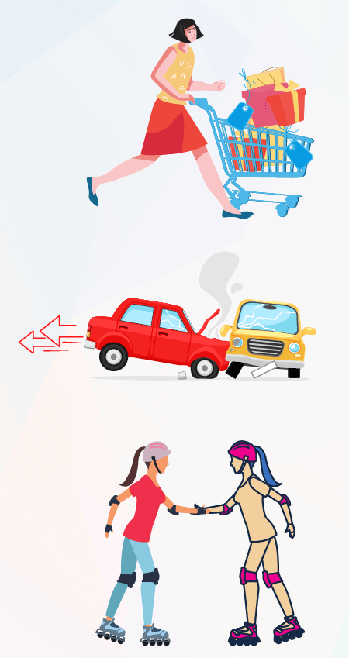
Laws of Motion:
First Law: Any object will remain in its existing state of motion or rest unless a net external force acts on it.
Second Law: If an object has a certain mass, the greater the mass of this object, the greater will the force required to be to accelerate the object.
Third Law: For every action, there is an equal and opposite reaction.

Slide 5
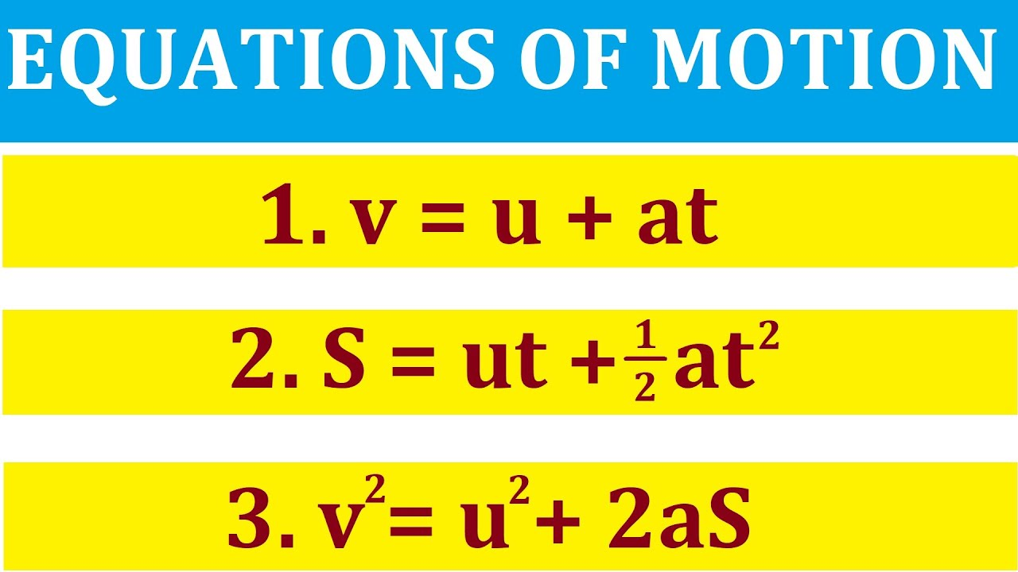
Equations of Motion
The primary equations of motion, often referred to as the SUVAT equations, relate the following variables :
u: Initial velocity
v: Final velocity
s: Displacement
a: Acceleration
t: Time

Slide 6
Speed
Speed is defined as the rate at which an object covers distance. It measures how quickly something is moving from one place to another, typically expressed in meters per second (m/s) or kilometers per hour (km/h).
v = d/t​

Slide 7
Velocity
Velocity is the rate at which an object changes position with time. An object is displaced when it changes its position
It is a vector quantity that has both magnitude and direction.
v = dx/dt

Slide 8
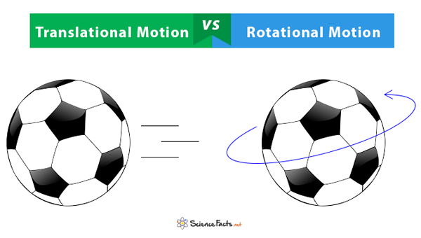
Types of Motion :
Translational – It is the type, where an object moves along a path in any of the three dimensions.
Rotational – It is the type, where an object moves along a circular path about a fixed axis.

Slide 9
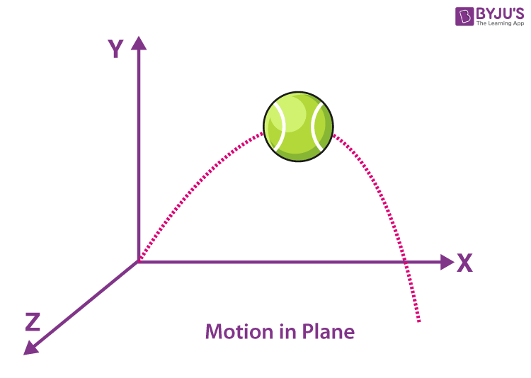
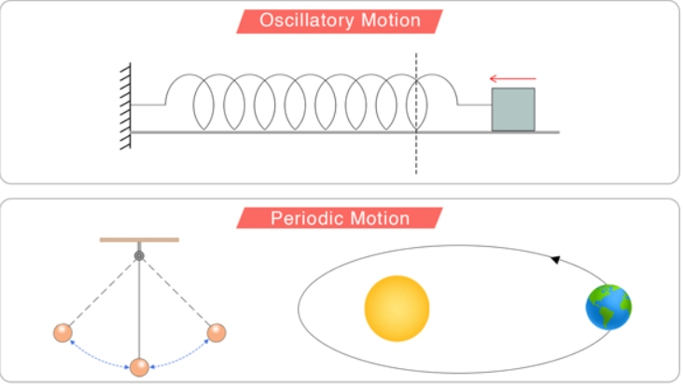
Linear – It is a type of translational motion where the body moves in a single direction along a single dimension.
Projectile – It is the type of motion which has a horizontal displacement as well as vertical displacement.
Oscillatory – It is the type of motion which is repetitive in nature within a time frame. If it is mechanical, it is called vibration.
Periodic – It is the type of motion that repeats itself after certain intervals of time

Slide 10
Thank You
Dimple Singh
Batch I.D. :
241004514302

