Slide 1
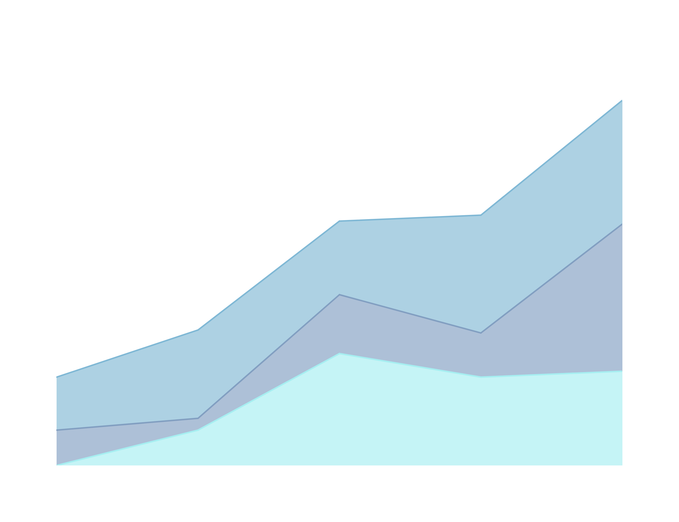

HUMAN RESOURCES ANALYSIS
Team 15
PRIYANSHI - 202418002
BHAVIN - 202418018
MEENAKSHI - 202418031
NUPOOR - 202418040

Slide 2
HR Data at a Glance
This synthetic HR dataset, created by Dr. Carla Patalano and Dr. Rich Huebner, represents employee information from a fictitious company. It includes demographics, employment details, performance metrics, and recruitment info. Designed for teaching and learning HR analytics, the dataset helps explore topics like diversity, retention, compensation equity, and employee engagement. Licensed under CC BY-NC-ND 4.0, it is widely used in HR courses for Tableau and data analysis practice.

Slide 3
Description of Dataset:
The Human Resource Dataset includes records of 311 employees with details on demographics (gender, marital status), employment (department, manager, hire/termination dates), performance (absences, performance score, termination status). Derived variables were also created for visualizations, such as average absences by termination and performance, median salary by gender and marital status, and salary distribution by role and gender.

Slide 4

Hypotheses Overview
Hypothesis 1: Employees with lower performance or higher absence are most likely to get terminated.
Hypothesis 2: Woman are paid less compared compared to male worker.
Hypothesis 3: Performace of employee can
depend upon the manager they are working under.
Hypothesis 4: Performance score of an employee can be associated from where the employee has been recruited.
Mean
average of all the data values in the set

Slide 5
Hypothesis 1
H1: Termination Analysis
Null Hypothesis (H₀): Absenteeism and performance score are not significantly related to an employee's likelihood of termination.
Alternative Hypothesis (H₁): Employees with more absences and lower performance scores are more likely to be terminated.

Slide 6
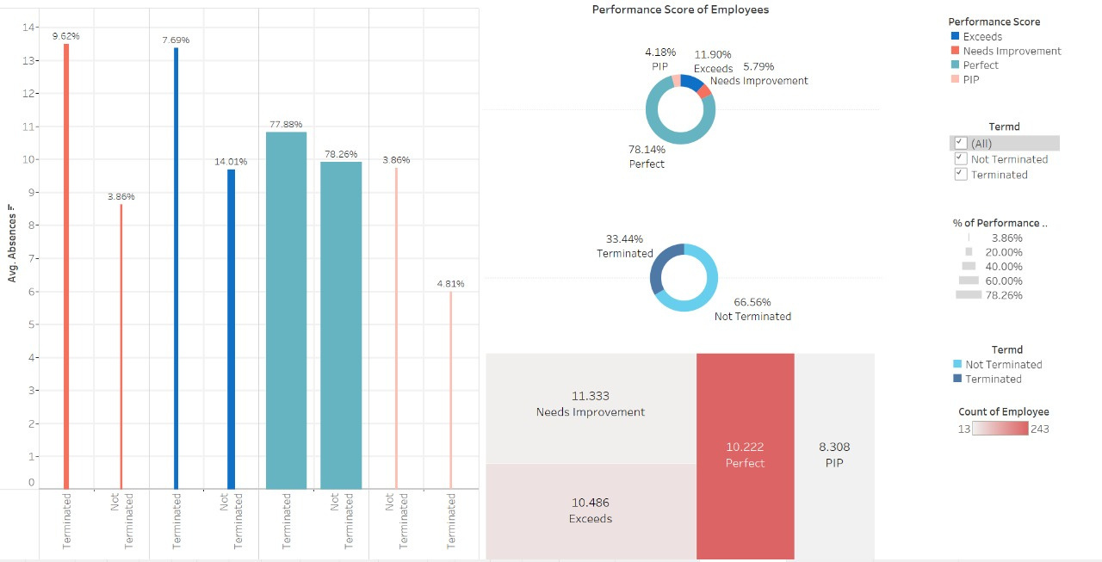
Analyzing Absences, Performance, and Termination

Slide 7
Key Insights: Termination Analysis
Higher absenteeism is strongly linked to termination, especially in low performers.
“Needs Improvement” group: 9.62 avg. absences (terminated) vs 3.86 (non-terminated)
Even “Perfect” performers face termination — avg. absences still high (10.2).
In the PIP group, performance alone may lead to termination, even with fewer absences.
Terminated employees consistently show higher average absences across performance categories compared to non-terminated ones.

Slide 8
Hypothesis 2
H2: Gender Pay Analysis
Null Hypothesis (H): There is no significant salary pay gap between men and women in the workforce.
Alternative Hypothesis (H): There is a significant salary pay gap between men and women in the workforce.

Slide 9
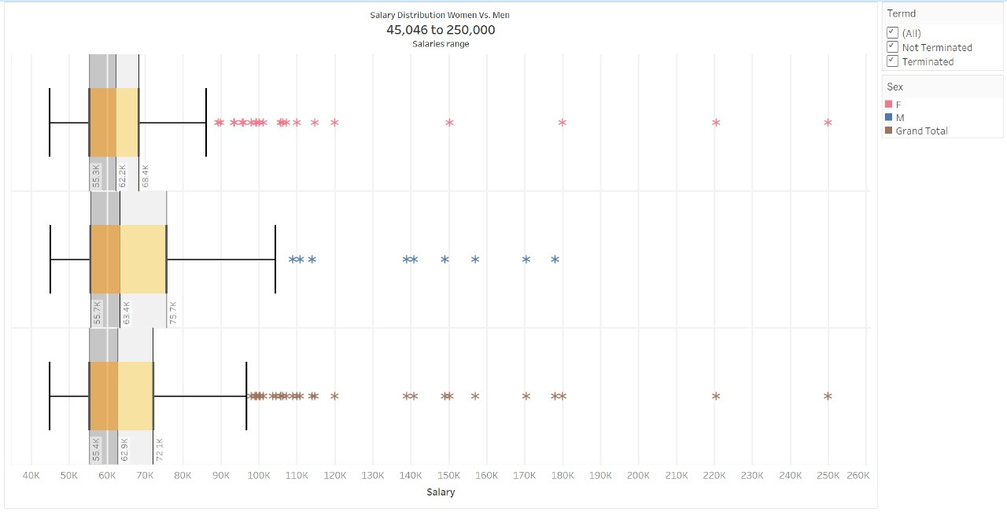
Gender-Based Salary Distribution:
A Visual Comparison of Male vs. Female Earnings

Slide 10
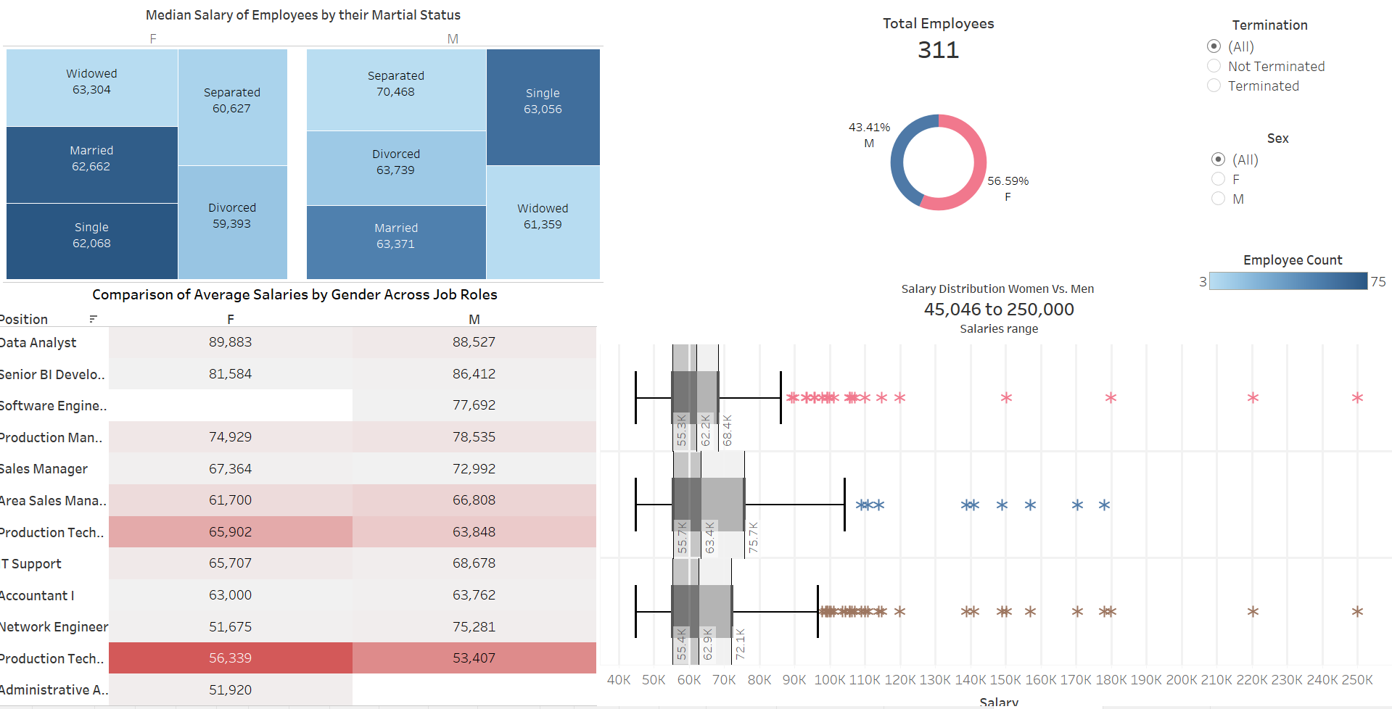
Are Women Paid Less? A Data-Driven View

Slide 11
Gender Pay Gap: Role Distribution, Not Discrimination
While women make up the majority of the workforce (56.6%), their median salary is slightly lower than men’s (~$1.1K difference). However, this gap is not due to unequal pay for equal work. Instead, it results from role distribution — more women occupy lower-paying positions, while men are more prevalent in high-paying technical and managerial roles. When salaries are compared within the same roles, women often earn equally or more, indicating that the observed gap is structural, not discriminatory.

Slide 12
Hypothesis 3
H3: Manager Impact Analysis
Null Hypothesis (H₀): There is no significant relationship between an employee’s performance and the manager they work under.
(Manager has no effect on employee performance.)
Alternative Hypothesis (H₁): There is a significant relationship between an employee’s performance and the manager they work under. (Manager does have an effect on employee performance.)

Slide 13
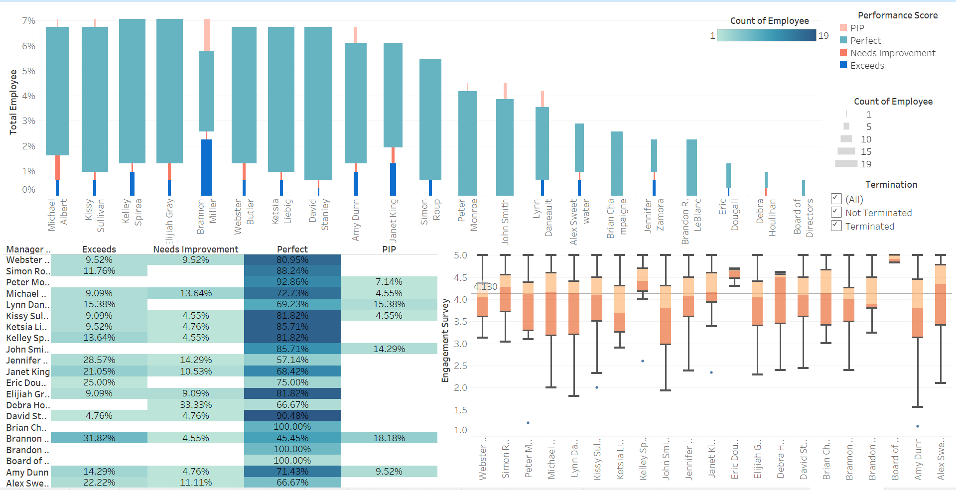
Manager Influence on Employee Performance and Engagement

Slide 14
Manager Influence on Employee Performance and Engagement
Variations in performance scores across managers.
Some managers have consistently high-performing teams (100% Perfect), while others have teams with more employees in PIP or Needs Improvement.
The Engagement Survey box plots correlate—managers whose teams perform better also tend to have higher engagement levels.

Slide 15
Hypothesis 4
H4: Recruitment Source Analysis
Null Hypothesis (H0): Employee performance is independent of the recruitment source. That is, the percentage of employees meeting or exceeding expectations does not significantly vary across different recruitment sources.
Alternative Hypothesis (HA): Employee performance depends on the
recruitment source. That is, certain recruitment sources yield employees who perform better or worse than those from other sources.

Slide 16
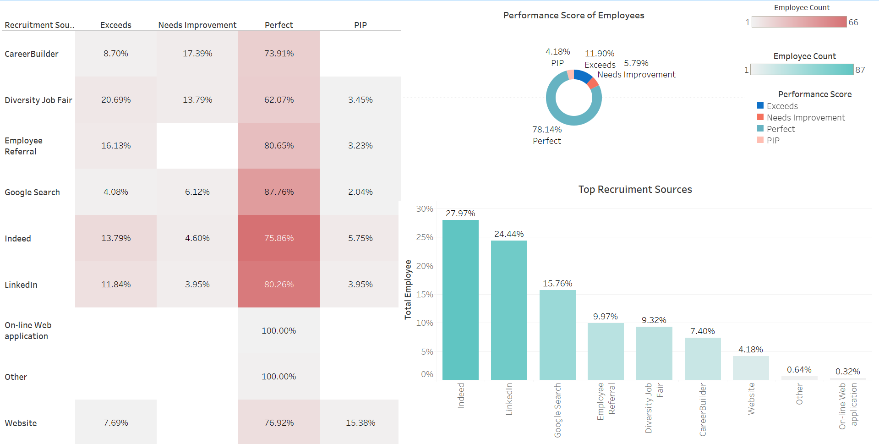
Impact of Recruitment Source on Employee Performance.

Slide 17
Recruitment Source Impacts Employee Performance
Employee performance clearly varies by recruitment source. While Indeed and LinkedIn are the top hiring channels by volume, Google Search delivers the highest-quality hires (87.76% rated “Perfect”). LinkedIn balances both quantity and quality, making it highly effective. Employee referrals also show strong performance reliability. This supports the idea that recruitment source significantly influences employee outcomes, suggesting that focusing on high-yield sources like Google, LinkedIn, and referrals can strategically enhance workforce quality.

Slide 18

?
Potential Questions
?
?
Does marital status influence employee attrition rates, particularly among married females?
?
How does an employee’s performance score correlate with their salary, and is there a gender-based pay gap?
Is there a significant relationship between an employee’s recruitment source and their performance score?

Slide 19
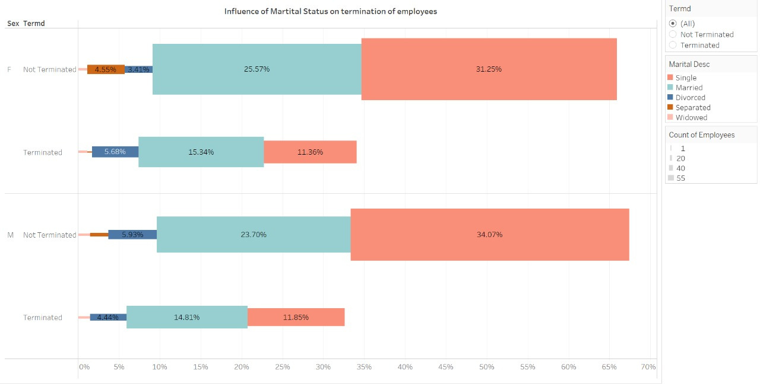

Slide 20
Does Marital Status Influence Employee Attrition Rates,
Particularly Among Married Females?
The chart analyzes termination rates by gender and marital status. Among female employees, 15.34% of married women were terminated, compared to 11.36% of single women. Similarly, 14.81% of married men were terminated, slightly higher than 11.85% of single men. While termination rates are marginally higher for married employees, the trend is similar across genders. Thus, marital status may influence attrition, but not specifically for females.

Slide 21
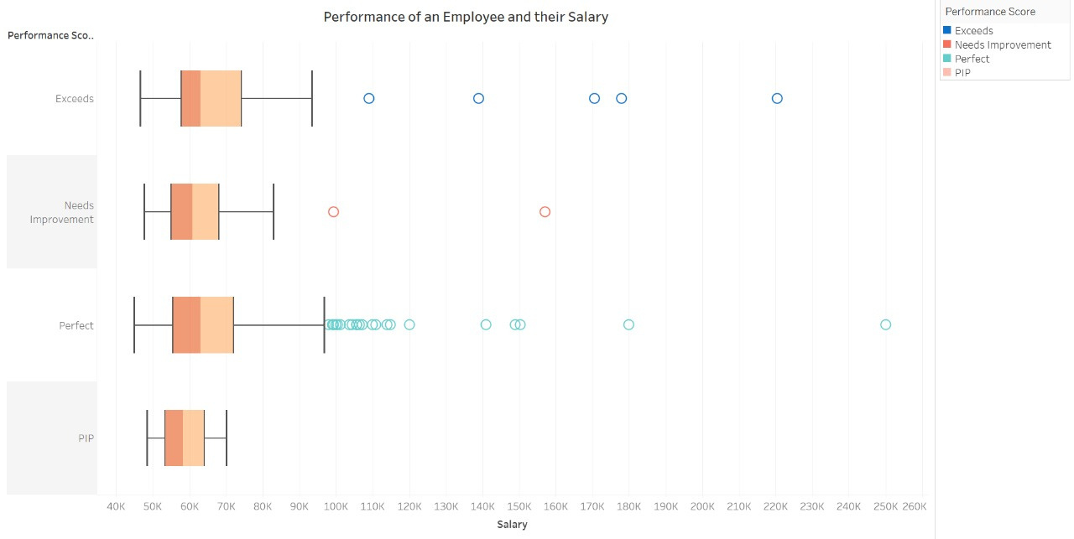

Slide 22
How Does an Employee’s Performance Score Correlate with Their Salary? Is There a Gender-Based Pay Gap?
This visualization shows salary distributions across performance scores. Employees with “Perfect” or “Exceeds” ratings tend to have higher and more varied salaries, while those rated “PIP” have lower, tighter ranges. Although salary appears to increase with performance, the chart doesn’t show gender. Therefore, no direct conclusion about a gender pay gap can be drawn without further gender-based breakdown.

Slide 23
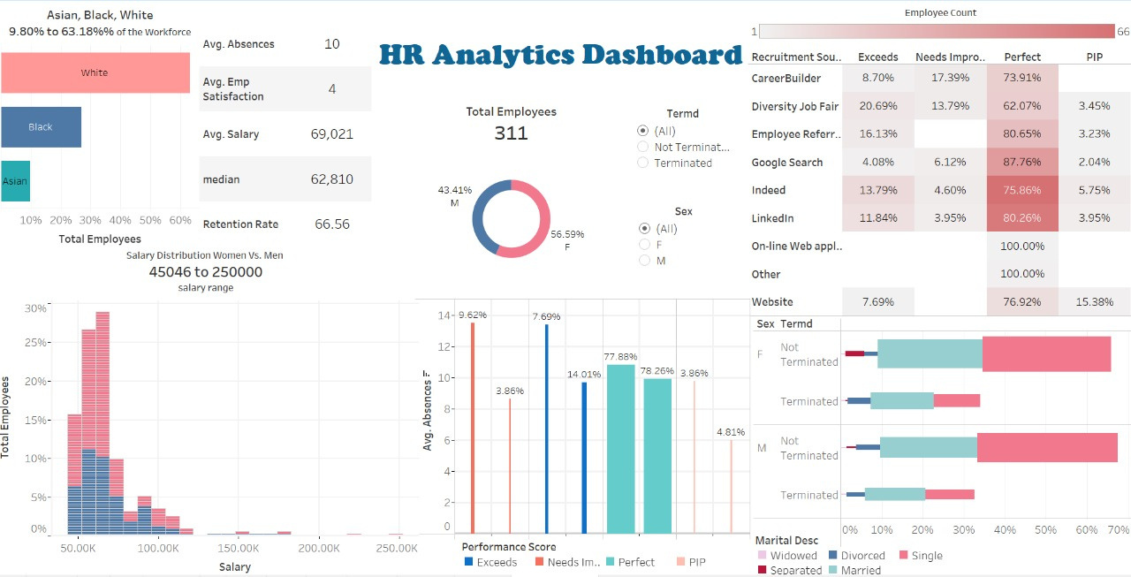

Slide 24
THANK YOU FOR
your time!

