Slide 1





STAN: Spatio-Temporal Attention Network for Next Location Recommendation
$${Yingtao Luo}^{1}, {Qiang Liu}^{2}, {Zhaocheng Liu}^{3}$$
$${}_{ }^{1}{University of Washington }{}_{ }^{2}{Chinese Academy of Sciences } {}_{ }^{3}{Renmin University of China}$$

Slide 2
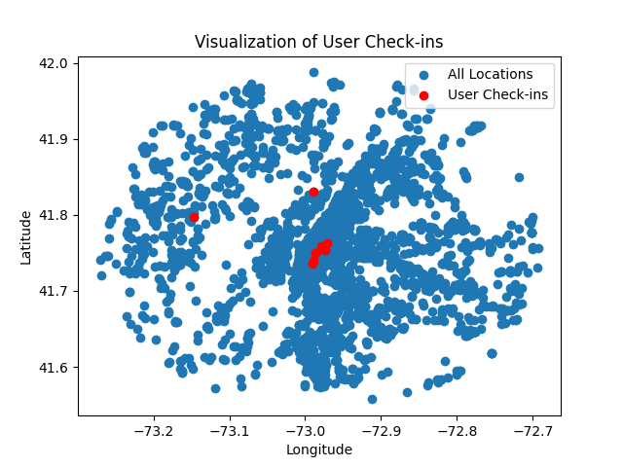
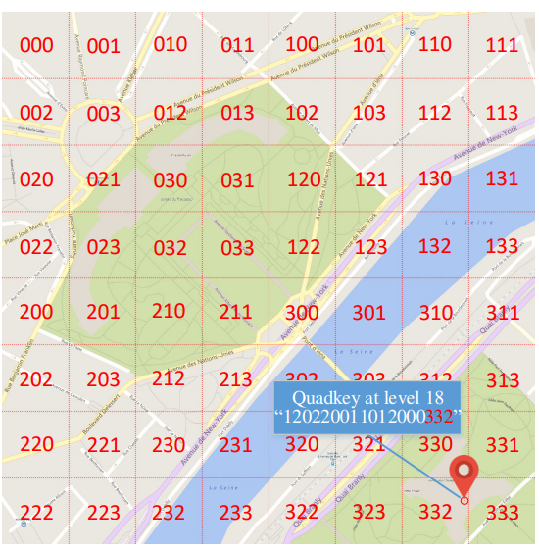


Previous assumption
User Activity Center(s) Group Adjacent Locations

Slide 3







Observation
Visits are spatially sparse Visiting frequency varies

Slide 4
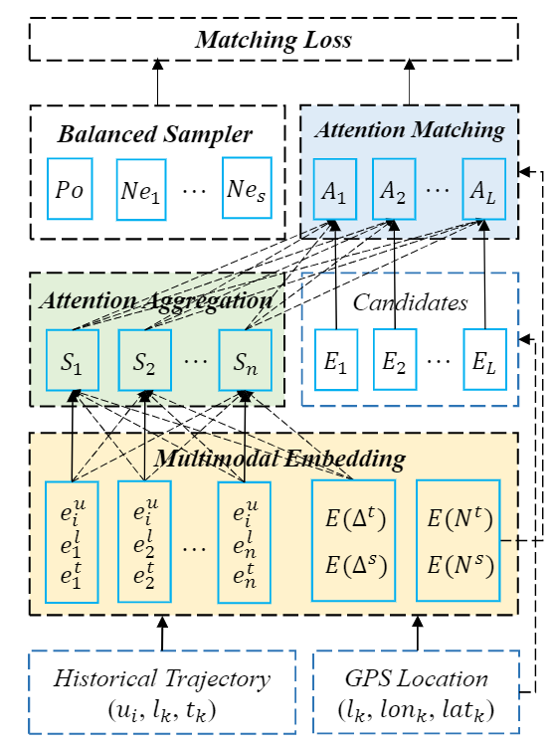
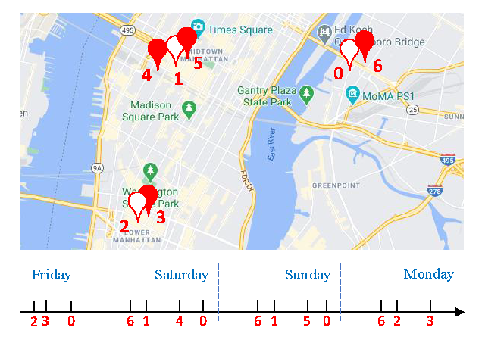
Motivation
Non-Adjacent Locations & Non-Consecutive Visits
Restaurant
0
Home
1
Workplace
2
Mall
Adjacency

Slide 5










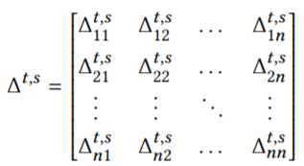
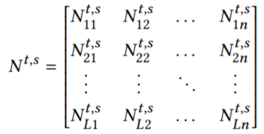


Spatio-Temporal Relation
The set of user, location and time.
The trajectory of each user.
Trajectory Spatio-Temporal Relation Matrix.
Candidate Spatio-Temporal Relation Matrix.
Location candidate
and location of the check-in

Slide 6




Trajectory Embedding
Direct latent embedding.
$$u_{i}∈ℝ^{1}→e_{i}^{u}∈ℝ^{d}$$
$$l_{i}∈ℝ^{1}→e_{i}^{l}∈ℝ^{d}$$
$$t_{i}∈ℝ^{1}→e_{i}^{t}∈ℝ^{d}$$
$$e_{i}^{r}=e_{i}^{u}+e_{i}^{l}+e_{i}^{t}∈ℝ^{d}$$

Slide 7
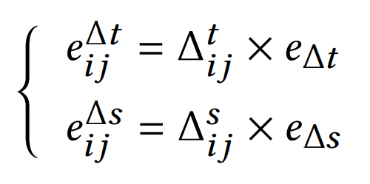









Spatio-Temporal Embedding
Dense and Continuous at the same time.
Separate Embedding (In the past)
$$∆_{i,j}^{l}=3→e_{i,j}^{∆l}$$
$$∆_{k,p}^{l}=4→e_{k,p}^{∆l}$$
$∆_{i,j}^{t}∈ℝ^{1}→e_{i,j}^{∆t}∈ℝ^{d}$, $∆_{i,j}^{l}∈ℝ^{1}→e_{i,j}^{∆l}∈ℝ^{d}$
$e_{k,p}^{∆l}/e_{i,j}^{∆l}$ is meaningless
Continuous Embedding (Now)
$Unit embedding: e_{∆t}∈ℝ^{d}$, $e_{∆l}∈ℝ^{d}$
Unit
$$Continuous:$$
$$∆_{i,j}^{l}=3→e_{i,j}^{∆l}=3×e_{∆l}$$
$$e_{k,p}^{∆l}/e_{i,j}^{∆l}=\frac{4}{3}$$
$$∆_{k,p}^{l}=4→e_{k,p}^{∆l}=4×e_{∆l}$$

Slide 8
Attention Aggregation
Update representations.
Separate Embedding (In the past)
$∆_{i,j}^{t}∈ℝ^{1}→e_{i,j}^{∆t}∈ℝ^{d}$, $∆_{i,j}^{l}∈ℝ^{1}→e_{i,j}^{∆l}∈ℝ^{d}$
Continuous Embedding (Now)
$Unit embedding: e_{∆t}∈ℝ^{d}$, $e_{∆l}∈ℝ^{d}$
$$Continuous:$$

