Slide 1


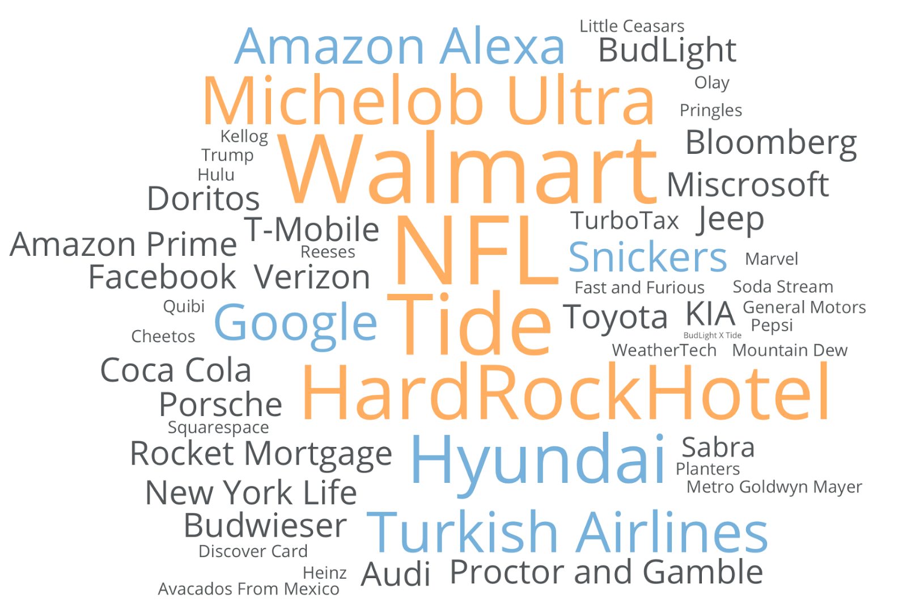
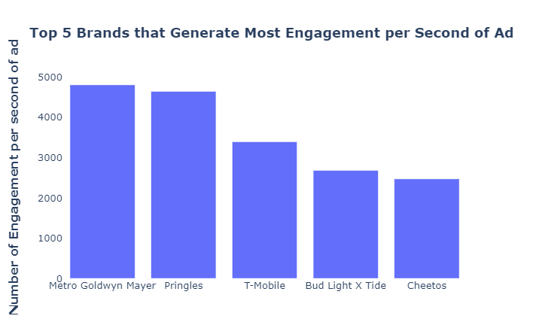
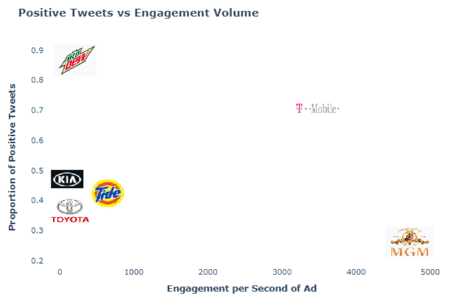
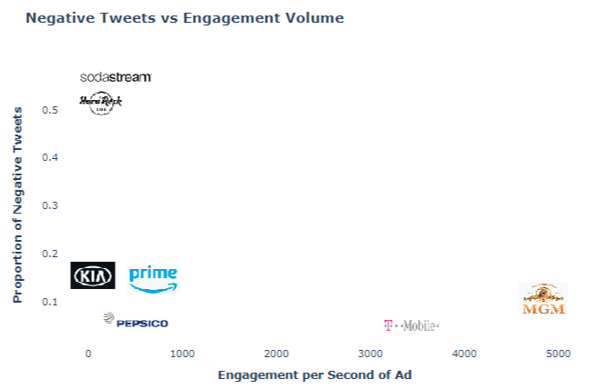

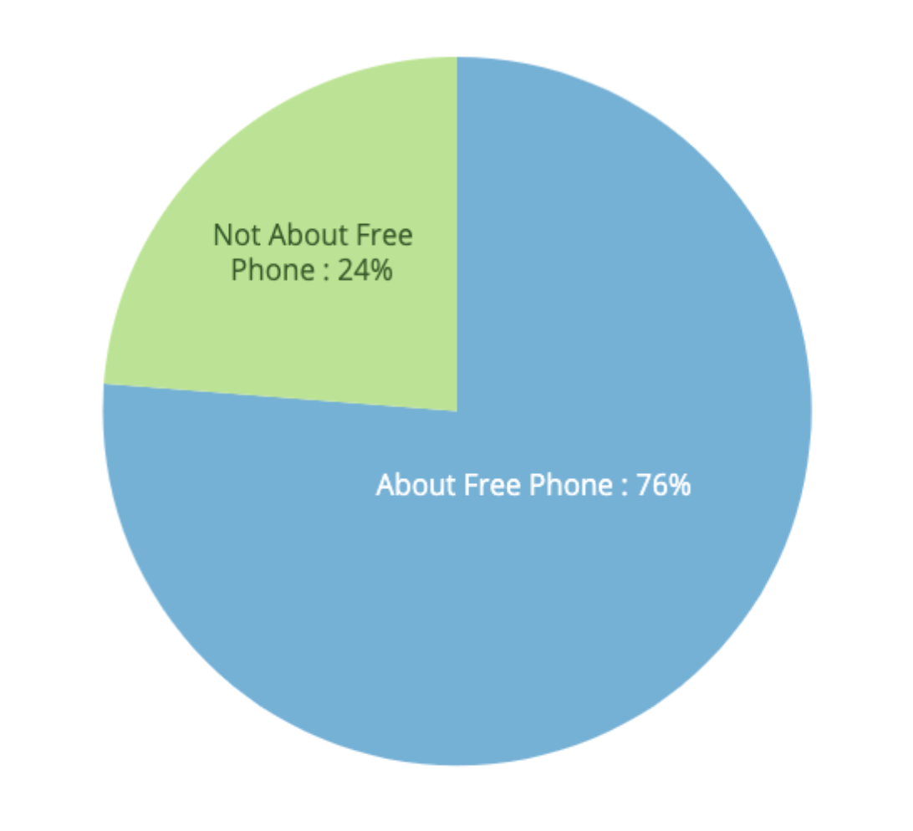
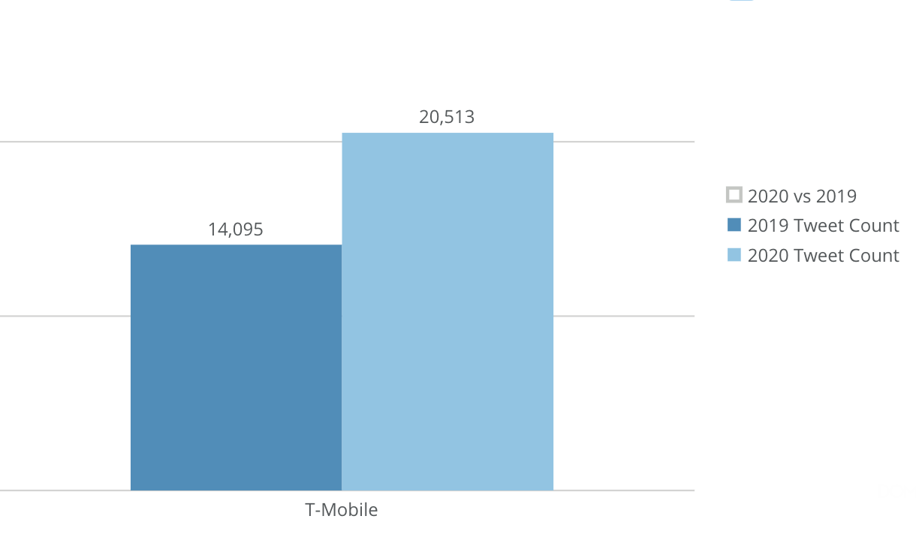
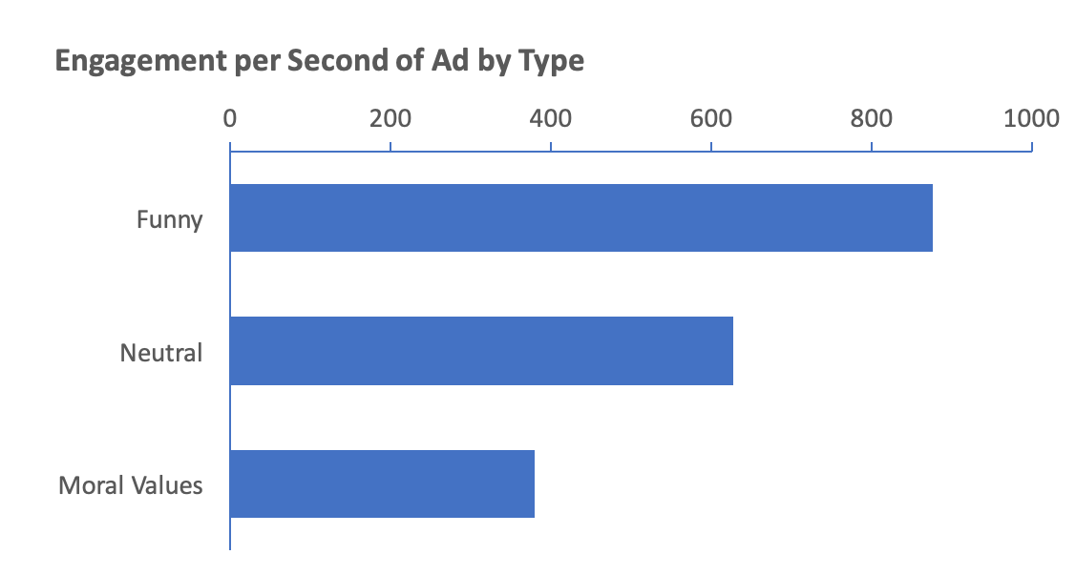

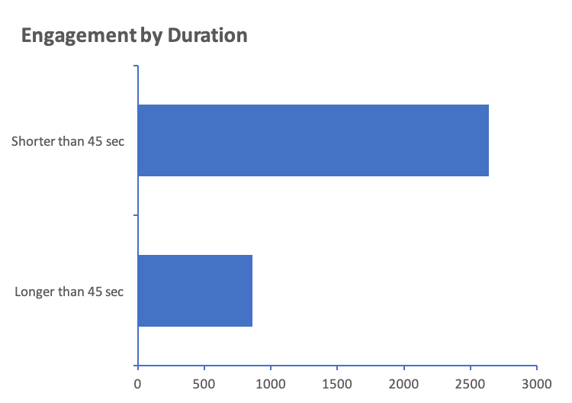
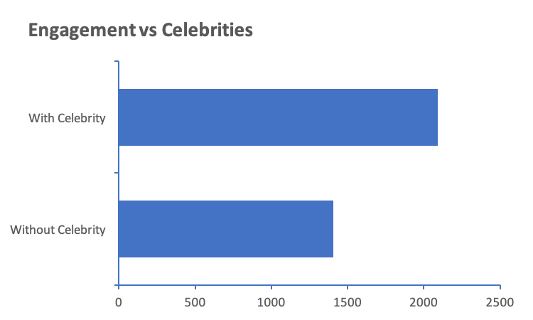





TEAM GOAL
How: gifts and commercials
What: funny stuff, celebrity, and shorter
When: 4th quarter
General
$9.7M
$5.6M
/30
sec
Avg.
Cost
Big Spenders
NFL
Walmart
Tide
HardRockHotel
Hyundai
METRICS
Engagement = Retweeted Count + Reply Count + Favorite Count
FUNNY!
SHORTER!
CELEBRITY!
2020 Game Day Analytics Challenge

