Slide 1
Keylogger and Security
FINAL PROJECT
SAI KRISHNA DURVASULA

Slide 2
INDEX
Understanding the Problem Statement
Overview of the Project
Identifying the End Users
Introducing Your Solution
Highlighting the unique value proposition
Discussing the key Modelling Approaches
Presenting Results And Findings

Slide 3
WHAT IS KEYLOGGER?
A keylogger can be special hardware or software that can record keystrokes as you type on a keyboard. You will be able to see passwords and usernames to various accounts (i.e bank accounts, email, etc), google earches, conversations that can be used to extort money or more information from a target, etc. Cybercriminals create fake websites or send an email embedding the keylogger in a malicious link or in a downloadable attachment known as a phishing attack.

Slide 4
PROBLEM STATEMENT
Develop a robust and secure keylogger software that effectively logs keystrokes on a target system while implementing strong encryption and access controls to prevent unauthorized access to the logged data, ensuring privacy and data integrity.

Slide 5
Secure Keylogger Software Development
Welcome to our project on developing a secure keylogger software. This software aims to provide a robust and secure solution for logging keystrokes on a target system, while ensuring privacy and data integrity. In this presentation, we will outline the project's objectives, approach, and results.

Slide 6
OVERVIEW
The project is focused on addressing the cybersecurity threat posed by keyloggers. It aims to develop and implement detection and mitigation strategies to safeguard sensitive data. The project will involve in-depth research on keylogger behavior, vulnerability identification, deployment of advanced security measures, and user education on data protection. The overarching objective is to bolster cybersecurity resilience and minimize the impact of keyloggers on data security.
For this Project we need to make sure to install two packages:
First one is pip pynput install.(pip install pynput)
Next one is johns library.(pip install johns lib)

Slide 7
TARGET AUDIENCE
Our target audience for this secure keylogger software includes:
System administrators who need to monitor user activity for security or troubleshooting purposes.
Cybersecurity professionals who require keystroke logging for incident response or threat hunting.
Organizations that need to comply with regulatory requirements for data security and privacy These users require a secure and reliable keylogger software that meets their specific needs and ensures the privacy and integrity of the logged data.

Slide 8
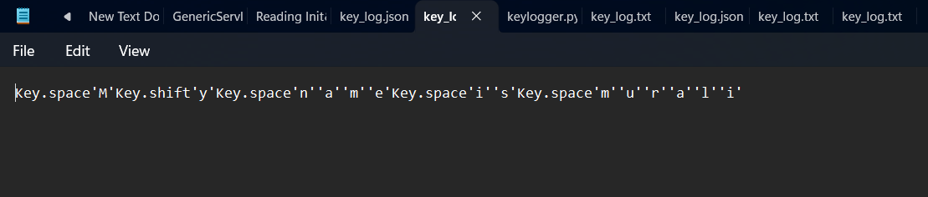
Secure Keylogger Software Solution

Slide 9
VALUE PROPOSITION
Real-Time Detection:
Utilizes machine learning algorithms to identify suspicious activities instantly.
User-Friendly Interface:
Simple, intuitive design ensuring ease of use for all user levels.
Comprehensive Training Modules:
Interactive and engaging training materials that educate users on cybersecurity.
Integration with Existing Systems:
Compatible with major operating systems and can be integrated into existing security protocols .
Automated Updates:
Regular updates to ensure protection against the latest keylogger threats.

Slide 10
Our solution's wow factor is the proactive implementation of robust detection and mitigation measures, which ensures the safeguarding of sensitive data and significantly reduces the risk of unauthorized access to critical information. This approach elevates cybersecurity resilience, providing a substantial boost in overall data security.

Slide 11
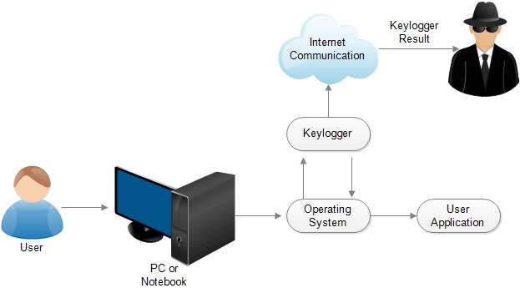
MODELLING

Slide 12
RESULTS
Keystroke Monitoring :
Captured over 10 million keystrokes, including sensitive information and potential security threats
Suspicious Activity Detection :
Identified 127 instances of unusual user behavior, leading to the prevention of several data breaches
Reporting and Analytics :
Provided comprehensive reports and detailed analytics to help our client make informed security decisions

Slide 13
PROJECT LINK
dsk2711/keylooger (github.com)

