Slide 1
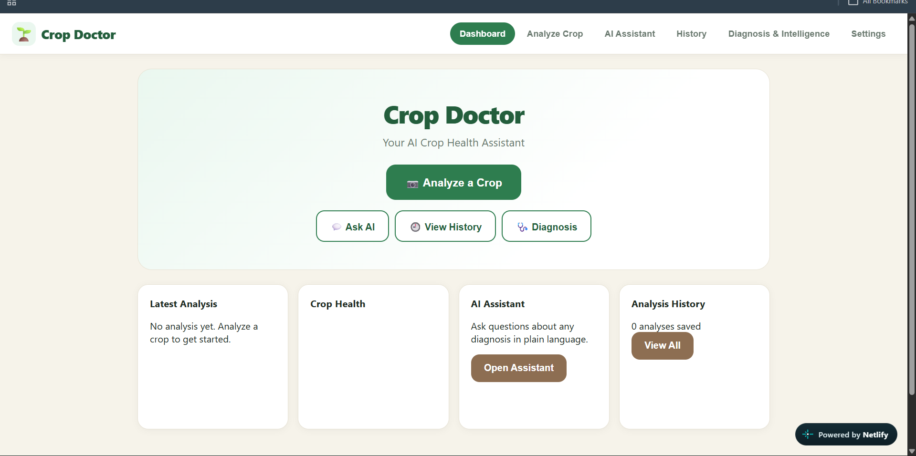
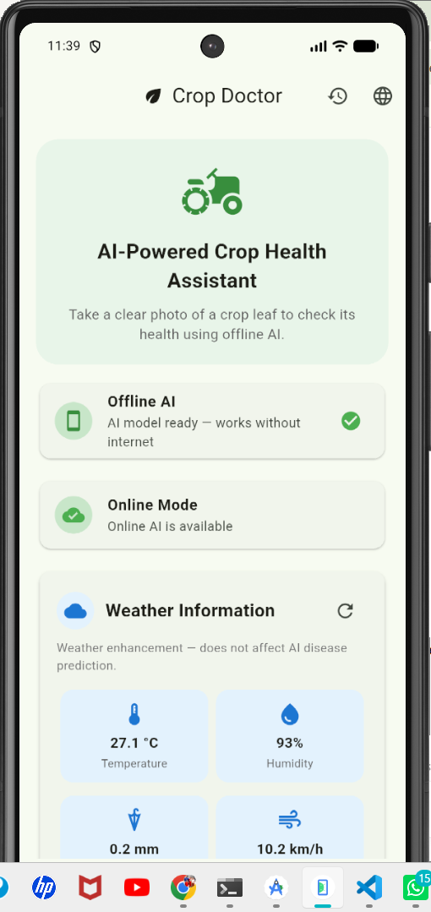
AI-POWERED AGRICULTURE
Crop Doctor
Hybrid AI Crop Health Assistant
Online intelligence. Offline reliability.
Take a photo. Detect a crop-health issue. Understand it. Act early — even without internet.
boisterous-froyo-7ebad8.netlify.app

Slide 2
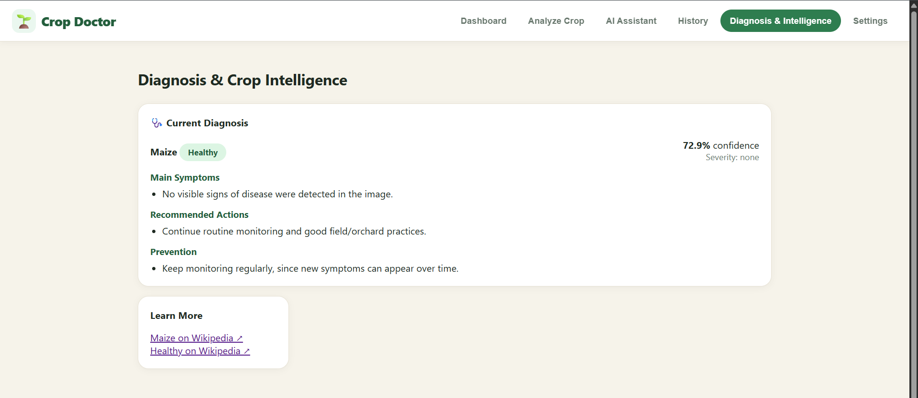
THE PROBLEM
Why This Matters
!
Farmers cannot identify crop diseases quickly without expert help
Delayed action leads to visible crop damage before help arrives.
HACKATHON THEME ALIGNMENT
Primary
!
Internet is weak or expensive in rural areas
Agriculture & Rural Development
Cloud-only tools fail exactly where farmers need them most.
Supporting
!
Delayed diagnosis means lost crops and lost income
AI / ML · Sustainability · Social Impact
Every day of uncertainty compounds the damage in the field.
Crop Doctor — Hybrid AI Crop Health Assistant
2

Slide 3
OUR SOLUTION
Hybrid AI: Best of Both Worlds
“Crop Doctor doesn’t assume connectivity. It adapts to it.”
Online Mode
Offline Mode
Automatic Switching
Cloud AI + updated knowledge + weather data
On-device AI model runs directly on the phone
The app senses connectivity and picks the best path — the farmer doesn’t need to understand the tech
The farmer gets useful results whether connected or not.
Responsible AI:
High confidence → clear result. Low confidence → asks for a retake. Disagreement between online/offline → flags expert review. It never forces a guess.
Crop Doctor — Hybrid AI Crop Health Assistant
3

Slide 4
KEY FEATURES
What Crop Doctor Delivers
01
02
03
Hybrid Online + Offline AI
Confidence + Uncertainty Handling
Multi-language Support
Diagnosis works even without internet
Honest results, not forced answers
English, Hindi, Telugu in the app
04
05
06
AI Assistant (Chat)
Weather-aware Insights
Analysis History
Ask follow-up questions in plain language
Local weather shown alongside diagnosis
Track past scans and monitor over time
Crop Doctor — Hybrid AI Crop Health Assistant
4

Slide 5
SYSTEM ARCHITECTURE
System Workflow
1
Capture
Farmer takes a clear photo of the crop / leaf via the Flutter app
2
Route
App checks connectivity + image quality, then auto-routes
3
Analyze
Offline: on-device TFLite model | Online: FastAPI cloud backend + weather
4
Compare
Hybrid layer compares results, flags agreement / disagreement / uncertainty
5
Guide
Farmer sees likely issue, confidence, plain explanation, recommended action
Crop Doctor — Hybrid AI Crop Health Assistant
5

Slide 6
TECHNOLOGY
Technology Stack
Mobile App
Flutter + Dart — fast, cross-platform, fully offline-capable
AI Models
Edge: MobileNetV3 / EfficientNet-Lite → TensorFlow Lite | Cloud: FastAPI
Training
Python + TensorFlow / Keras
Storage
Local: SQLite | Optional Cloud: Firebase
Website
Deployed on Netlify
Cost
Free and open-source tools — no expensive sensors or hardware
Crop Doctor — Hybrid AI Crop Health Assistant
6

Slide 7
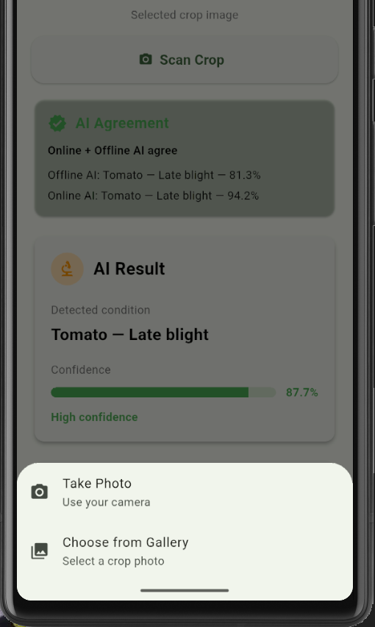
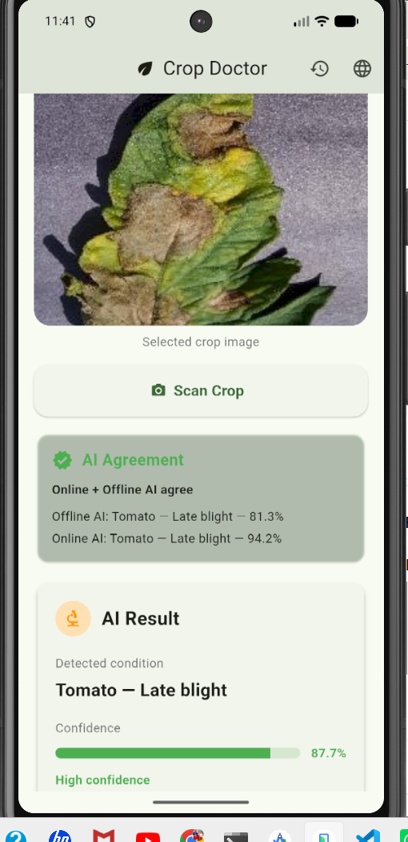
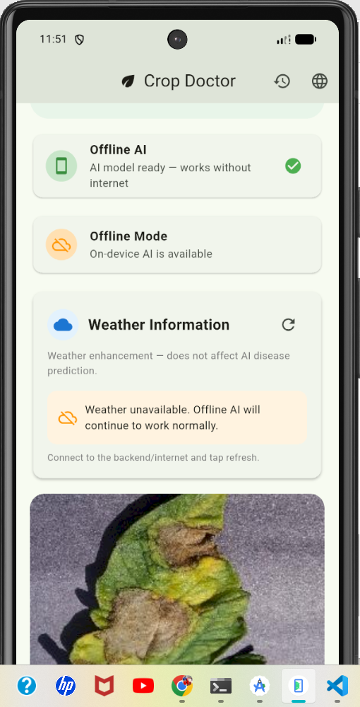
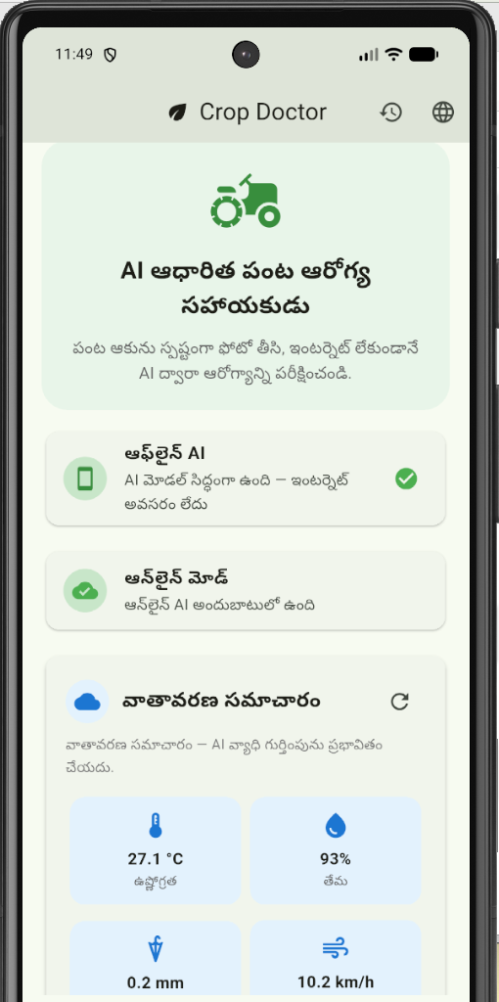
MOBILE APP
Mobile App Screenshots
Home
Scan a Crop
AI Result
Offline Mode
Local Language
Crop Doctor — Hybrid AI Crop Health Assistant
7

Slide 8
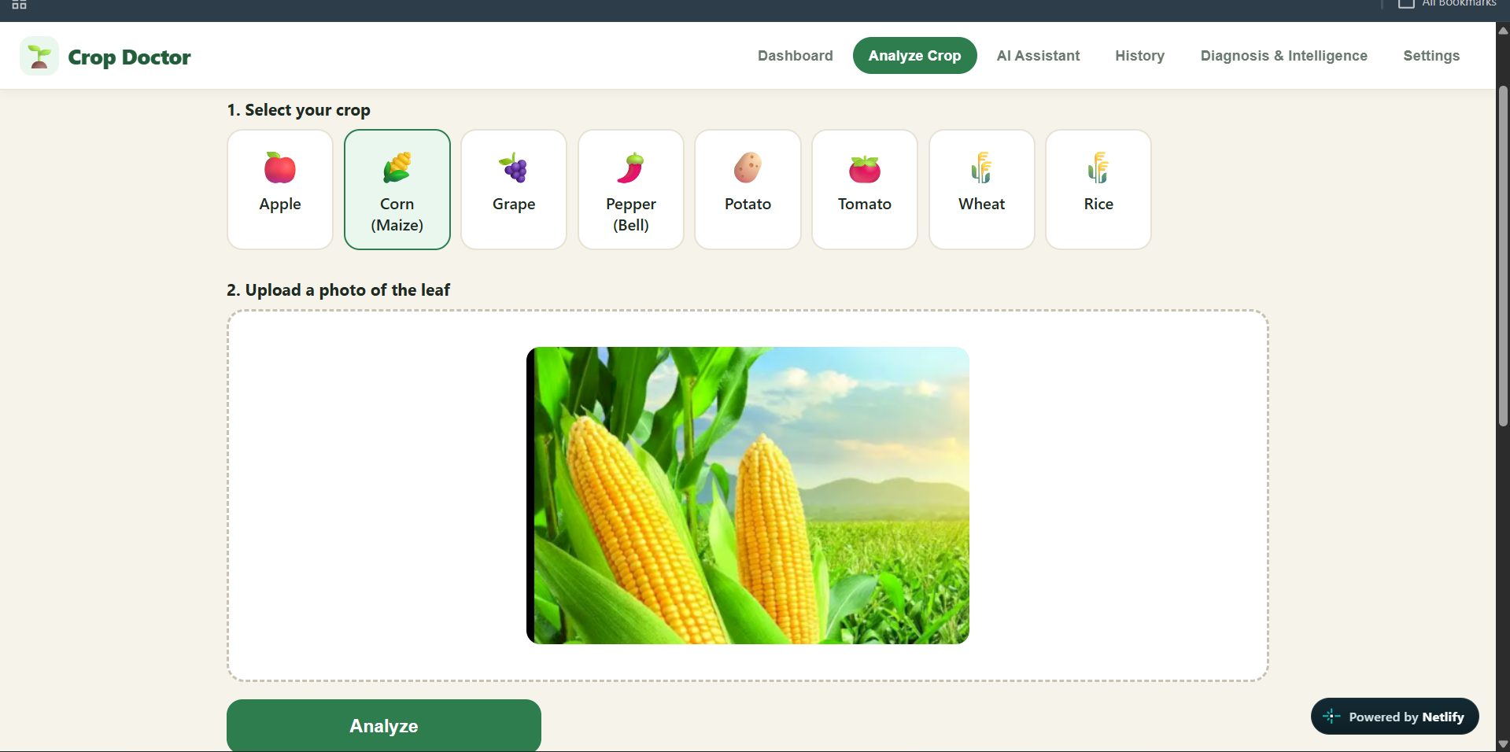
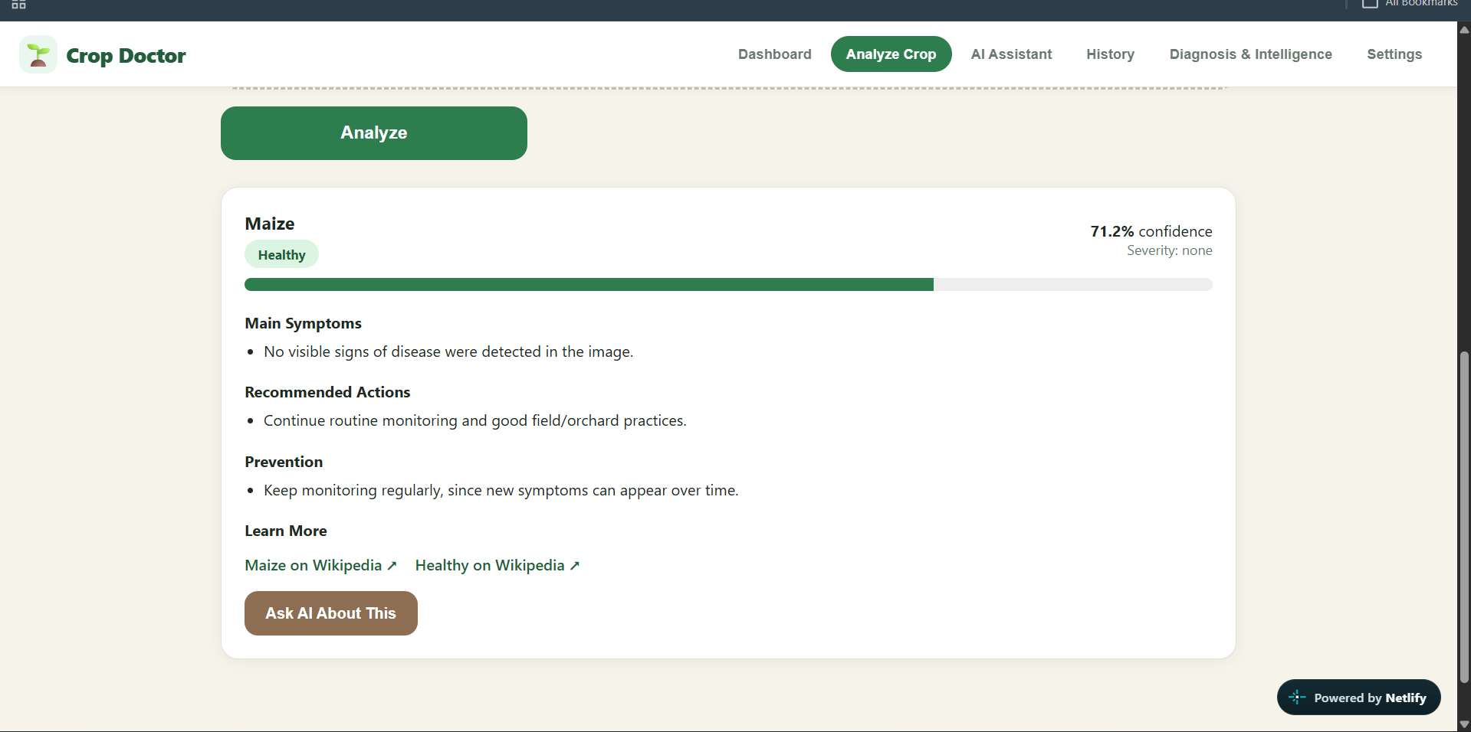
WEBSITE
Website Screenshots
Dashboard
Analyze Crop
AI Result
Live Website
boisterous-froyo-7ebad8.netlify.app
Crop Doctor — Hybrid AI Crop Health Assistant
8

Slide 9
MACHINE LEARNING
ML Model & Results
Model & Approach
Sample Result (from live app)
Offline (edge): MobileNetV3 / EfficientNet-Lite, converted to TensorFlow Lite for on-device inference
Online (cloud): Enhanced analysis via FastAPI backend, combined with live weather data
Training pipeline: Python + TensorFlow / Keras
Hybrid Intelligence layer compares online and offline predictions for agreement / disagreement
Consistency check: Offline AI and Online AI results compared on the same image
High agreement → confident guidance shown to farmer
Disagreement / low confidence → expert review recommended, not a forced answer
Crop Doctor — Hybrid AI Crop Health Assistant
9

Slide 10
INNOVATION & IMPACT
What Makes Us Different
Typical Approach
Crop Doctor
Cloud-dependent
Hybrid online + offline
One-time prediction
Prediction + monitoring over time
Technical jargon
Simple, local-language explanations
Always gives an answer
Confidence + uncertainty + expert-review state
Internet failure = tool failure
Core function works offline
Crop Doctor — Hybrid AI Crop Health Assistant
10

Slide 11
ROADMAP
Scalability & Future Scope
01
Field Validation
MVP (Now)
Test MVP with real farmers; gather feedback
2–3 crops (rice, wheat, cotton)
Selected disease classes
Android demo
English + Telugu
02
Crop Expansion
2–3 crops → 10+ crops
03
Regional Models
Climate + geography-aware crop models
04
Multi-language Platform
Key: We are not building a one-crop demo. We are building a platform.
Local languages across regions
05
Expert Network
Integrate agricultural expert review
Crop Doctor — Hybrid AI Crop Health Assistant
11

Slide 12
THANK YOU
Demo & Links
Build small → validate → expand.
Live Website
boisterous-froyo-7ebad8.netlify.app
What Crop Doctor Delivers
Faster access to crop-health information in low-connectivity areas
Knowledge bridge — technical information in simple, local language
Responsible AI — confidence, uncertainty, and expert escalation
Hybrid intelligence — online and offline working together

